Slide 1
Central Region Sessions
Mark Palmer
Cornell University

Slide 2
Central Region - Transition
Mid-plane
DR Inj/Ext Straight
Section C:
Horizontal arc of ~26 deg
Section D:
Straight containing energy
compressor. Length to be
set by the separation between
DR and main tunnels.
Section A:
Injection/Extraction
lines to/from the DR.
Horizontal bend only.
Approx. 30m long.
Exit angle approx.
243mrad = 13.9deg
Section B:
Vertical manipulation
section for positron and
electron injection and
positron extraction. No
horizontal changes!
Nominal 75m length.
To ML Tunnel
Section E:
39.5deg (5 x 7.9deg) arc for
spin rotation of injected beam.
Relative Injection & Extraction Locations: e+ = red, e- = blue
PLTR
ELTR

Slide 3
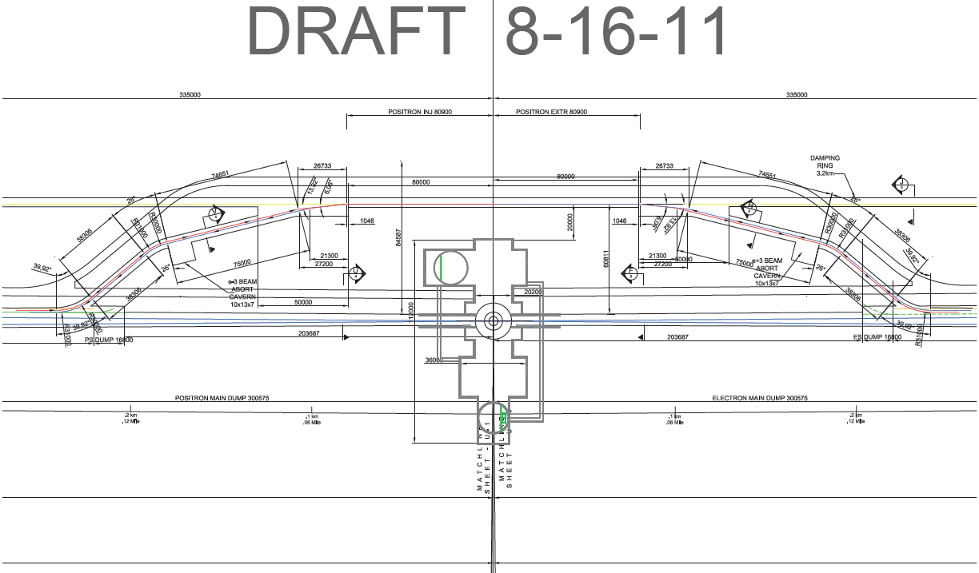
Updated CFS Drawing of Central Region

Slide 4
Nick’s Summary from Last WebEx
Extraction angles/geometry from DR: Need to be fixed ASAP so RTML/sources can proceed with design work, especially give the proposed timeline
(points 4 and 8 below). DR should provide a date when these numbers will be available. RTML and source design work should attempt to proceed in
parallel as much as possible without these geometry defining features being fixed.
Susanna and I have discussed this and have the following proposal:
a) We will set the extraction angle from the DR Inj/Ext straight at 240mrad
b) We will need time to optimize the extraction line with this angle with the most likely scenario being that the distance from the
inj/ext septa to the start of the ELTR/PLTR tunnel may have to translate somewhat in order to accommodate the final lattice.
Based on our discussions at FNAL, I believe that a small translation, along the axis of the DR straight and roughly along the line of the MLs,
is the simplest modification to deal with in the long term. It will allow us to fully specify the lattice pieces in Sections A-E as well as the tunnel
specifications. At that point, a translation looks like a modest lattice change along with a change of the connecting points to the DR and
BDS tunnels, but no actual changes in shape or transitions (hence no major impact on the CFS group).
CFS - need to get some consensus from detector groups that L shape is OK. Current working assumption for design work is based on the CFS drawing
shown today by Vic. Need confirmation ASAP.
With exception of e- source (which should be relative straightforward), all remaining beamlines currently have a designer designated.
Face-to-Face meeting at Granada: Tuesday morning - review progress on lattice work and CFS solutions. Should fix time required ASAP (I suspect
1.5 hours is sufficient).
For design work, initial focus should be on the definition of the central region vertical dogleg(s) (RTML responsibility) in preparation for (4) above
(request from Mark P.)
If we can get an update on the vertical dogleg Tuesday morning in Granada, we would like to hold a Tuesday afternoon discussion of the
pulsed element specification for the positron splitter/merger. I believe that we can draw on the expertise of at least a few of the attendees
to help nail this down.
As iterations of lattice sections become available, send to Benno for upload to EDMS (also 3D CAD generation and integration consistency
cross-checks).
Likewise CFS 2D drawing iterations.
Benno to review and rename lattice sections. Produce dictionary (isn't that our design register? ;-)
Benno - please let us know as soon as possible how you would like sections A-E renamed. Could you update us on the naming conventions
at the proposed WebEx?
14mr IR crossing angle needs to be reflected in lattice designs (if not in the CFS drawings).
0 Primary milestone is to have working lattice solutions in place and agreed-upon by DESY TBR in October.
I assume this means the baseline lattice without the splitter/merger. If possible (and I'm not certain it will be), it would be good if the
splitter/merger specifications and elements can be settled by then.

Slide 5
Overall Layouts
End of E- Linac to End of E+ Linac
CFS Tunnel Cross Sections Drafts exist for the whole region ( including DR’s) showing tunnel sizes, cross sections and beam-line locations based on best available info as of late August 2011
Beam-line Optics Designs Many pieces or sections of systems exist, some as old as RDR, but they need updating to be compatible with the present baseline designs and a hard look at compatibility where they intersect or overlap and share tunnel space.
Component sizes Probably well enough known for next iteration of above bullets unless major conflicts immediately surface! Exception may be keep alive source technical design choice. I suggest a warm S-band linac for the time being?
Ewan – Sept 14

Slide 6
NEXT STEPS?
We need to have enough new or updated info to have (complete) reviews of issues or questions on previous slide, during the parallel/joint sessions at LCWS followed by one more iteration? before the BTR at DESY.
This is a very tight schedule but a necessary one to make sufficient progress at the BTR, where these will not be final complete systems designs ready for the TDR but rather designs with no show stoppers arising from interferences between optics, system layouts and CFS.
Ewan – Sept 14

Slide 7
Questions???
We are now aware of how the design of the IR hall may affect the design and layout of the DR and Central Region Beamlines. (The minimum distance between them and ground deflection from push pull detectors) Is this a problem?
Is there any change in optics or layout required for 10 Hz ops?
Is there any incompatible layout problems with different TeV BDS optics and sources?
ADD YOUR OWN ??
Ewan – Sept 14

Slide 8
Plan for Central Region Sessions
Tuesday Session 1 (8:30-10:30)
  Naming Conventions: B. List
  DR Injection/Extraction Line Update
    Optics: J. Shanks/D. Rubin
    Treaty Point and Layout Issues: M. Palmer
  Section “B-E” (treaty point to RTML) Optics: N. Solyak
  Section “B-E” (e+ source to treaty point) Optics: W. Gai
Tuesday Session 2 (11:00-13:30)
  Central Region Layout Update:
  Central Region Mechanical Update
  Central Region Electrical Update
  Central Region – Remaining Issues
  Last half hour of session will provide an opportunity to discuss any “loose ends” in greater detail

Slide 9
Other Relevant Discussions
Fill Pattern Discussion – 15:45 Last portion of today’s Session 3
Splitter/Merger Pulsed Element Options – Thursday Session 2 - 13:00

Slide 10
Goals for Today
Set up naming conventions in preparation for Baseline Review in DESY
Review status of lattices and verify handoff points
Review CFS plans and constraints
Review outstanding questions
  In particular, identify what validations are required in preparation for the review next month at DESY
  Check on interference issues in this complicated region
  Identify any items that we have not yet addressed

