Slide 1

LCWS 2012
At
The University of Texas at Arlington

Slide 2
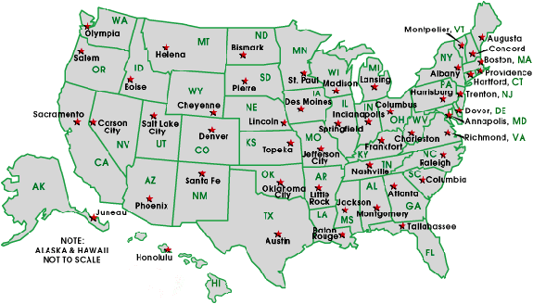

Slide 3
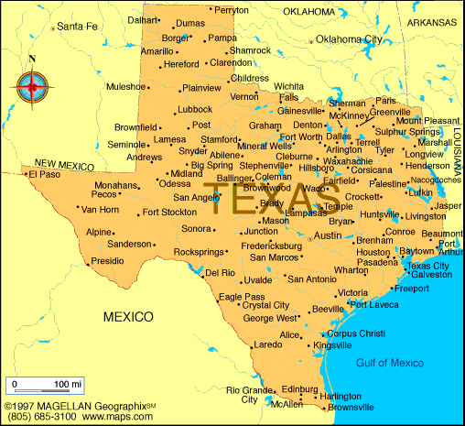
Arlington

Slide 4
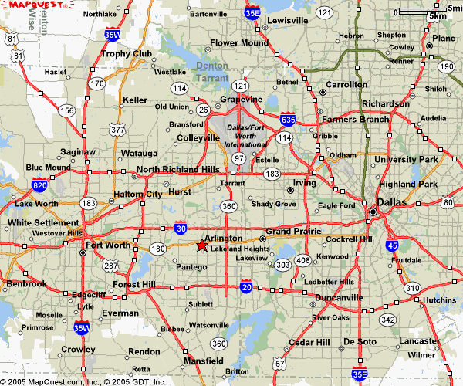
The Venue
DFW Airport
Texas Instrument
Microsoft
Lockheed Martin
Bell Helicopters
Alcon labs
UTA

Slide 5
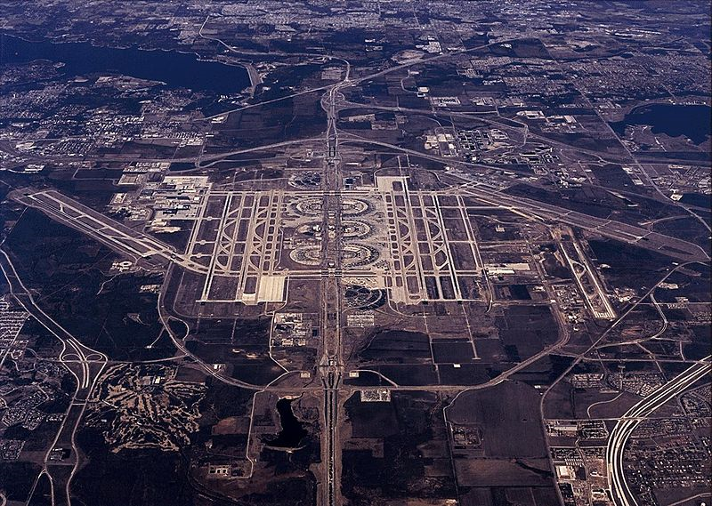
Your arrival !
DFW Airport – about 20 min from UTA

Slide 6

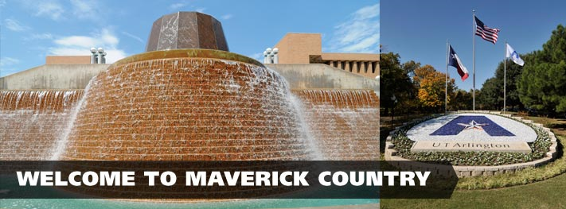

Slide 7
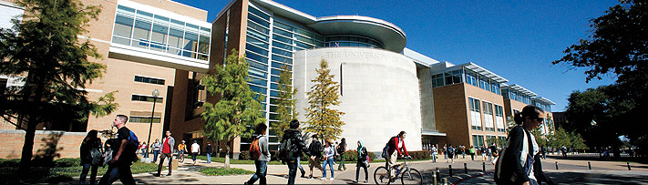
UT Arlington – the second largest institution of the 14 campuses in the UT System
~34,000 students and growing!
The new Chemistry and Physics Research Building

Slide 8
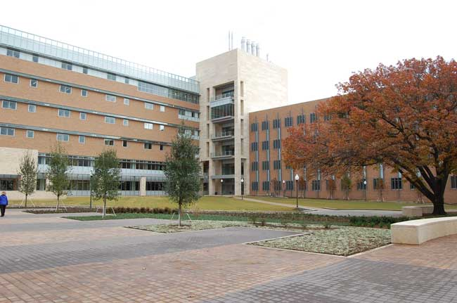
UTA’s new Engineering Complex

Slide 9
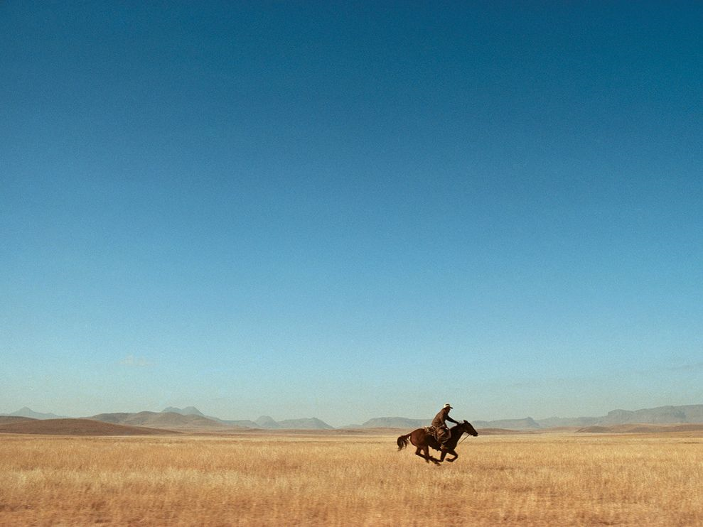
Plenty of room!

Slide 10
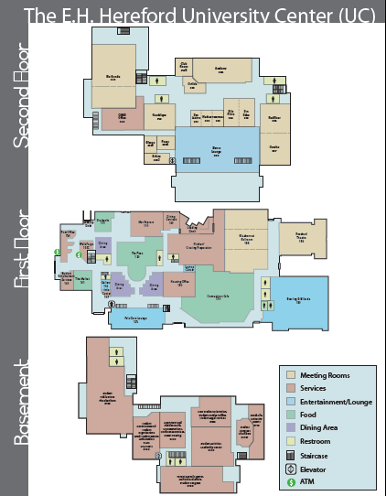
University Center
14 meeting rooms
Capacities 25 – 940
Lunches in same facility – efficient !

Slide 11
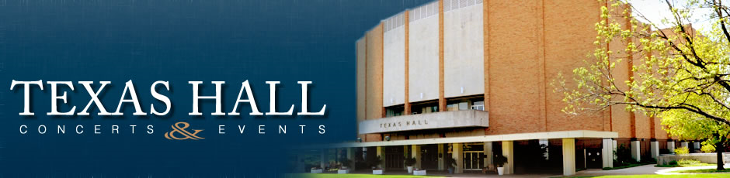
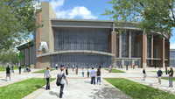
Capacity 7,000
Capacity ~2,700
Square Footage: 218,000 square feet
Seating Capacity: 7,000
Cost: $78 million

Slide 12
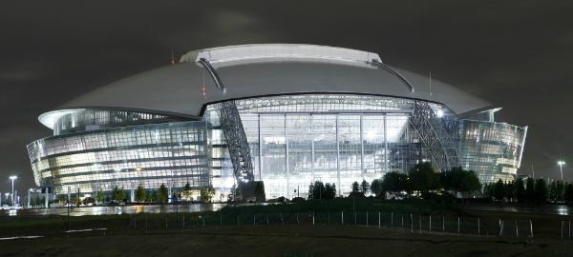
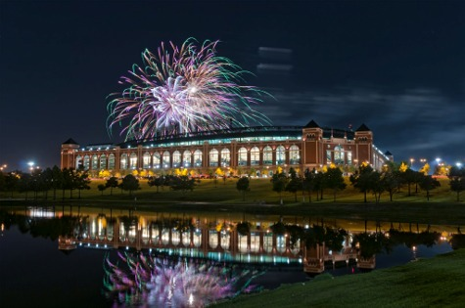
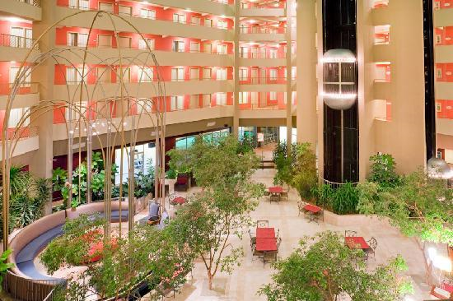
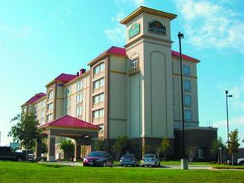
Major facilities in Arlington
Many good local hotels at reasonable cost

Slide 13
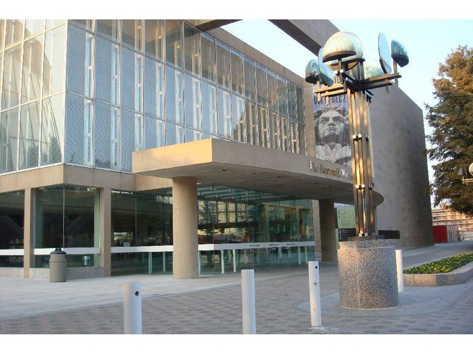
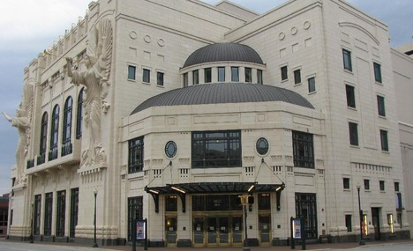
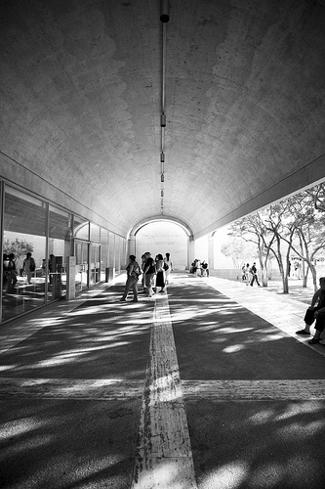
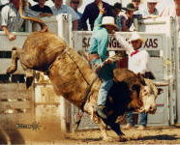
Cultural facilities

Slide 14
…so y’all come on down to Texas !

