Slide 1

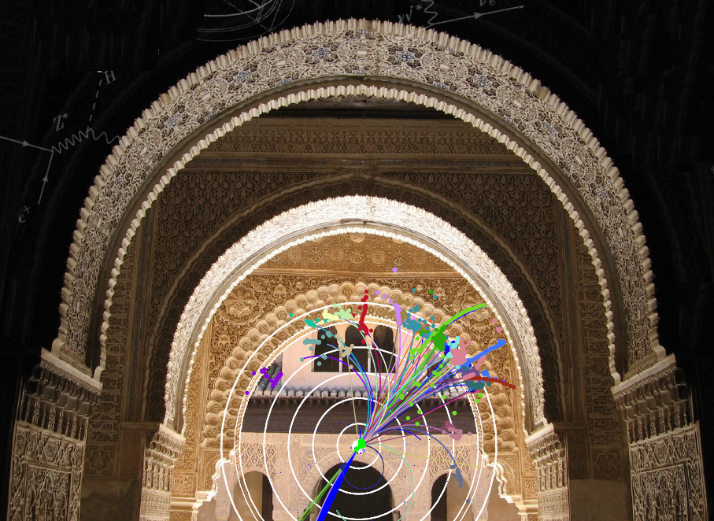
Work packages : Overview of experimental verification, CTF3 and CLIC Zero
R. Corsini for the CLIC/CTF3 Collaboration
Basically all WP scientific and technical details have been (or will b discussedelswhere in the WGs, therefore:
I will only give a short description of work packages – motivation, objectives, initial evaluation of resources
I will say a few more words on module tests in CTF3, not fully covered elsewhere
1

Slide 2
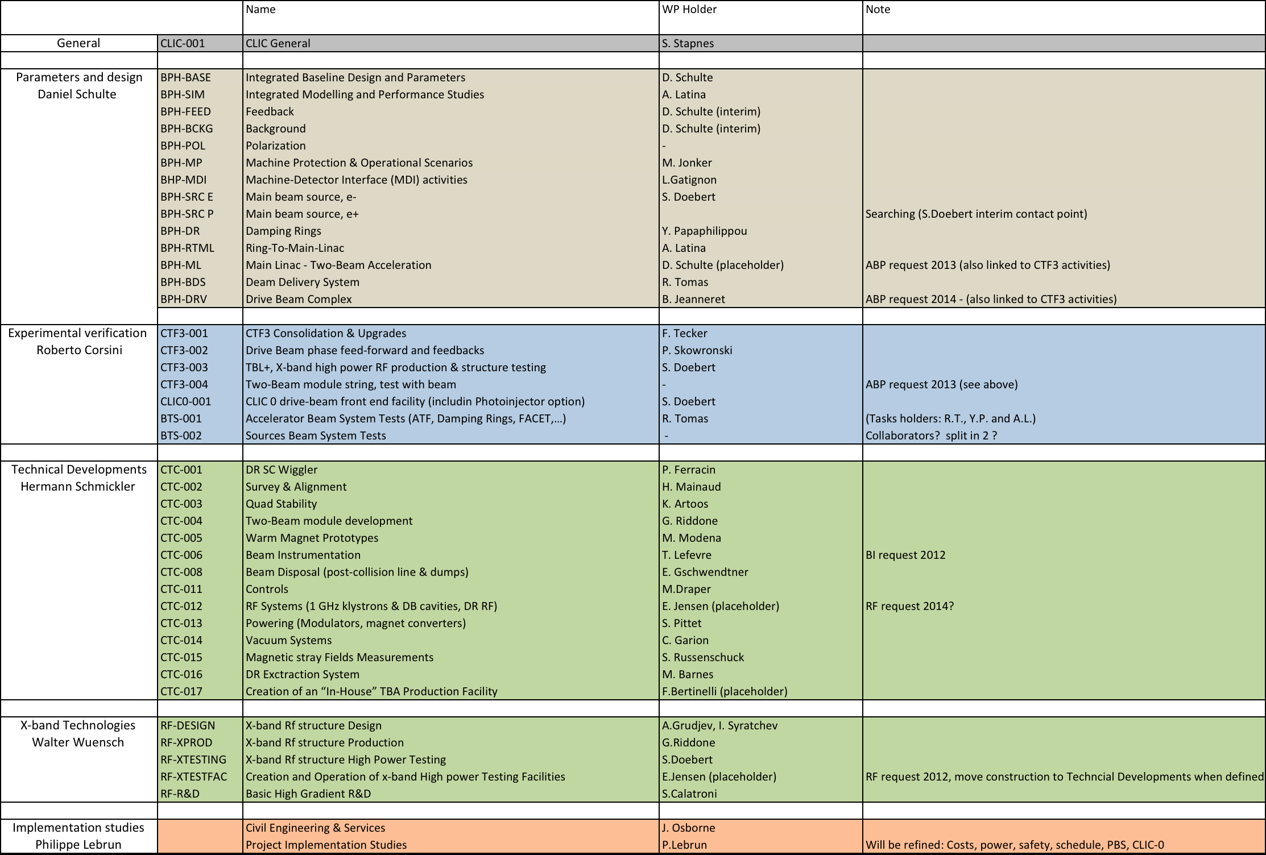

Slide 3
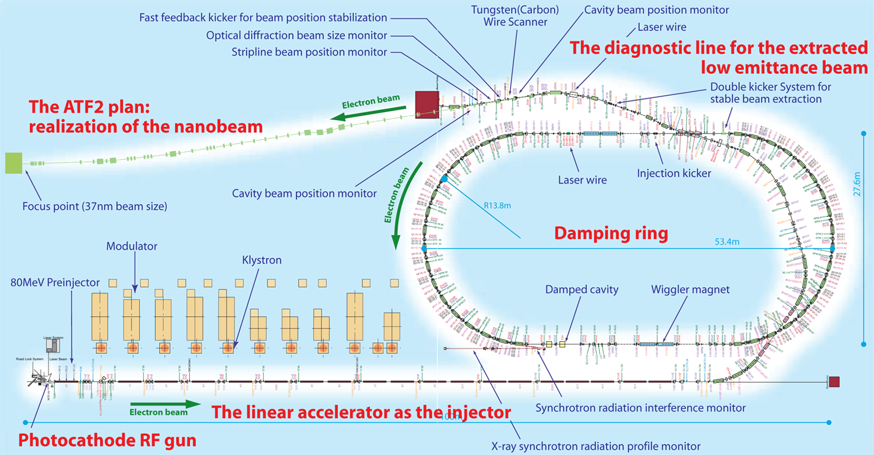
Beam Test Facilities
CTF3+
Phase feed-back
DELAY LOOP
Present experimental program of CTF3 (feasibility issues)
 completed by end 2012
Goals for (2011-2016):
Consolidation/upgrade of CTF3 to fully exploit its potential:
  Verify stability/reliability performance in view of CLIC requirements , improve operational experience
  Contribute to high-power RF testing, demonstrate operation of a drive -beam driven power source
  Test with beam CLIC two-beam modules
New drive beam injector facility, at nominal CLIC parameters
  Final proof of drive beam performances, long-pulse, high -power operation
  provides a focus for development and pre-industrialization of drive beam components – all hardware reusable
  First step towards CLIC Zero, facility for….
Pursue and intensify experimental program in other facilities
  ATF II
  CesR-TA, SLS, ATF I, ANKA…
  Facet, Asset
  …
COMBINER RING
RF power production
DRIVE BEAM LINAC
CLEX
Two beam modules
TWTs, 500 MHz
Modulator-klystrons, 1 GHz
Magnetic chicane, diag. & collimation
Quads
Quads
Gun
SHB 1-2-3
PB
Buncher
Acc. Structures
~ 30 MeV
CLIC Drive Beam injector schematic layout
ATF - KEK

Slide 4


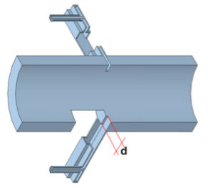
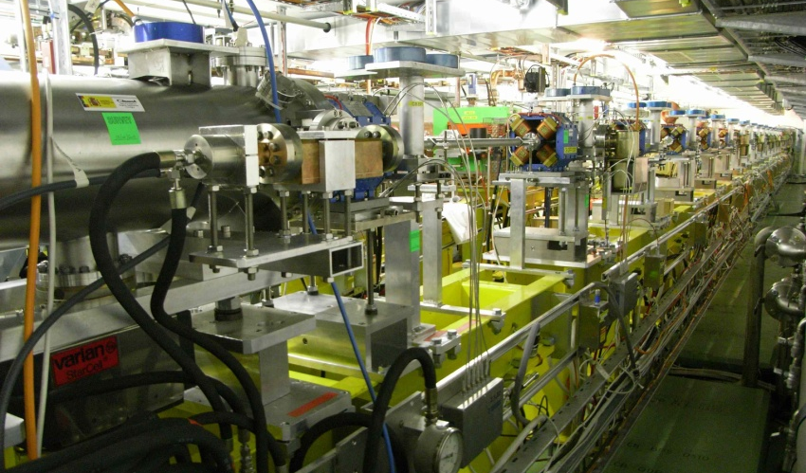
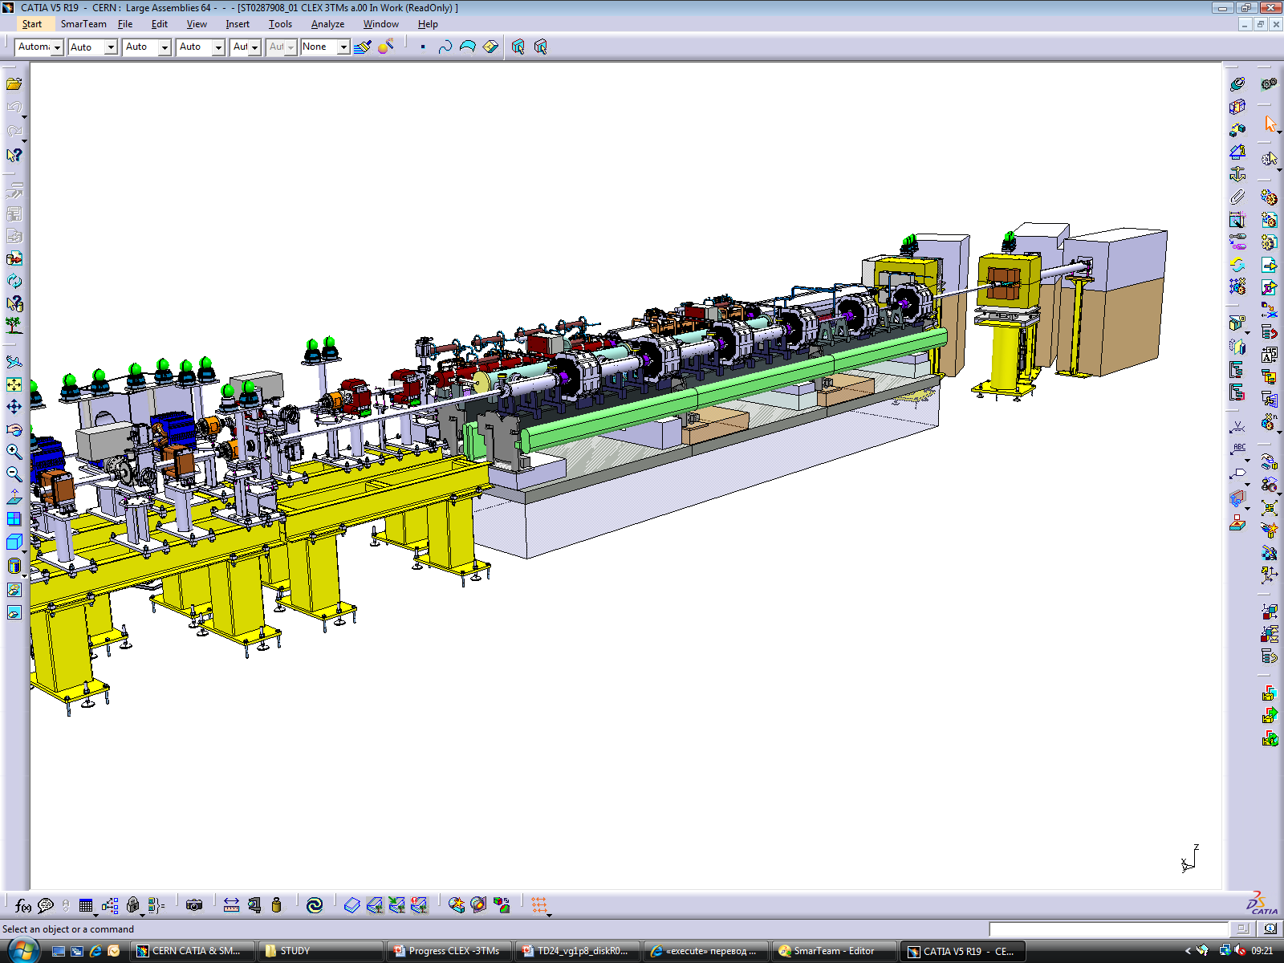
R. Corsini, CLIC Project Meeting
1st June2011
Test facilities – CTF3+
CTF3 consolidation and upgrade | Consolidation and upgrade (higher energy, stability, reliability, rep. rate) Drive beam phase feed-forward experiments Upgrade and operate TBL as 12 GHz power production facility Operation with beam of a long string of CLIC two-beam modules
CTF3 consolidation and upgrade
CTF3 - Phase feed-forward
See yesterday’s talk by F. Tecker
TBL - CLEX
Two-Beam modules in CTF3

Slide 5
CTF3
F. Tecker
WP: CTF3-001 CTF3 consolidation & upgrades |  | Purpose/Objectives/Goals: Enable CTF3 continued operation until 2016 with performances compatible with the experimental program (system performance) |  |  |  | Deliverables |  |  | Schedule
Energy upgrade |  | Required for long string of modules. Useful for TBL deceleration demonstration, TBL+ high power testing, drive beam transport in modules, beam tests. |  |  |  | 2 new modulators/klystrons (3GHz, 45 MW) and associated infrastructure. M budget: 2.5 MCHF |  |  | 1st MDK: 2012 – 2Q 2nd MDK: 2013 – 1Q
Repetition rate upgrade |  | Required for TBL+ high power testing. Useful for operation. |  |  |  | Additional shielding, pulsed charge power supplies for MKS, interlocks. M budget: 3.5 MCHF |  |  | Interlocks: 2011 – 3Q MKS PS: 2012 – 1Q Shielding 2013 – 1Q
Consolidation, stability, operation |  | Required for continued CTF3 operation 2012-2016. |  |  |  | Consumables (klystrons), spares (TWTs), feed-backs, diagnostics and control system maintenance and improvements, operating support. M budget: 9 MCHF |  |  | Distributed 2012-2016
Effect of beam-loading on breakdown |  | Assess the break-down rate behaviour in beam-loaded X-band structures |  |  |  | Re-furbish CTF3 dog-leg, RF network Experiment report. M budget: 0.5 MCHF |  |  | 2012 – 1Q 2013 – 1Q
Link to other WPs/activities: This WP is integrated to WPs CTF3-002, CTF3-003 and CTF3-004 (see above)
Lead collaborator(s): CERN: BE/RF, BE/BI, BE/ABP, BE/OP
Resources: | 2011 |  | 2012 | 2013 | 2014 |  | 2015 | 2016 |  | Total
Material (kCHF): |  |  | 3500 | 3500 | 3000 |  | 3000 | 2000 |  | 15000
Personnel (FTE): |  |  | 20 | 20 | 15 |  | 15 | 15 |  | 85
Most resources will necessarily come from CERN. Basically uncompressible if any CTF3 program is to be preserved.

Slide 6
CTF3
P. Skowronski
WP: CTF3-002 Drive Beam phase feed-forward and feedbacks |  | Purpose/Objectives/Goals: Understand sources of drive beam phase jitter, develop and test feed-forward system to stabilize drive beam phase (performance, risk) |  |  |  | Deliverables |  |  | Schedule
Drive Beam phase monitors |  | Understand sources of drive beam phase jitter. Used in feedbacks and feed-forward test. |  |  |  | Drive Beam phase monitor prototype, phase monitor small series (2-3), electronics and acquisition. M budget: 0.5 MCHF |  |  | Monitor proto: 2011 – 4Q Monitor series: 2013 – 2Q
Feed-forward kickers |  | Required to demonstrate feed-forward performance. |  |  |  | Two strip-line kickers. M budget: 0.75 MCHF |  |  | 2012 – 4Q
Feed-forward pulsers |  | Required to demonstrate feed-forward performance. |  |  |  | Fast amplifiers for the two kickers. Fast electronics. M budget: 1.25 MCHF |  |  | 2013 – 4Q ?
Infrastructure and operation |  | Required for testing. |  |  |  | Cabling, infrastructure, controls, operational support. M budget: 0.5 MCHF |  |  | Distributed 2012-2016
Link to other WPs/activities: This WP depends on WP CTF3-001
Lead collaborator(s): INFN/LNF, Oxford Un./J. Addams, CERN: BE/RF, BE/BI, BE/ABP, BE/OP…
Resources: | 2011 |  | 2012 | 2013 | 2014 |  | 2015 | 2016 |  | Total
Material (kCHF): |  |  | 500 | 900 | 1100 |  | 300 | 200 |  | 3000
Personnel (FTE): |  |  | 4 | 4 | 4 |  | 4 | 4 |  | 20
Work plan reviewed with INFN-Frascati & Oxford and updated. Need to check total resources and repartition with collaborators.

Slide 7
CTF3
S. Doebert
WP: CTF3-003 TBL+ |  | Purpose/Objectives/Goals: Contribute to high-power testing program of accelerating structures, understand break down behaviour of PETS-structure system and conditioning scenarios (performance, cost) |  |  |  | Deliverables |  |  | Schedule
Upgrade of TBL drive beam line |  | Provide high-power slots for testing. |  |  |  | 4 PETS in mini-tanks with input couplers, waveguide network, supports and cables. M budget: 750 kCHF |  |  | 2012 – 3 Q
RF Test stands |  | RF conditioning and high-power testing of structures. |  |  |  | waveguide network, supports and cables, instrumentation and control for 4 slots M budget: 750 kCHF |  |  | First 2 slots: 2012 – 4Q Addit. 2 slots: 2013 – 4 Q
Operation |  | Support testing. |  |  |  | Maintenance, operating support. Annual reports on testing results. M budget: 1 MCHF |  |  | Distributed 2012-2016
Link to other WPs/activities: This WP is partly overlapping with WPs CTF3-000
Lead collaborator(s): CERN: BE/RF, BE/BI, BE/ABP, BE/OP
Resources: | 2011 |  | 2012 | 2013 | 2014 |  | 2015 | 2016 |  | Total
Material (kCHF): |  |  | 950 | 950 | 200 |  | 200 | 200 |  | 2500
Personnel (FTE): |  |  | 4 | 4 | 2 |  | 2 | 2 |  | 14
Resources comment: Material budget for full eight slots – (four slots ~1 MCHF less)

Slide 8
CTF3
WP: CTF3-004 Two-Beam module string |  | Purpose/Objectives/Goals: Understand behaviour and limitations of a few generations of CLIC two-beam modules in a real accelerator environment testing them with beam (performance, cost) |  |  |  | Deliverables |  |  | Schedule
First phase |  | Test behaviour of a single complete Two-Beam Module. |  |  |  | One Two-Beam Module type 1 installed and tested in CTF3 M budget: 0.5 MCHF |  |  | 2013 – 1Q
Second phase |  | Test behaviour of a module string with a minimum number of interconnects. |  |  |  | Two-Beam Module string (type 101) installed and tested in CTF3 M budget: 0.75 MCHF |  |  | 2014 – 1Q
Third phase |  | Test behaviour of a module string, new generation. |  |  |  | Two-Beam Module string, new generation (3 modules) M budget: 0.75 MCHF |  |  | Modules: 2016 – 1Q
Operation |  | Provide operational support |  |  |  | Provide operational support M budget: 1 MCHF |  |  | 2012 to 2016
Link to other WPs/activities: This WP is linked to WP CTC-004 – only installation/operation budget foreseen
Lead collaborator(s): Uppsala, IRFU/Saclay, CERN: BE/RF, BE/BI, BE/ABP, BE/OP
Resources: | 2011 |  | 2012 | 2013 | 2014 |  | 2015 | 2016 |  | Total
Material (kCHF): |  |  | 500 | 700 | 700 |  | 600 | 500 |  | 3000
Personnel (FTE): |  |  | 3 | 3 | 3 |  | 3 | 3 |  | 15
Resources comment: Only resources for installation/integration/services/running in CTF3 are accounted for here. Resources for module construction in CTC-004
Other comments: total CTF3 manpower (2012) 31 FTE, 30 only CERN in 2011.

Slide 9
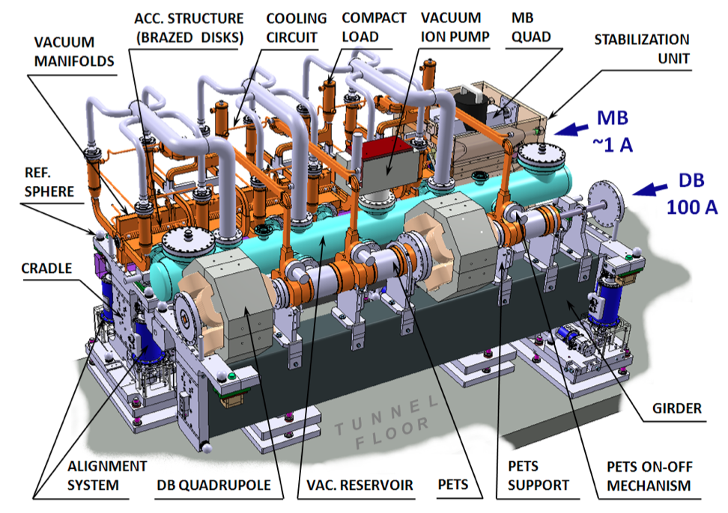
Two Beam Scheme
CLIC Two-Beam module (2m)
RF power
12 GHz – 135 MW
Main Beam
1 A – up to 1.5 TeV
Drive Beam
100 A – 2.4 GeV
9

Slide 10
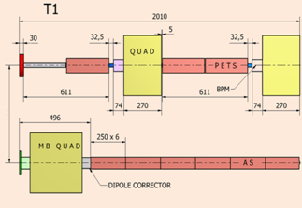
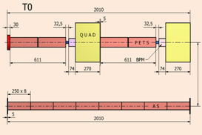
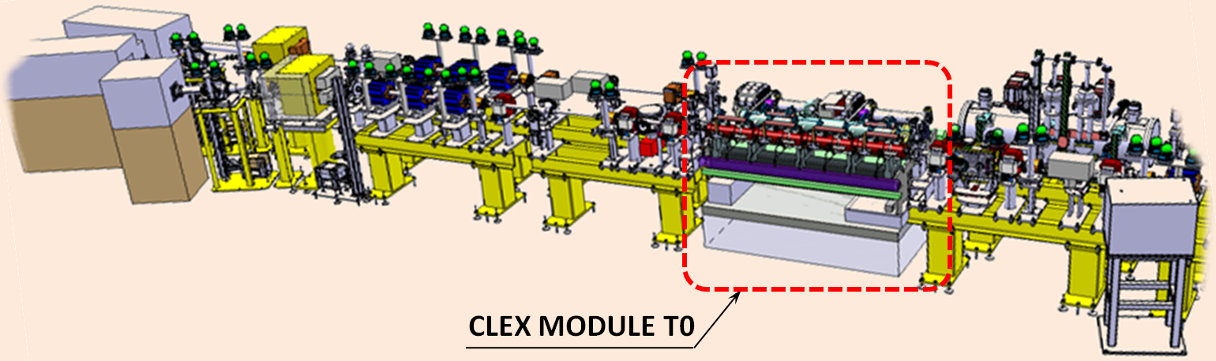
Two Beam Modules in CLEX
3 modules to be tested with
beam and RF
- module layout compatible with CLEX
Schematic layout of CLIC Modules in CLEX
3D model of integration
of the first CLIC Module in CLEX
G. Riddone

Slide 11
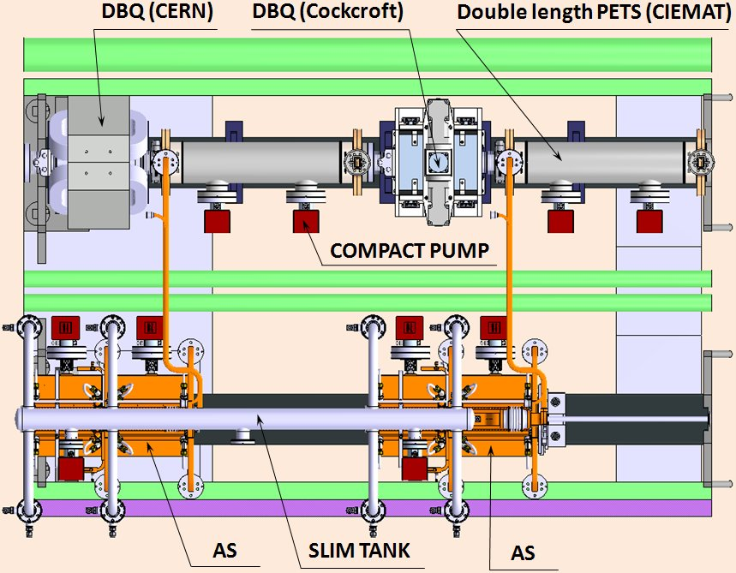
Two Beam Modules in CLEX
double length PETS feeding two accelerating structures
accelerating structures with all technical systems and damping
features
First module to be ready
by end of 2012
G. Riddone

Slide 12
Two Beam Modules in CLEX
Goals:
Test two-beam acceleration in full-fledged modules integrating all technical systems, including RF production, beam diagnostics, alignment, stabilisation and vacuum, close to their nominal parameters.
Test BPM and wake-field monitor performance, in conjunction with active alignment system & stabilization, in an accelerator environment.
Force construction/industrialization of “real” components – including ancillaries –, which can be used in accelerator environment.
Check RF network phase stability with beam
Vacuum system performance, both static and dynamics with RF
Cooling system, especially dynamics due to beam loss and power flow changes
Validation of assembly, transport, activation, operation, maintenance etc.

Slide 13
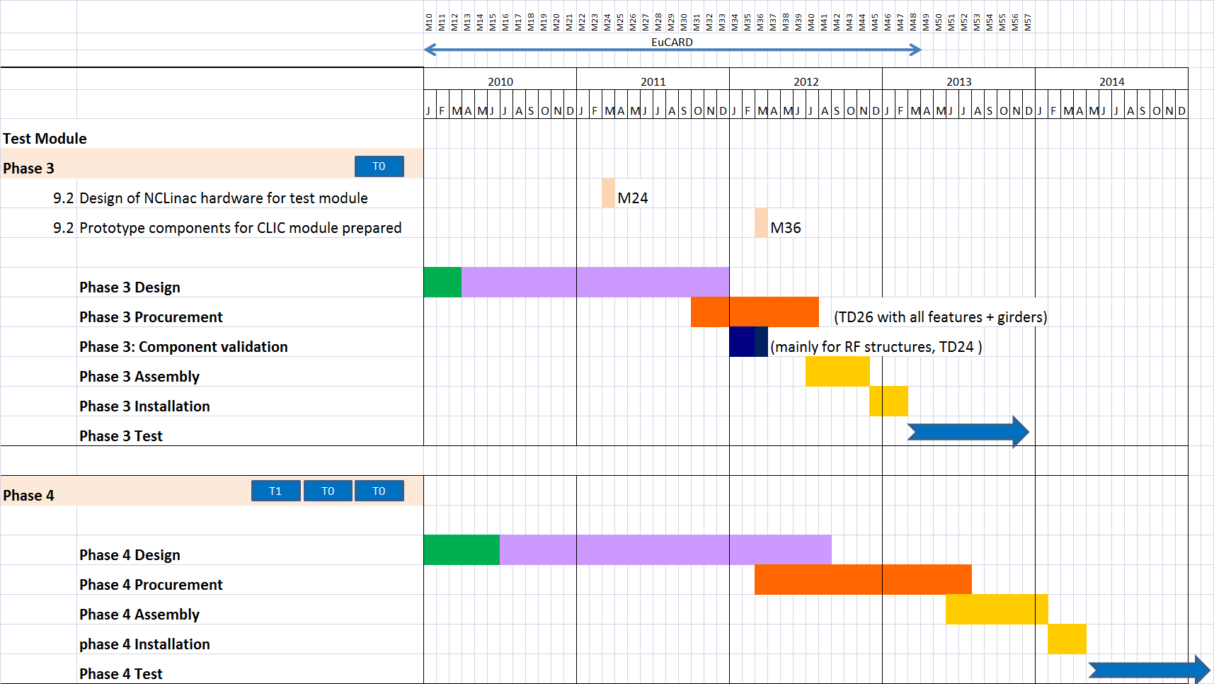
Two Beam Modules in CLEX
G. Riddone

Slide 14
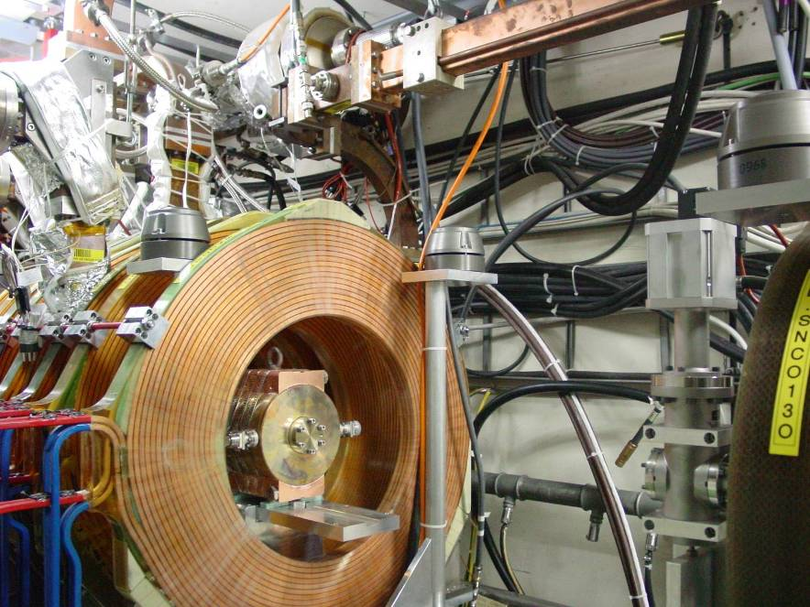
CLIC Zero
R. Corsini, CLIC Project Meeting
1st June2011
CLIC Drive Beam Front-end
Build and commission 30 MeV Drive Beam front-end with nominal CLIC parameters | Build and commission 30 MeV Drive Beam injector with nominal CLIC parameters Build and commission a few Drive Beam accelerator nominal modules Contribution to Technical Design of full CLIC Zero facility
CTF3 Injector
Modulator-klystrons, 1 GHz
CLIC Drive Beam injector schematic layout
TWTs, 500 MHz
Magnetic chicane, diag. & collimation
Quads
Quads
Gun
SHB 1-2-3
PB
Buncher
Acc. Structures
~ 140 keV
~ 6 MeV
~ 30 MeV

Slide 15
CLIC Zero
S. Doebert
WP: CLIC0-001 Drive Beam Front-End | Purpose/Objectives/Goals: Assess CLIC drive beam injector/front-end performance, provide focus for development and industrialization of CLIC large series components (1 GHz MDKs and accelerating structures), constitute first building block of CLIC 0 (risk, cost) | Deliverables | Schedule
Design & preparation | Overall optimization of CLIC injector, study of implementation | Detailed design of facility, implementation plan | 2012 – 4Q
Gun | Provide gun | Thermionic electron gun, HV deck and front-end controls M budget: 1 MCHF | 2013 – 4Q
RF structures | Provide structures for bunching system and acceleration. | Three 500 MHz wide-band sub-harmonic bunchers, one single-cell pre-buncher, one travelling wave buncher, 6 accelerating structures M budget: 1.7 MCHF | SHBs: 2014 – 2Q PB, buncher: 2014 – 4Q Structures: 2015 – 4Q
RF high-power system | Provide RF high-power system | 500 MHz sources (TWTs?), Four15 MW 1 GHz Modulators-Klystrons, waveguide networks, operational support M budget: 16 MCHF | TWTs: 2014 – 2Q 2 MKS proto: 2014 – 4Q MKS series: 6 2015 – 4Q 6 in 2016 – 4Q
RF low-power system | Provide RF low-power system | low-power systems , 500 MHz and 1 GHz, operational support M budget: 1 MCHF | Protos: 2014- 2Q Series: 2015 – 4Q
Magnets | Provide magnets | Solenoids, quadrupoles (about 12), four bending magnets, H-V dipole correctors M budget: 2 MCHF | Solen./corr.: 2013 – 4Q Quadrupoles: 2015 – 4Q Bends: 2015 – 4Q
Vacuum | Provide vacuum system | Vacuum chambers, pumps, gauges, control system, operational support M budget: 2 MCHF | Distributed 2013 – 2016

Slide 16
CLIC Zero
WP: CLIC0-001 Drive Beam Front-End continued | Purpose/Objectives/Goals: Assess CLIC drive beam injector performance, provide focus for development and industrialization of CLIC large series components (1 GHz MDKs and accelerating structures), constitute first building block of CLIC 0 (risk, cost) |  |  |  |  | Deliverables |  |  | Schedule
Diagnostics | Provide diagnostics |  |  |  |  | BPMs - electrostatic (~4), BPMs - magnetic (~ 5) - transverse profile monitors (3), time resolved energy spectrum measurement, operational support. M budget: 1.3 MCHF |  |  | BPM e: 2013 – 4Q BPM m: 2014 – 4Q Monitors: 2013 – 2015 Spectro: 2014 – 4Q
Controls | Provide controls |  |  |  |  | Injector control system, operational support. M budget: 1 MCHF |  |  | Distributed 2013 – 2016
Civil Engineering & infrastructure | Provide building and infrastructure |  |  |  |  | Shielded hall, Cooling and ventilation, electrical equipment, cabling. M budget: 4 MCHF |  |  | 2013 – 4Q Cabling Distr. 2013 – 2016
Commissioning & operation | Provide commissioning and operation |  |  |  |  |  |  |  | Distributed 2012-2016
Link to other WPs/activities: This WP is linked to WP CTC-004
Lead collaborator(s): CERN: BE/RF, BE/BI, BE/ABP, BE/OP
Resources: |  | 2011 | 2012 | 2013 | 2014 |  | 2015 | 2016 |  | Total
Material (kCHF): |  |  | 1000 (500) | 4000 (3000) | 8000 (4250) |  | 9000 (4250) | 8000 (5000) |  | 30000 (17000)
Personnel (FTE): |  |  | 10 | 10 | 20 |  | 20 | 20 |  | 80
Resources comment: technical manpower partly shared with CTF3
Other comments:
Modulator/Klystrons are on the critical path. Lower efficiency prototypes (direct scaling from ILC/X-FEL?) could arrive earlier, allowing to keep the schedule. Discussion with RF group needed. Option: delay program. First stage with minimum number of 1 GHz klystron prototypes (4?), short pulse + compression. Full upgrade in 2017-2018 (GAIN 13 MCHF)

Slide 17
R. Tomas
WP: BTS-001 Accelerator Beam SystemTests | Purpose/Objectives/Goals: Perform CLIC-related beam tests in existing test facilities and operational accelerators, not CERN–based. |  |  |  |  | Deliverables |  |  | Schedule
ATF and ATF2 | Provide coordination and operational support for beam tests in ATF and ATF2 facilities.
Damping Ring beam facilities | Provide coordination and operational support for beam tests relevant for CLIC damping rings, in various facilities (CESR-TA, SLS, ANKA…)
FACET/SLAC beam facilities | Provide coordination and operational support for beam tests carried out at SLAC (FACET, ASSET…)
Link to other WPs/activities: This WP is linked to several work-packages in CTC and Beam Physics.
Lead collaborator(s): CERN BE/ABP, KEK, Cornell, PSI, ANKA, SLAC…
Resources: |  | 2011 | 2012 | 2013 | 2014 |  | 2015 | 2016 |  | Total
Material (kCHF): |  |  | 500 | 500 | 500 |  | 500 | 500 |  | 2500
Personnel (FTE): |  |  | 2 | 2 | 2 |  | 2 | 2 |  | 10
Resources comment: Tentative, need review. Include material contribution to experimental programs outside CERN for experiments concerning CLIC
R. Tomas
Y. Papaphilippou
A. Latina

Slide 18
WP: BTS-002 Sources Beam System Tests | Purpose/Objectives/Goals: Perform CLIC-related beam tests, source related, in existing test facilities and operational accelerators, not CERN–based. |  |  |  |  | Deliverables |  |  | Schedule
Polarized electron source | Tests at SLAC, J-LAB, Grenoble. Limited tests (laser/cathode) at CERN …
Conventional positron source | Test of hybrid target at KEK, development of adiabatic matching device?
Link to other WPs/activities: This WP is linked to …
Lead collaborator(s): CERN:EN/STI, KEK, SLAC, JLAB, Grenoble…
Resources: |  | 2011 | 2012 | 2013 | 2014 |  | 2015 | 2016 |  | Total
Material (kCHF): |  |  | 200 | 200 | 200 |  | 200 | 200 |  | 1000
Personnel (FTE): |  |  | 4 | 4 | 4 |  | 4 | 4 |  | 20
Resources comment: Placeholder. Need review!

