Slide 1

Cavity Summary and Projected Status in 2012
Jim Kerby with thanks to everyone in the S0 team

Slide 2
Outline
Reminder of 2012 Target
Current Database plots
Expected total numbers by mid 2012
Alternatives
NB!: at the time of writing I do not have exact numbers from the regions for 2012 plans…therefore mistakes are mine…

Slide 3
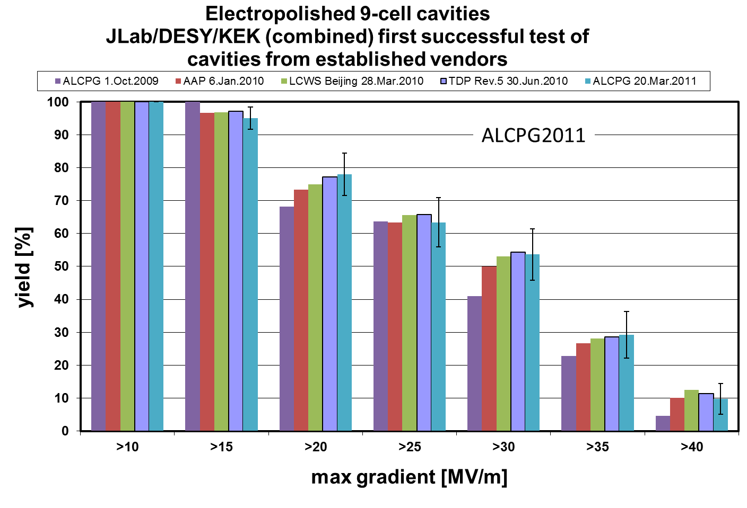
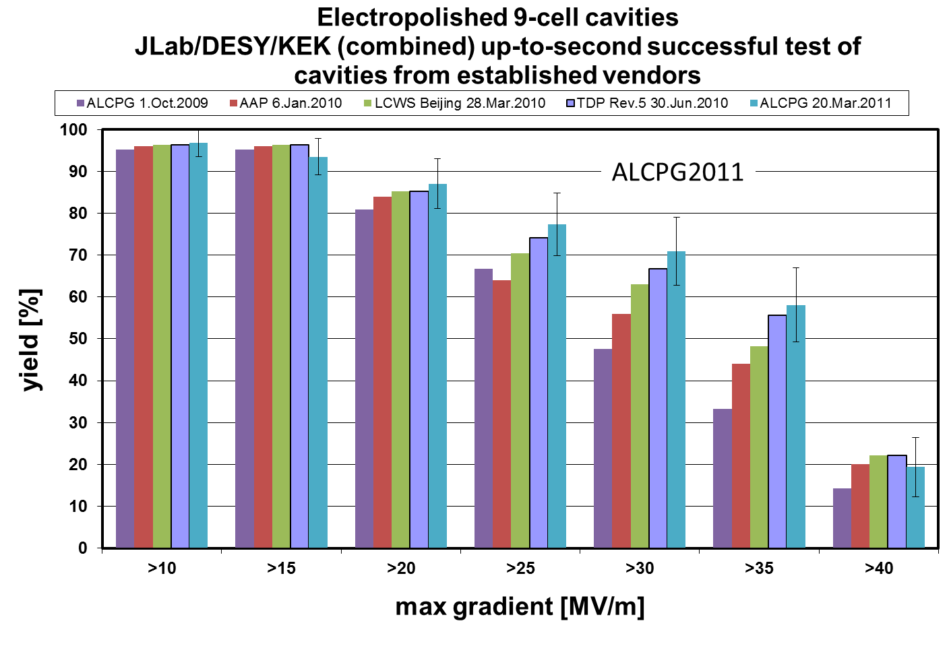
‘One of The DG’s Favorite Plots’

Slide 4
TDP Goal for 2012
Cavity Yield goal was 90% after two passes
  in at least one writing this was 80% first pass, 50% second pass
Currently we stand at ~60% after two passes
  ~30% in first pass, and 42% in second pass
NOTE: In October 2009 our success rate was ~33% after two passes; ~23% first pass and ~12% in second pass
  The past two years have been remarkable

Slide 5
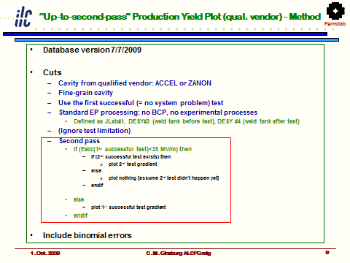
Database Logic Reminder

Slide 6
Database Updates
As presented the results are cumulative
New vendors / processing facilities are added after qualification
The database is a snapshot in time
The logic of the 2nd pass cut in essence assumes that a sub-par cavity will be retested; the snapshot is taken while the cavity was ‘in process’
  Does not account for cavity tests w/ non-ILC goals
  Does not account for cavities halted after first test
Current plot would include 38 first pass and 29 second pass cavities
For the TDR should we do a closer accounting of the cavities in limbo?

Slide 7
Alternative view of data
Under any circumstances, without a large number of cavities (>100), due to legacy cavities it was seen that reaching 90% yield with this presentation was not feasible
Discussions over the summer led to a first attempt at alternative presentation of the data, in discrete time periods as opposed to cumulative

Slide 8
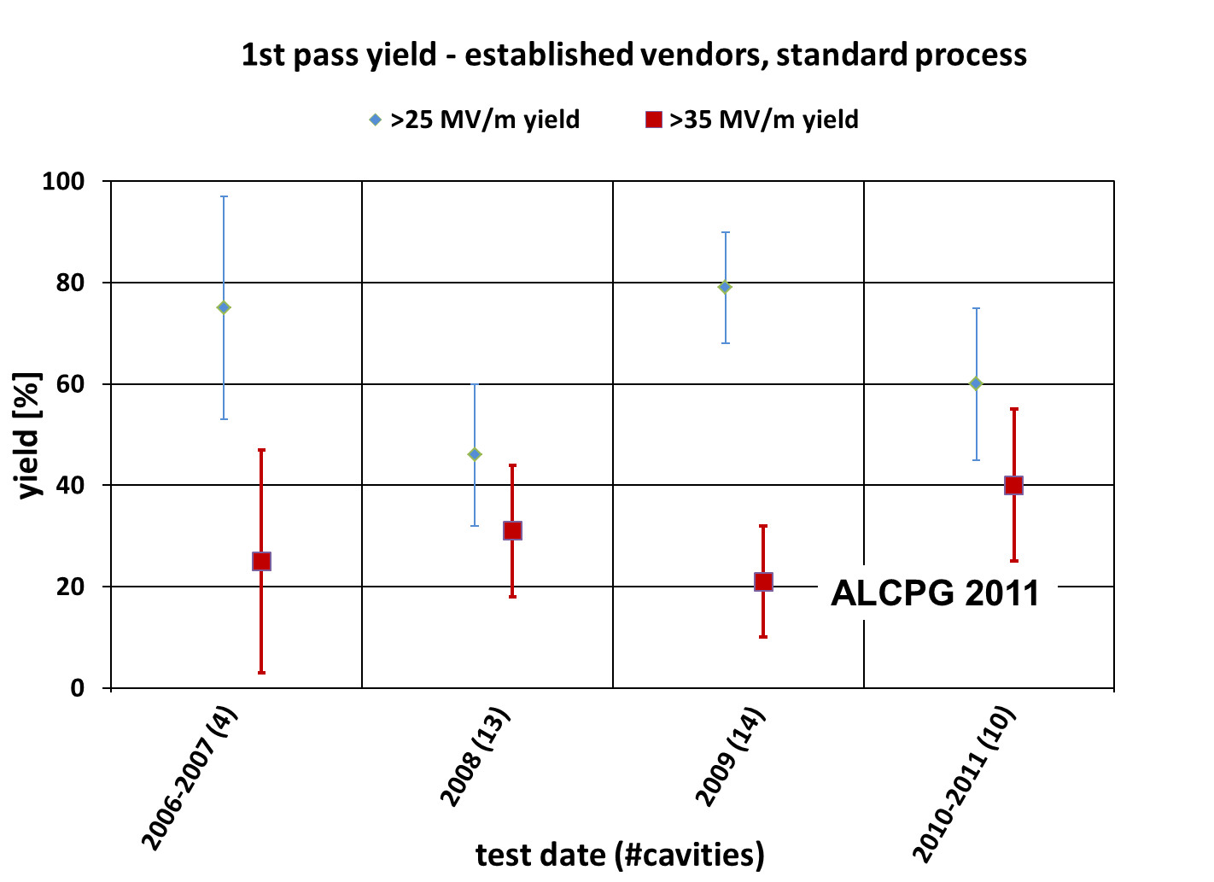
Discrete Time 1st Pass

Slide 9
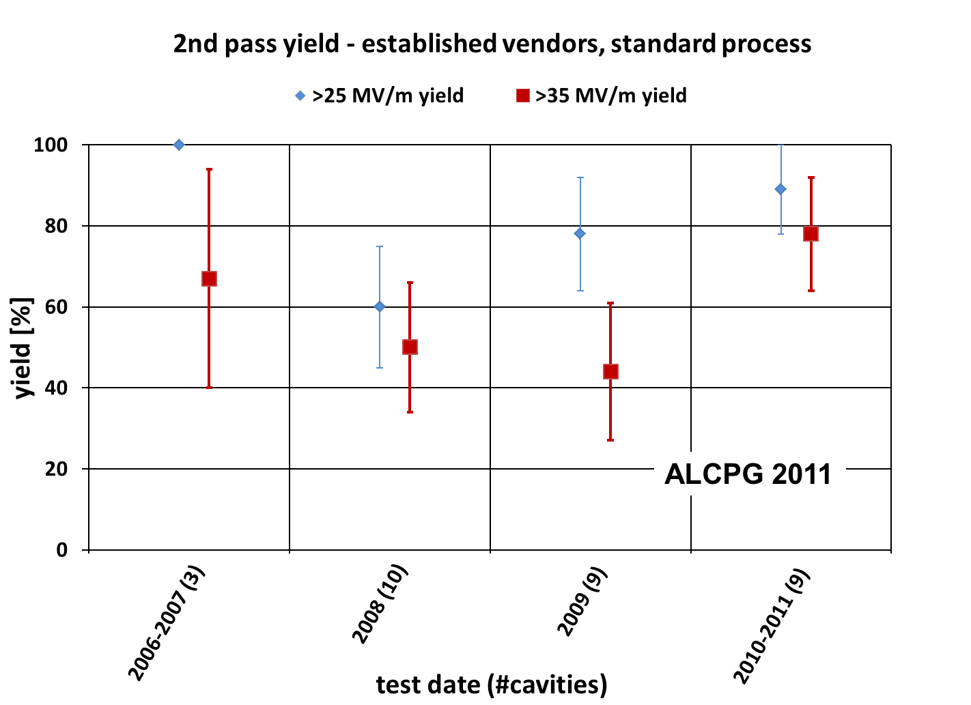
Discrete Time 2nd Pass

Slide 10
Discrete Presentation
Highlights the progress of the past year
  Yield of 9 cavities in 2010-11 is ~77% after two passes; 40% first pass and a 2nd pass success rate of ~50-60%(!)
  By comparison 2008 and 2009 numbers are ~45% total after two passes; ~25% first pass and ~30% in the 2nd pass.
  EXCELLENT progress!
One proposal would be to continue with the discrete method as well, and plot 2011/2012 data as the next increment to this plot (in addition to the cumulative plot)
Constant vigilance in cavity manufacture!

Slide 11
From here to 2012
Incoming cavities at first glance would appear to be on order of…
  5 MHI
  ~40 NR / AES / PAVAC (ARRA funds)
  ? (a few?) at XFEL
Appears to be more than enough, but remember…
  XFEL cavities have non-ILC goals
  In the US
    Vendor qualification continues
    Vendor roles are increasing
    Alternative processes are being developed
    There are limitations on throughput
Total ‘production’ cavities available by mid-2012 probably closer to 15

Slide 12
Standard Procedure Established for ILC-SCRF Cavity evaluation, in guidance of TTC
 | Standard Fabrication/Process
Fabrication | Nb-sheet purchasing
 | Component Fabrication
 | Cavity assembly with EBW
Process | EP-1 (~150um)
 | Ultrasonic degreasing with detergent, or ethanol rinse
 | High-pressure pure-water rinsing
 | Hydrogen degassing at > 600 C
 | Field flatness tuning
 | EP-2 (~20um)
 | Ultrasonic degreasing or ethanol (or EP 5 um with fresh acid)
 | High-pressure pure-water rinsing
 | Antenna Assembly
 | Baking at 120 C
Cold Test (vertical test) | Performance Test with temperature and mode measurement
Key Process
Fabrication
Material
EBW
Shape
Process
Electro-Polishing
Ethanol Rinsing or
Ultra sonic. + Detergent Rins.
High Pr. Pure Water cleaning

Slide 13
Gradient Range Yield Gain
+~15%

Slide 14
Range; Cumulative v Discrete
Allowing a minimum vertical test gradient of 28MV/m (-20%) increases the yield ~15% in the cumulative plot
From the 2010-2011 data, a similar application of a linear fit from 25MV/m (88%) – 35MV/m (77%) data increases the yield ~7%
  Limited numbers, but should we discuss the range of RF power being included for the vertical test portion of the cavity range?

Slide 15
Conclusion
The Cavity R&D effort has to date been a remarkable technical success
  We need to make sure it is understood this way!
  The cavity database provides us with a credible way to present our ‘production’ results (and record our R&D efforts at a high level)…thanks to the database group and please keep it up!
  We will continue R&D efforts leading to longer term payoffs both technically and industrially; this may limit the number of ‘production’ data points over the course of the next year
  We should have enough results to show…with constant vigilance!
  We should discuss the payoffs of yield, and allowing a variation in the yield, to the overall machine costs.

