Slide 1
New features in PLACET
Andrea Latina (CERN)
Slides prepared with the help of J. Snuverink (CERN)

Slide 2
Outline of this talk
PLACET is a tracking code that simulates linear colliders, originally written by Daniel Schulte
PLACET has significantly evolved during the last years, thanks to the contribution of several people: myself, Jochem Snuverink, Barbara Dalena, Erik Adli, Peder Eliasson, …
In this talk we present some of these improvements and outline the plans for future developments
  PLACET overview
  Tracking improvements
  New commands
  Code fixes
  Future plans

Slide 3
PLACET Overview
PLACET simulates beam transport and orbit correction in electron/positron linear colliders, from the damping rings exit to the interaction point, and also the CLIC drive-beam
It implements 4d and 6d tracking using multiple beam models
It can simulate static and dynamic imperfections, such as element misalignment, ground motion, arbitrary failures and provides several counteracting schemes
It simulates many single-particle, collective, single-bunch and multi-bunch effects:
  ISR, CSR, short-range wakefields, long-range wakefields, collimator wakefields, RF-kicks, HALO generation and beam-gas scattering
Pros:
It’s easily programmable (Tcl/Tk – Octave)
It can be greatly customized, at the user level (no messing up with the C++ required!)
It’s fast
It’s open-source, and it relies only on open-source components
Cons:
Somehow steep learning curve (but great productivity when you get started)

Slide 4
Improved Multipoles
New command syntax and functionality
The strength can be a complex number, in order to consider normal and skew components at the same time. For example:
Multipole –type 3 –strength (2,3)
  creates a sextupole with normal component 2 and skew component 3
Multiple multipole strengths can be specified at the same time:
Multipole –strength_list “(1,1) (2,2) (3,3)”
  implements an element that gives simultaneously a dipole, a skew quadrupole and a sextupole kicks (normal and skew components)
It can be used to simulate higher order modes contamination in magnets
Multipole –type 3 –strength (2,3)
Multipole –strength_list “(1,0) (0,2) (3,0)”

Slide 5
Tracking through thin-lenses
An abstraction for tracking through thin lenses has been created
  It is sufficient for each element to provide a “kick” at a specific location
    (leap-frog integration)
It implements single-particle tracking and sliced-beam tracking
  Each element just need to provide “a kick” which depends on the particle parameters and its longitudinal location within the element
It takes into account synchrotron radiation emission
  Statistical process for single-particle beams
  Average energy loss for sliced beams
So far was mostly an hidden feature of each basic elements (but it is used in the multipoles)
  It will allow to create mixed elements (QUAD+SOLENOID for instance)

Slide 6
1-particle tracking with SR
In some cases it can be useful to track 1 single particle representing the entire bunch (for instance when computing a response matrix)
In such a case, energy loss due to synchrotron radiation cannot be applied as a statistical process, and it must applied ad an average energy loss
➔ This has been implemented

Slide 7

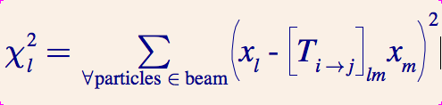
(2nd –order) transfer matrix calculation
The possibility to retrieve the first-order transfer matrix has been added to each element
➔ For a beamline, the transfer matrix from i -> j, can be calculated in two ways:
Ordinary matrix multiplication
    T = placet_get_transfer_matrix(“beamline”, i, j);
Tracks a bunch and performs a polynomial fit to minimize the following chi²
  where l and m are the indexes 1 to 6 : (x,x’,y,y’,z,δ)
      [T, U] = placet_get_transfer_matrix_fit(“beamline”, “beam”, i, j);
  This procedure returns also the second-order transfer matrix U_{ijk}

Slide 8
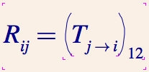

Response matrix calculation
Traditionally, the response matrix was calculated using an “experimental” approach, i.e. by exciting each corrector and measuring the induced orbit distortion
➔ Two new methods have been implemented:
Response matrix calculation from the optics
  [ Rxx, Ryy ] =
  = placet_get_response_matrix_optics(“beamline”, B, C);
  Tracking one single bunch and fitting the polynomial
    to find R_{ij} (and also R_{ikj})
    [Rxx, Rxy, Ryx, Ryy, Rxxx, Rxxy, Rxyy, Ryxx, Ryyx, Ryyy] =
    = placet_get_response_matrix_fit(“beamline”, “beam”, B, C);

Slide 9
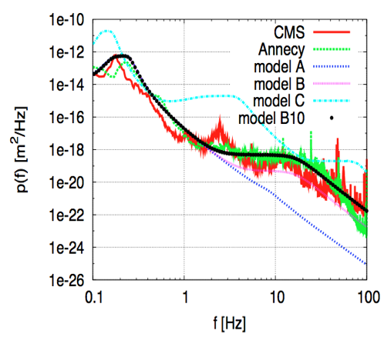
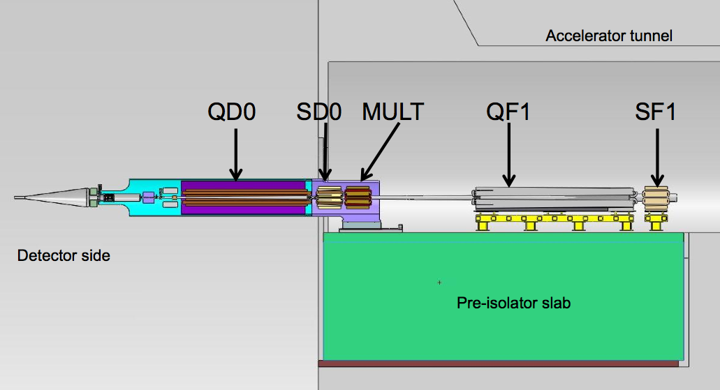
Ground motion
Based on models from A. Seryi¹
Standalone program integrated
Possibility to add stabilisation
  to each individual girder or element
Pre-isolator for QF1 and QD0 implemented realistically
[1] A. Seryi, “Ground Motion Models for Future Linear Colliders”, EPAC2000, Vienna

Slide 10
Simulation Frameworks
Simulation frameworks for CLIC ML and BDS
  Goal: simulate as realistically as possible
  Including all feedback systems and dynamic imp.
  One settings file: easy to switch on and off features
  Scripts to analyse results
Similar framework for CLIC decelerator. See:
  https://indico.cern.ch/conferenceOtherViews.py?confId=102652
All in PLACET repository
Modular setup: more will/can be added easily

Slide 11
Code. Memory consumption
Beamline consumes most memory (situation 2010)
  ELEMENT: 408B + ~30 ‘attributes’ * 96B = 3kB
  90k elements per main linac for CLIC
  Each cavity (50% of ML) has an additional BPM element
  One ML+BDS simulation takes about 800MB
    About ok for one job, but two start to slow down desktop/laptop significantly
Attribute class scrutinized (96B->48B)
BPM in Cavity changed to simple struct
About 50% memory reduction achieved
More reduction possible (if needed)

Slide 12
Coverity
Coverity is a computer security company, with in-depth experience of static analysis. They have conducted many open source scans, on complex and critical software (such as the Linux kernel), and were able to detect numerous bugs. Their static analysis tool is thorough and boasts 100% path analysis.
Coverity has kindly donated a license of Coverity Static Analysis tool to CERN - which means that all CERN users can use the tool.

Slide 13
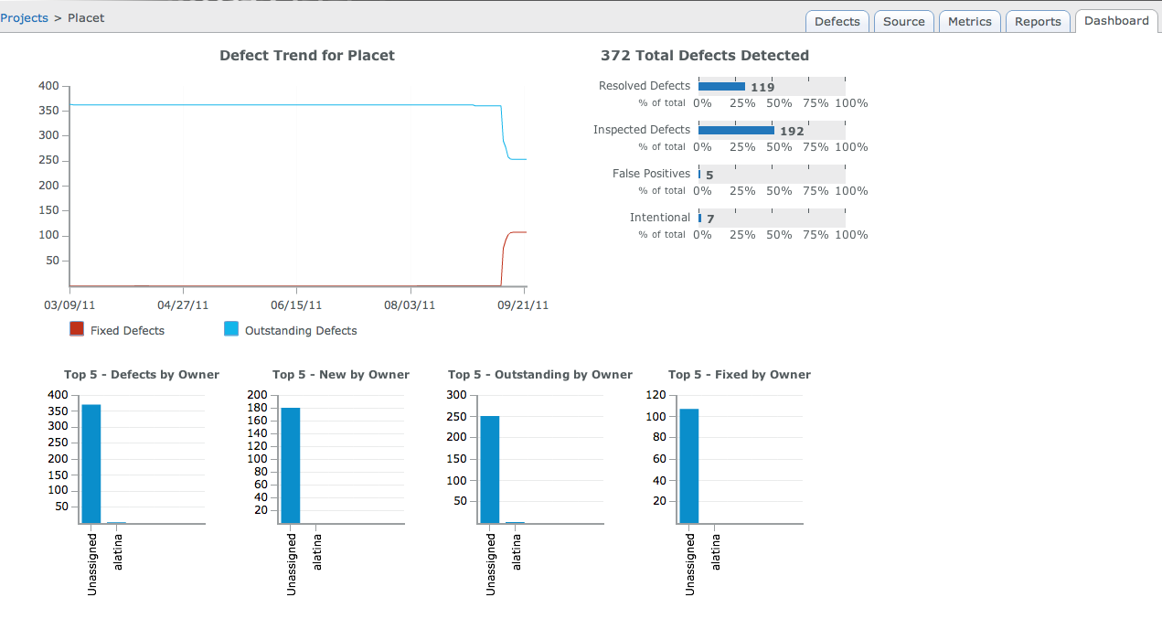
Coverity
Checking PLACET since March 2011
372 issues found (cf. ROOT 5274)
  151 ‘high impact’ (mem. leaks, mem. corruption, use of uninitialised variables)
  79 fixed + 45 ignored (27 high impact outstanding)

Slide 14
Conclusions and future plans
PLACET is more stable, and mature
New features open new simulation / orbit correction capabilities
Still it can be improved
  in terms of modularity (adding new features is somehow complicated)
  the interface toward Octave must be made more flexible (decouple the embedding?)
  code must be parallelized
  documentation must be beefed

