Slide 1
CTF3 operation in 2012-2016
Introduction
Consolidation + upgrade
Phase feed-forward + feedbacks
TBL+
Two-beam module string
Collaborations

Slide 2
Motivation
Goal: fully exploit potential of CTF3
Consolidate performance in view of CLIC requirements
(we have been mainly pushing for current and power)
improve operational experience
phase feed-back / feed-forward
BDR with beam loading
high-power RF testing:
demonstrate operation of
a drive-beam driven
power source
CLIC module tests with beam
as close as nominal
as reasonable
Phase feed-back
DELAY LOOP
BDR with
beam-loading
RF power production
COMBINER RING
DRIVE BEAM LINAC
CLEX
Two beam modules

Slide 3
Consolidation + Upgrade
Certainly need consolidation for aging equipments
energy upgrade will ease the operation, required for full TBL
repetition rate upgrade will decrease conditioning times
required for TBL+ RF testing
continue efforts on further stabilizing the machine
feedbacks on current and energy
finalize the feasibility demonstration in terms of
  stability
  emittance
  pulse shape
  routine operation
  …

Slide 4
TWTs for the 1.5GHz SHBs
most problematic components presently
out of the 3 nominally working ones, we have only 1 or 2!!!
the repair takes ages
the running time exceeds already the specified lifetime
=> definitely need replacement and spares
call for tender soon, could order beginning of 2012
=> need to review the phase variation requirements
TWT from different company available end 2013
two further TWTs to be ordered after validation of 1st prototype

Slide 5
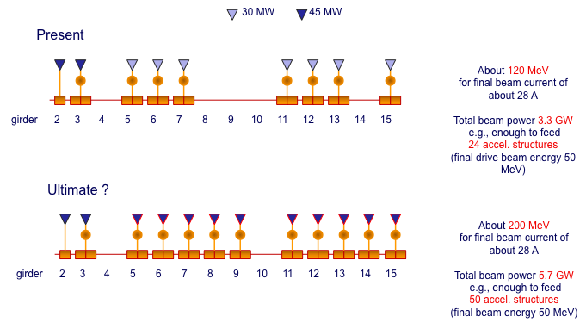
Energy upgrade
R.Corsini
Upgrades to 45 MW tubes and MKS14 already planned
Keep spectrometer 10 + PETS line from girder 8 (loaded BDR)
We have 4 accelerating structures, need 2 additional MKS
need to check availability of pulse compressors
price enquiry for S-band modulator together with X-band
one MKS by mid of 2013, PSI modulator could be rebuilt (depending on manpower)

Slide 6
Repetition rate upgrade
required for RF structure conditioning and BDR statistics
presently limited to 5Hz by MKS11 and MKS15 (10Hz specs)
practically limited by radiation losses
test with 4x combined beam up to TL2 done already last year
further tests with 8x combined beam
Identify shielding / zone classification as a function of rep rate and operation mode (4x/8x)
Identify hardware changes as function of rep rate
Decide ultimate rep rate

Slide 7
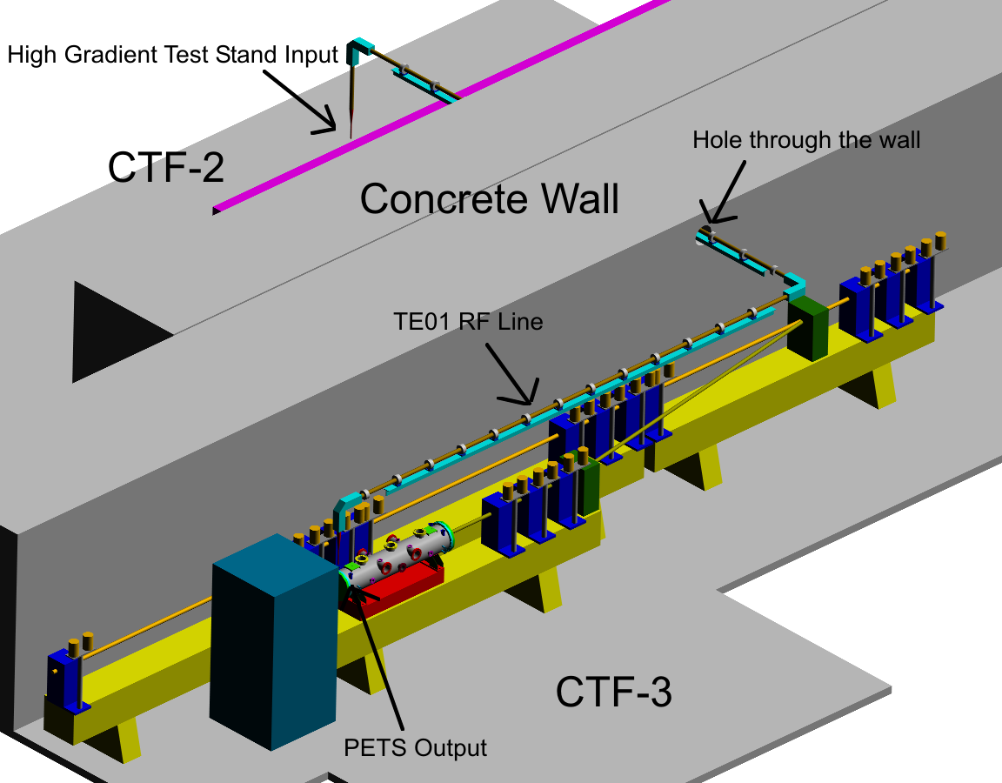
BDR with beam loading
Beam loading reduces field => BDR lower?
CLEX probe beam has only low current
=> use CTF3 drive beam and klystron driven X-band structure
reactivate the old ‘30 GHz PETS’ line
DELAY LOOP
BL - BDR experiment
COMBINER RING
DRIVE BEAM LINAC
CLEX

Slide 8
BDR with beam loading (2)
line can be reused, some magnet, power converter repair needed
accelerating structure centered on current tank position
Radiation level: tank ~10 μSv/h, copper collimator: 50 μSv/h
=> work planning needed, otherwise no particular problem
will be removed in shutdown 2011/12
30 GHz waveguide network has to be converted to X-band
Interface to regular structure test area and switchable connection to klystron
RF instrumentation from stand-alone power source
=> need cables from linac to there
RF elements on the critical path
installation foreseen in spring 2012

Slide 9
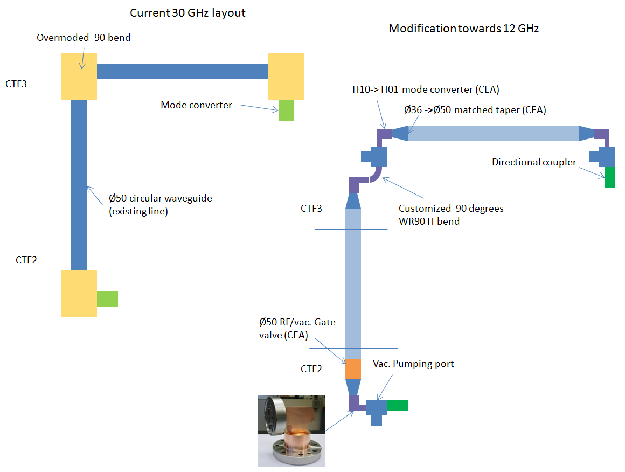
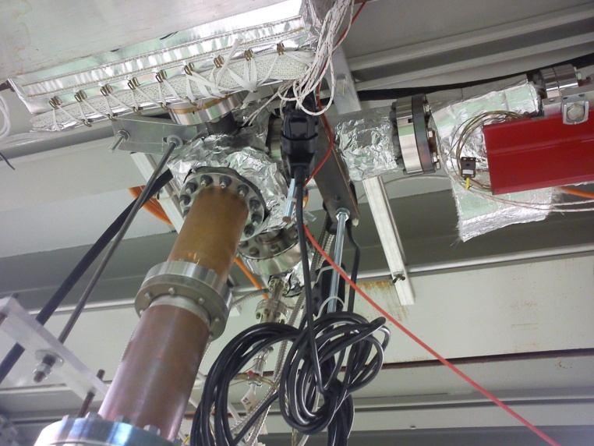
RF modifications
Accelerating Structure
T24 and TD24
Connection to the RF line?
Other RF components?

Slide 10
Phase Feed-Forward
Phase measurement and correction in CTF3 in view of CLIC phase feed-forward
was covered in detail in previous talks
phase monitors ready end 2011 – 1st half of 2012
=> beam tests with 2 or 3 installed behind each other in 2012
kicker mid 2012
modification of the TL2 dog-leg needed
=> installation shutdown 2012/13
standard optics close to existing => setup easy
commissioning of the special optics for the line required
later installation of amplifier with CLIC specifications
several weeks of operation for setup + measurements

Slide 11
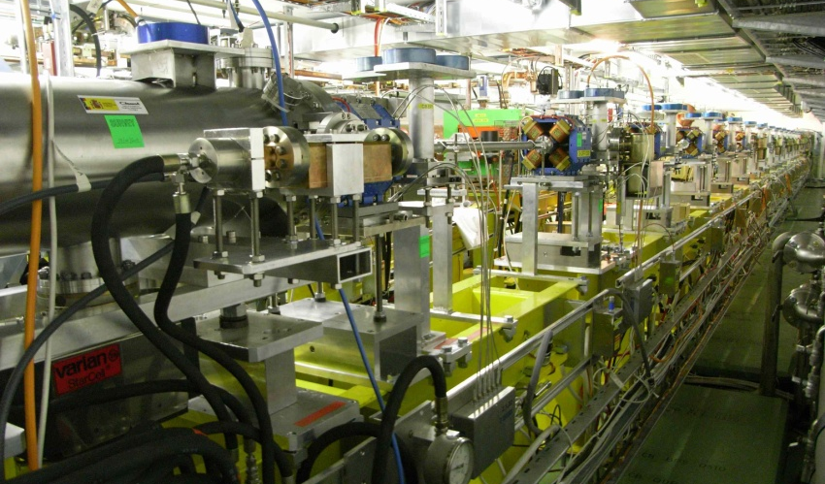
TBL+ as RF power source
One TBL PETS produces
~ 135 MW for 28 A
Need factor 8 combination
short RF pulse length
“chaining” two PETS – almost doubling the length – multiplying by 4 the power
Conservative assumption (losses, reduced active length for input coupler):
=> factor 2 gain, i.e., 135 MW (nominal) power for 14 A
Can use factor 4 combination, access to up to ~260 ns pulses
=> easier and more stable operation, can increase the rep. rate
Or substantially lower current to produce power (~60MW) for one structure
E
s

Slide 12
TBL+
presently 9 PETS structures installed
upgrade to 13 PETS for 2012
leave every other slot free for priming
install 4 PETS with priming and 2(?) testing slots (RF network, supports, instrumentation) in 2013
=> total of 16 PETS for final deceleration studies
need higher energy at this point!
install 2(?) more testing slots for 2014

Slide 13
TBL+ as RF power source
  Contribution to testing program:
  Klystron based:
    from 1 to 4 klystrons from 2012 to 2016, 1 slot each, 50 Hz, 80% uptime
    Npulses = <Nslots>× Nyears ×Reprate × Nseconds_per_year ×uptime
    = 2 × 5 × 50 × 31,556,952 × 0.8 = 12.5 ×10⁹
  TBL based:
    4 ports, 2 slots each, from 2013 to 2016, 10 Hz, 40% uptime
    Npulses = <Nslots>× Nyears ×Reprate × Nseconds_per_year ×uptime
    = 4 × 4 × 10 × 31,556,952 × 0.4 = 2 ×10⁹
  Demonstration of routine use of two-beam power source.
  Reliability, stability, uptime…

Slide 14
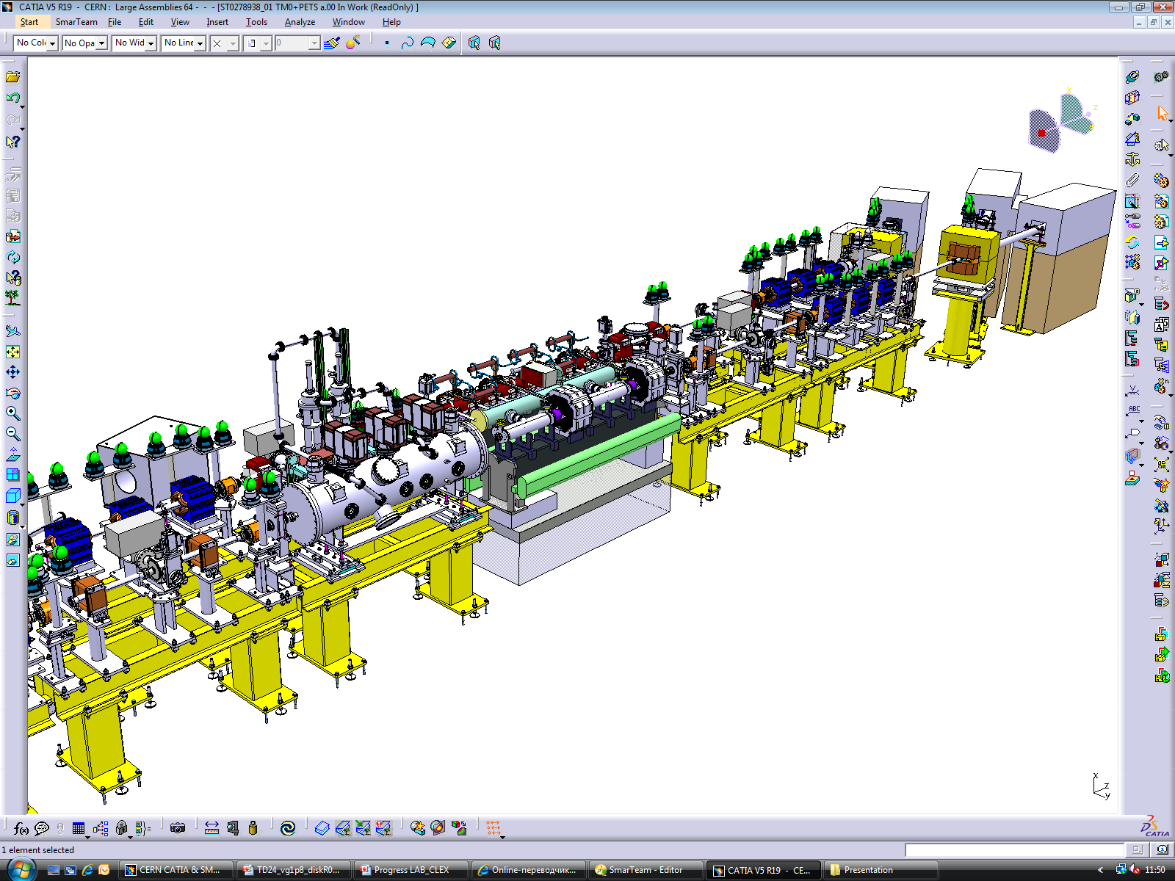
Two beam modules
Goal: understand behaviour and limitations of a few generations of CLIC two-beam modules in a real accelerator environment testing them with beam (performance, cost)
1st module installation shutdown 2012/13
3 modules from 2013/14
test behaviour of a
module string with
minimum number
of interconnects
string of a new generation of modules later (>2016)
need to start planning the foreseen experiments…

Slide 15
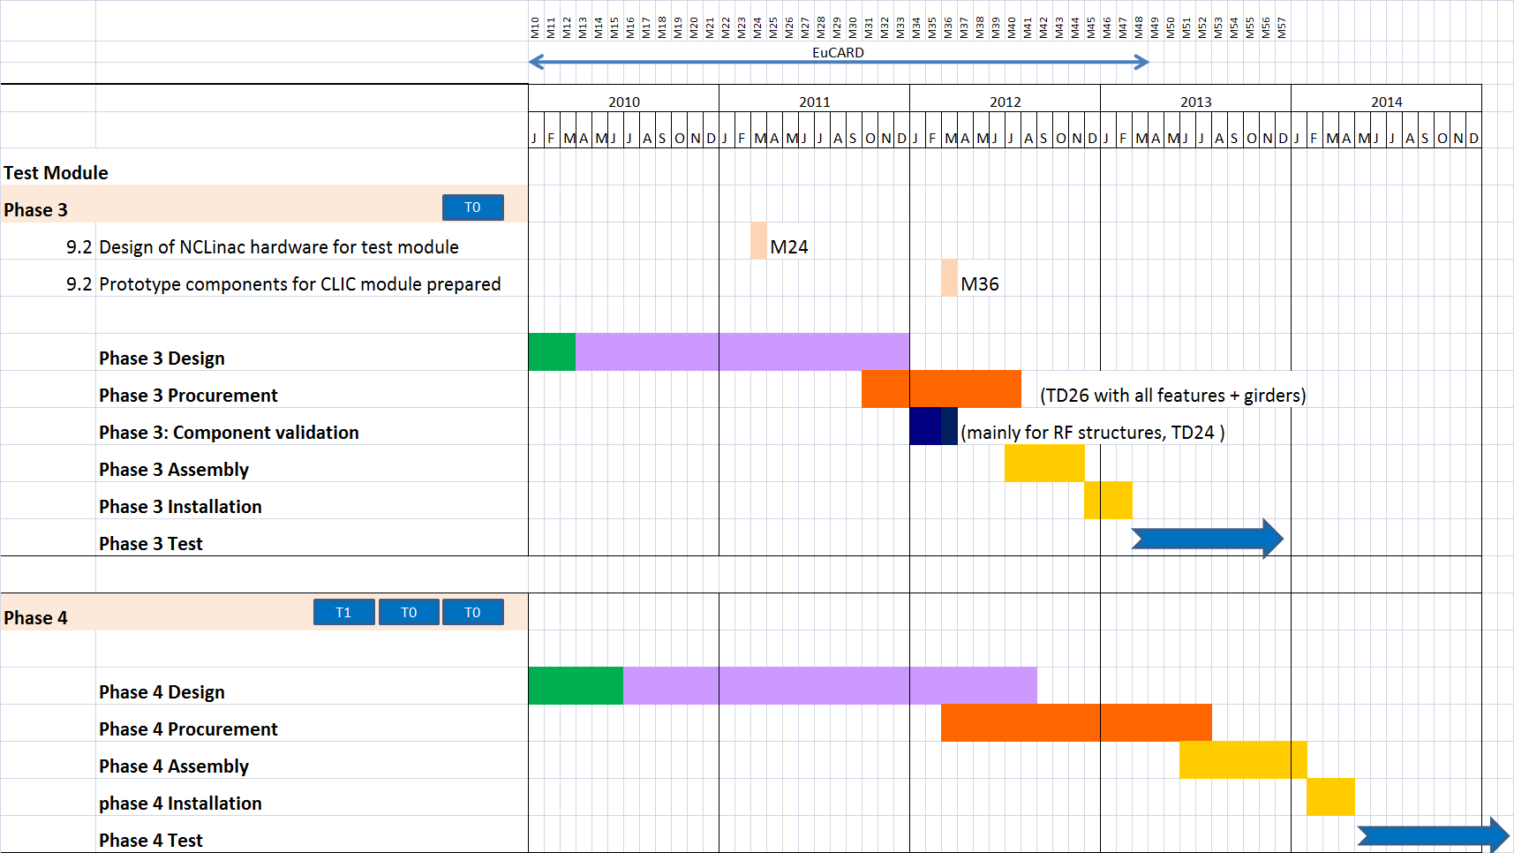
TB Module prototypes - CLEX

Slide 16
Other items
optimize RF deflector bump configuration
decoupling the CR septas
test algorithms for CLIC machine commissioning (safe beam)
machine protection concepts
loss monitors
test alignment in the accelerator environment (?)
CLIC specific beam instrumentation
any tests in view of CLIC0 (injector) (?)
sextupoles in the CR deflector bump (?)
…

Slide 17
Running in 2013
LHC and injector chain will be completely stopped
=> normal piquet support not available
CTF3 has been running outside normal operation periods
Need to organize:
  Water
  Vacuum
  Power
  Controls
  Access
Specialist support on best effort system

Slide 18
Timeline
2012:
  TBTS: two TD24 structures with wake-field monitors (or T24)
  TBL: running with 13 PETS
Shutdown 2012/13 installation:
  First Two-Beam module
  4 PETS for priming + 2 testing slots
  Phase feed-forward kicker + TL2 line modification
2013:
  module tests
  phase forward tests
Shutdown 2013/14 installation:
  2 further Two-Beam modules
  2 more TBL+ testing slots

Slide 19
Collaborations
this work is covered in various workpackages related to CTF3
  WP CTF3-001: CTF3 consolidation & upgrades
  WP CTF3-002: Drive Beam phase feed-forward and feedbacks
  WP CTF3-003: TBL+
  WP CTF3-004: Two-Beam module string
part of it is covered by collaborators
we would like to invite collaborators to express their interest in any of the workpackages or parts of it
  some longer term commitment would be ideal
  long-term operational support (>1 year) would be helpful
  can be also for dedicated experiments

Slide 20
Thank you very much for your attention!
Thanks to everyone for the input to this talk.

