Slide 1
Special ATF Session
- ATF/ATF2 day on 28th September -
Nobuhiro Terunuma
KEK
9/26/2011 LCWS11

Slide 2
Special ATF Session on 28th
Target of ATF/ATF2; R&D for ILC
    Generation of 2 pm-rad low emittance beam
    Demonstration of ILC Final Focus optics (ATF2 Goal-1)
      37 nm vertical beam size at IP
    Stabilization of 37 nm beam (ATF2 Goal-2)
Goal of this session
  Review/understand the present status of ATF and ATF2 after the great earthquake in details.
  Discuss the machine schedule and planning for the goal-1 in this Fall and by end of this year.
This session is composed by Joint with AWGs
    Damping Rings (WG2), Beam Delivery (WG5), Low Emittance Beam Dynmacis (WG7), Instrumentation and Technical Systems (WG8)
9/26/2011 LCWS11

Slide 3
Schedule: Special ATF Session
8:30- 10:30 | Understanding ATF machine status and planning runs in this fall (WG2+WG5)
30 | Status of ATF/ATF2 and machine schedule in this Fall | N. Terunuma |  |  | KEK
30 | IPBSM status ( for a key devise ) | J. Yan (webex) |  |  | KEK/Tokyo
30 | Planning for the goal-1 | P. Bambade |  |  | LAL
30 | Discussion on the planning, following P.Bambade's talk | T. Tauchi |  |  | KEK
11:00- 13:30 | Status Report of beam tuning and Instruments (WG2+WG5+WG8)
30 | Overview of ATF beam diagnostics |  |  | N. Terunuma |  | KEK
30 | ATF2 lattice matching and beam tuning for ATF2 lattice v4.5 |  |  | G. White |  | SLAC
30 | Study of ATF2 multipoles and their influence of the nominal and reduced beta optics |  |  | S. Bai (webex) |  | IHEP
30 | OTR R&D at ATF2 |  |  | A. Faus-Golfe |  | IFIC
30 | Latest results on laser wire developments. |  |  | L. Corner |  | Oxford
15:00- 16:30 | – continued -
30 | Cavity BPM system at ATF2 |  | S. Boogert (webex) |  |  | Holloway
20 | High power laser wires using fibers |  | L. Corner |  |  | Oxford
20 | Update on FONT R&D |  | P. Burrows |  |  | Oxfort
17:00- 18:30 | Study for future plan (WG2+WG5+WG7)
10 | Tolerances for ATF3 QF1 from beam dynamics |  | H. Garcia Morales |  |  | CERN
20 | Sorting magnets for ATF2 nominal and ultra-low beta* |  | E. Marin |  |  | CERN
20 | A new QF1 magnet for ATF3 |  | A. Vorozhtsov |  |  | JINR
20 | Feed-forward of measured ground motion in ATF2 |  | Y. Renier |  |  | CERN
5 | Concluding |  | A. Seryi |  |  | JAI
9/26/2011 LCWS11

Slide 4
Brief report of ATF after the Great East Japan Earthquake
9/26/2011 LCWS11

Slide 5
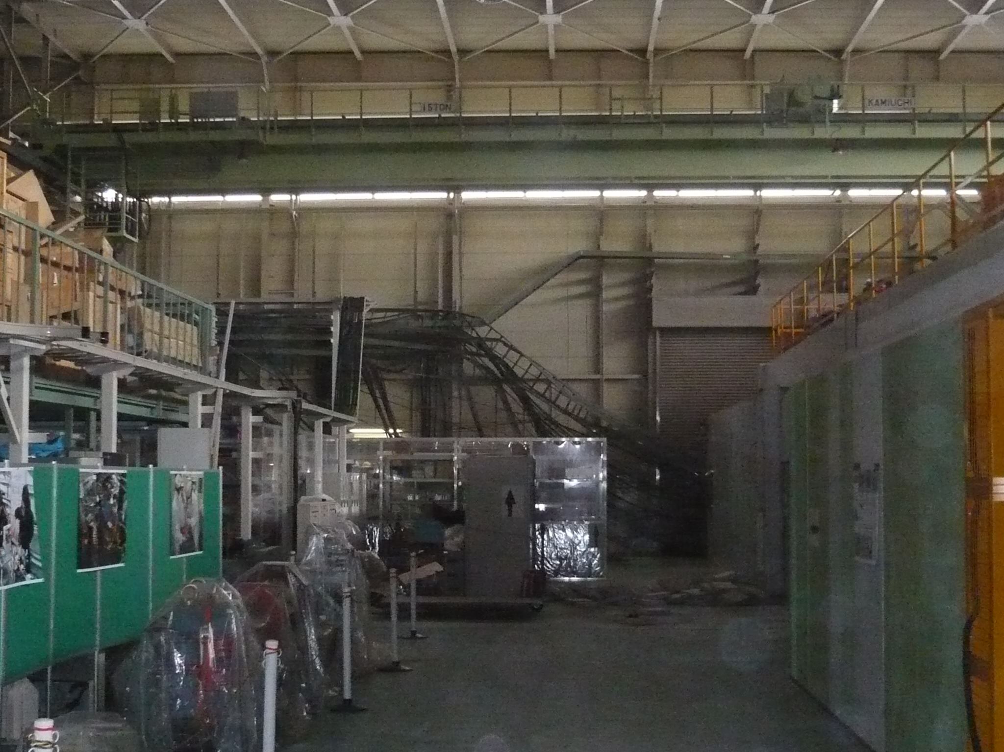
Impact of the earthquake on ATF
Photo: 2011/March/11 15:55

Slide 6
Recovery History for Test Beam
Mar 11 | 14 | 21 | 28 | Apr 4 | 11 | 18 | 25 | May 2 | 9 | 16 | 23 | 30 | Jun 6 | 13 | 20 | 27 | Jul 4
 | KEK MW |  | 1.7 | 2 / 5 MW (day/night) |  |  |  |  |  | 24 MW |  |  |  |  |  |  | 20
Blackout
½ power
Power line recovery
ATF Shield
ATF2 Shield
Radiation Safety
Test Beam
KEK
Requested
Standby
at Home
Summer Shutdown
Vacuum
Power
Distri-bution
Cooling Water
RF
Rough Alignment (LINAC)
(BT)
(DR)

Slide 7
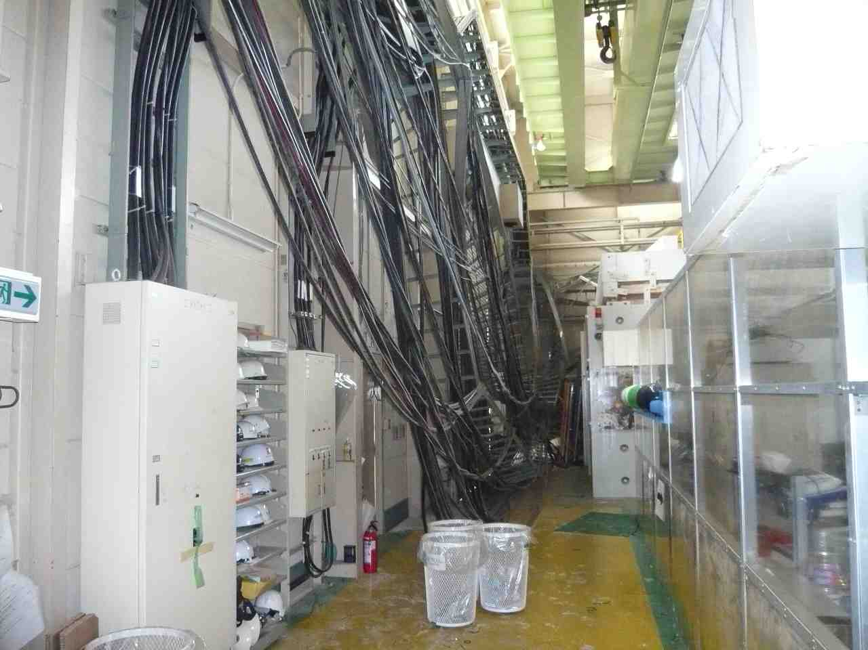
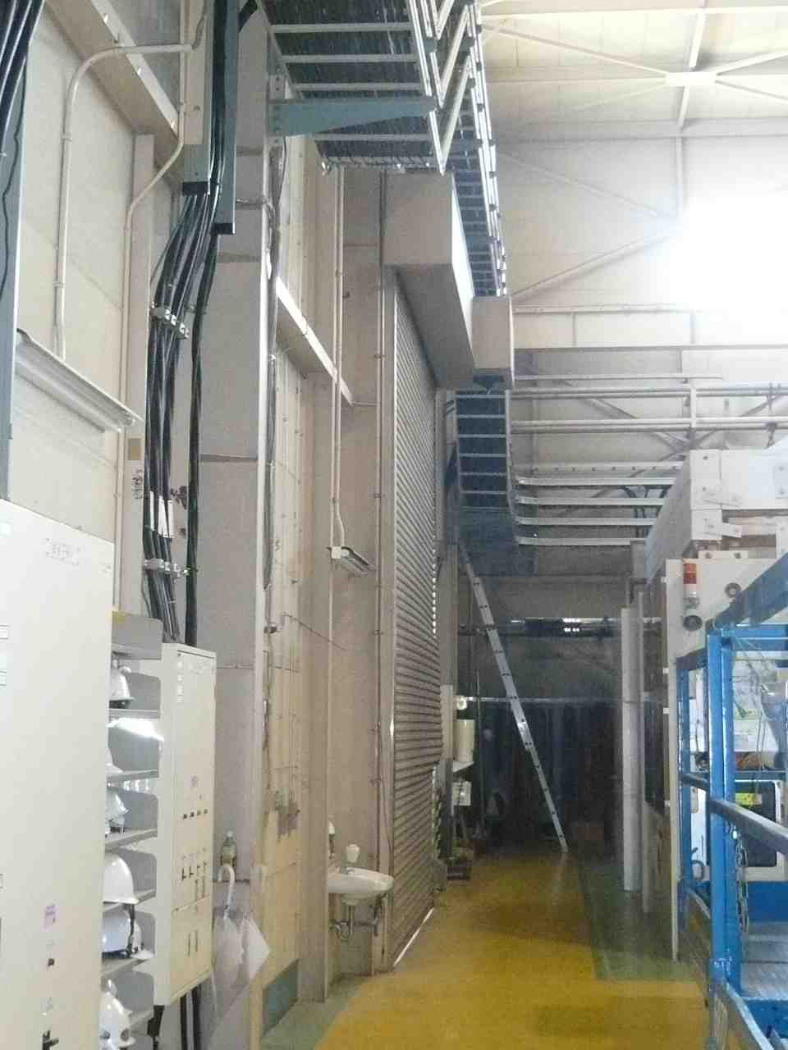
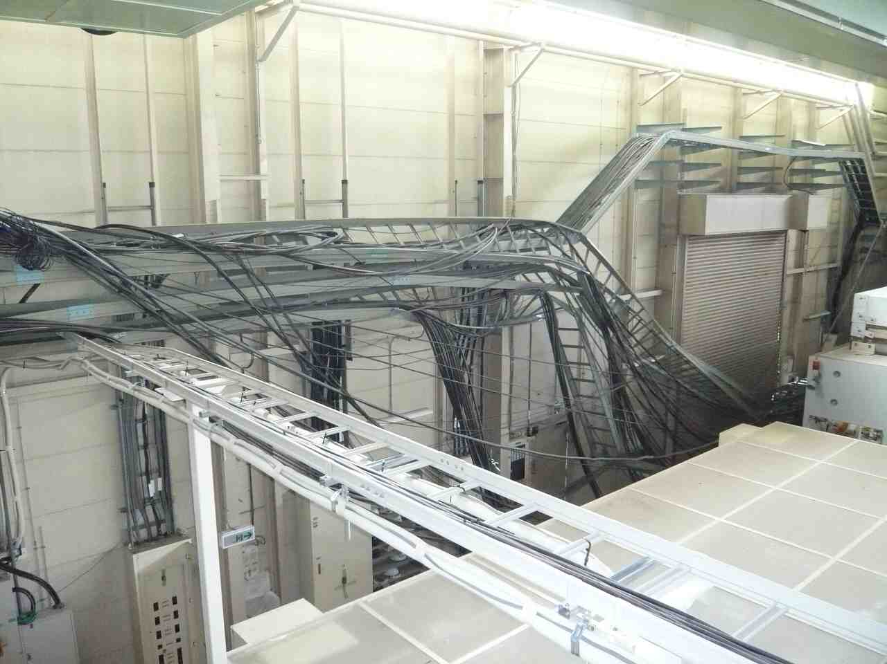
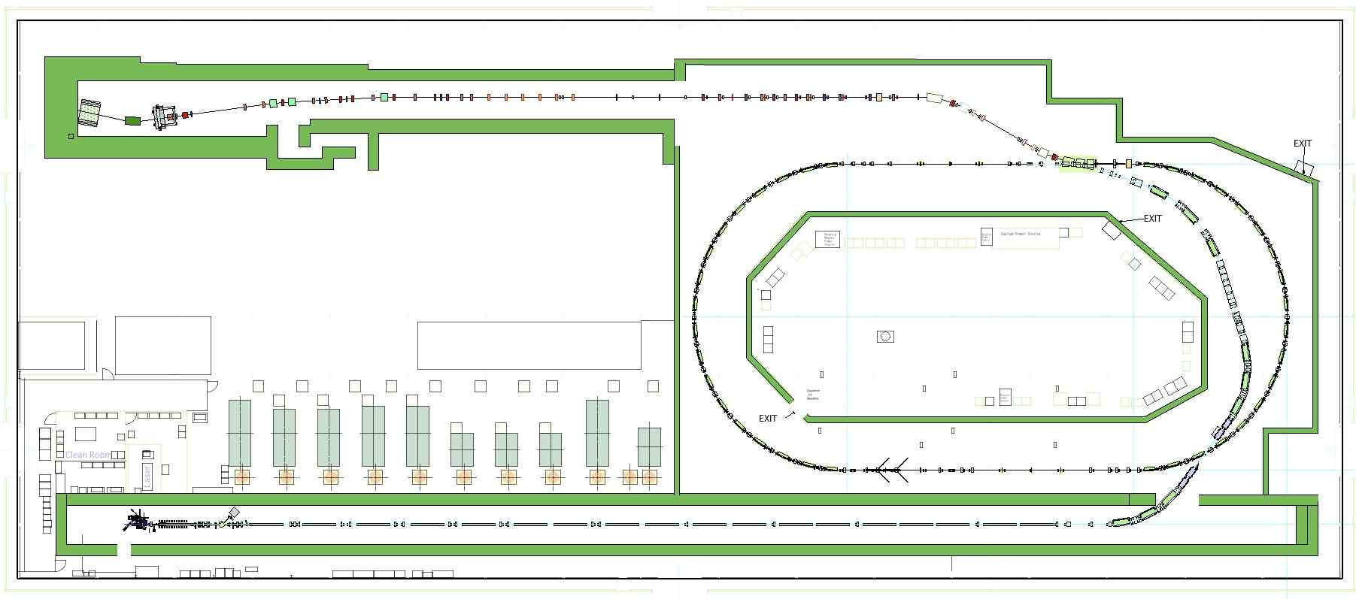
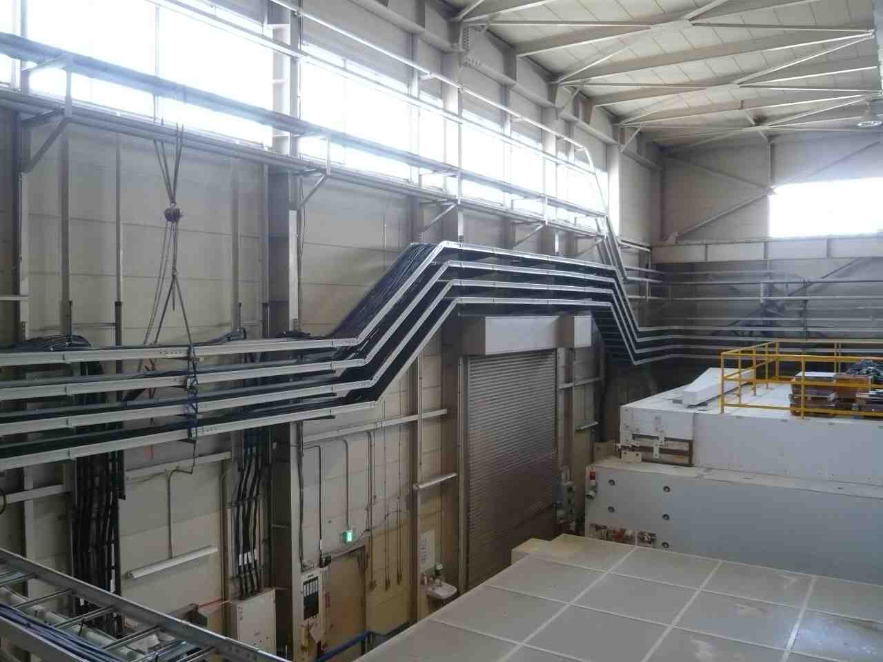
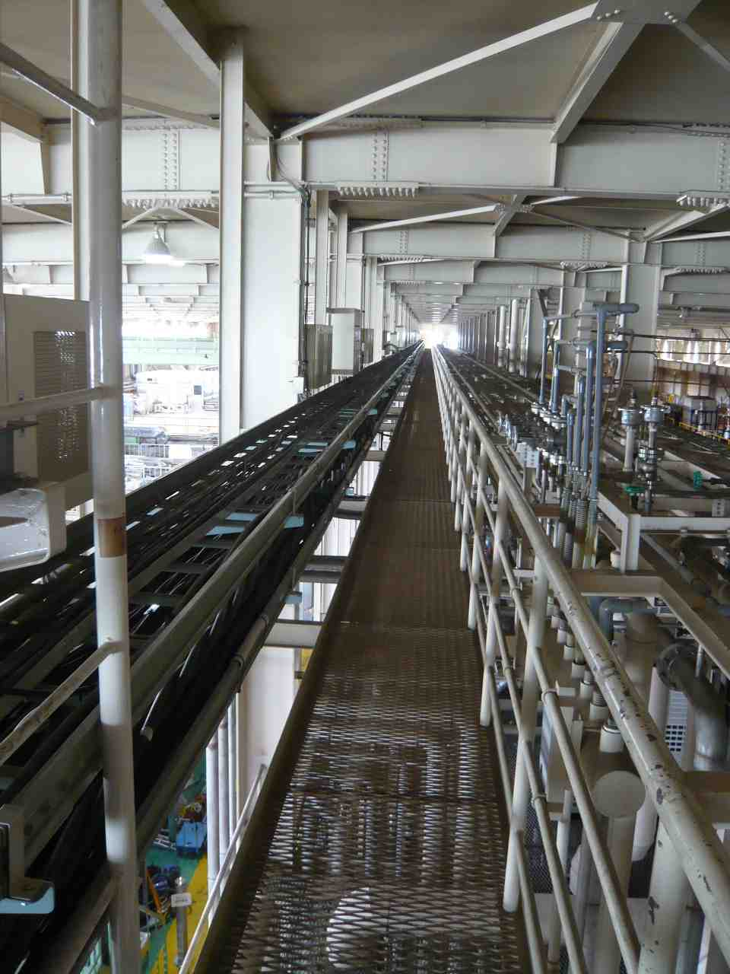
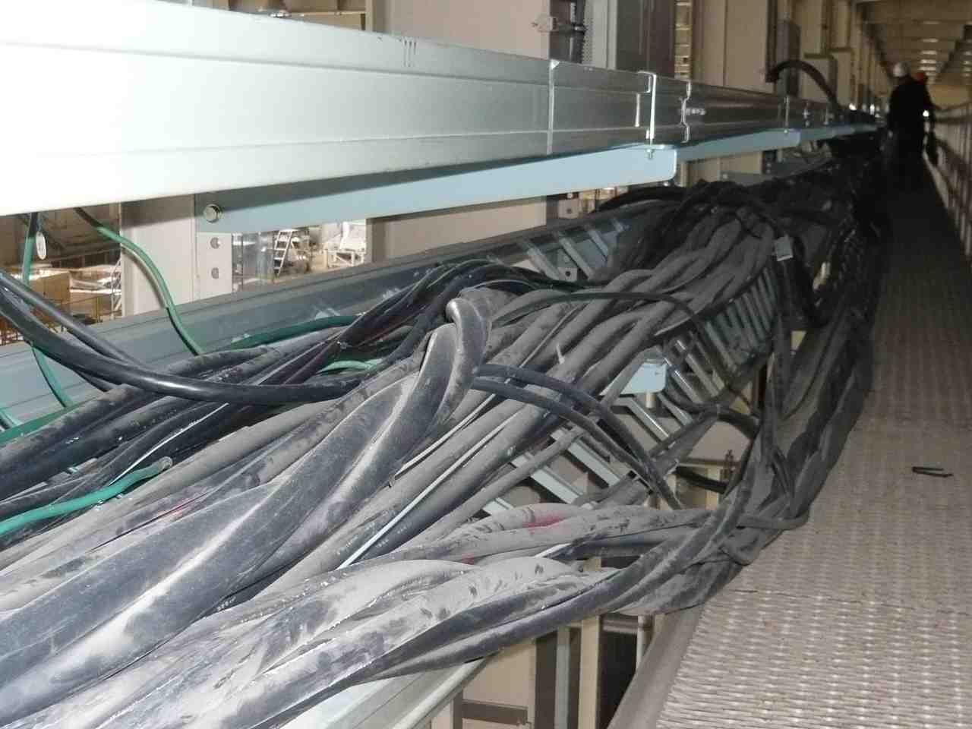
Main Power Lines
Recovered in April

Slide 8
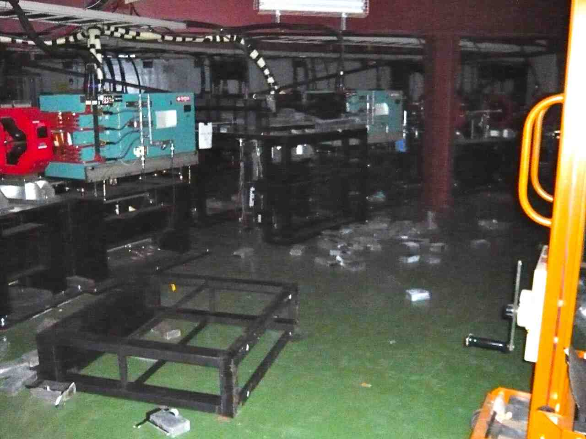
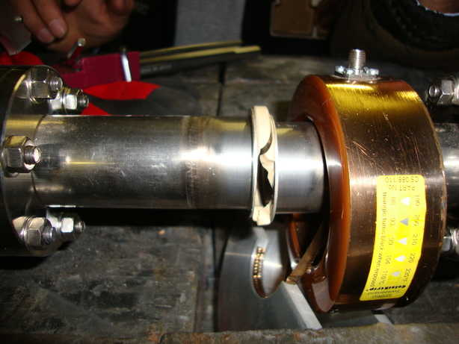
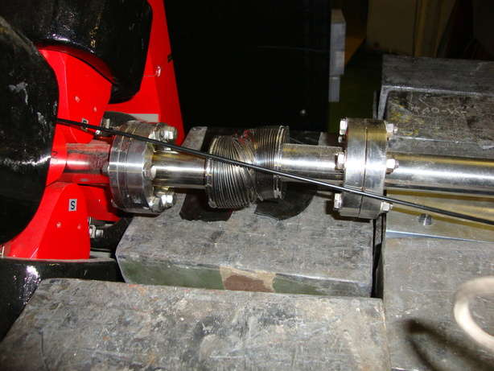
Beam Transport
Fallen Pb blocks were cleared.
Ceramic of the CT monitor and a bellows were exchanged.
Repaired in April.

Slide 9
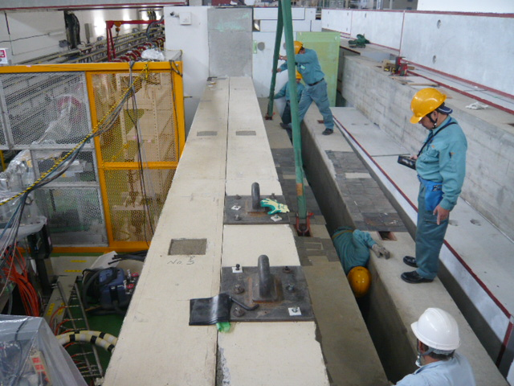
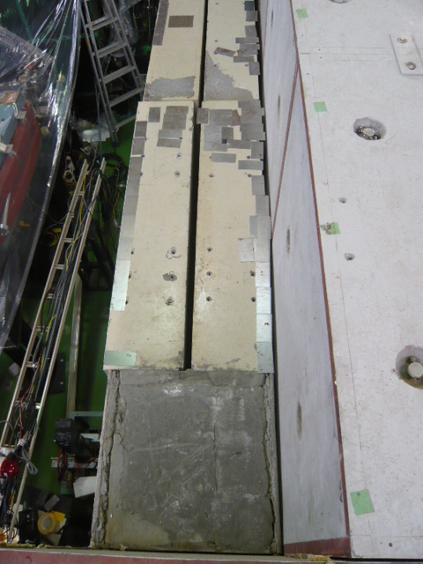
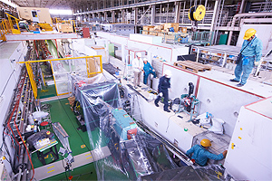
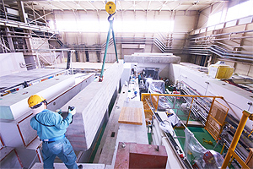
ATF2 FD/IP shield works: re-positioning
Big work! 3 weeks

Slide 10
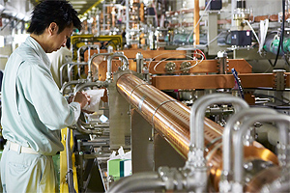
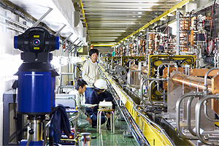
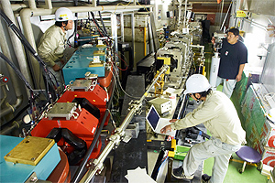
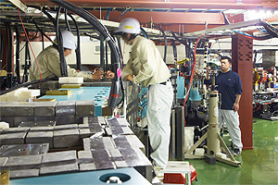
Alignment of the beamline
- continued work -

Slide 11
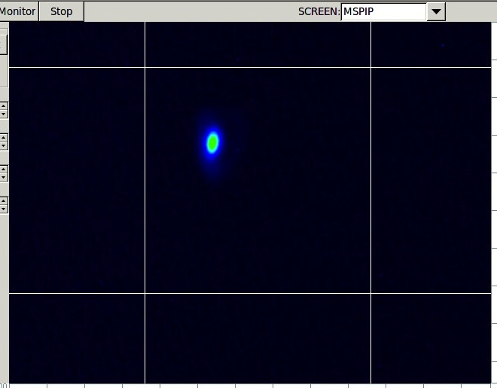
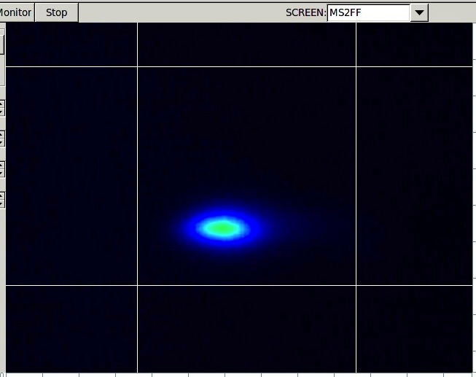
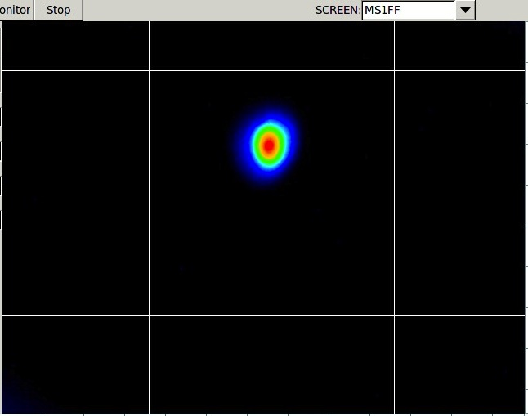
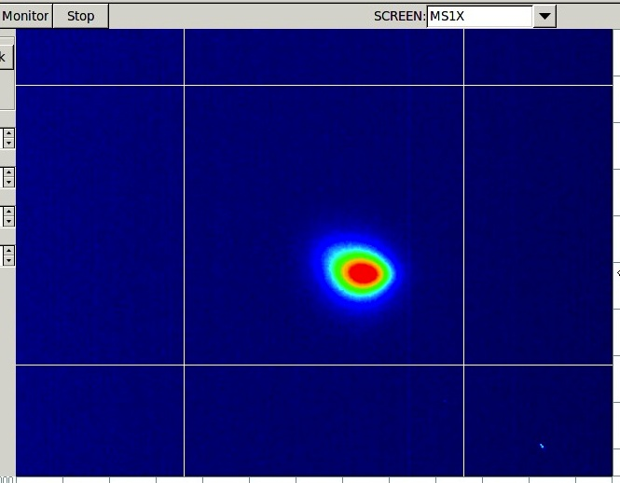
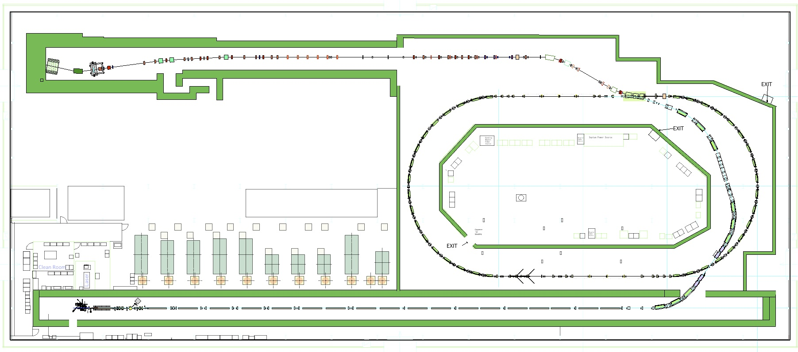
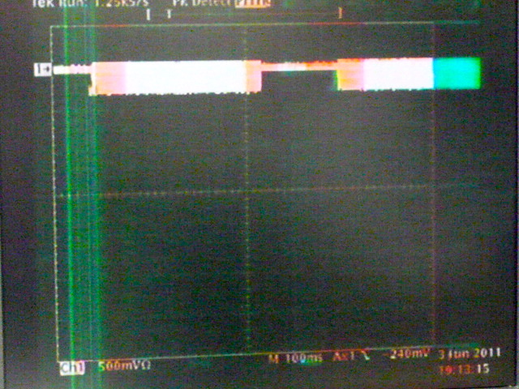
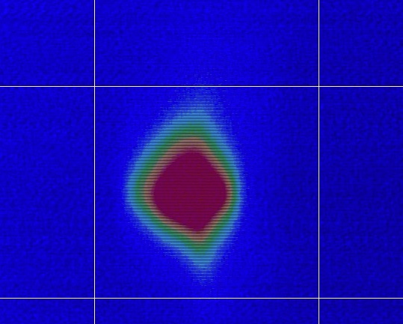
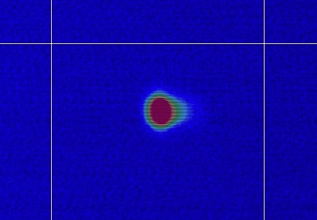
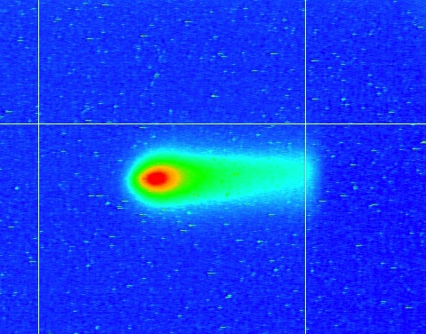
A test beam passes all beamline
Single bunch, 0.78 Hz, 0.3 x 10¹⁰ e/bunch DR&ATF2
6/3 MSPIP
6/3 MS1FF
6/2 MS1X
6/3 MS2FF
5/27 BT end
6/2
DR storage
5/31
DR 1st turn
2011/5/25
Injector
2011/5/26
LINAC
2011/06/03
N.Terunuma

Slide 12
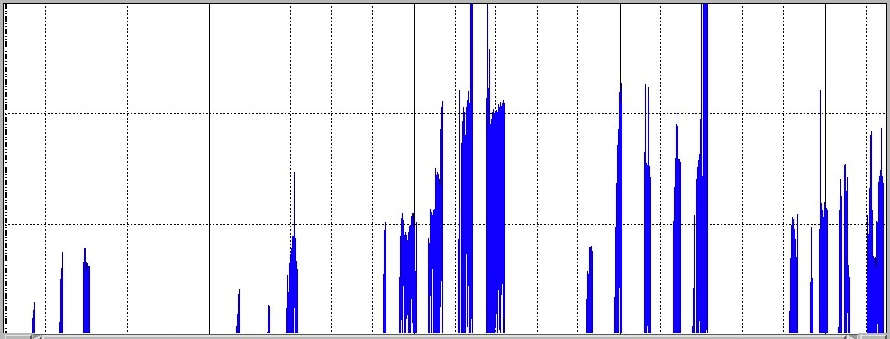
Stored beam in DR (x10¹⁰ e/bunch)
A stored beam was delivered to the dump of ATF2.
No critical damage on the accelerator was found.
3 trains
3 trains
1.0x10¹⁰
XSR ready
Inspection of the radiation safety
FONT
V-emittance (XSR) ~30pm
Freq. Adjust
0.5x10¹⁰
Compton
^{2-mirror}
FFTB mover
HAPS
Cavity BPMs
6/1
6/3
6/8
6/10
6/13
6/17
6/24
6/30
DR rough alignment for checkout was continued in daytime.

Slide 13
ATF Schedule (draft for discussion)
Sep.26 | Oct. 3 | 10 | 17 | 24 | 31 | Nov. 7 | 14 | 21 | 28 | Dec. 5 | 12 | 19 | 26
 |  |  | Beam
Alignment
ATF2 &TB
meeting
DR
DR survey
survey
survey
EXT-FF
Checkout of beam instruments
ATF
R&D
Low emittance,
Compton and Others
Recovery of
10 pm (DR)
ATF2
R&D
extraction
Recovery of
300 nm
Goal-1 and others

Slide 14
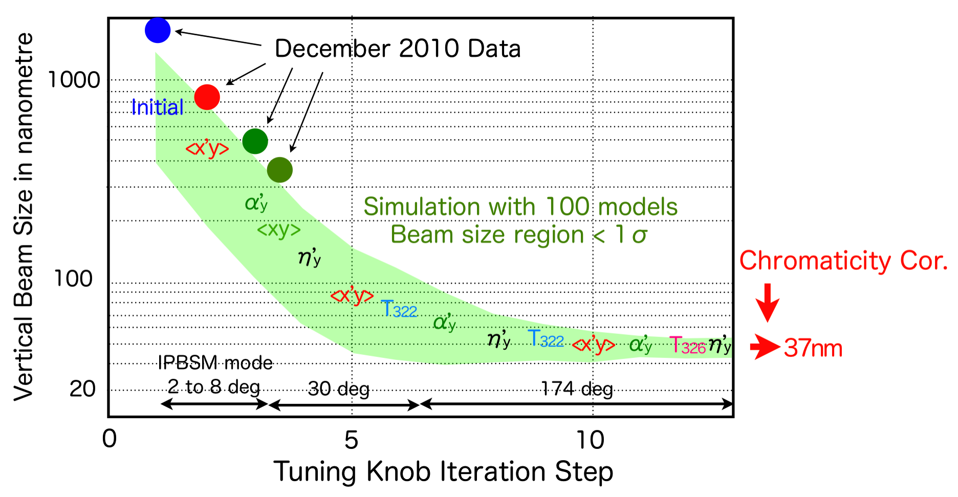
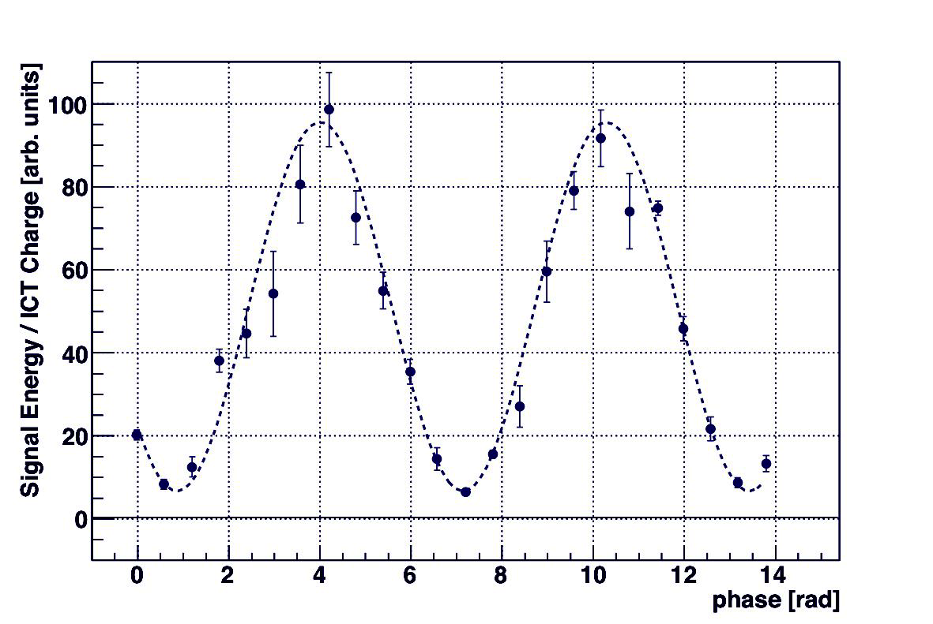
Measurement of the vertical beam size at ATF2
A smaller beam size, 37 nm, is one of the target of Goal-1.
The reached size was 300 nm before the Great East Japan earthquake.
Recover 300nm again, then continue the tuning down to 37 nm.
Example:
A beam size measured (2010/May/20)
  Modulation Depth = 0.87 @ 8.0 deg. mode
  σ_{y} = 310 +- 30 (stat.) +0-70 (syst.) nm

