Slide 1
Accelerator Working Group 2
Damping Rings
Summary
Mark Palmer
Cornell University

Slide 2
DR Session Overview
Tuesday AM
Central Region Design
Joint with Sources, RTML, and CF&S
Tuesday PM
1. Baseline Lattice and Fill Pattern Issues
2. Joint Session with Instrumentation & Technology Group
Wednesday AM & PM
ATF/ATF2 Day
Joint with BDS
Thursday AM
Physics and R&D Updates
Thursday PM
1. ILC TDR Session
2. TDP-II Planning & Costing Session

Slide 3
Tuesday AM
Central Region Design
Session 1
  Introduction: M. Palmer
  Lattice Design Integration: B. List
  DR Injection/Extraction Lines: J. Shanks
  RTML Effort: N. Solyak
  Positron Source: W. Gai
Session 2
  Layout: T. Lackowski
  Mechanical and Electrical Planning: R. Wielgos, L. Hammond
  Discussion (lots of this throughout)

Slide 4
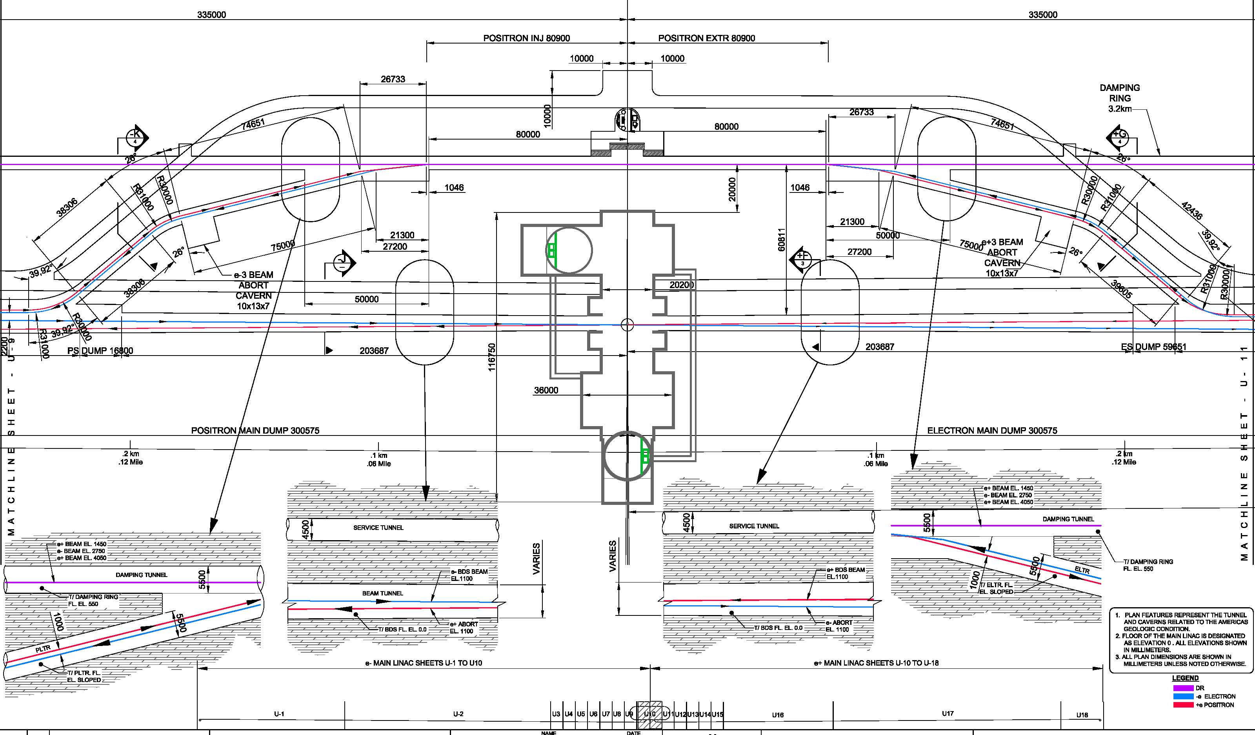
IR Hall
T. Lackowski
DR Injection Extraction (ELTR & PLTR Tunnels)
RTML Lines with vertical merger of 2 e+ rings (high power opt.)
Source Lines (energy compressor, spin rotator) with vertical
splitter for 2 e+ rings (high power opt.)

Slide 5
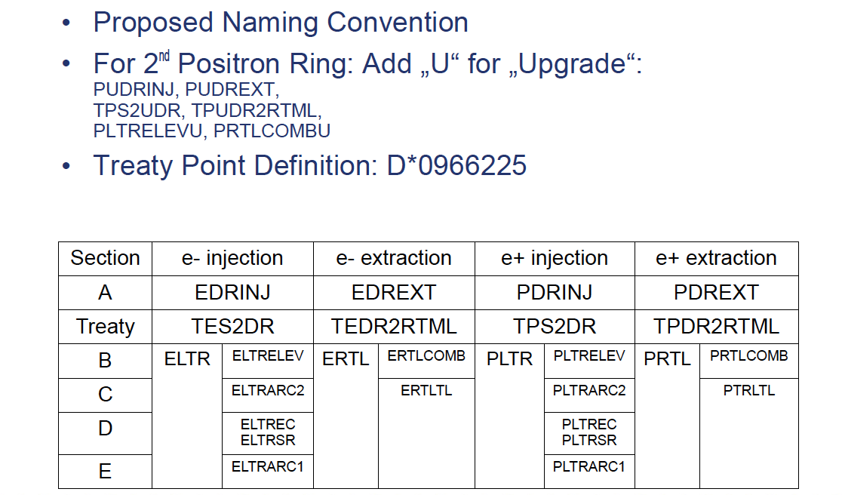
Section Names for ELTR/PLTR
Proposed Naming
Conventions –
B. List

Slide 6
Updated DR Injection/Extraction Lines
Updated Treaty Points
Shanks/Rubin

Slide 7
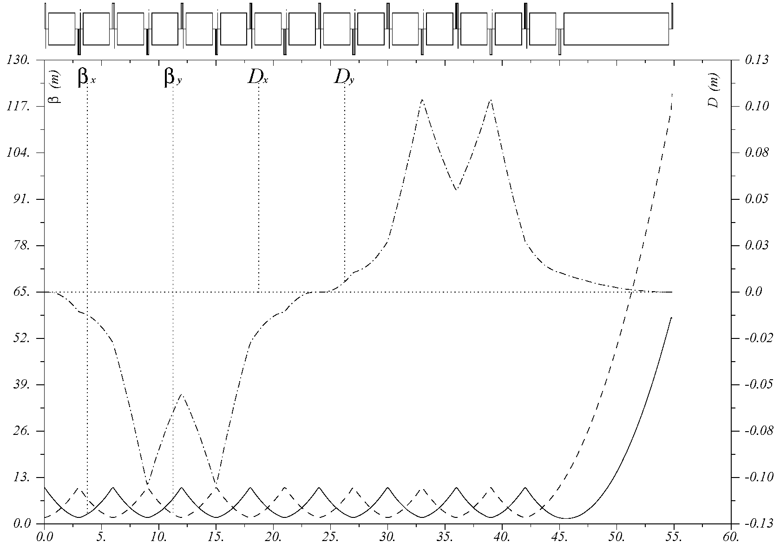
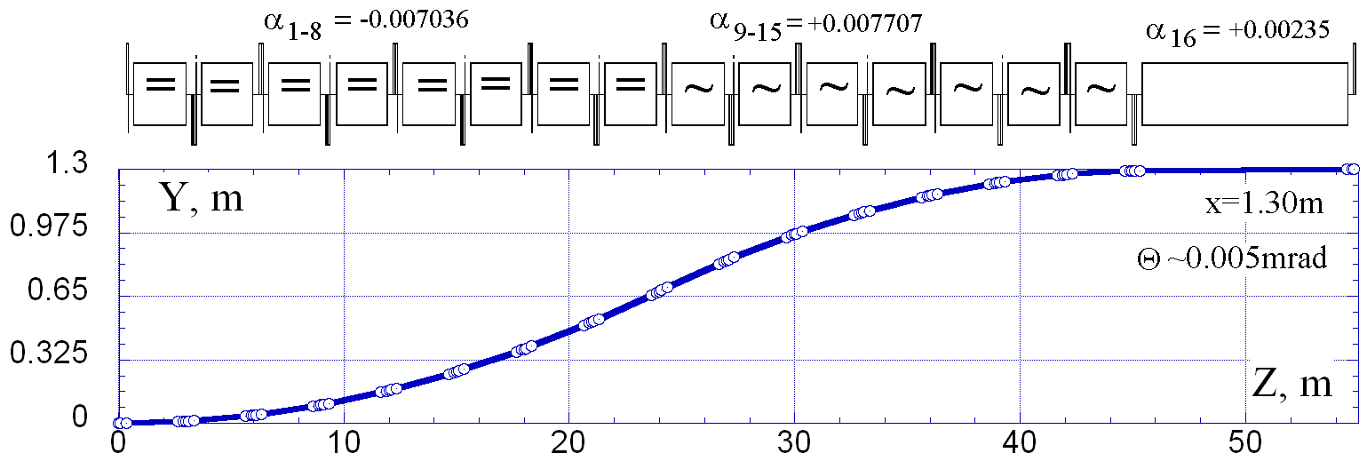
Example of the Merger design: (tune Θ and d=1.3m)
Total azimuth angle is tuned to 0 by changing bend angles in the 9-15th cells
The distance d is also re-adjusted by scaling of bending angles a
Both must be done simultaneously
B_{kicker}= 40 Gs
7

Slide 8
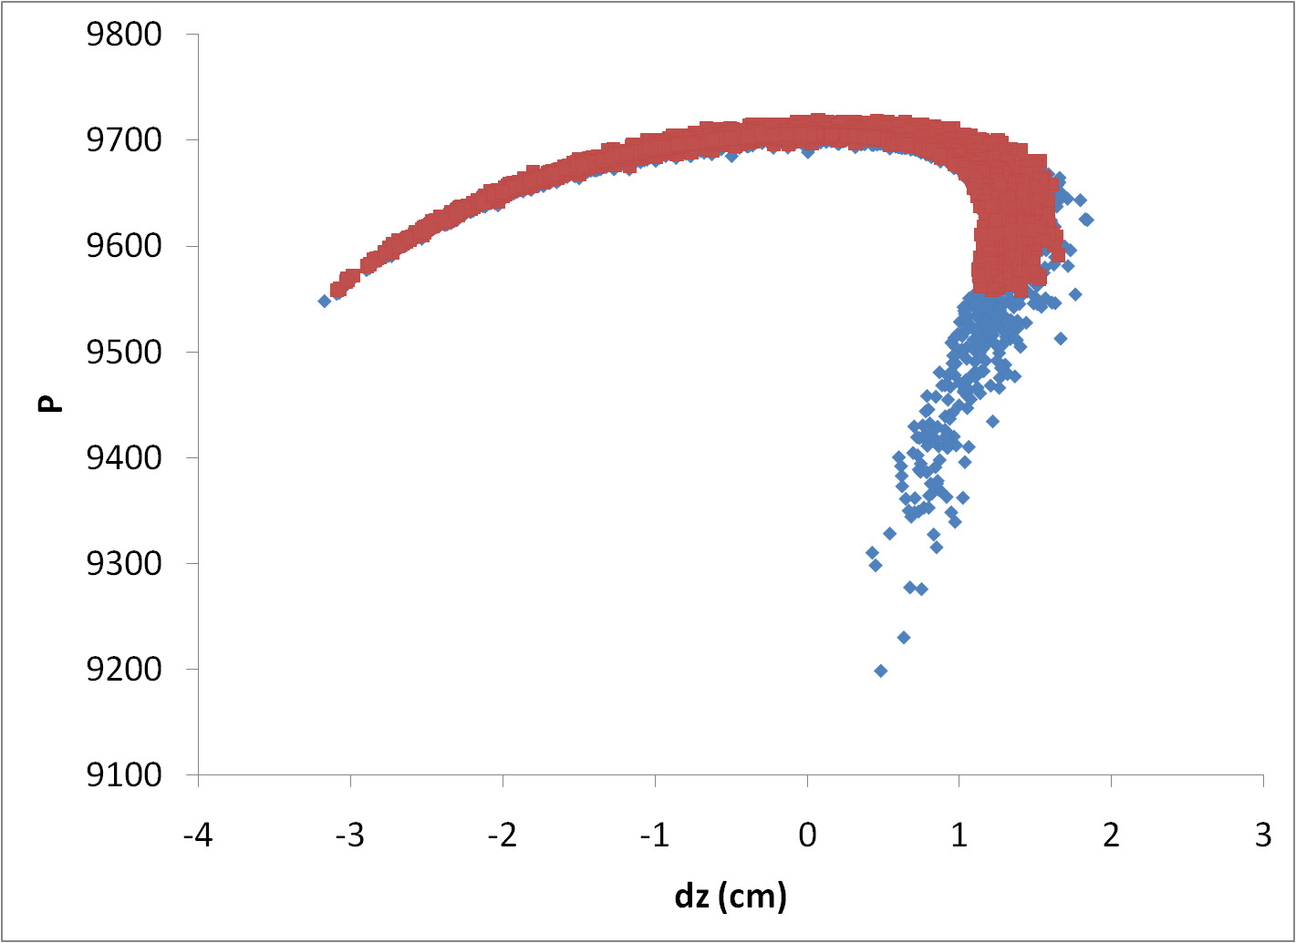
Longitudinal distribution of e+ at treaty point
Gai/Liu
Need to add collimators at PCAP to clean up those e+ outside the damping ring acceptance window. As a result, some good e+ will be collimated too.

Slide 9
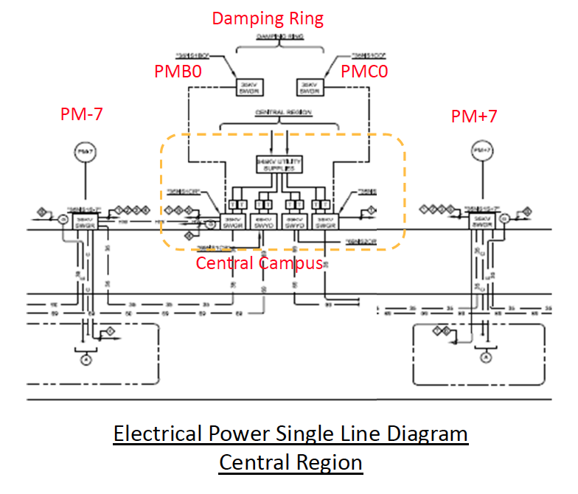
Central Region Power Distribution
Wielgos/Hammond

Slide 10
Tuesday PM
Baseline Lattice Updates, Fill Patterns and Technology
Session 1
  DTC02 Lattice Update: J. Crittenden
  Fill Pattern Issues: B. List
Session 2 (Joint with AWG8)
  IRBPM: H. Hayano (a see AWG8 Summary)
  CLIC DR Extraction Kicker: J. Holma

Slide 11
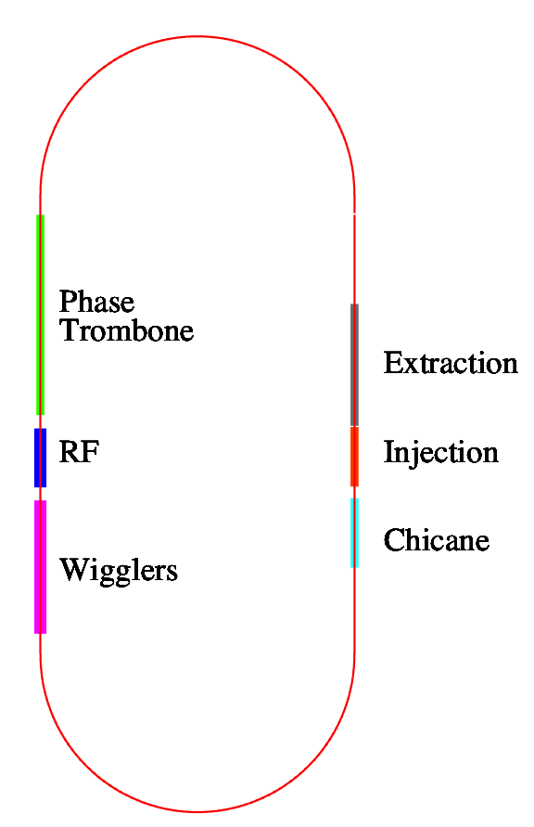
DTC02 Layout
(D.L.Rubin)
Circumference = 3238.681 m
Harmonic number =7022
710-m straights
6 phase trombone cells
Sixty 2.1-m long wigglers:
30-cm period, 14 poles
B_{max} = 2.16T
Space for 16 RF cavities
The cryostats for upper and lower
positron rings are interleaved.
Crittenden

Slide 12
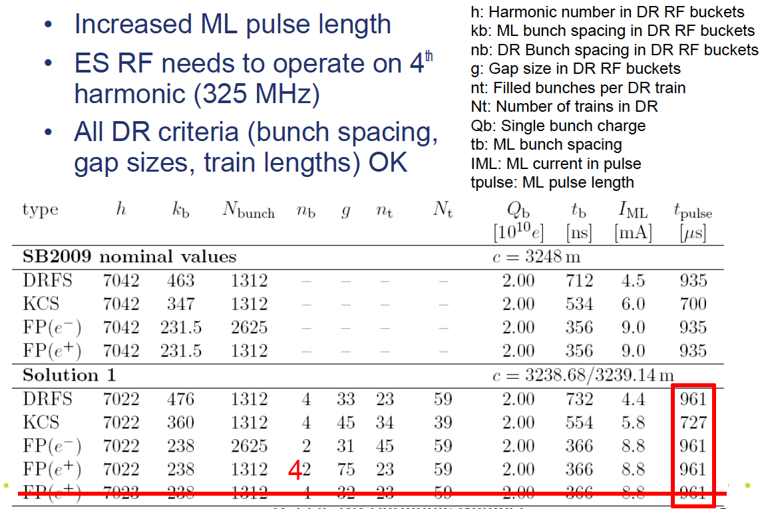
Solution 1
Possible Fill Patterns –
B. List

Slide 13
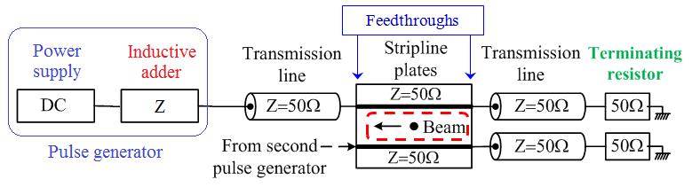
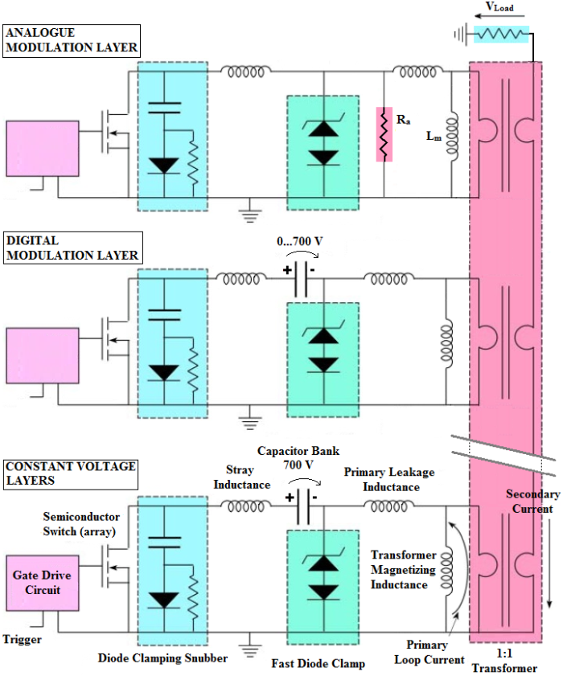
Kicker System with an Inductive Adder
J. Holma
Schematic of kicker system with an inductive adder
Inductive Adder
Solid-state switches;
Control electronics referenced to ground;
No electronics referenced to high voltage despite the high voltage output of the adder;
Modularity: the same design can potentially be used for DR and PDR kickers despite the different specifications. The PDR version will require more layers in series;
Redundancy and machine safety: if one switch or layer fails, the adder still gives a significant portion of the required output pulse;
Possibility to generate positive or negative output pulses with the same adder: the polarity of the pulse can be changed by grounding the other end of the output of the adder;
Source impedance is low, hence minimizing number of layers;
The output voltage can be modulated during the pulse.
(N-2)
layers
Schematic of an inductive adder

Slide 14
Wednesday: ATF/ATF2 Day
DR-related Talks
Will focus on recovery from the earthquake and upcoming plans…
Following slides from
N. Teranuma and J. Urakawa

Slide 15
Recovery History for Test Beam for ATF
Mar 11 | 14 | 21 | 28 | Apr 4 | 11 | 18 | 25 | May 2 | 9 | 16 | 23 | 30 | Jun 6 | 13 | 20 | 27 | Jul 4
 | KEK MW |  | 1.7 | 2 / 5 MW (day/night) |  |  |  |  |  | 24 MW |  |  |  |  |  |  | 20
Blackout
½ power
Power line recovery
ATF Shield
ATF2 Shield
Radiation Safety
Test Beam
KEK
Requested
Standby
at Home
Summer Shutdown
Vacuum
Power
Distri-bution
Cooling Water
RF
Rough Alignment (LINAC)
(BT)
(DR)

Slide 16
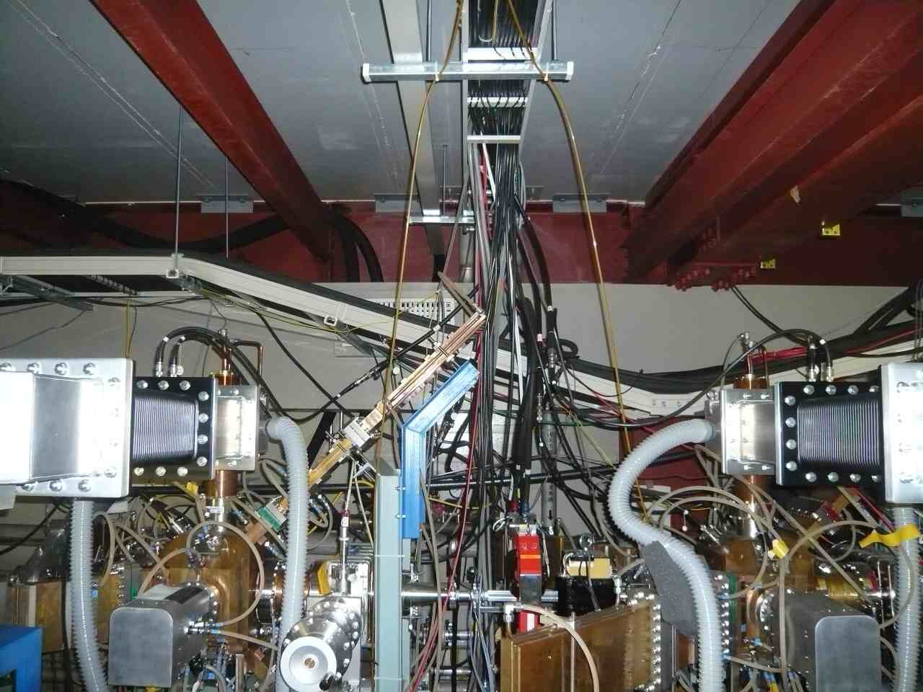
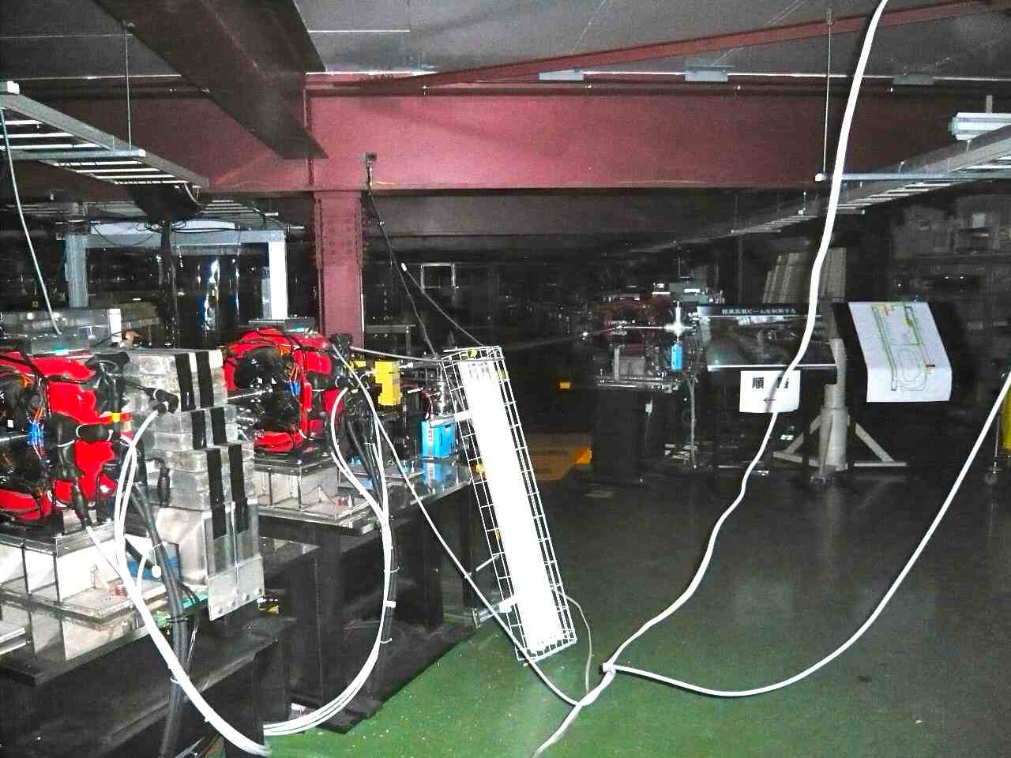
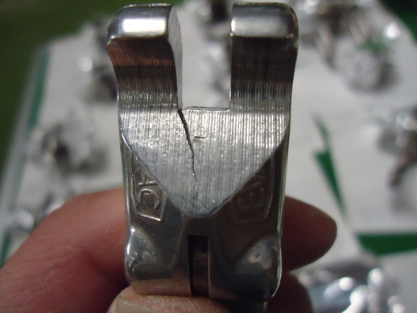
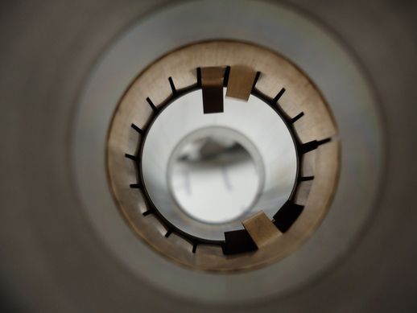
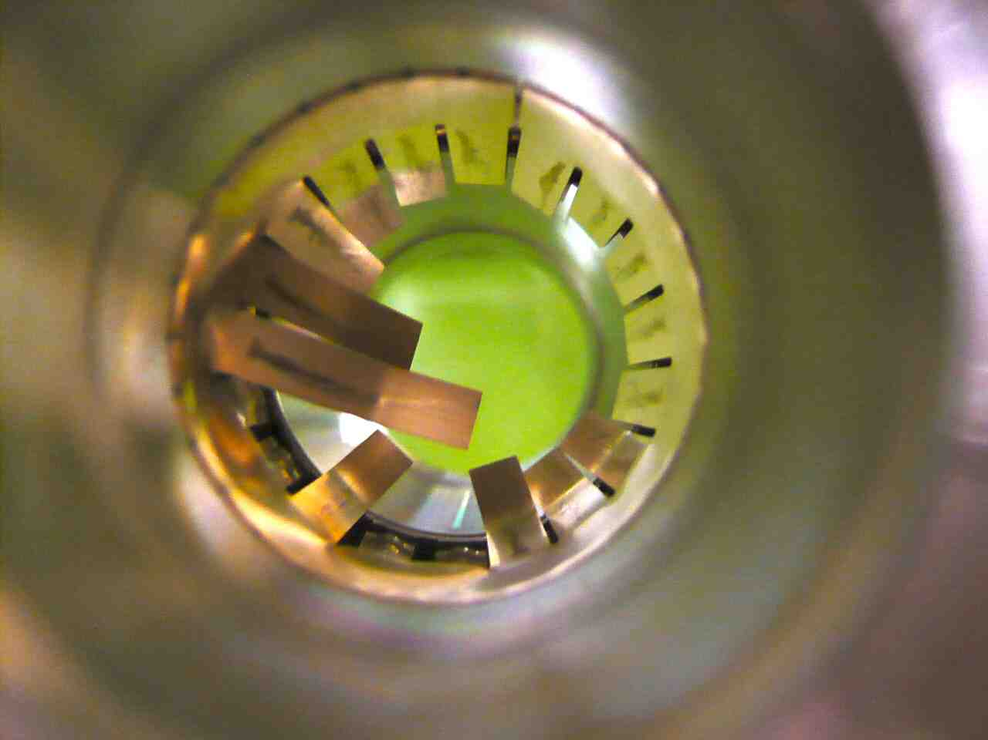
Damping Ring
Repaired in April/May

Slide 17
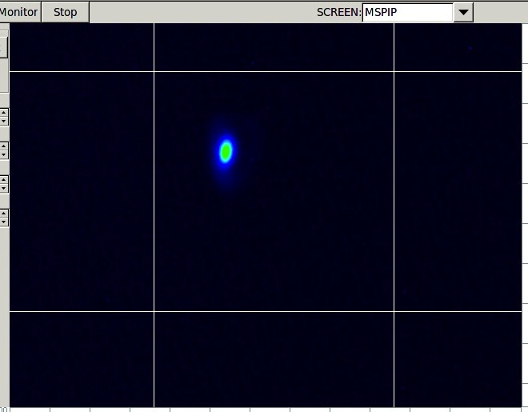
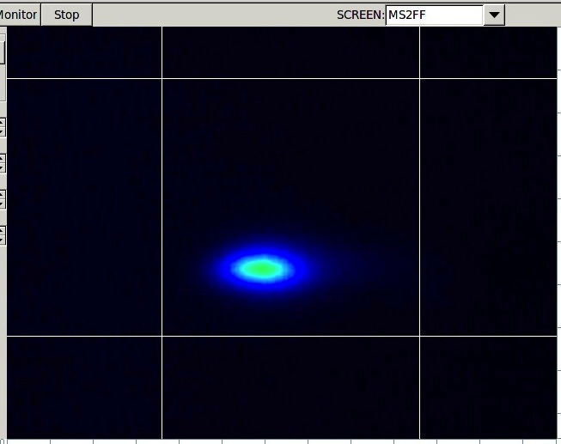
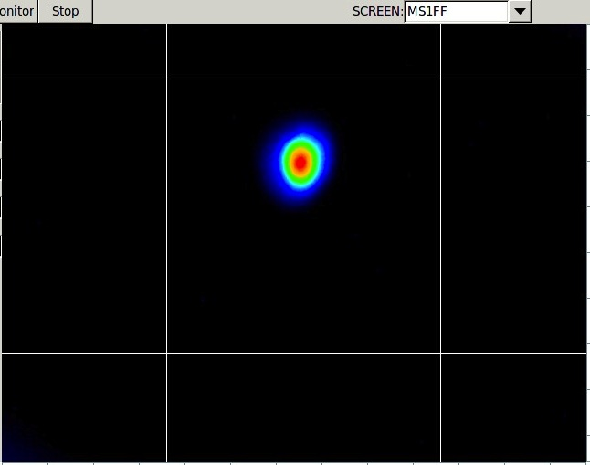
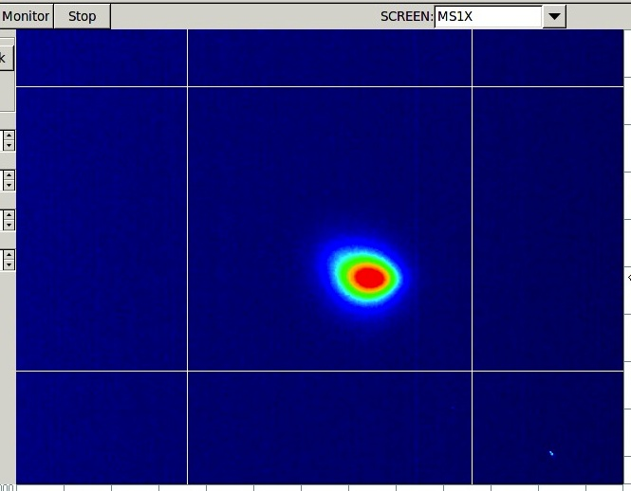
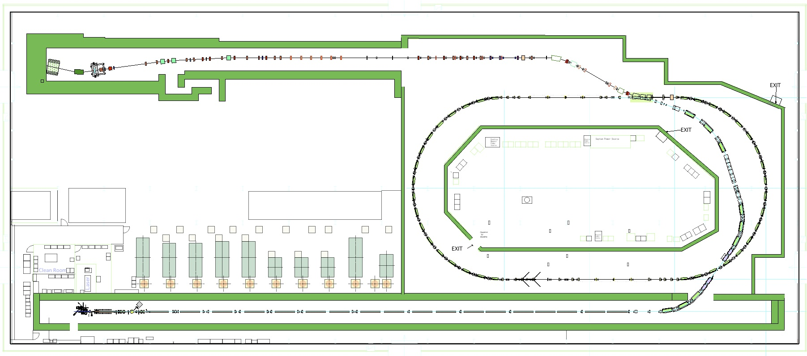
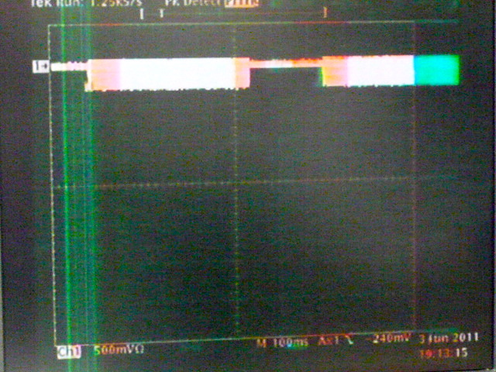
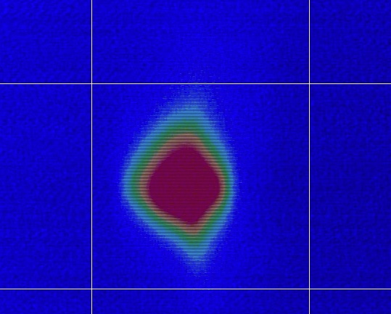
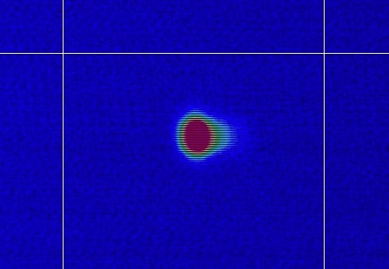
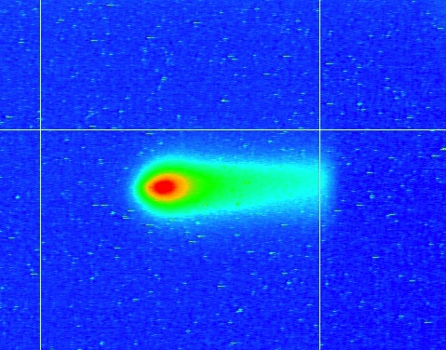
A test beam passes all beamline
Single bunch, 0.78 Hz, 0.3 x 10¹⁰ e/bunch DR&ATF2
6/3 MSPIP
6/3 MS1FF
6/2 MS1X
6/3 MS2FF
5/27 BT end
6/2
DR storage
5/31
DR 1st turn
2011/5/25
Injector
2011/5/26
LINAC
2011/06/03
N.Terunuma

Slide 18
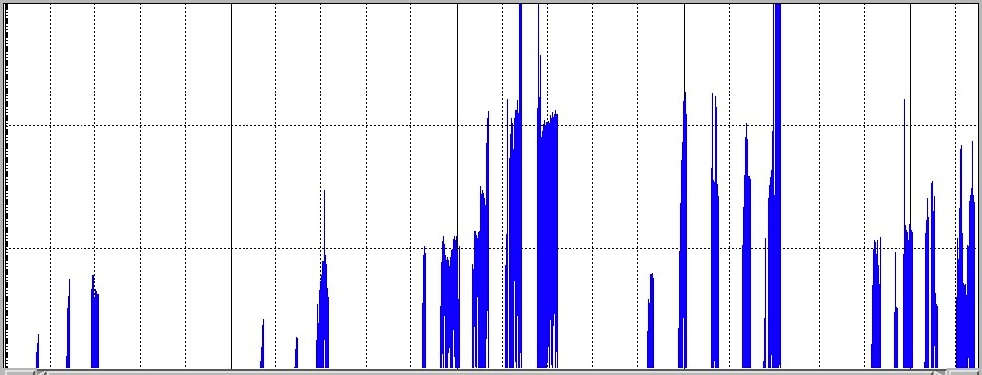
Stored beam in DR (x10¹⁰ e/bunch)
A stored beam was delivered to the dump of ATF2.
No critical damage on the accelerator was found.
3 trains
3 trains
1.0x10¹⁰
Inspection of the radiation safety
XSR ready
FONT
V-emittance (XSR) ~30pm
Freq. Adjust
0.5x10¹⁰
Compton
^{2-mirror}
FFTB mover
HAPS
Cavity BPMs
6/1
6/3
6/8
6/10
6/13
6/17
6/24
6/30
DR rough alignment for checkout was continued in daytime.

Slide 19
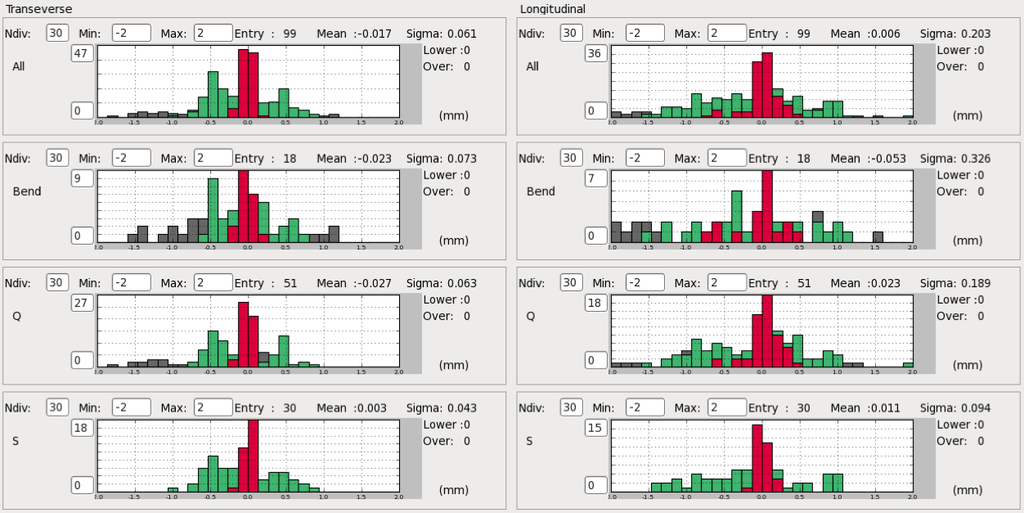
Alignment: DR
After earthquake, aligned in June, aligned in summer
Horizontal
Longitudinal
all
- 2.0 mm
+2.0 mm
- 2.0 mm
+2.0 mm
B
Q
Sx

Slide 20
Schedule (draft for discussion)
Sep.26 | Oct. 3 | 10 | 17 | 24 | 31 | Nov. 7 | 14 | 21 | 28 | Dec. 5 | 12 | 19 | 26
 |  |  | Beam
Alignment
ATF2 &TB
meeting
DR
DR survey
survey
survey
EXT-FF
Checkout of beam instruments
ATF
R&D
Low emittance, less than 5pm
Compton and Others
Recovery of
10 pm (DR)
ATF2
R&D
extraction
Recovery of
300 nm
Goal-1 and others

Slide 21
2012 Schedule (draft for discussion)
2012 Jan. 2 | 9 | 16 | 23 | 30 | Feb 6 | 13 | 20 | 27 | Mar.5 | 12 | 19 | 26 | Apr 2 | 9 | 16 | 23 | 30 | May 7 | 14 | 21 | 28 | Jun 4 | 11 | 18 | 25
GDE meeting?
JPS meeting
Summer Shutdown
New IP-BPM installation at IP
vertical emittance, 2pm tuning
Compton and Others
Goal-1? and others
Goal-2? and others

Slide 22
Thursday AM
Physics, R&D and Development
Session 1
  Fast Ion Instability Evaluation for DTC: G. Xia
  Materials for EC Mitigation @ LNF: R. Cimino
  CESRTA EC Build-up Studies: J. Crittenden
Session 2
  CESRTA LET Update: J. Shanks
  CESRTA Beam Dynamics Studies: M. Billing
  DTC Lattice Evaluations and Options for Lowering the Momentum Compaction: Wang Dou
  2nd Harmonic Cavity for Bunch Length Control: A. Gallo
  Discussion of DR-to-RTML Merger Pulsed Elements
  SLAC Pulser Development Update: C. Burkhart, etal.

Slide 23
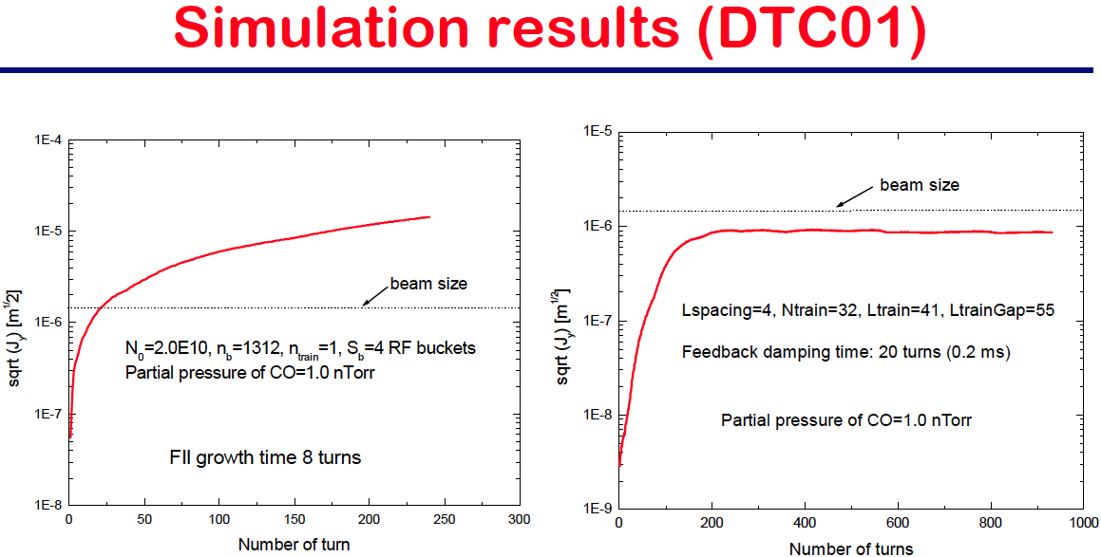
First FII Simulations for New Baseline Lattice
Guoxing Xia
Single Train
Trains with Gaps

Slide 24
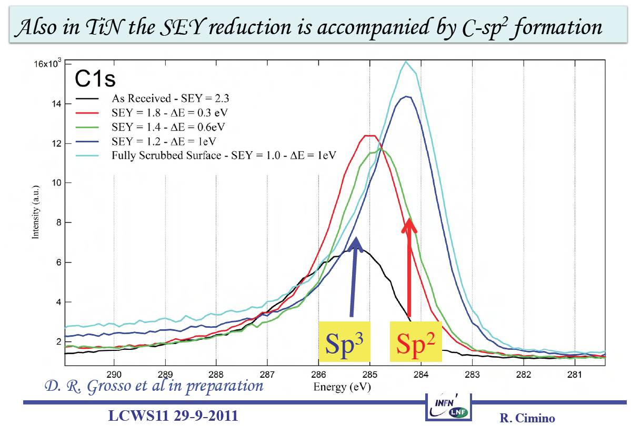
Studies of Scrubbing Effects on Surfaces @ LNF
R. Cimino

Slide 25
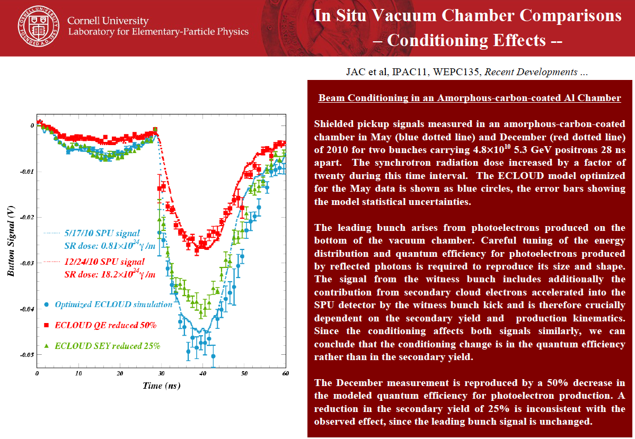
Time-Resolved Experiments to
Understand PEY & SEY Models
J. Crittenden

Slide 26
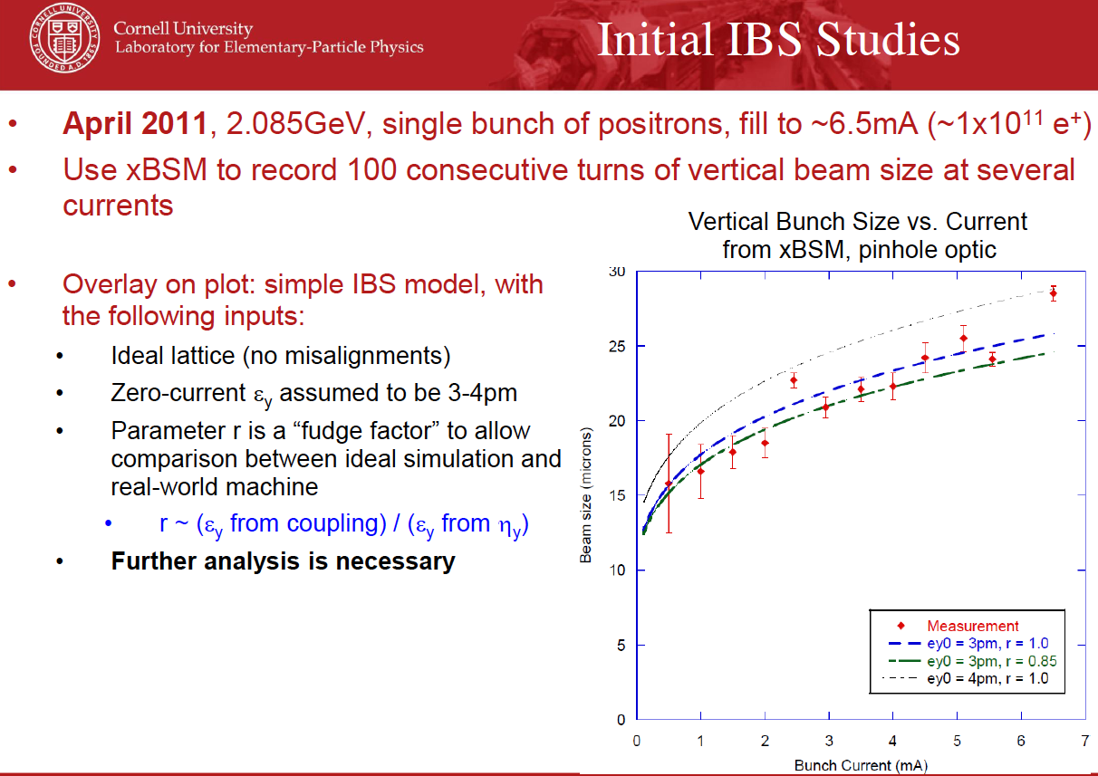
LET Update from CESRTA
J. Shanks

Slide 27
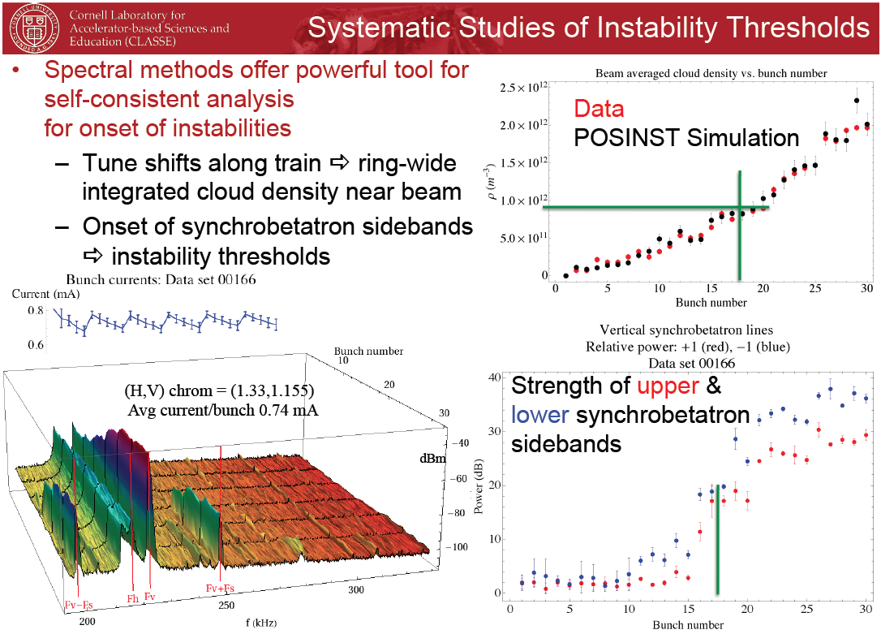
EC Beam Dynamics Update from CESRTA
M. Billing

Slide 28
Lowering the Momentum Compaction
Reduce RF requirements
Wang Dou
IHEP

Slide 29
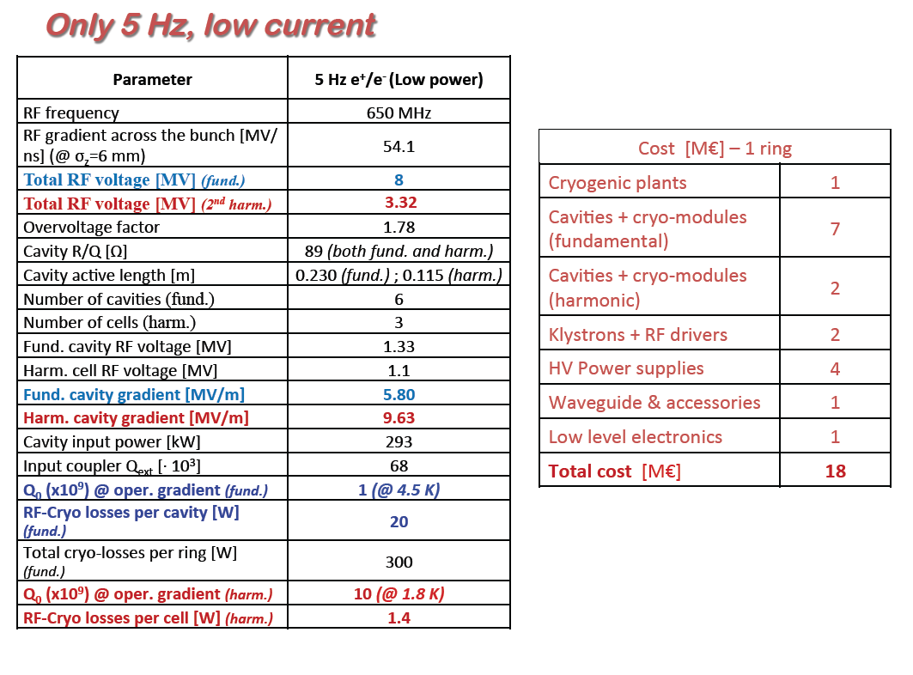
Use of 2nd Harmonic Cavities for Bunch Length Control in DR
vs. 10 in
baseline
A. Gallo
Reduce required RF
cavities at low power
More flexibility to raise
momentum compaction

Slide 30
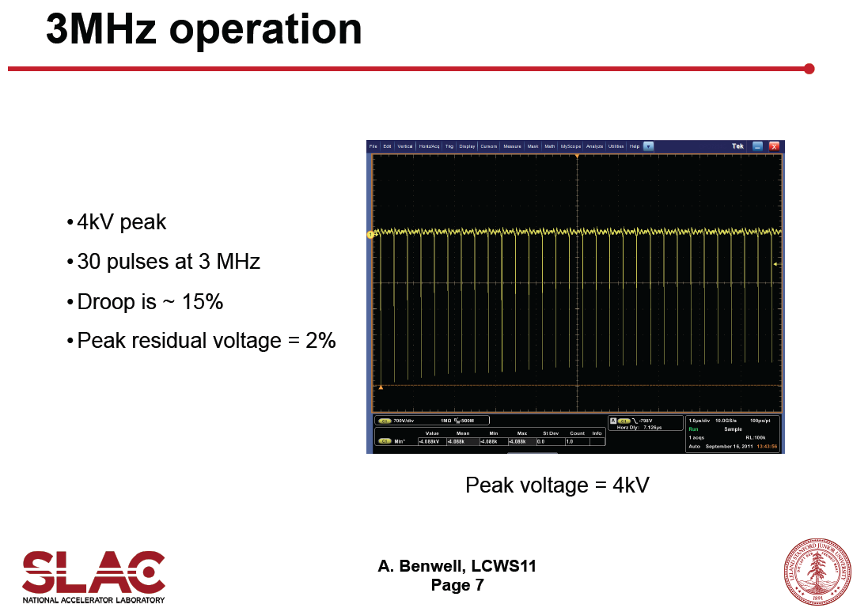
Fast DSRD Pulser
C. Burkhart
A. Benwell
A. Krasnykh
T. Tang

Slide 31
Thursday PM
Technical Design Phase II
Session 1
  ILC TDR Outline: S. Guiducci
Session 2
  TDP-II Schedule and Resources: M. Palmer
  TDP-II Costing: G. Dugan

Slide 32

An Invitation

