Slide 1
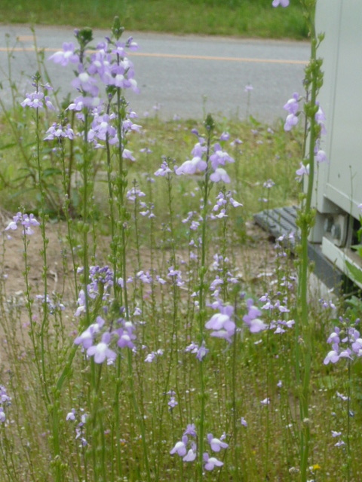
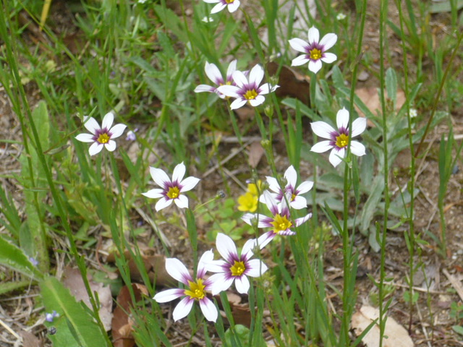
Recovery Status
N.Terunuma, KEK
ATF2 meeting, May 11, 2011

Slide 2
Recovery schedule

Slide 3
Status update
Re-assembling of the radiation shields
DR roof and FF side wall were reassembled.
FD-IP section has been started in this week.
It will need more than two weeks.
Inspection of the cooling water system
It has been started in this week and will be continued to the end of next week.
Alignment of the beamline
A half of the LINAC has been already realigned.
Remaining LINAC/BT will be done in this month.
DR/ATF2 will be done in June; alignment in daytime and beam commissioning in evening.

Slide 4
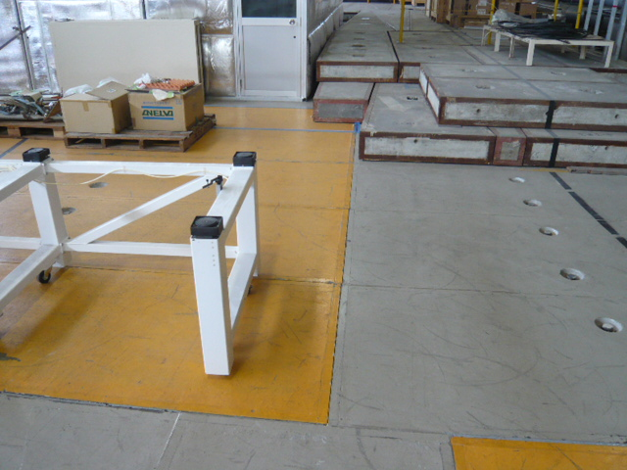
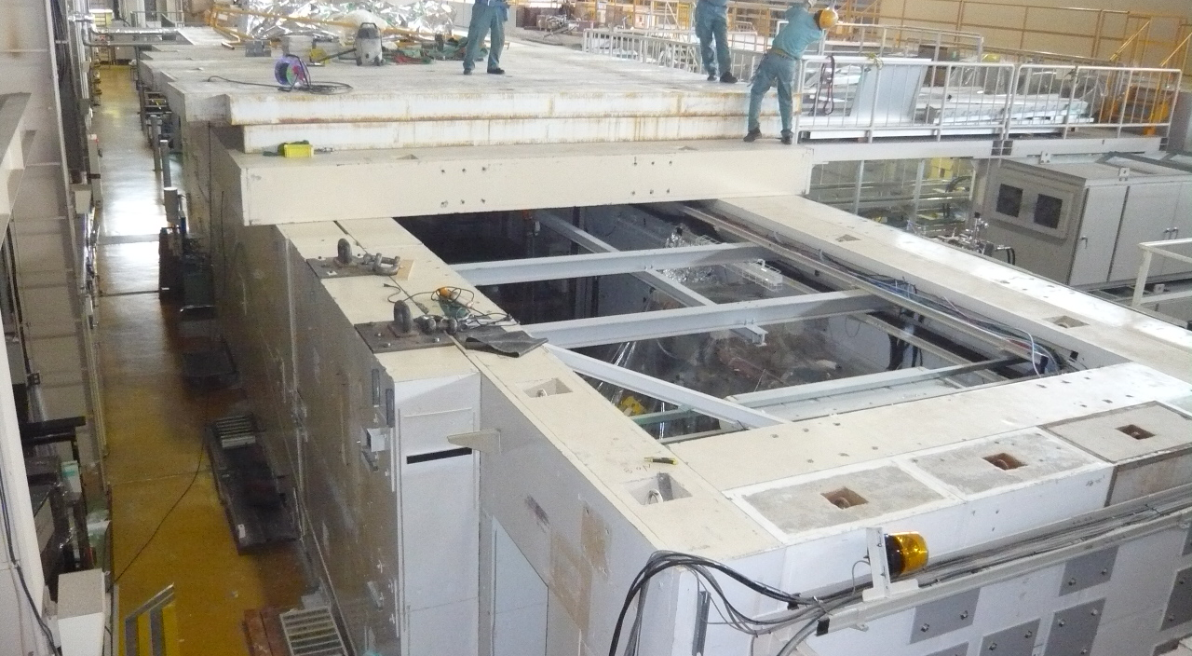
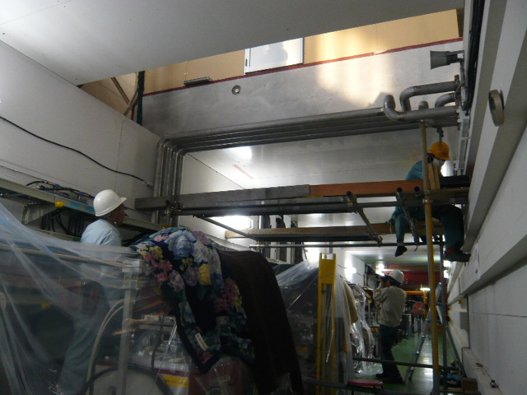
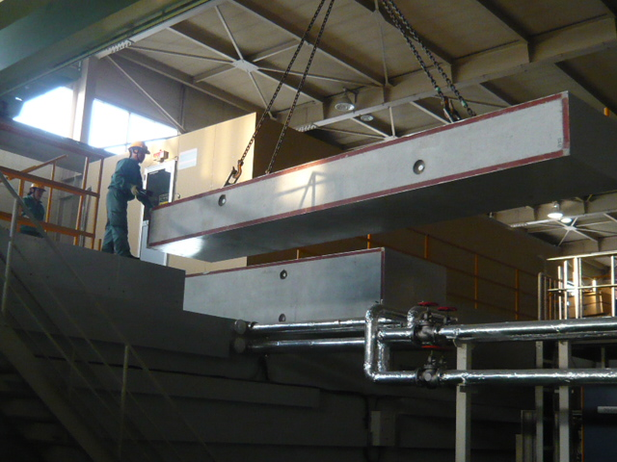
LUCX/DR/FF shields
Near the EXT-LW hut

Slide 5
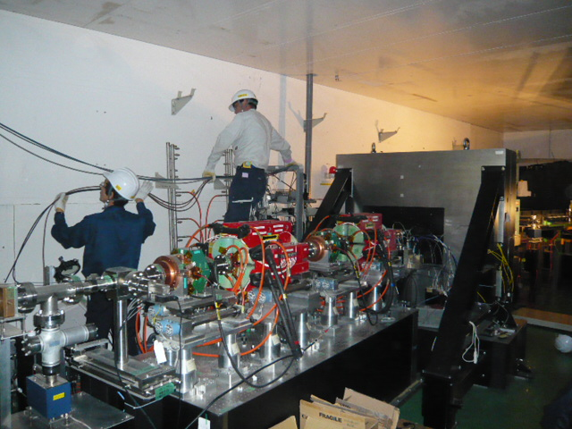
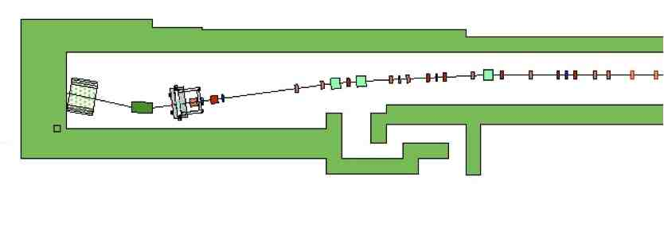
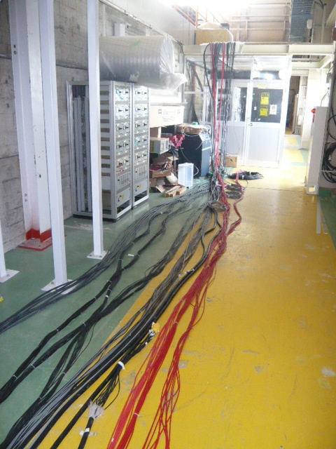
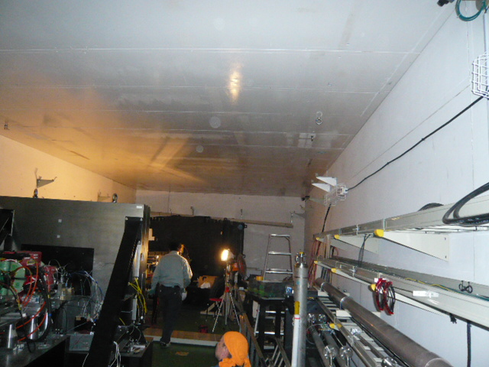
Removing the FD/IP cables
Repositioning

Slide 6
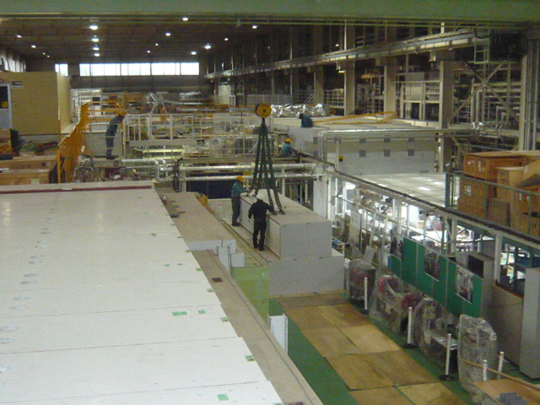
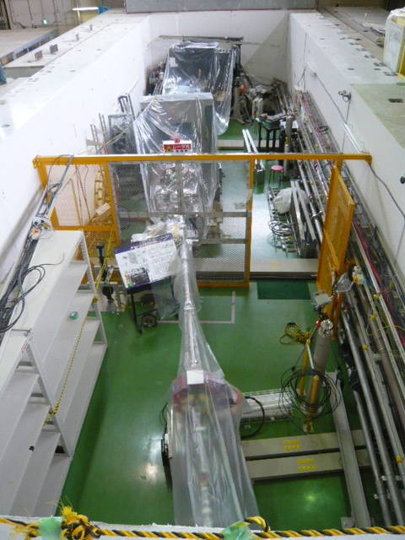
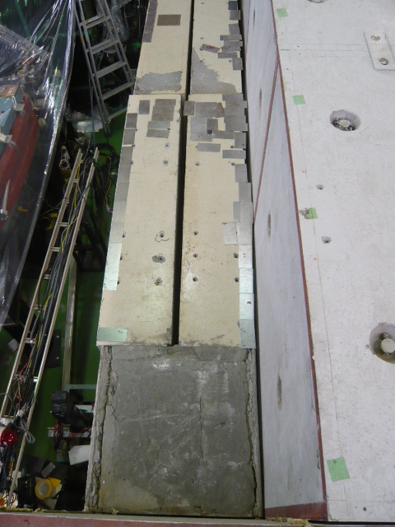
FD/IP shield works

Slide 7
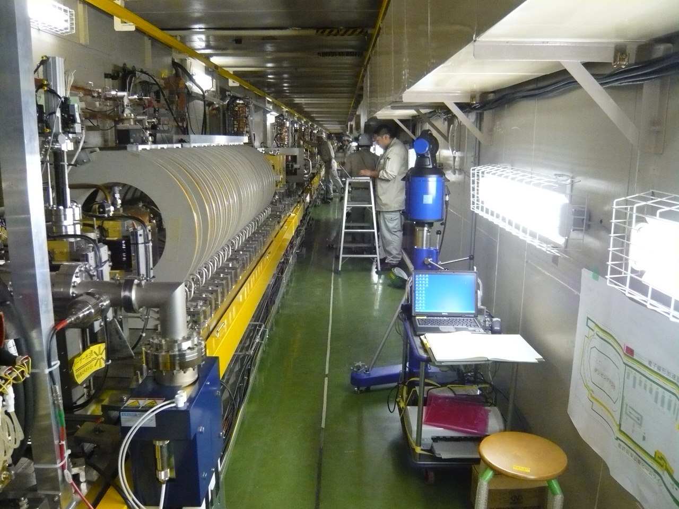
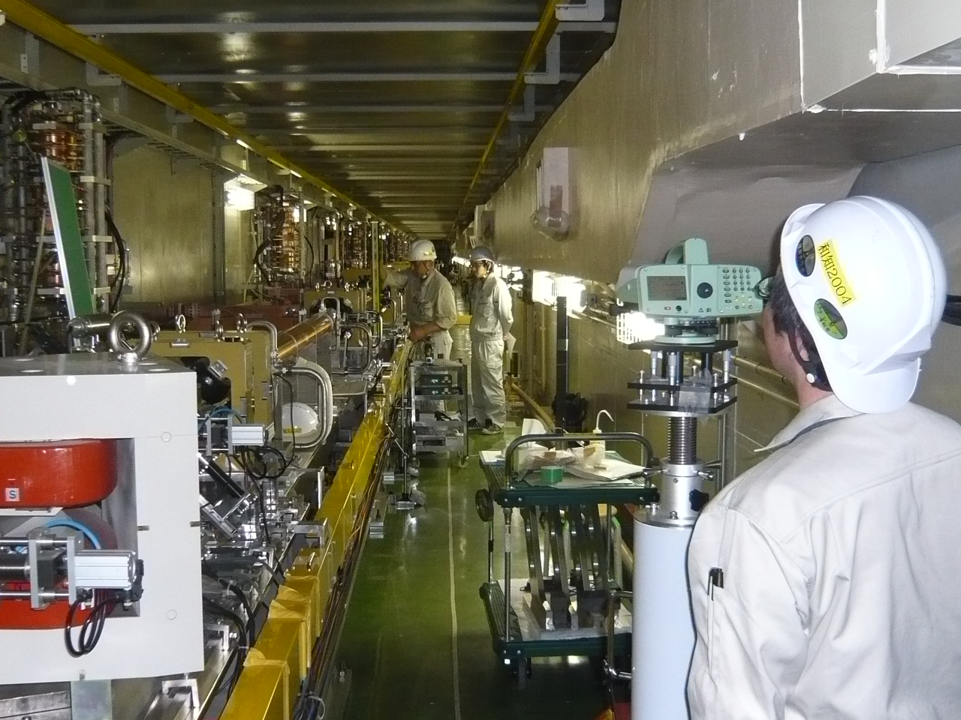
LINAC realignment

Slide 8
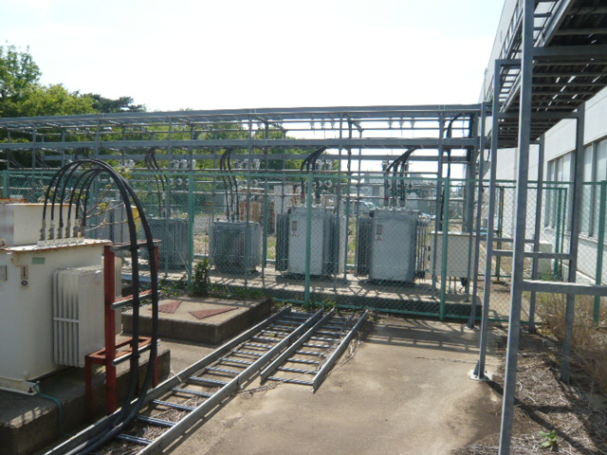
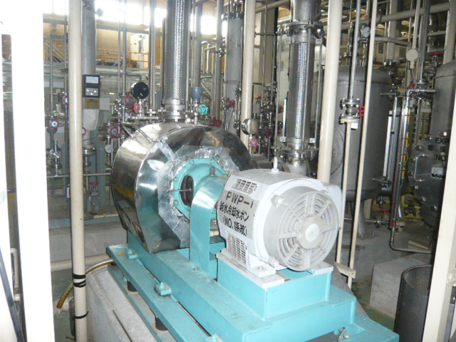
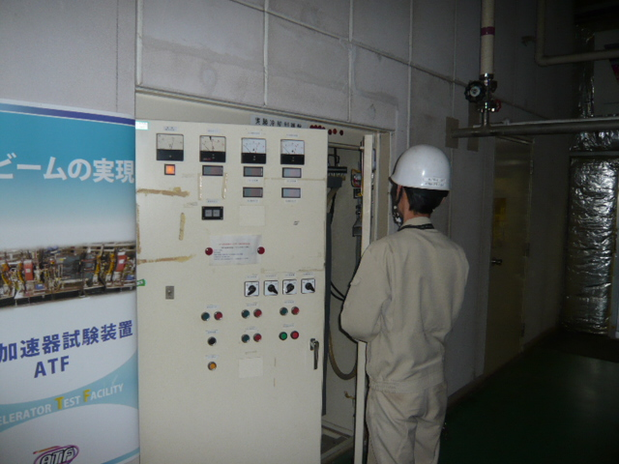
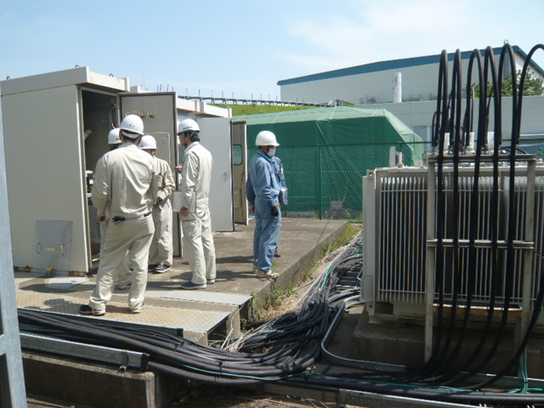
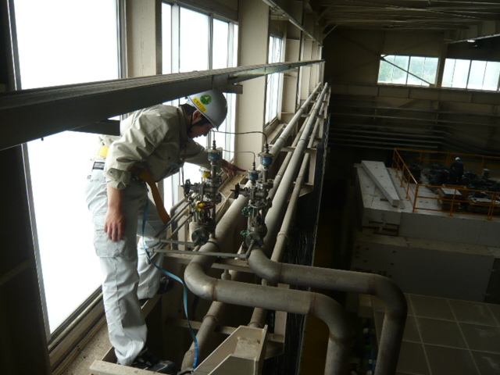
Recovering Electricity and Water
DR magnet PW station, 6.6kV
Cooling Water pipes

Slide 9
Work for a week
Re-assembling of the radiation shields will be continued.
Commissioning of the LINAC RF will be started.
Realignment of the beamline will be moved to the BT line.
Prepare the safety inspection for the beam operation in June.

