Slide 1
S1 Global: 2 hours at high gradient
Take an ad-hoc collection of pulse waveforms recorded during S1Global operation in the late afternoon 15 December, 2010.
For this period, 7 of the 8 cavities in the S1Global cryomodule were powered by a single klystron, similar to the RDR baseline.
The eighth cavity (C2, ACC11) could not be tuned to resonance and was not connected to RF power.
The average gradient was 27MV/m. 7195 pulses were recorded at a rate of 1 Hz for 2 hours with a fast waveform sampling rate of 1 MHz. 2048 samples were recorded for each waveform under study.
The total data sample is large: 7 cavity waveforms + a few other signals * 2048 sample points/waveform * 7195 pulses =150M numbers.
A similar study of this data was reported by Shin Michizono and T. Matsumoto on 25 January, 2011:
http://ilcagenda.linearcollider.org/getFile.py/access?contribId=2&resId=1&materialId=slides&confId=4993 .

Slide 2
S1 Global Data
Waveform ‘clippings’
showing general stability (excellent)
and correlations
Detuning:
per Shin’s definition
just after RF pulse turned off
Average 40 sample phase; linear fit to extract slope
Correlation with cryosystem pressure

Slide 3
C1
C2
C3
C4
A1
A2
A3
A4

Slide 4
Figure 1 shows a typical cavity 6 (A2, MHI06) amplitude pulse. The fill is complete after 540 us, the flat-top is 1.0ms long and the characteristic decay time constant is t=.5 ms. Four segments of the flattop portion of the waveform, each twenty points long, were used for the figures below (i.e.,points A 751:770; B 1001:1020; C 1251:1270; D 1501:1520 in the above figure).

Slide 5
Figure 2 shows the phase as recorded during the same typical cavity 6 pulse. Without a beam reference, we should assume there is an arbitrary phase offset. An accurate phase reference is required to estimate the actual acceleration field a beam would see.

Slide 6
pulse to pulse amplitude (A-D)

Slide 7
Klystron p/p stability (A-D)

Slide 8
100 pulse average vs time

Slide 9
100 pulse rms vs time

Slide 10
Close-up: Pulse 6000-6100

Slide 11
Observations :
General stability is excellent, almost to the level required for linac operation.
Long term drifts (~15 minutes) can be seen during the two hours. This can impact cavity tuning (see slide 10 of the 25 January presentation). The cryogenic system pressure fluctuations should be plotted.
Cavity – to – cavity fluctuations are highly correlated (or anti-correlated). This suggests that microphonics is not a cause; instead RF power fluctuations appear to be important. This may be the most important observation from this data and appears to be inconsistent with slide 10 of the presentation noted above).
Klystron and cavity fluctuations appear to be inconsistent. The klystron amplitude rms is larger than the cavity rms. (4 e-3 vs 2 e-3; figure 14 and figure 9).
Klystron and cavity amplitude behavior do not appear to track each other. This may be caused by detuning or feedback and is yet to be understood.

Slide 12
Detuning (from Shin’s code)

Slide 19
Detuning – closeup (6000-6100)
Cavity detuning, as estimated using the code “analysis_8cav_cPCI2” for S1Global baseline pulses numbered 6000 to 6100 in the 7195 pulse data sample recorded 15 December, 2010. (Cavity C2 was off.) The standard deviation of the estimated detuning for the 100 pulses is shown for each cavity. Note that the apparent detuning of each cavity appears to be uncorrelated. There also appears to be different characteristic frequencies – note the differences between the data for C1, C3, C4 and A4. The average detuning for the A cavities is 3.7 (±2.3) Hz and the average detuning for the three C cavities is 7.0 (±1.8) Hz.

Slide 21
Detuning rms
Cavity | Detuning std (Hz)
A1 | 1.2
A2 | 4.5
A3 | 2.4
A4 | 6.5
C1 | 7.0
C3 | 8.9
C4 | 5.3

Slide 22
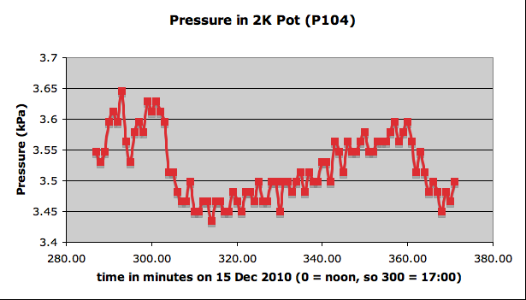
1500 - 5800

Slide 23
1500 - 5800

