Slide 1
Beam test of a new integrated Micromegas module
Saclay Carleton Bruxelles

Slide 2
Completely new setup aimed at 7-module operation
New detector : new routing to adapt to new connectors, lower anode resistivity, new res. foil grounding on the edge of the PCB.
New 300 points flat connectors
New front end: keep naked AFTER chips and remove double diodes (count on RF to protect against sparks)
New Front End Mezzanine (FEMI)
New backend ready for up to 12 modules
New DAQ, 7-module ready and more compact format
New trigger discriminator and logic.

Slide 3
Beam Test
Started Monday May 2
Up and running in 24 hours, but 2 days for debugging monitoring, mapping, tuning HV, etc…
All the initial program has been done (150 good runs of 5000 evts, + lots of cosmics).
Plan to dismount on Friday night and Saturday morning May 14.
Small problem yesterday with magnet -> solved

Slide 4
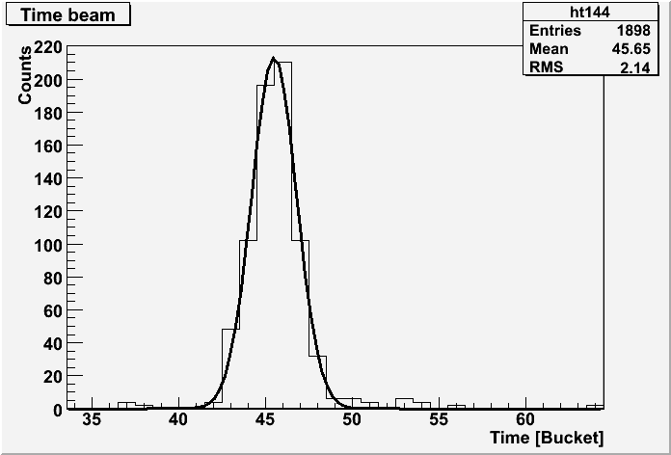
Beam size, Vdrift
Fitted rms 1.3 bins -> 3.9 mm
Vdrift checked OK

Slide 5
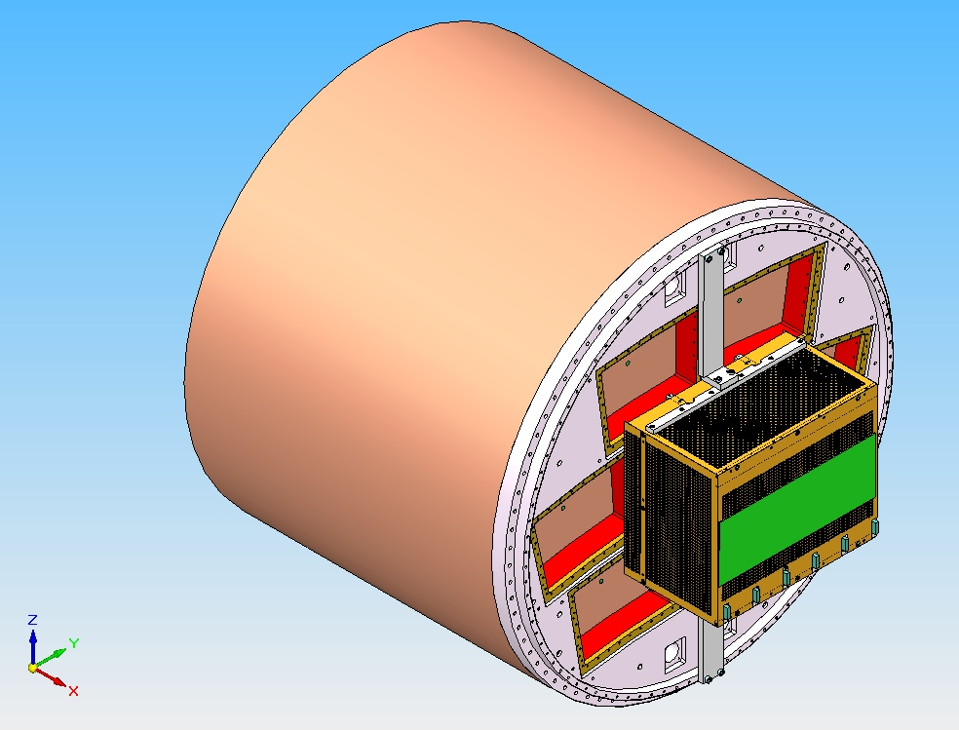
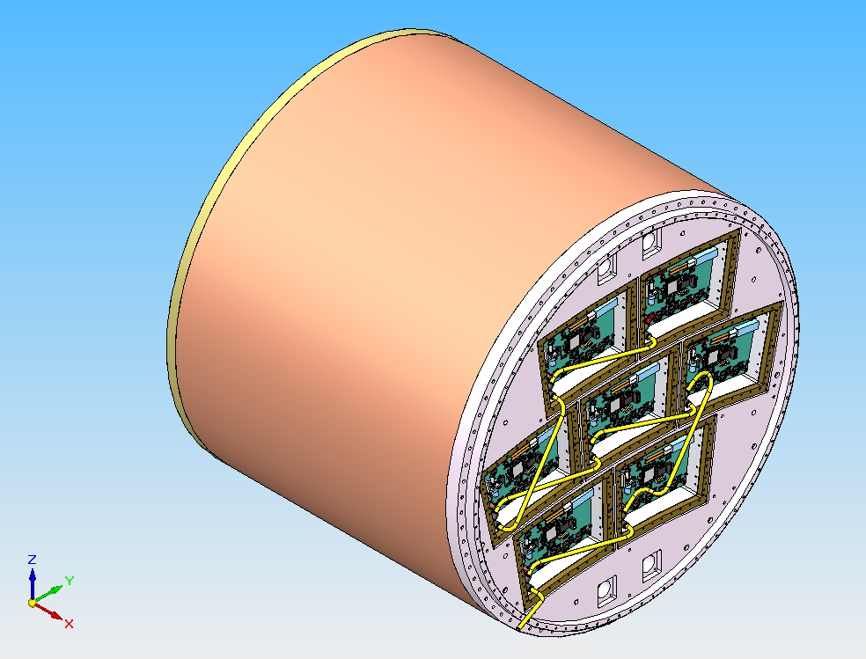
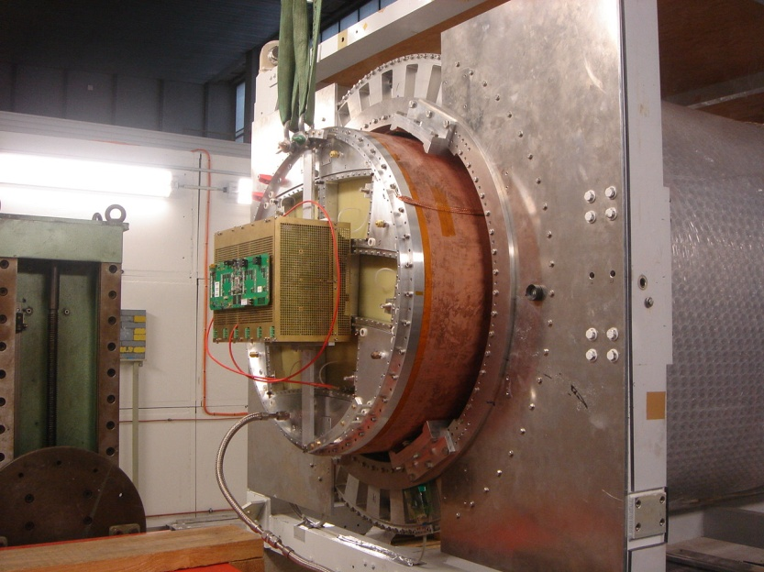
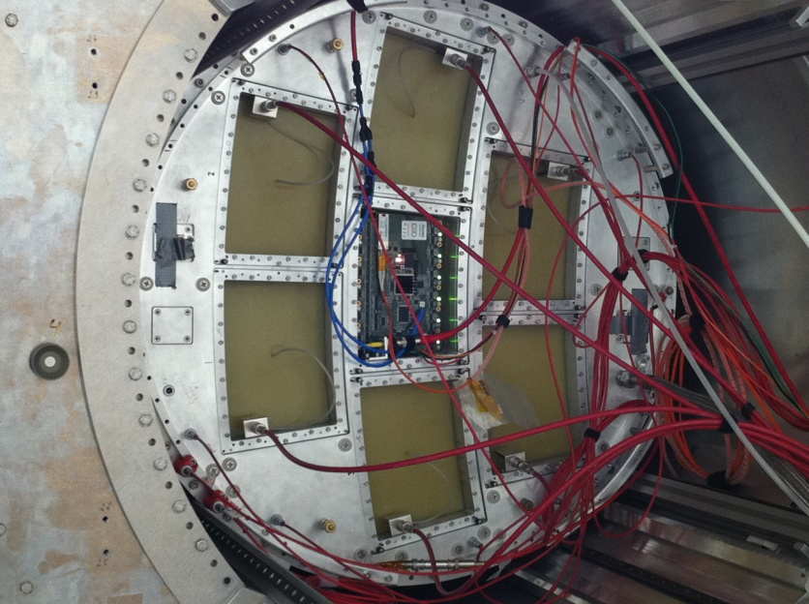
Integrated electronics for 7 module project

Slide 6
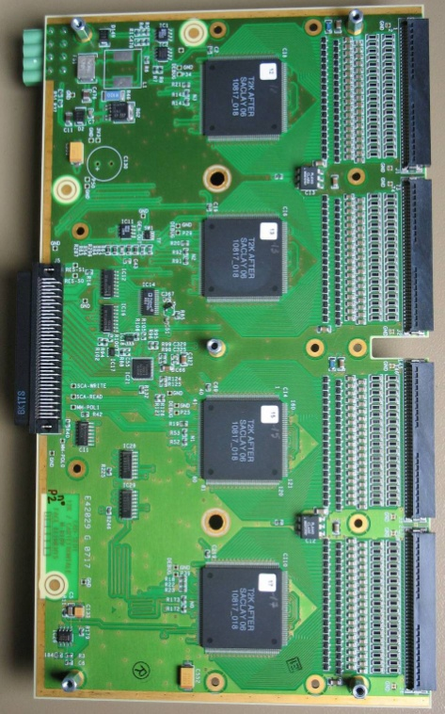
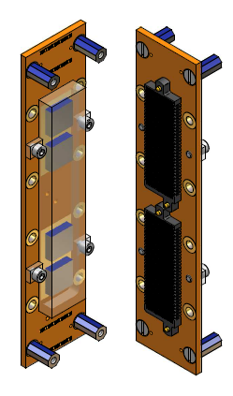
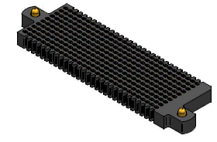
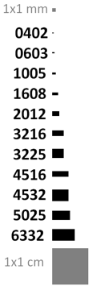
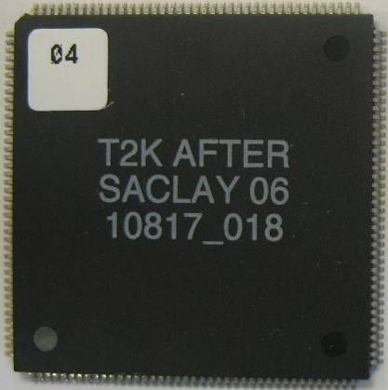
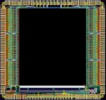
Integrated electronics for 7 module project
Remove packaging and protection diodes
Wire –bonding on board for AFTER chips
Use 2 × 300 pins connector
Replace resistors SMC 0603 by 0402 (1 mm × 0.5 mm)
FEC
25 cm
12,5 cm
4,5 cm
14 cm
3,5 cm
2,8 cm
3,5 cm
0,78 cm
Chip
0,74 cm

Slide 7
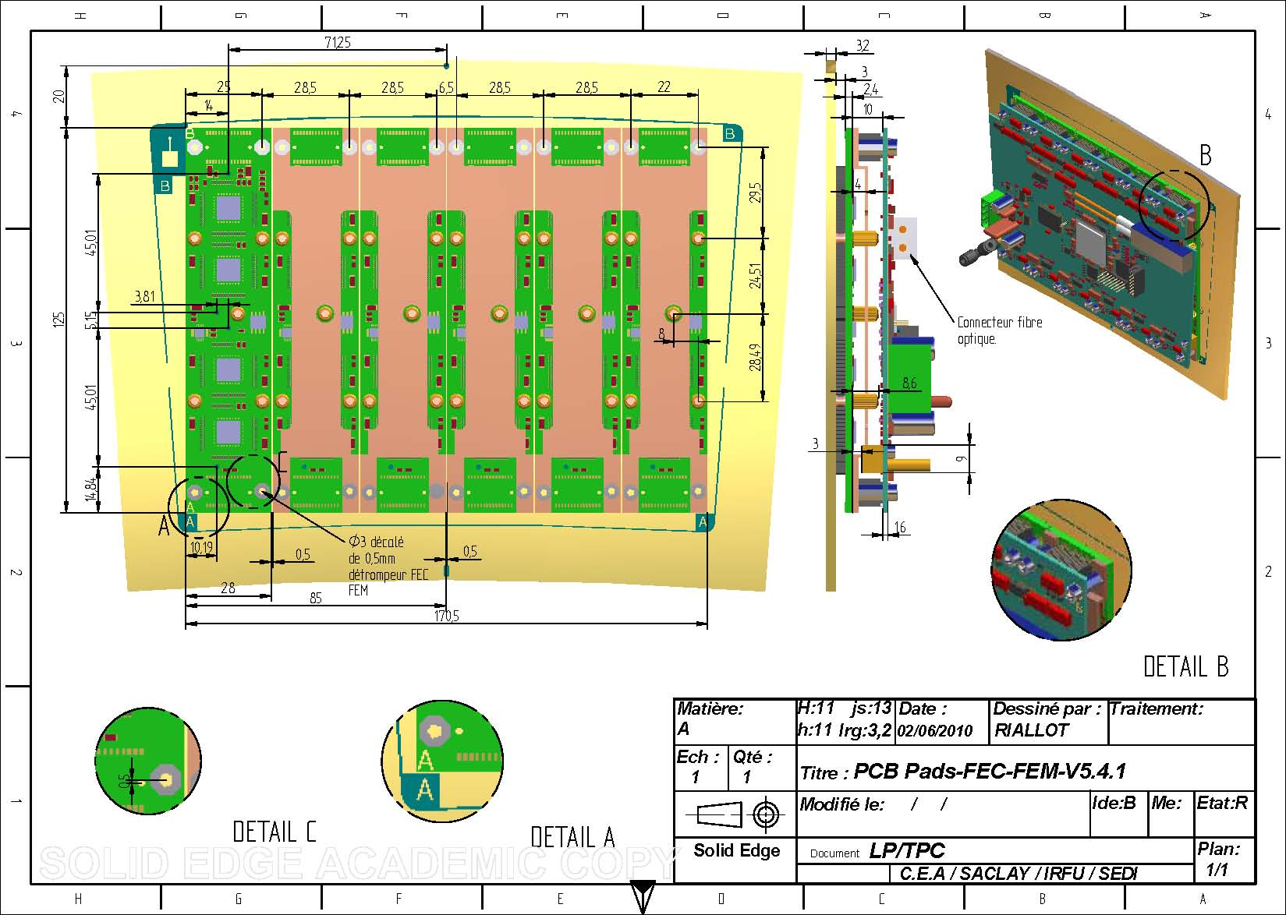
Design of the integrated electronics

Slide 8
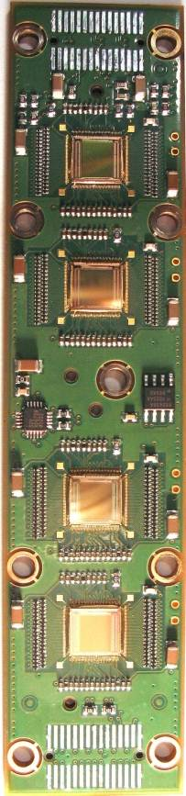
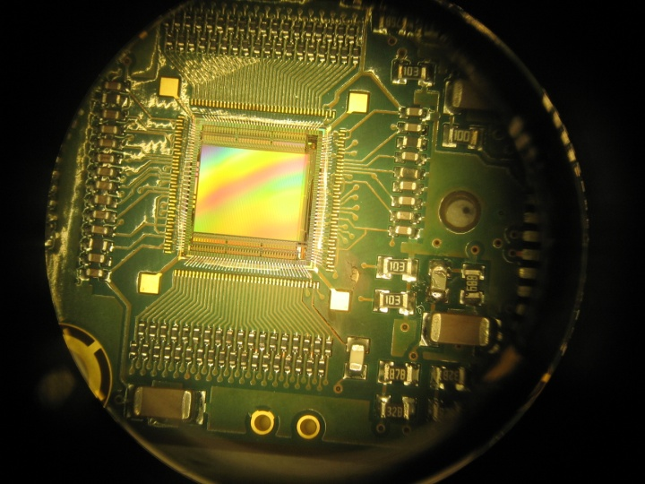
Front-End Card (FEC)
4 chips per FEC wire bonding on the 8-layer PCB
Protections: a resistor (0201 SMC) at each channel input
A0: 0Ω
A1: 3Ω
A2: 5,1Ω
A3: 10Ω
Temperature measurement device for each FEC

Slide 9
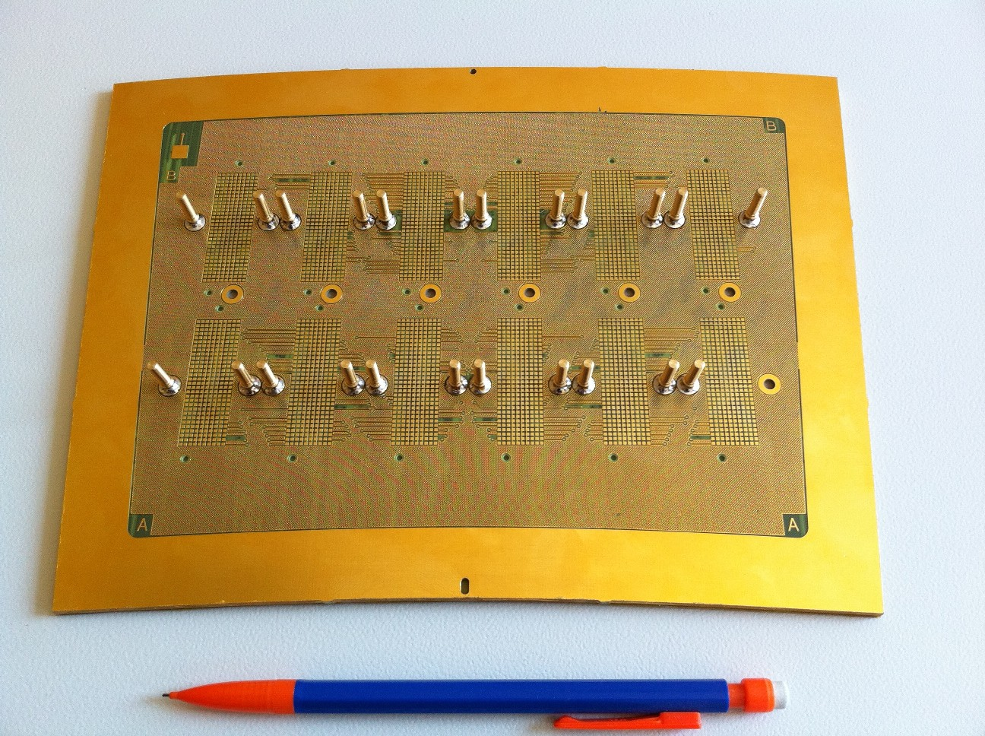
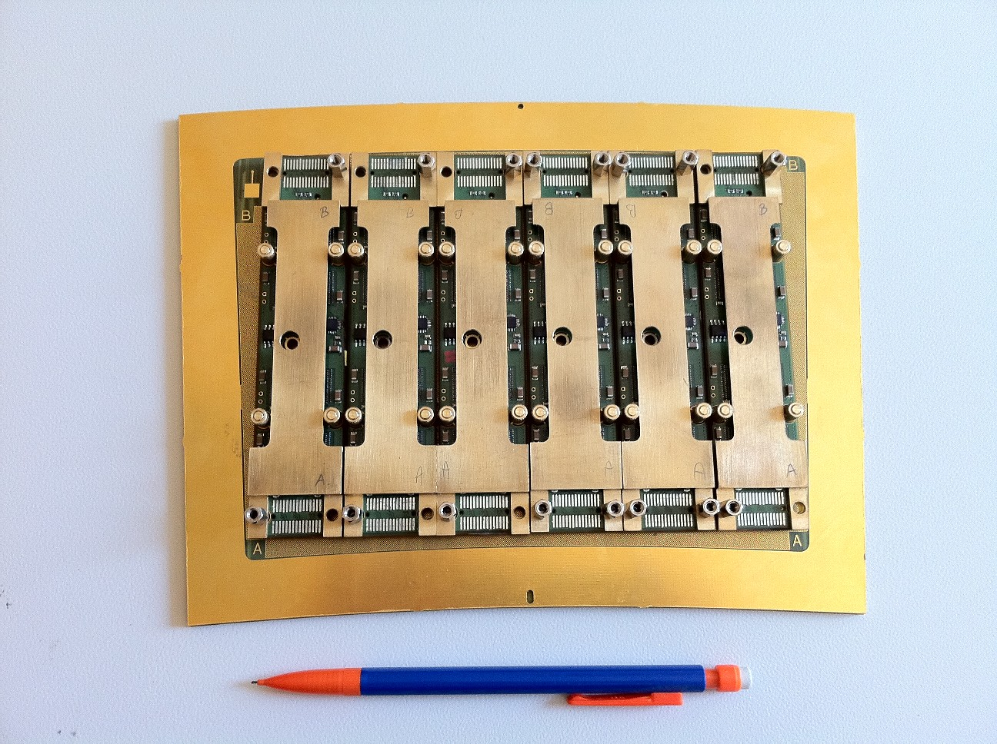
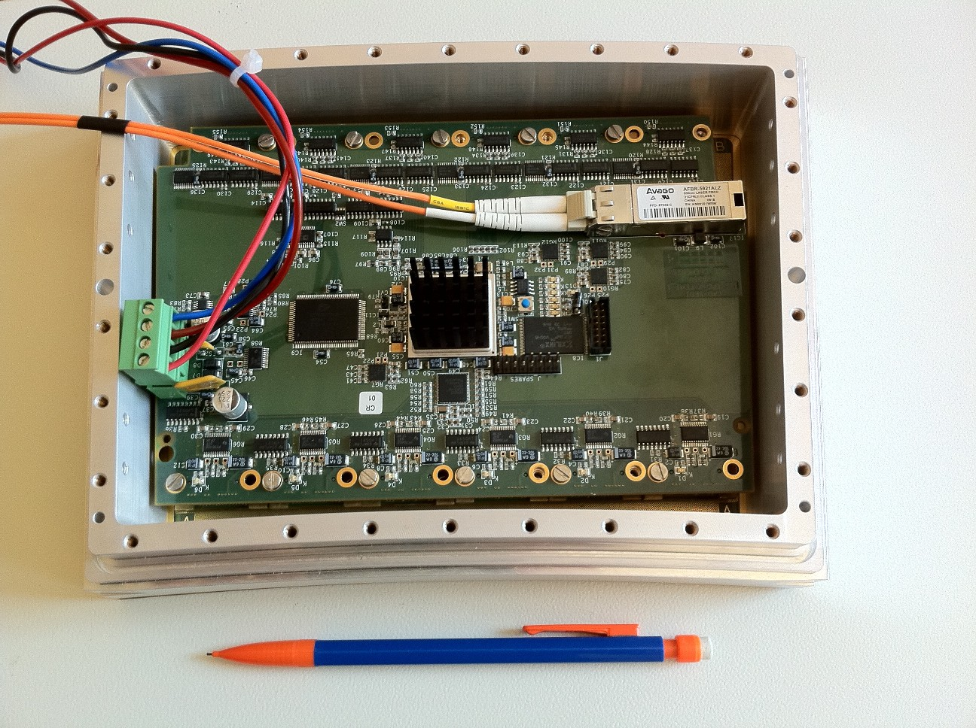
First prototype of the electronics

Slide 10
Temperature during switching on
Temperature in the hall

Slide 11
Temperature after cooling
Increasing of the Nitrogen flow
Temperature in the hall

Slide 12
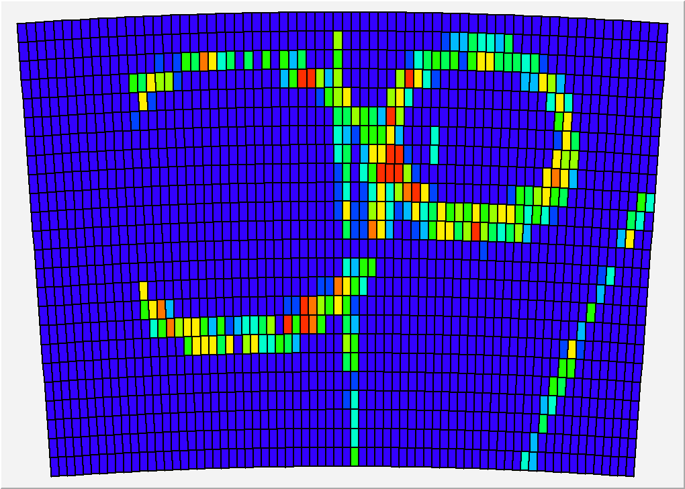
Event samples in B=1T

Slide 13
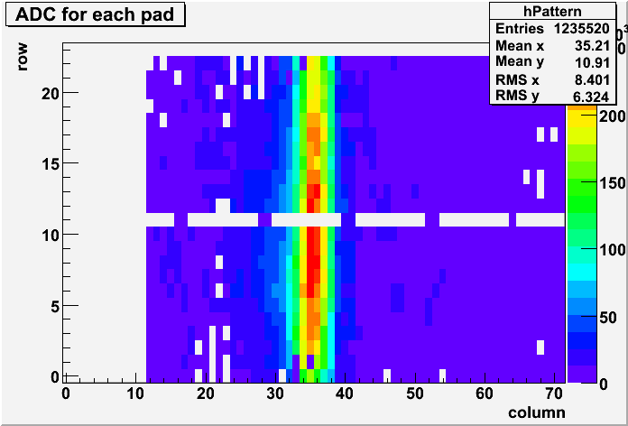
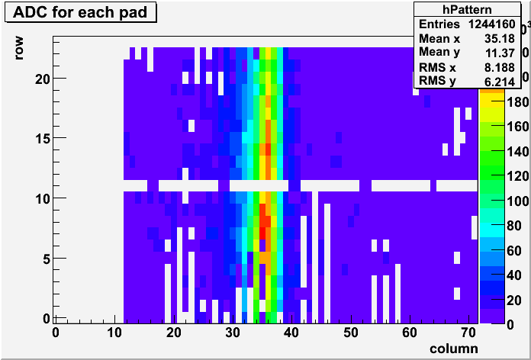
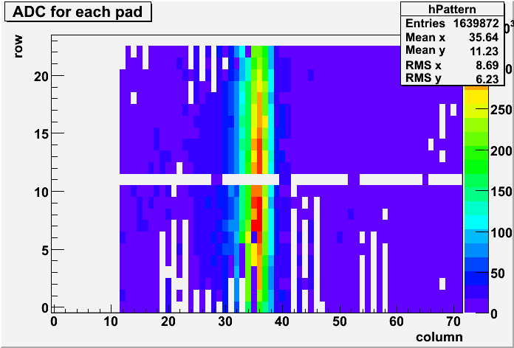
Are we loosing ASICs?
May 6
Mainly ASICs 1 and 2 tend to be missing
-not especially where the beam is
Pedestal fluctuations?
Bad contacts?
Investigate…
May 10
May 12

