Slide 1
SUMMARY OF THE ORSAY LD-TPC ELECTRONICS MEETING
P. Colas

Slide 2
Reminder on signals, beam conditions, etc… at ILC and CLIC (PC and Lucie L)
No special difference between signal shape and length between GEM and Micromegas
Possibility of power pulsing for ILC
Very variable backgrounds in CLIC

Slide 3
Summary of experiences with the PCA16-ALTRO (EUDET) electronics
(12-27mV/fC) (30-130ns shaping) (20MHz sampling)
  Good
  Excellent noise, ca 350 electrons. One FEC connected to chamber
  Routine operation of ~8000ch with global threshold at 4 adc channels
  ( ca 2000 electrons).
Problems
  Breaking amplifier channels with GEMs. Severe, has to be solved
  Diffcult assembly
  cooling FECs, needs forced air cooling . Not OK for the future
  Global threshold limited by
    Touching cables.
    Edges of pad panel
    Long cables. The cables are the unpredictable part of the system

Slide 4
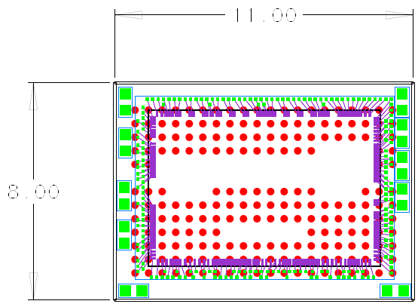
It has been (is) the working assumption that the final LD-TPC will have the readout
electronics mounted directly on the outer face of the pad panel.
With SALTRO16 the channel density is too low , limiting the pad size to 1*9mm (in theory). In practise probably twice that even if we bond naked die to the panel.
As long as we are bonding untested chips we have to work with fabrication modules with few chips otherwise we are killed by the yield.
We plan to place the SALTRO16 on a multi-chip-module (FEC-MCM) which
connects to the pad panel with the JAE connectors used for the ALTRO electr.
After some detours we have now settled on a
FEC-MCM module with 8 SALTRO16 (bonded
individually on a carrier card) chips (128channels)
resembling the present FEC.
The digital readout and control on a
separate pc-board

Slide 5
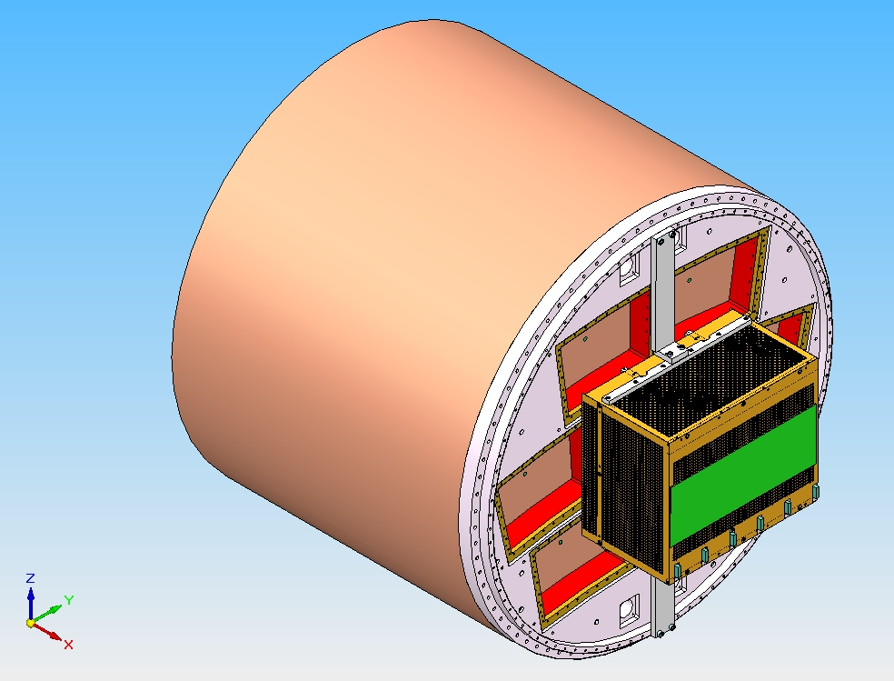
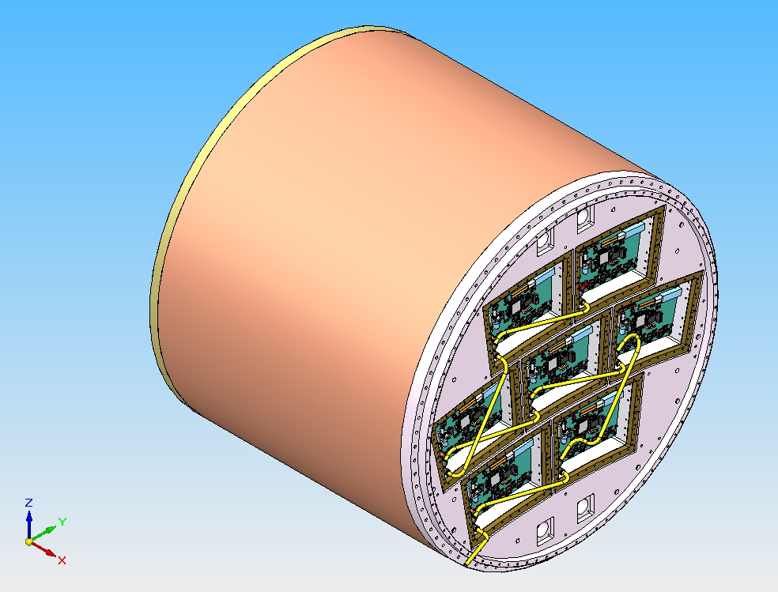
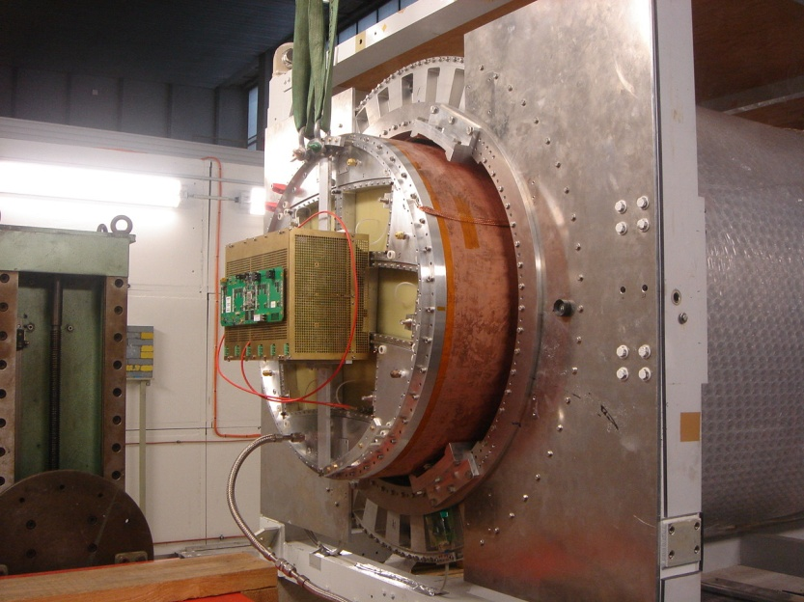
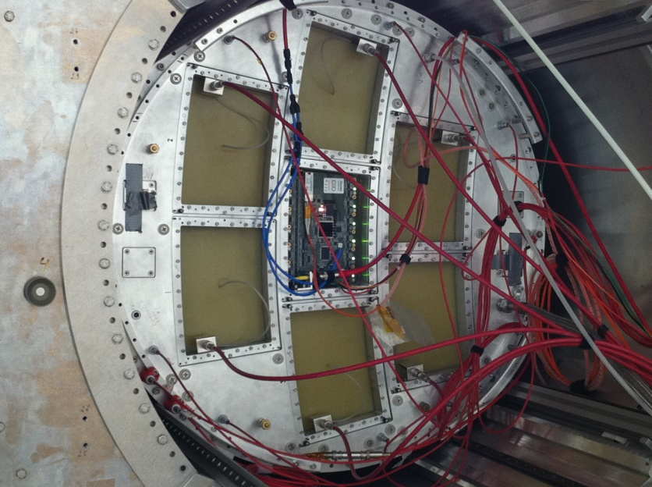
Integrated electronics for 7 module project

Slide 6
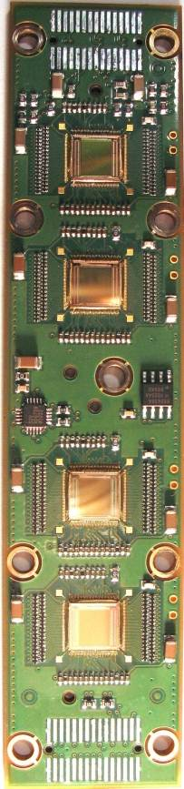
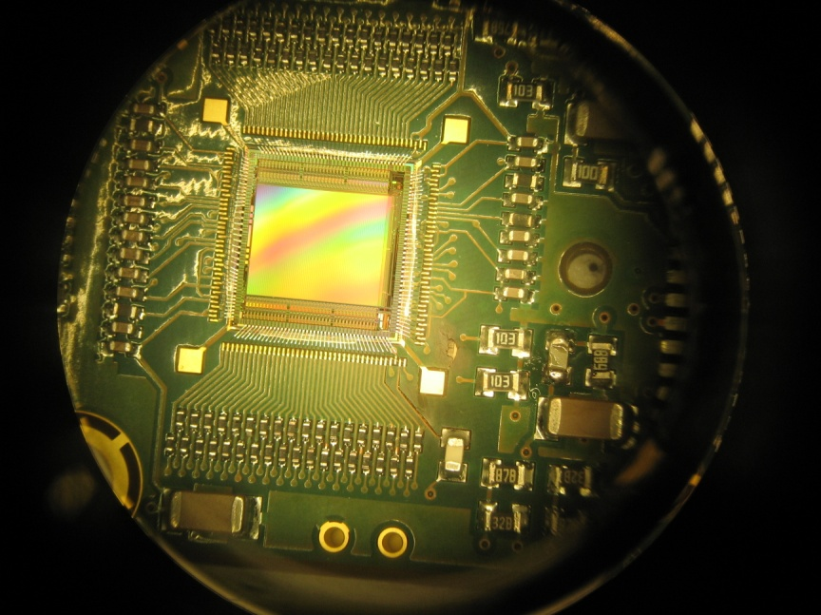
Front-End Card (FEC)
4 chips per FEC wire bonding on the 8-layer PCB
Protections: a resistor (0201 SMC) at each channel input
  A0: 0Ω
  A1: 3Ω
  A2: 5,1Ω
  A3: 10Ω
Temperature measurement device for each FEC

Slide 7
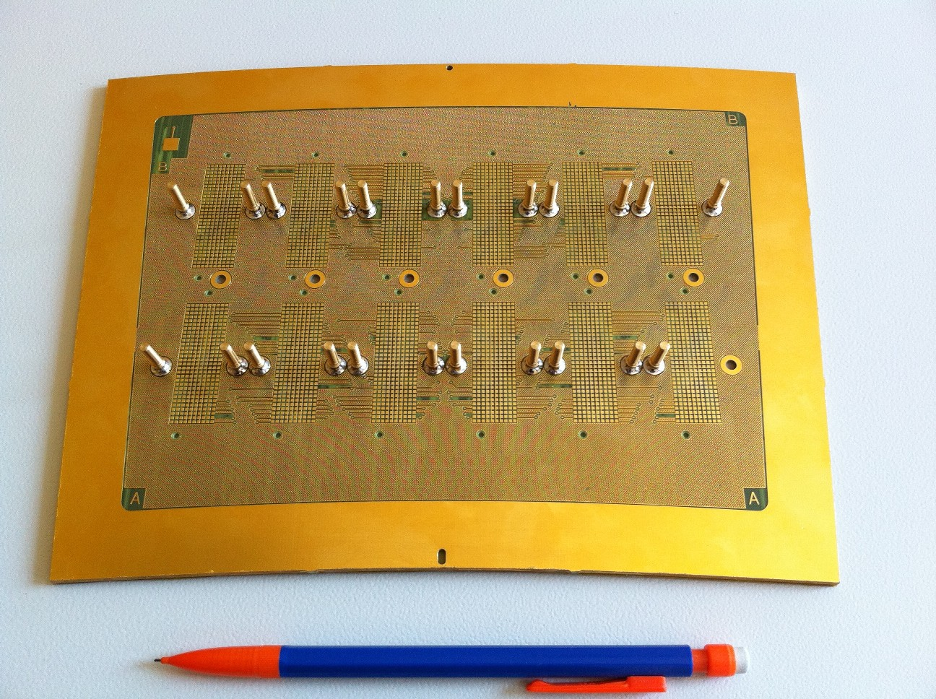
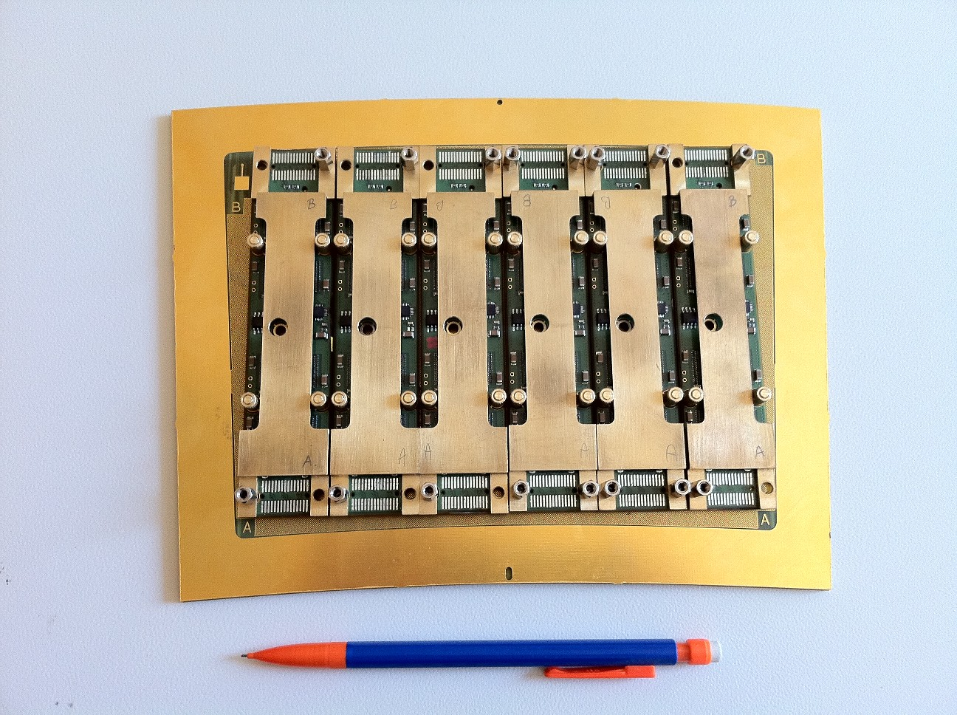
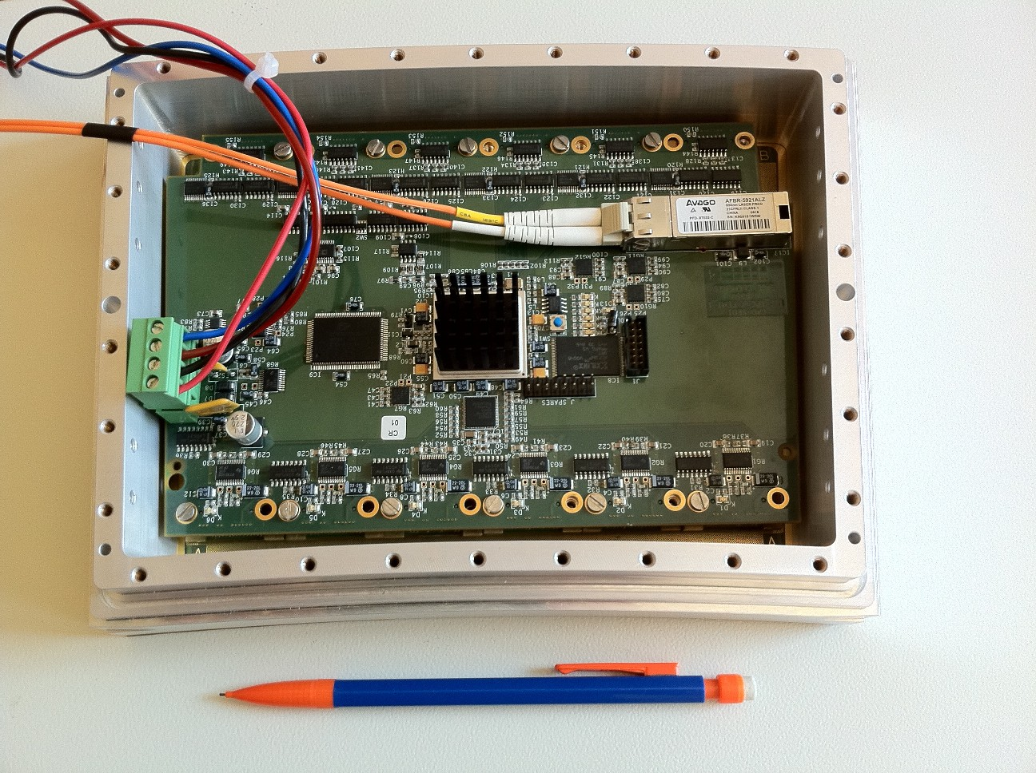
First prototype of the electronics

Slide 8
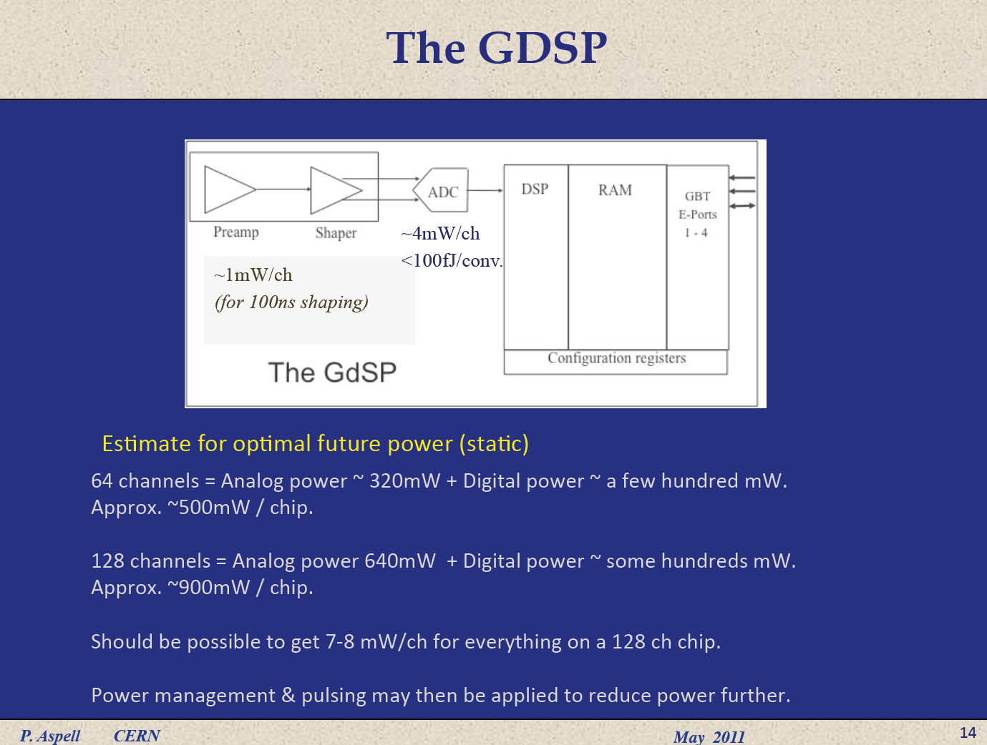

Slide 9
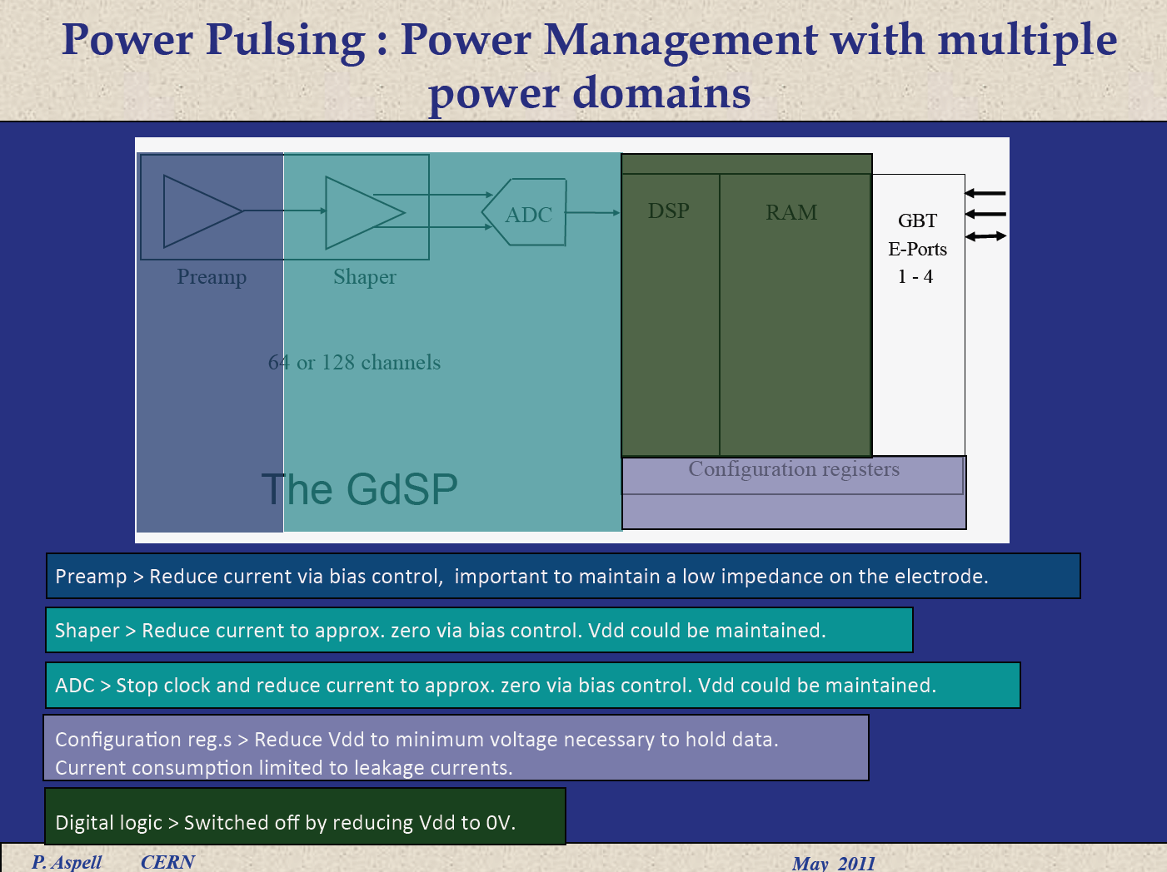

Slide 10
Summary
Time (2013) to re-think from scratch the electronics for ILD TPC readout
Should also be usable for other projects
130 nm seems to be the technology, but might be questionned
Power distribution and consumption are important issues (taking in and out power both need matter)
To start with: improve SALTRO 16 design:
  Compact, make less gourmand ADC,
Work out storage and real-time data reduction

Slide 11
New Conclusions
Continue integration work with PCA16+ALTRO and SALTRO16 or AFTER with help from AIDA (Lund, Saclay,…). None of these is the final LD electronics (insufficient packing, protection, too much consumption, memory depth,… )
Start design work on a future GdSP chip using synergy between LD-TPC and SLHC muon chambers. Paul Aspell is putting together a design team. Saclay volunteer to participate. Directly going to full Si chip is too expensive and premature.

