Slide 1
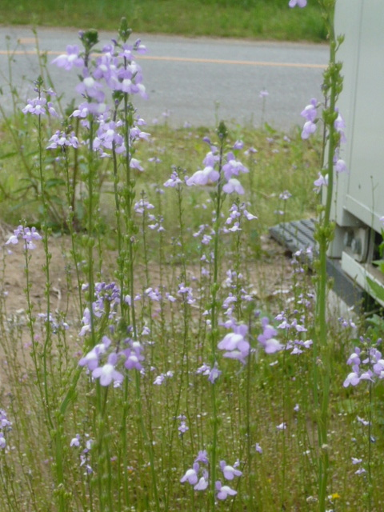
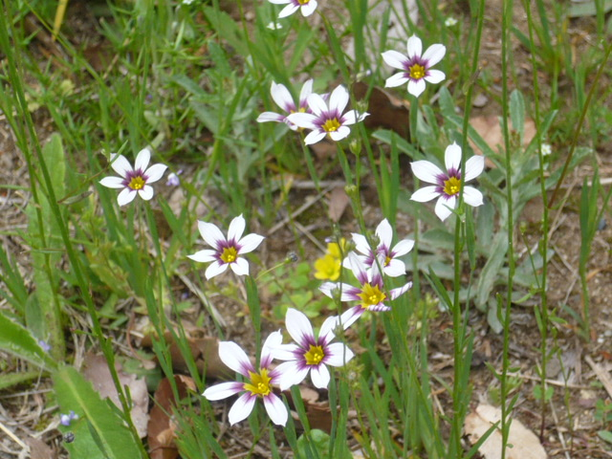
Recovery Status
N.Terunuma, KEK
ATF2 meeting, May 18, 2011

Slide 2
Recovery schedule

Slide 3
Status update
Re-assembling of the ATF2 radiation shields
  South wall of the FD-IP section has been aligned.
  End of the tunnel will be aligned in this week.
  The work will be continued until the end of this month.
Recover the cooling water system
  No severe damage was found. Circulating is OK.
  Temperature control is under inspection. The system will be ready in this week.
Alignment of the beamline
  LINAC alignment will be finish in this week.
  Realignment of BT line has been started.
  DR/ATF2 will be done in June; alignment in daytime and beam commissioning in evening.

Slide 4
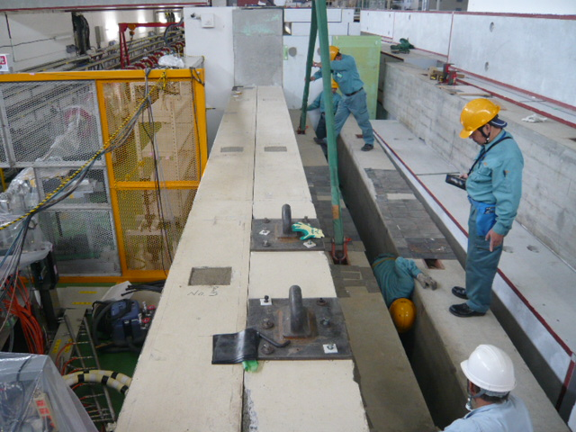
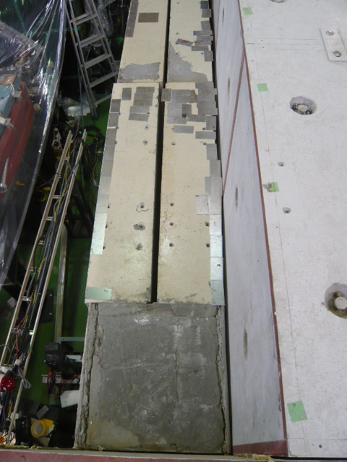
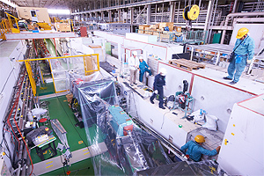
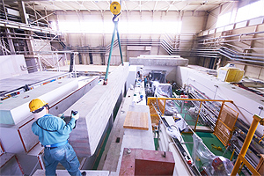
ATF2 FD/IP shield works

Slide 5
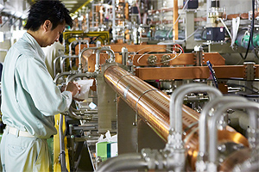
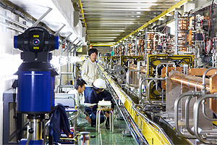
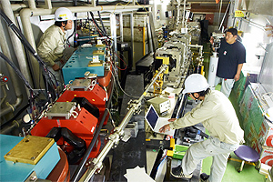
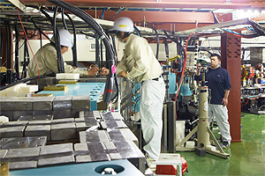
LINAC/BT alignment

Slide 6
Work for a week
Re-assembling of the radiation
Re-alignment of the beamline (LINAC→BT)
Recover the cables for FD/IP monitors
Restart the EXT/FF control stations
Commissioning of the LINAC RF
Beam commissioning at the RF Gun will be started when the above works are done.

