Slide 1
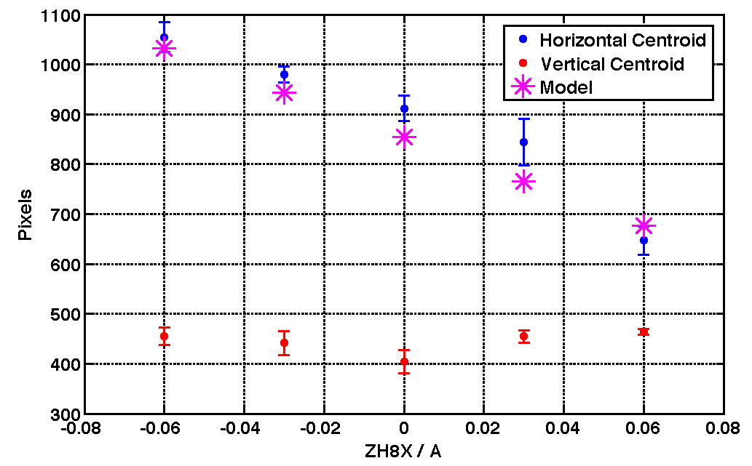
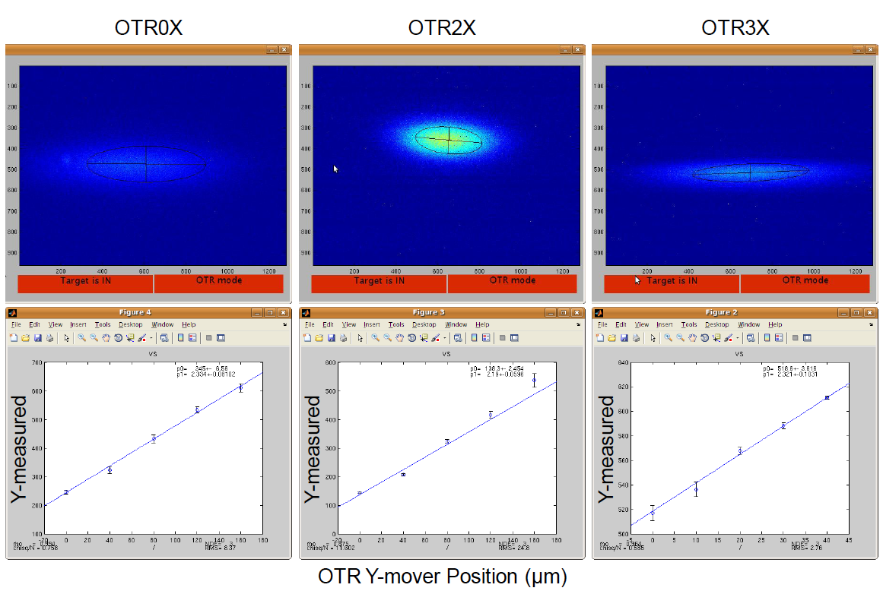
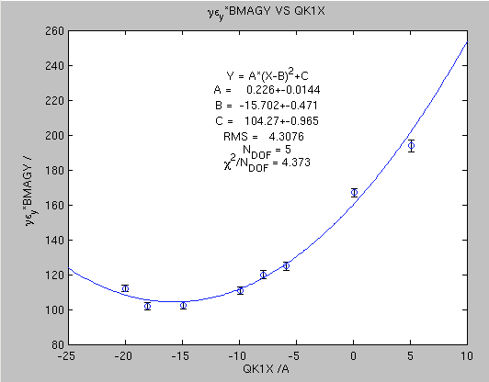
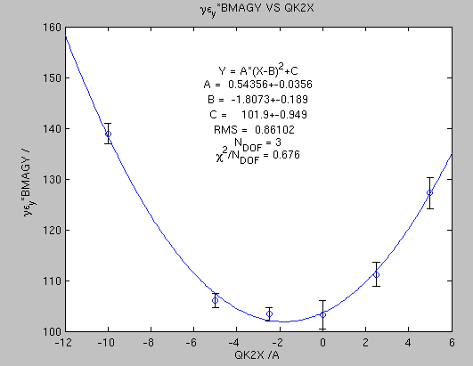
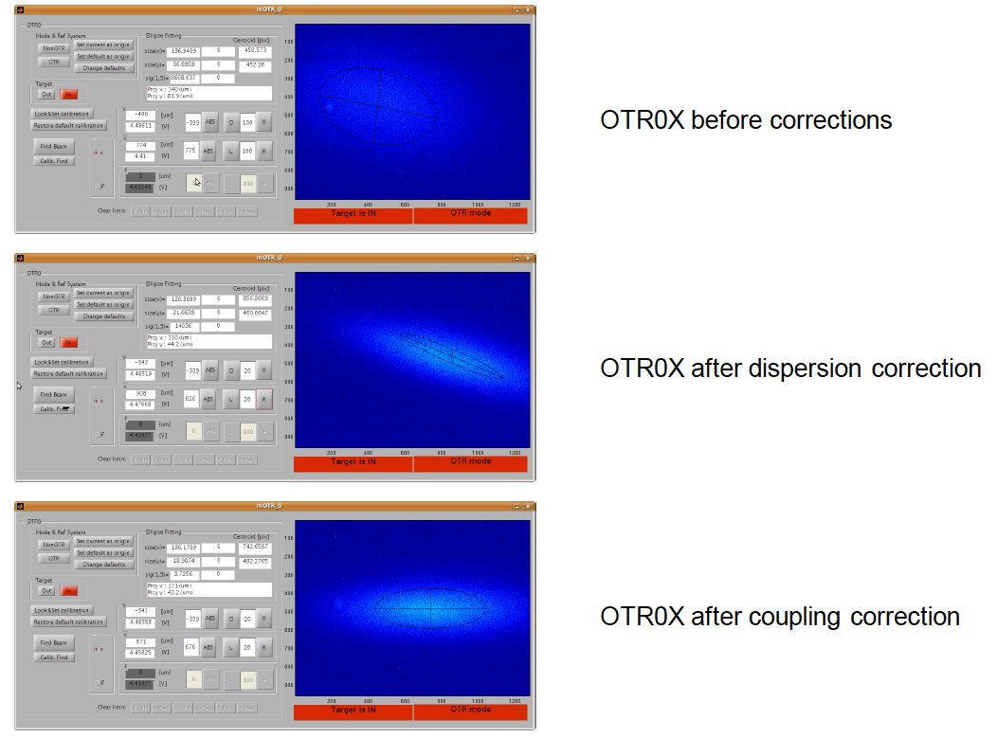
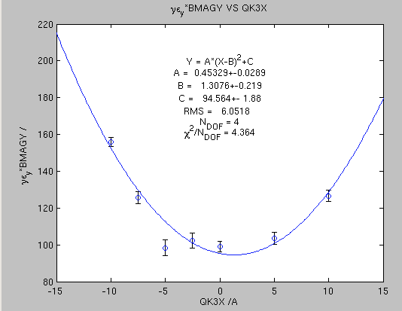
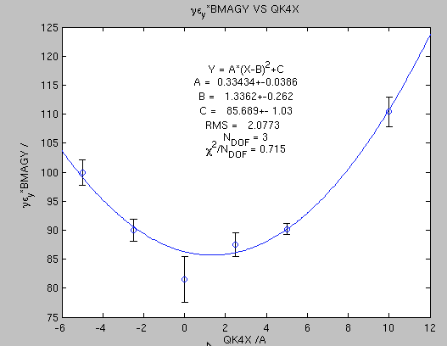
Multi-OTR System
2011: Calibration
Before quake some calibrations and alignments were made
A systematic measurement campaign was expected in the first part of 2011 but impossible after the quake
After the quake, hardware has been checked and works ok
Roll alignment
Coupling correction
Vertical calibration

Slide 2
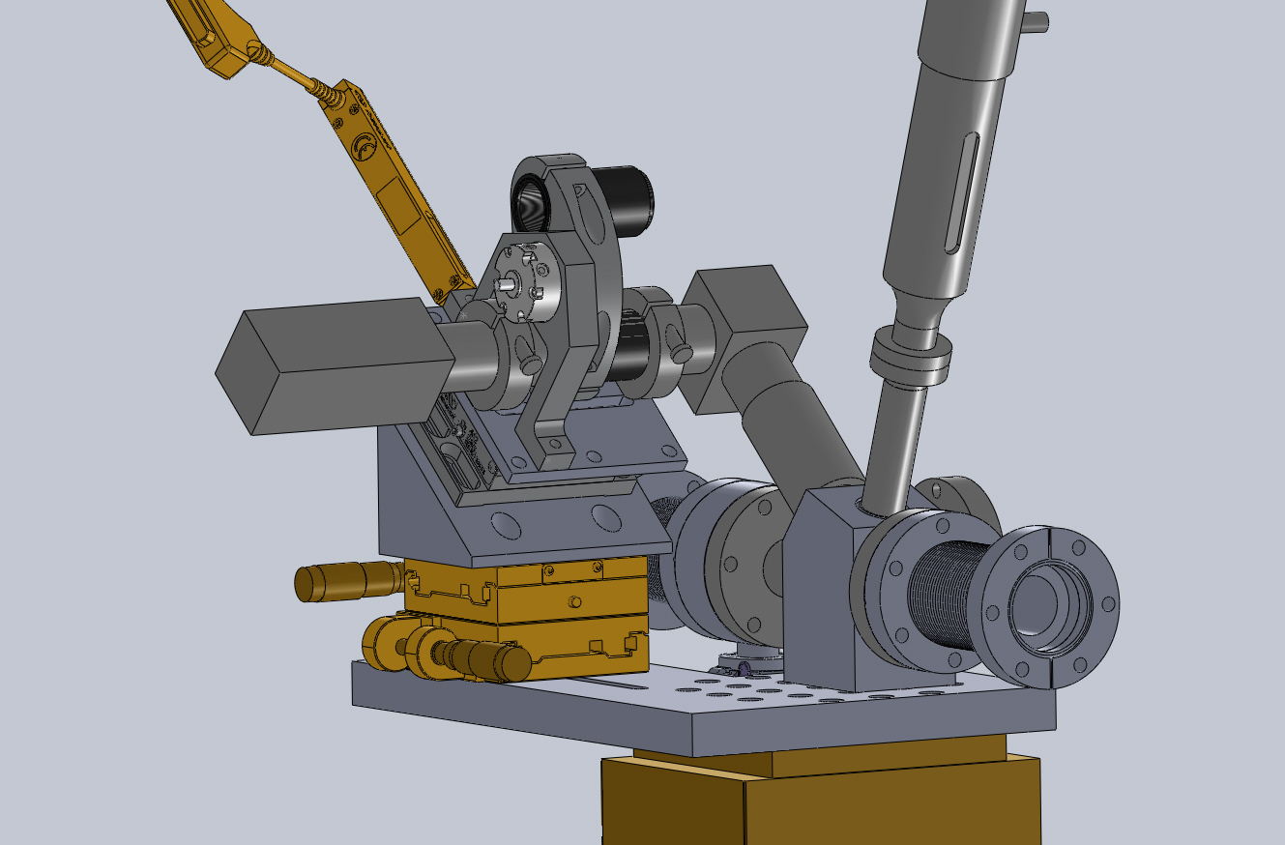
Multi-OTR System
Hardware progress
Demagnifier system to speed up the beam finding and to measure horizontal size when beam is large in x

Slide 3





Multi-OTR System
Emittance reconstruction
New design of the OTR for ATF-ATF2
By measuring the beam sizes in 4 places and knowing the optics in between the beam matrix is reconstructed:
To take the emittance value it is possible to neglect the coupling and diagonalize the x and y submatrices: 2D emittance.
X submatrix
Y submatrix
To take in account the coupling terms the diagonalising of the beam matrix is needed: 4D emittance.
Notes:
3

Slide 4
Multi-OTR System
Emittance reconstruction
New design of the OTR for ATF-ATF2
2D emittance reconstruction is fully implemented and it is working.
Systematic measurements for comparison is needed.
4D algorithm is under study.
The algorithm gives some
times imaginary emittances!
Nexts slides are simulations. Emittances are vertical if not specified.
1000 emitt measurements per error.
50.001 particles.
Standard nominal v3.1 optics
Tracking with Lucretia
Relative error in size measurement
OTR measurement error around 2%
Notes:
4

Slide 5
Multi-OTR System
Emittance reconstruction
New design of the OTR for ATF-ATF2
Mean of measured value compared with input one
Relative error in size measurement
Input emittance
Mean of measured emittances
Standard deviation of measured emittances
Notes:
5

Slide 6
Multi-OTR System
Emittance reconstruction
New design of the OTR for ATF-ATF2
Effect of each OTR in the emittance imaginary ratio
WS
0
WS
1
WS
2
WS
3
WS
4
OTR
0
OTR
1
OTR
2
OTR
3
20°
28°
46°
Δψ
8.5
7.2
11.4
7.3
σ (μm)
Notes:
6

Slide 7
Multi-OTR System
Emittance reconstruction
New design of the OTR for ATF-ATF2
Efect of coupling in the emittance imaginary ratio
Notes:
7

Slide 8
Multi-OTR System
Emittance reconstruction
New design of the OTR for ATF-ATF2
Study of the reconstructed beam matrix elements
sig7
Blue dots are beam matrix elements that lead to a real emittance value and red ones are for the imaginary value
Notes:
8

Slide 9
Multi-OTR System
Simulation/experiments tracking comparison
New design of the OTR for ATF-ATF2
During first part of the year no systematic measurements were made. There are some records of tests but they are caotic and not easy to analize. Got this week the lattices corresponding to these days and will try if there’s agreement within the measurements and the simulations and to test the emittance algorithm with these real measurements.
Notes:
9

