Slide 1
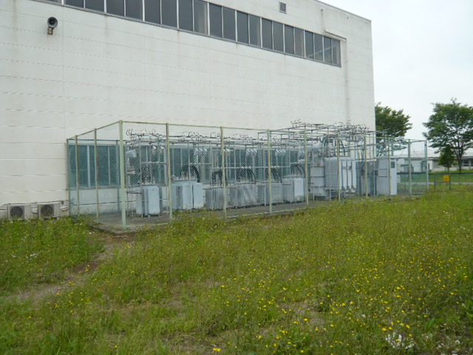
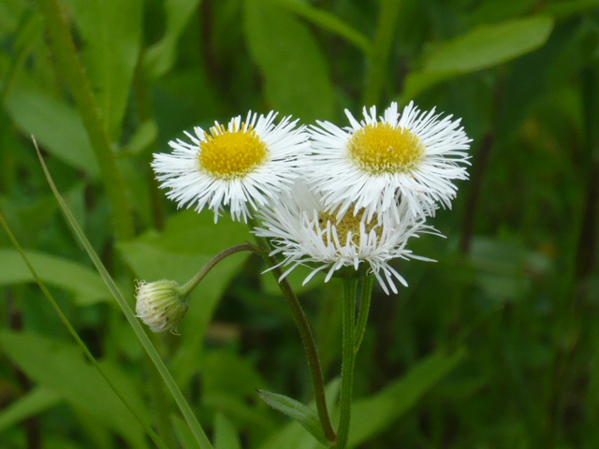
Recovery Status
N.Terunuma, KEK
ATF2 meeting, June 1st, 2011

Slide 2
Recovery schedule
We are in the commissioning of DR.

Slide 3
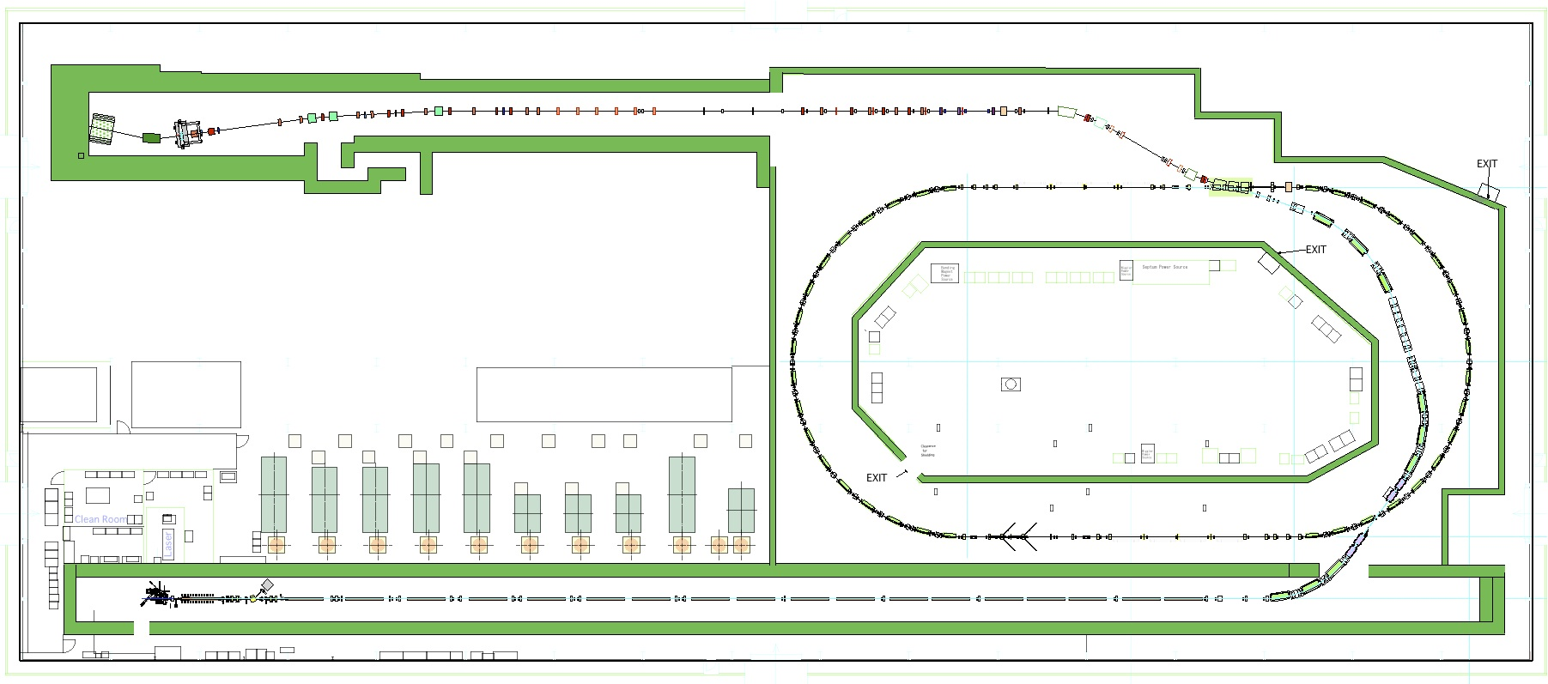
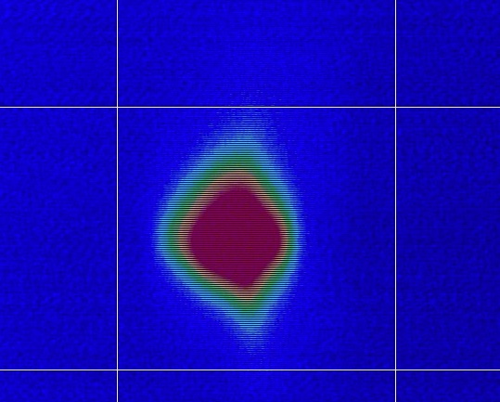
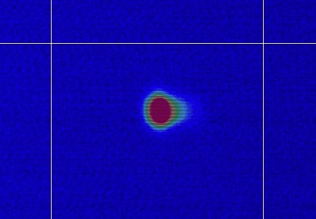
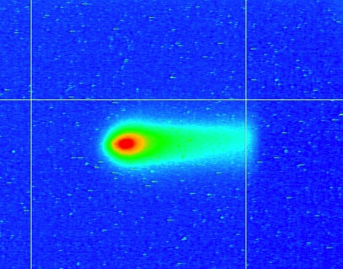
Checkout with a test beam, ATF-KEK
Single bunch, 0.78 Hz limited by radiation safety
0.8 x 10¹⁰ e/bunch at Linac
0.2 x 10¹⁰ at the end of BT
Very small in DR
2011/5/27
BT
2011/5/30
DR 1st turn
2011/5/25
Injector
2011/5/26
LINAC

Slide 4
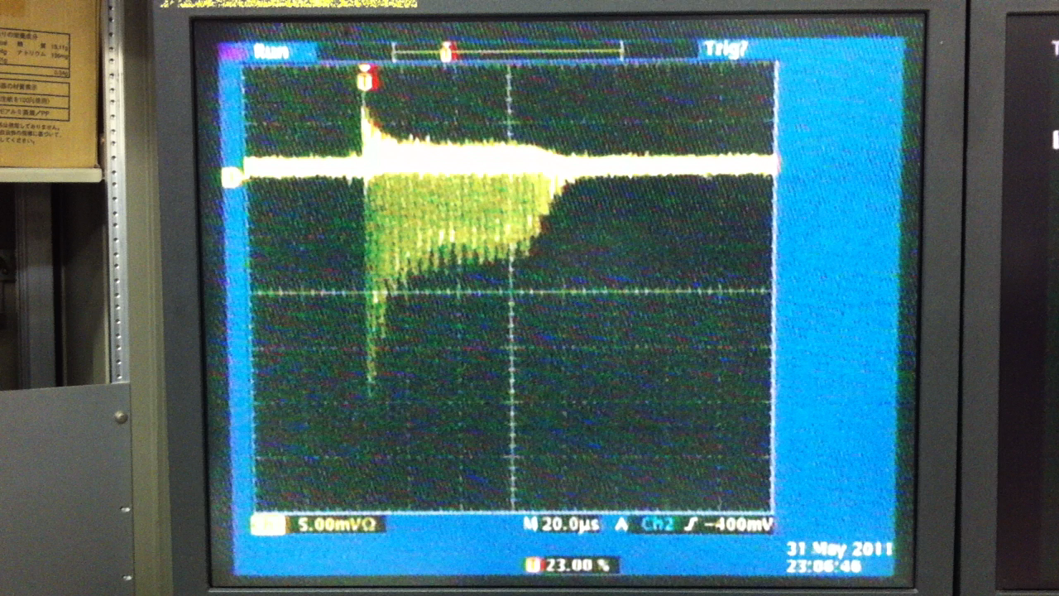
DR checkout has been started
5/30(Mon): DR injection. One turn only.
5/31(Tue): Adjust the magnets to have a storage.
60 usec storage.
We found QM5R is 1 mm lower. East arc is also needed to align.
It seems that the RF frequency should be re-adjusted for the DR circumference; expanded by getting warmer.

Slide 5
Work for a week - same as before -
Daytime
Add the fixing plates for shield blocks
Re-align the beam line especially in DR
Repair and upgrade
Evening
Checkout of the beamline components with beam
Retune the beamline

