Slide 1
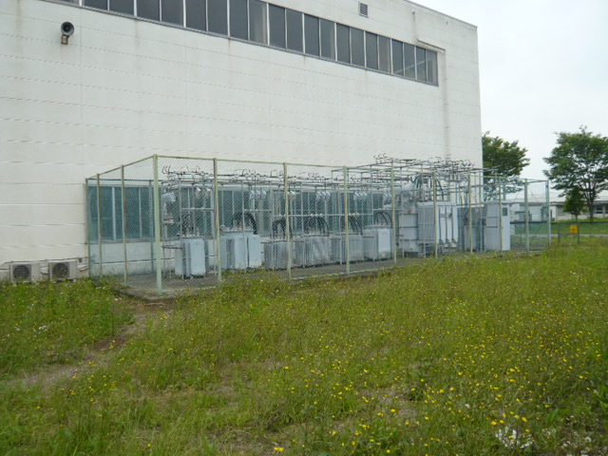
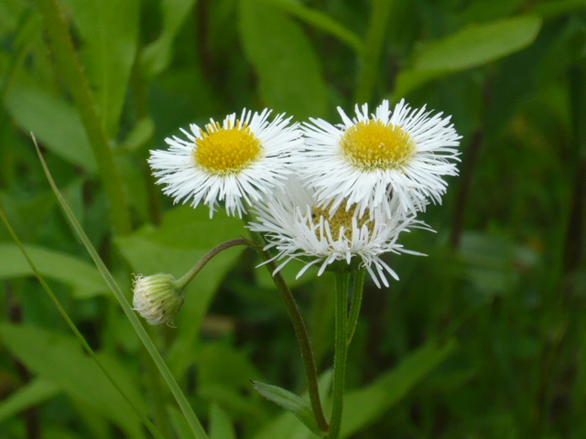
Recovery Status
N.Terunuma, KEK
ATF2 meeting, June 7, 2011

Slide 2
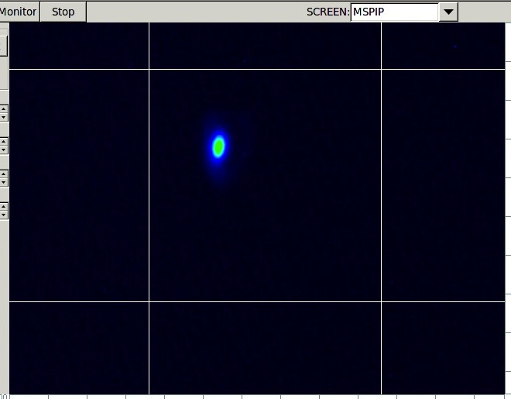
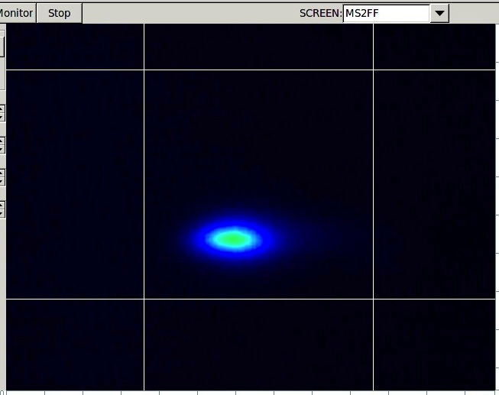
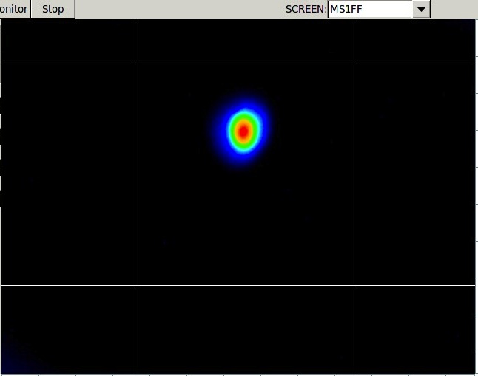
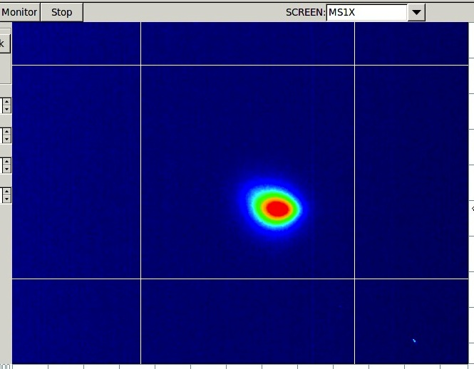
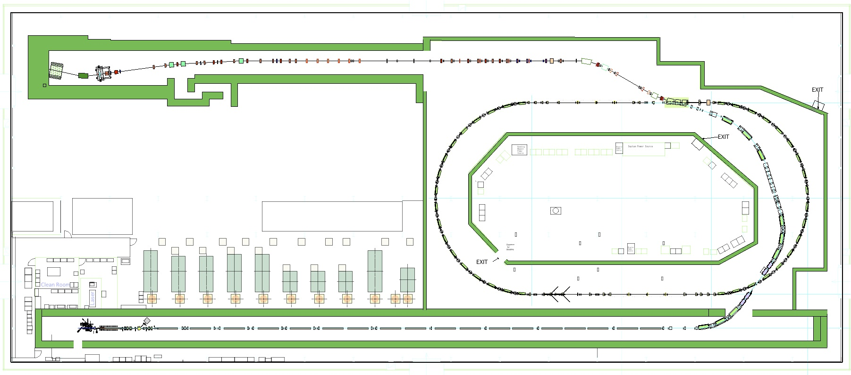
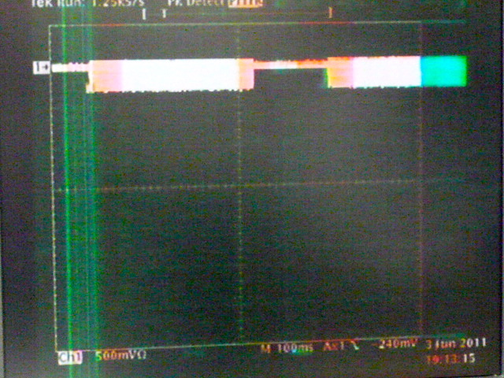
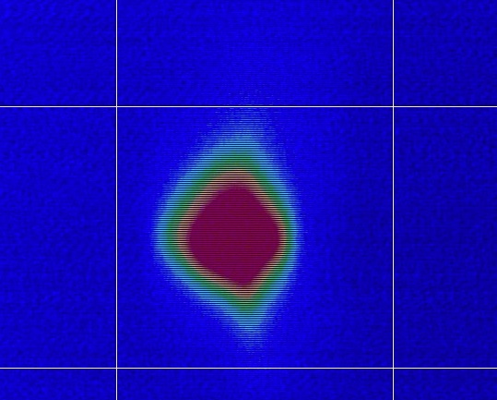
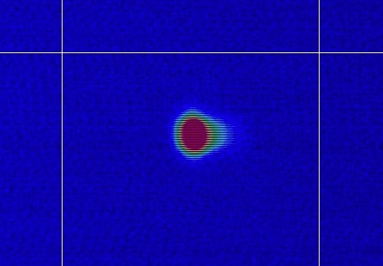
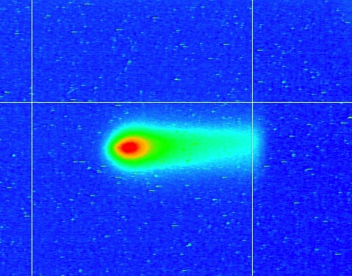
Test Beam ran the whole ATF beamline
Single bunch, 0.78 Hz, 0.3 x 10¹⁰ e/bunch DR&ATF2
6/3 MSPIP
6/3 MS1FF
6/2 MS1X
6/3 MS2FF
5/27 BT end
6/2
DR storage
5/31
DR 1st turn
2011/5/25
Injector
2011/5/26
LINAC
2011/06/03
N.Terunuma

Slide 3
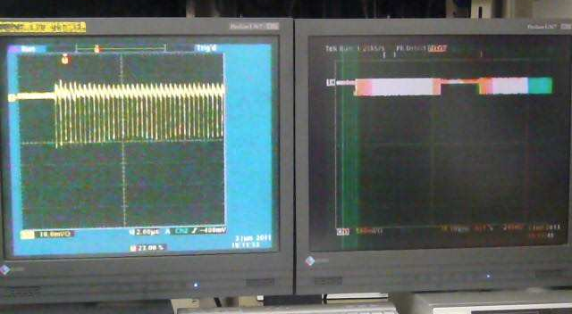

Slide 4
Work for a week - same as before -
Daytime
Re-align the beam line especially in DR
Repair and upgrade
Evening
Checkout of the beamline components with beam
Retune the beamline

