Slide 1
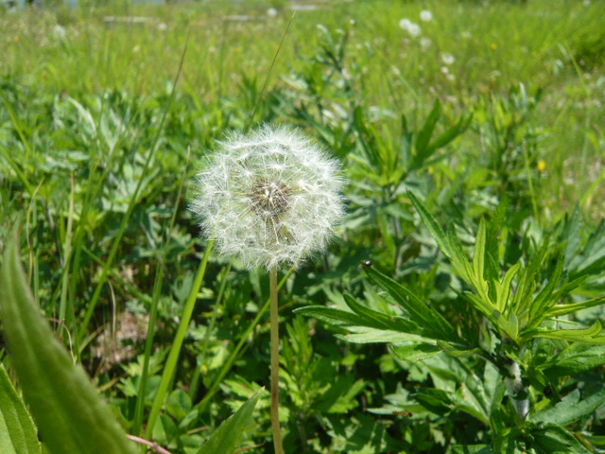
Recovery Status
N.Terunuma, KEK
ATF2 meeting, June 22, 2011

Slide 2
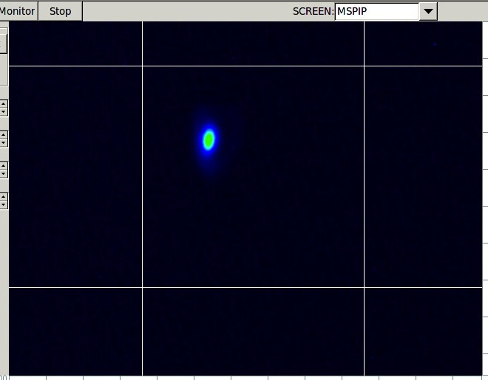
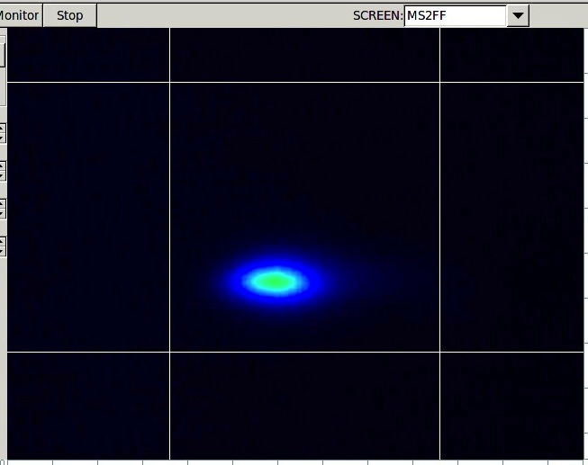
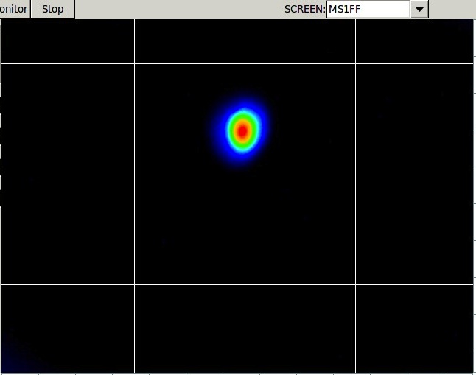
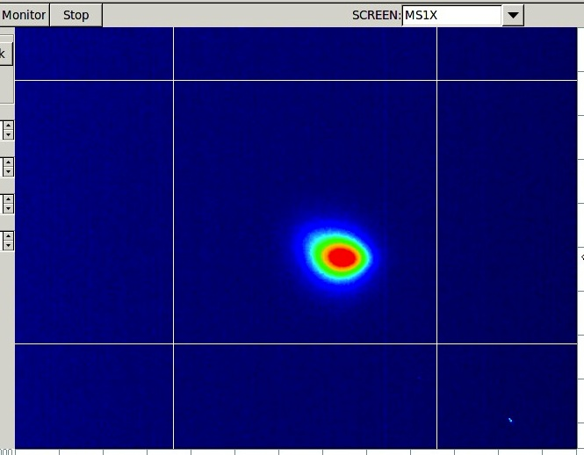
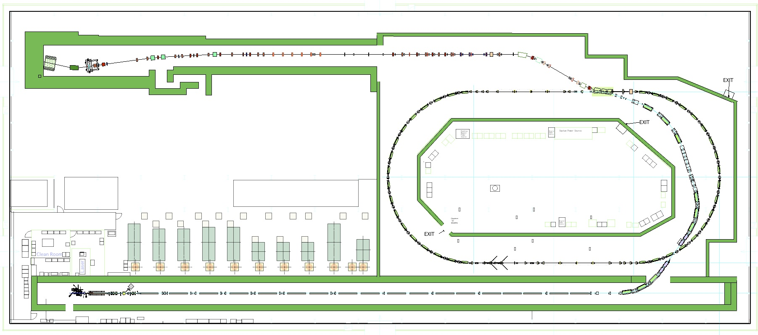
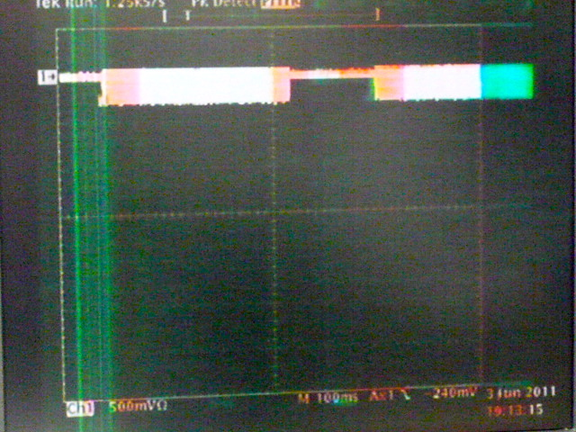
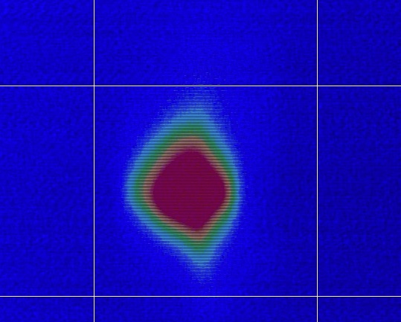
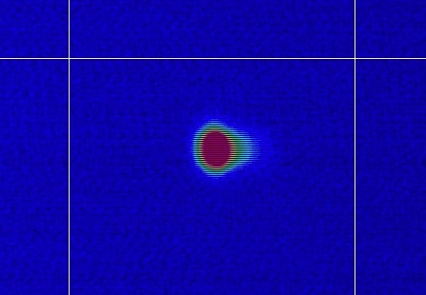
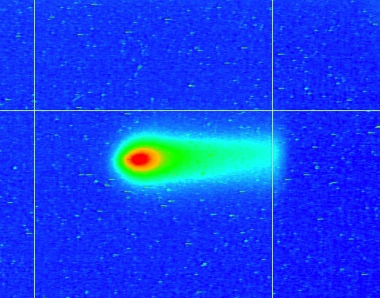
Test Beam ran the whole ATF beamline
Single bunch, 0.78 Hz, 0.3 x 10¹⁰ e/bunch DR&ATF2
6/3 MSPIP
6/3 MS1FF
6/2 MS1X
6/3 MS2FF
5/27 BT end
6/2
DR storage
5/31
DR 1st turn
2011/5/25
Injector
2011/5/26
LINAC
2011/06/03
N.Terunuma

Slide 3
Works in daytime
DR survey
We found the DR is about 3 mm shorter than design. It is confirmed by beam and also by position survey data. RF freq. for DR has to be adjusted → LINAC freq. = 4xDR’s → Temperature of LINAC cavities have to be change to match the volume against the RF frequency.
No longitudinal alignment was done. Rough alignment, level of 0.3 mm or less, was done only for the transverse position of magnet.
Further survey will be continued to prepare the fine alignment in summer.
Instruments recovery
Cavity BPMs will be reported by S. Boogert
DR-LW, Compton (2-mirror): commissioning of the optical cavity was done. Alignment of detector was done.
Compton (4-mirror) : checkout started on last Monday.
Shintake-monitor: Cleaning of Optical component was done. Reconnecting cables, checkout of mirror tools, performance check of seed laser

Slide 4
Beam in evening
5/31: 60 usec storage in DR
6/1: 0.1x10¹⁰ (DR), Freq. 1428.009 MHz → 1427.989 → 1428.006 (-3 kHz)
6/8: 0.1x10¹⁰ (DR), Freq. 1428.017 (+11 kHz), 29.7 degree
6/9: 0.1x10¹⁰ (DR), Freq. 1428.027 (+10 kHz), 29.5 degree
6/10: 0.4x10¹⁰ (DR), Freq. 1428.039 (+12 kHz), 29.0 degree ,
XSR commissioned
6/14: 0.5x10¹⁰ (DR), Freq. 1428.035 (-4 kHz), 28.9 degree
dispersion correction, local bump, XSR 11.3 um→35 pm,
6/15: 1.0x10¹⁰ (DR), Freq. 1428.031 (-4 kHz), 28.9 degree
dispersion correction, local bump, XSR 9.9 um→32 pm.
6/17: 1.0x10¹⁰ (DR), DR-LW checkout, signal was not found.
6/20: 0.3x10¹⁰ (DR), Injection tuning, Cavity BPM checkout
6/21: 1.0x10¹⁰ (DR), Compton(2-mirror) checkout→signal was found.
Cavity BPM(S-band) checkout→done

Slide 5
Stored beam in DR (x10¹⁰ e/bunch) beam was delivered to ATF2 dump without a significant loss

