Slide 1
First quick Sensor Evaluation for Ground Motion Detection and Feedforward
A.Jeremie

Slide 2
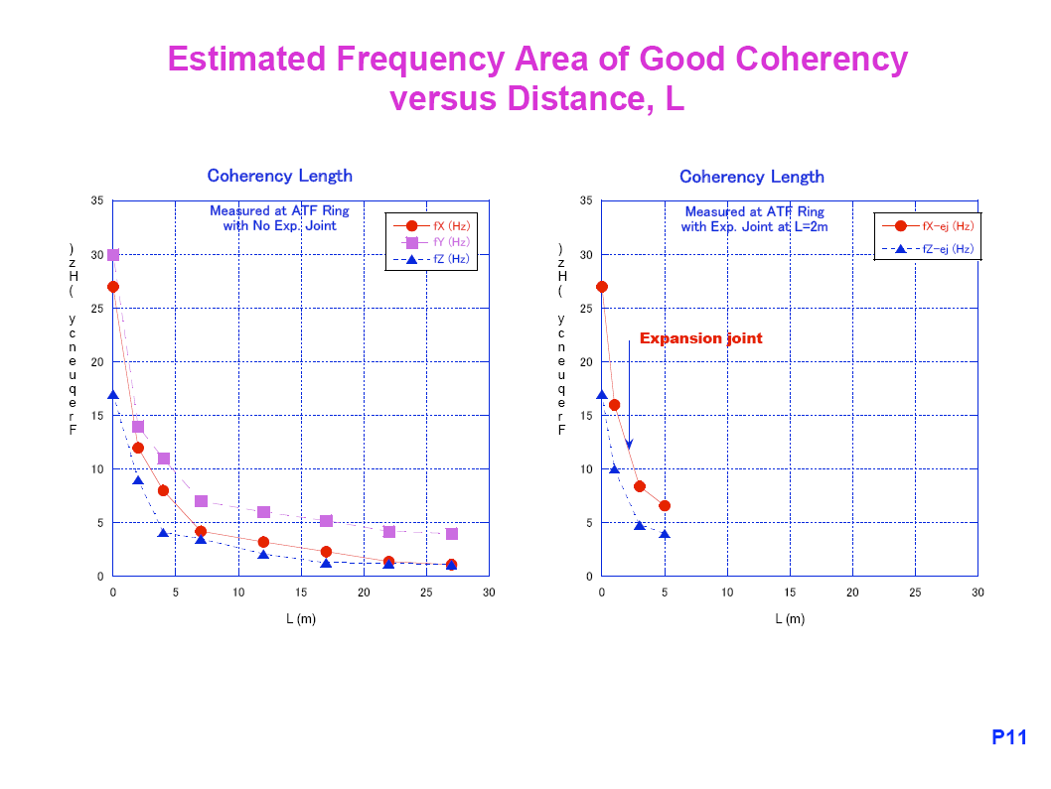
Coherence lost above 4m => Need a sensor every ~4m
Sugahara-san 2006

Slide 3
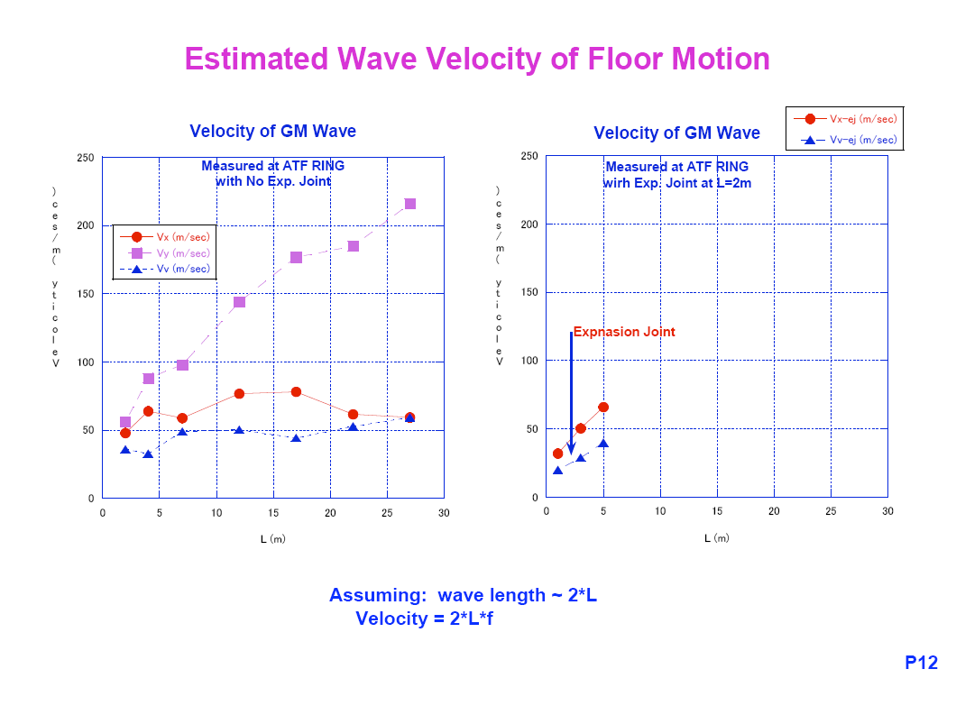
In frequency range of interest, the ground velocity is about 40 m/s
Sugahara-san 2006

Slide 4
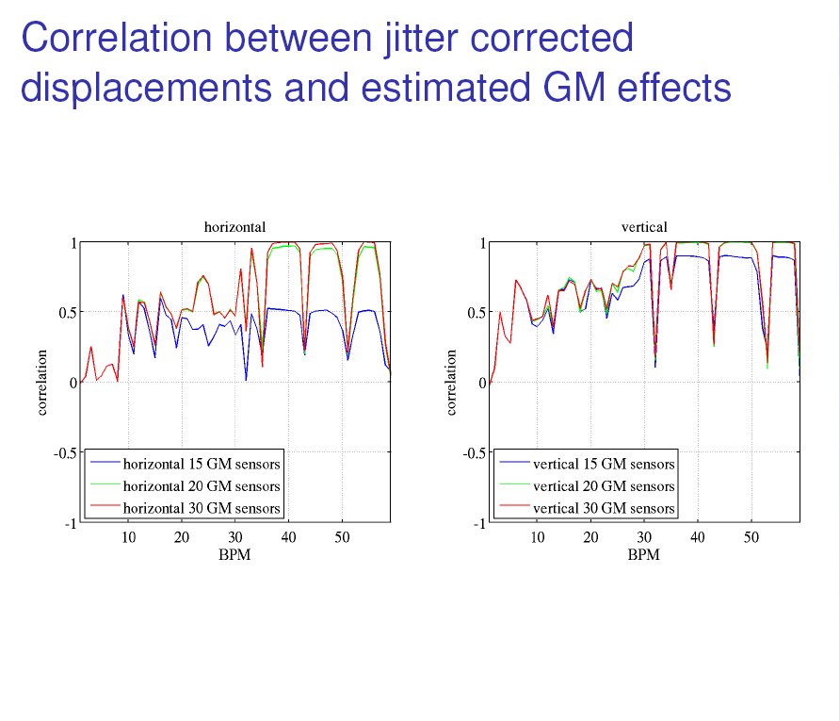
Yves Renier 2011

Slide 5
Characteristics of needs
Need sensors that can measure ATF2 ground motion (nanometre range)
in frequency range 0.1Hz to 50Hz (to 100Hz better)
Magnetic field resistant
Radiation hard

Slide 6
Prices
DAQ: « cheap » 6 channels (2 sensors if 3 directions acquired) by Güralp 3500 € but no file saving (still needs some explanation…!) or expensive 30 000 € for 12 channels or 20 000€ (?) 16 channels by Müller-BBM.
Accelerometer: 1200€
Güralp: 4200€ (or 3300€ alum)
SP500: 5000€
Signal filter: 5000€
Delivery in 3 months

Slide 7
Proposal Total available (LAPP) : ~50 000€
Total for 1 DAQ, 1 filter = 25 000€
Total for sensors:
Either 5 Güralp = 21 000€
Either 20 accel.= 24 000€
Or a combination of the 2 types of sensors

Slide 8

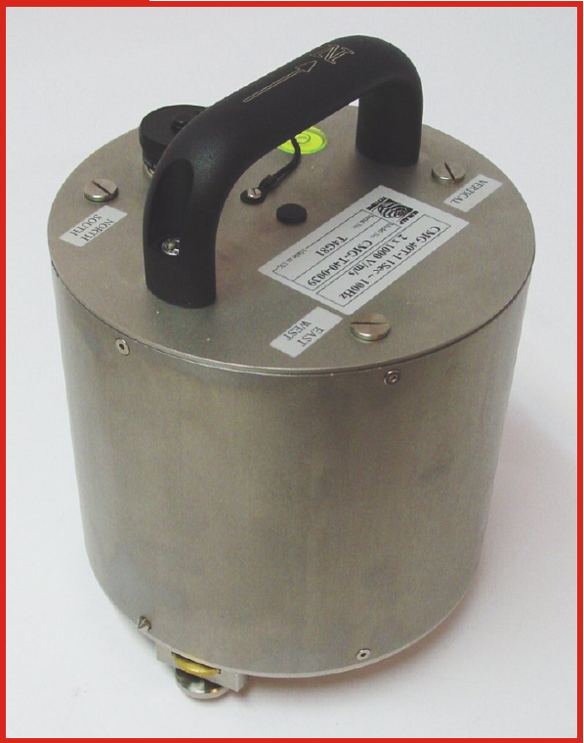
Güralp CMG-40T
Sensor type: electromagnetic geophone broadband
Signal: velocity x,y,z
Sensitivity: 1600V/m/s
Frequency range: 0,033-50Hz
Mass: 7,5kg
Radiation: Feedback loop so no
Magnetic field: no
Feedback loop
First resonance 440Hz
Temperature sensitivity: 0,6V/10°C
Electronic noise measured at >5Hz: 0,05nm
Stable calibration

Slide 9
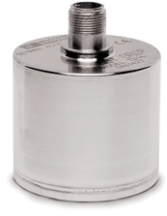
Wilcoxon
Sensor type: piezoelectric accelerometer
Signal: acceleration z
Sensitivity: 10V/g
Frequency range: 0, 1-300Hz but useful from 7Hz
Mass: 670g
Radiation: piezo OK, but resin?
Magnetic field: probably OK but acoustic vibrations?
Feedback loop
First resonance 815Hz
Temperature sensitivity: <1%
Electronic noise at 2Hz 0.03microg/√Hz
Stable calibration, flat response
Doesn’t like shocks

Slide 10
Constraints
End of spending period: November 5, 2011
So if we go back in time: Payment (30 days) => October 5, 3 months delivery => July 5!
We thus have to order now!
=> need to decide if the risk is too big to buy all these sensors even if the study is not mature and use it for something else, or we go ahead with the risk to buy now for a test in a few years?

Slide 11
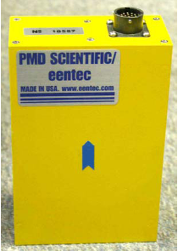
SP500
Sensor type: electrochemical, special electrolyte
Signal: velocity
Sensitivity: 20000V/m/s
Frequency range: 0,016-75Hz
Mass: 750g
Radiation: no effect around BaBar (don’t know exact conditions)
Magnetic field: tested in 1T magnet => same coherence, amplitude?
Feedback loop
First resonance >200Hz
Electronic noise measured at >5Hz: 0,05nm
Unstable calibration, response not flat
Robust

