Slide 1
New Board Tests
D. R. Bett

Slide 2
ADC tests
Sine wave generated by AWG
Split and input to ADC channels
Amplitude of AWG varied
  100 mV
  500 mV
  2000 mV
  5000 mV (max)
Arbitrary Waveform
Generator

Slide 3
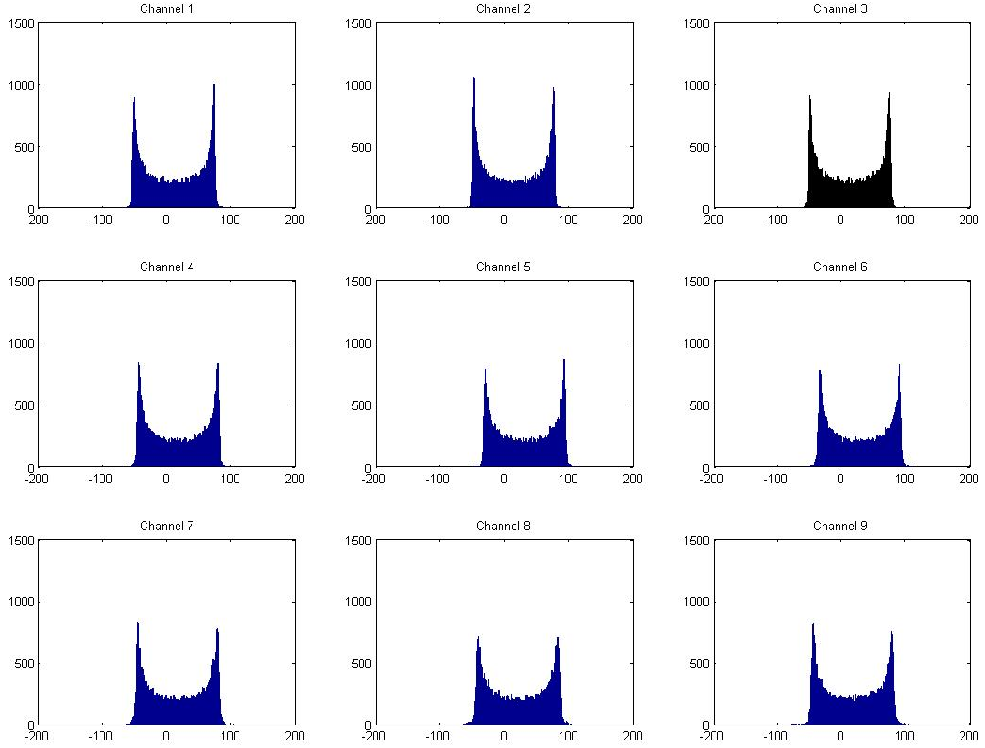
100 mV

Slide 4
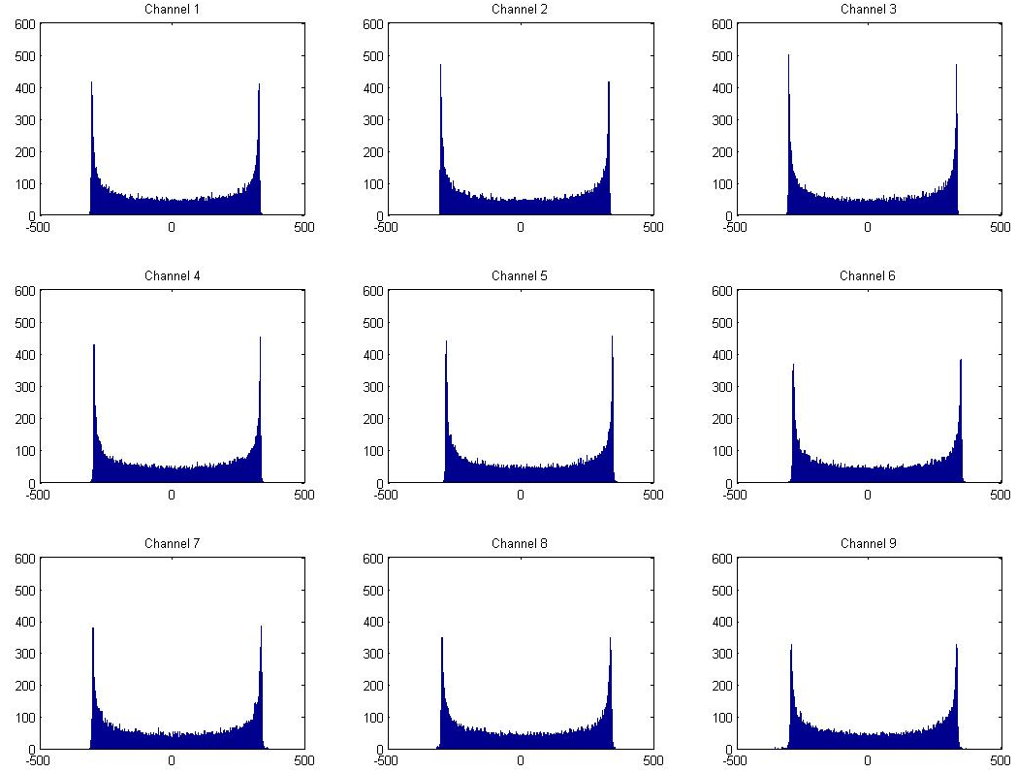
500 mV

Slide 5
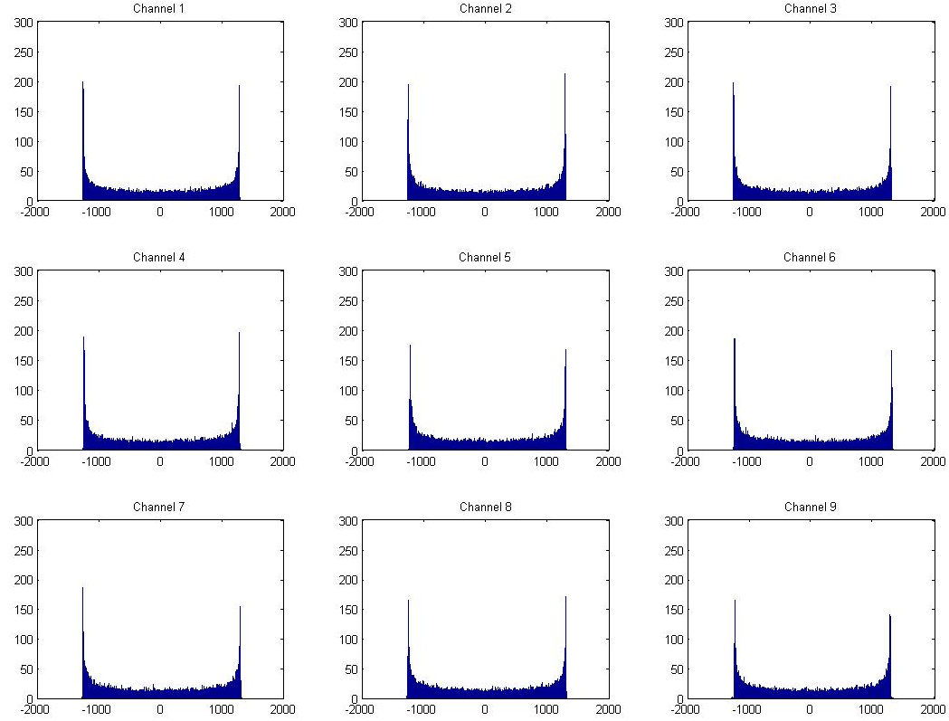
2000 mV

Slide 6
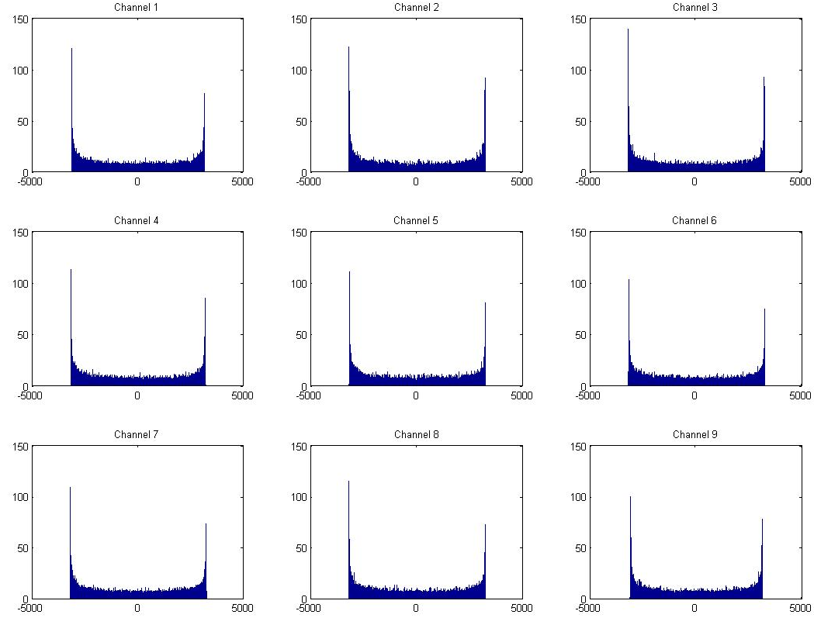
5000 mV

Slide 7
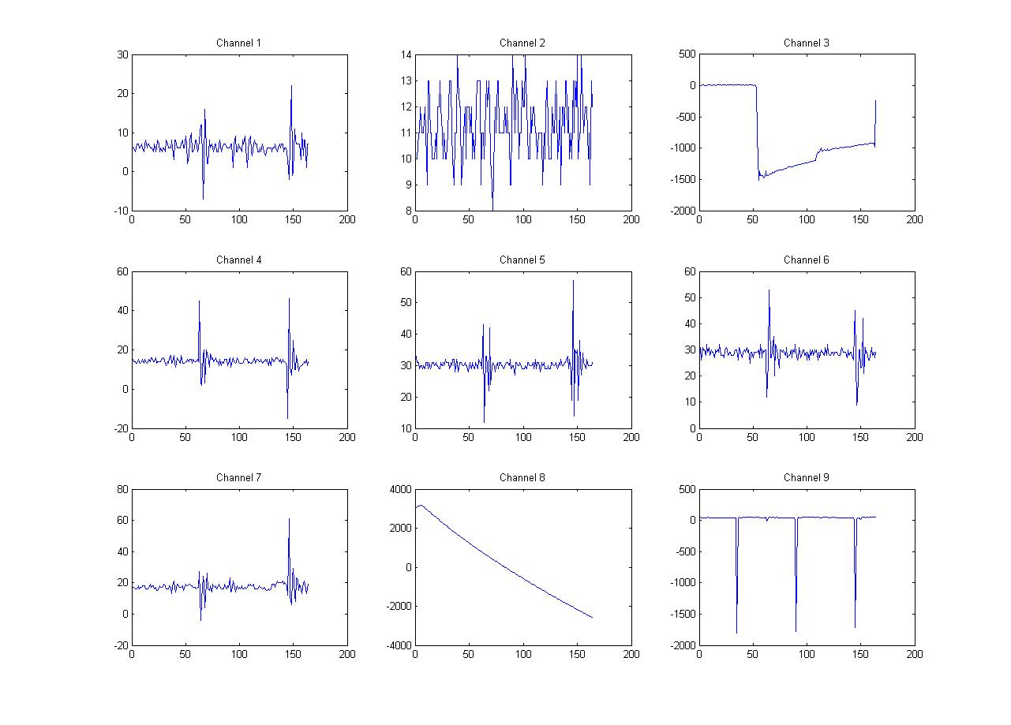
DAC tests
Dif = Ramped AWG output
Sum = DR test bench output
DAC output input to one of the ADCs
Run feedback in uncoupled mode

Slide 8
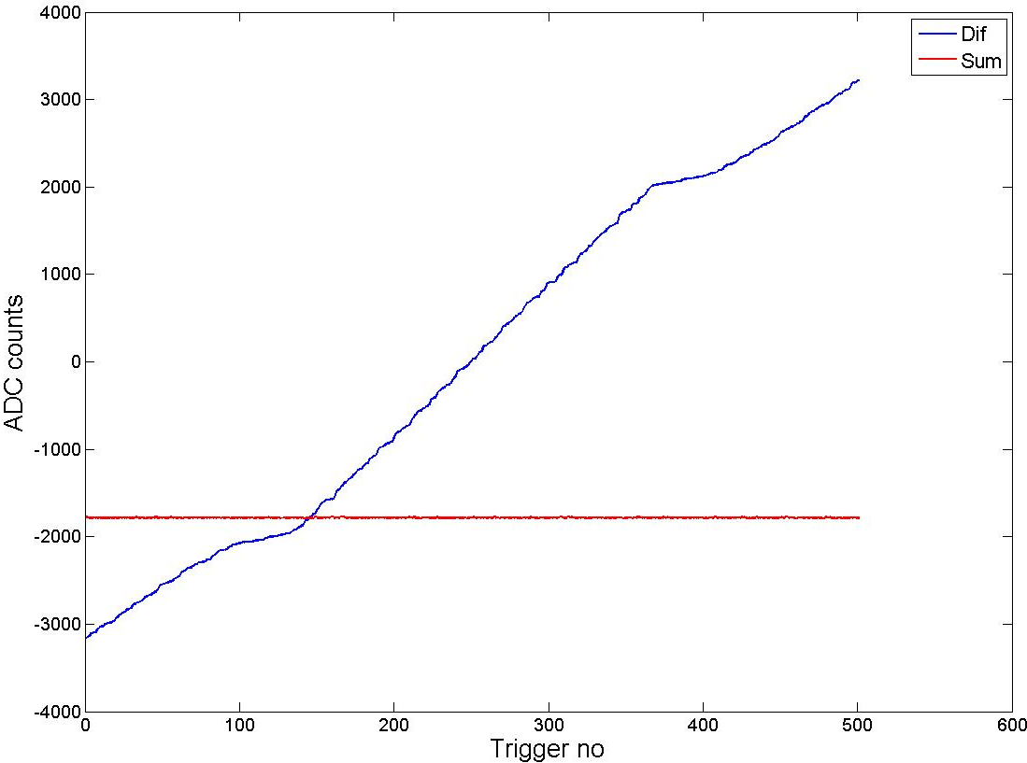
DAC1

Slide 9
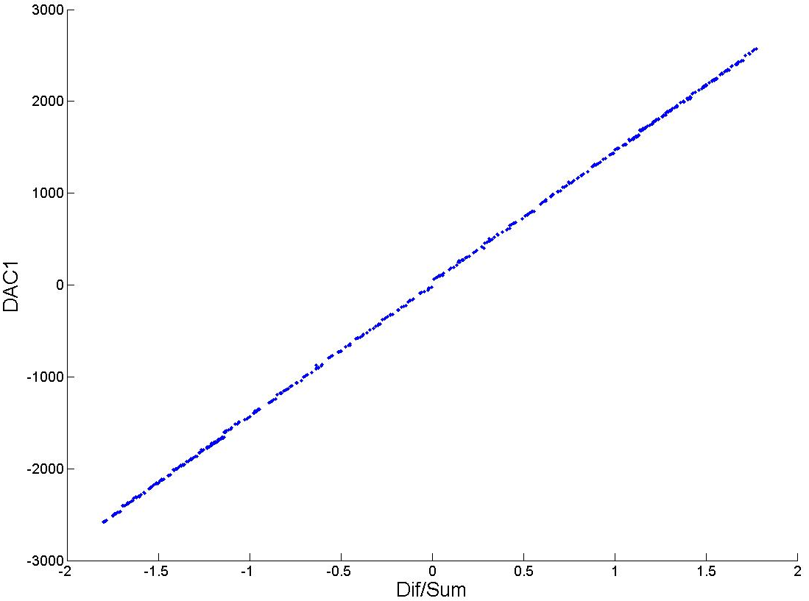
DAC1

Slide 10
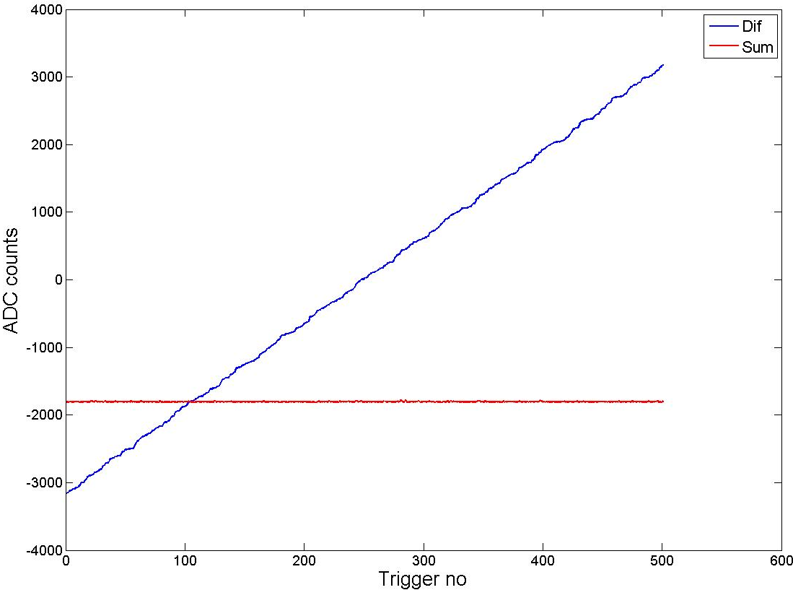
DAC2

Slide 11
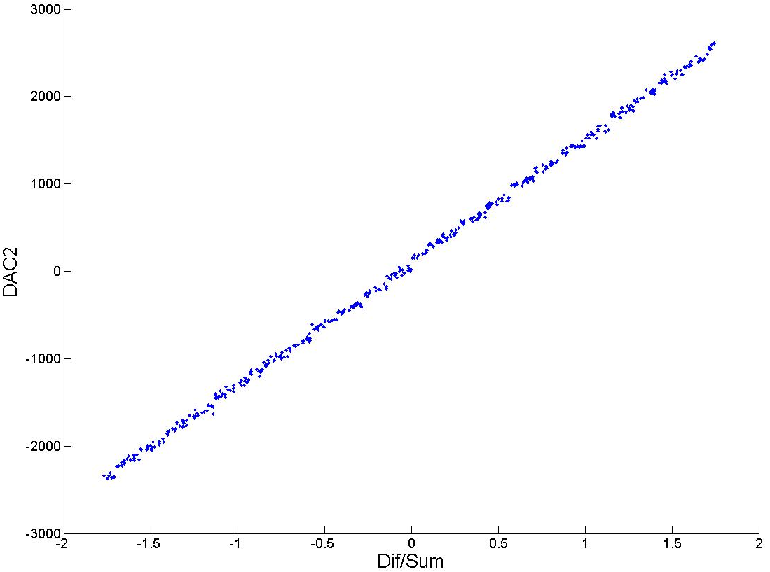
DAC2

