Slide 1
Utilization of Industrial Electron Beam Processing in Order to Optimize Fabrication of SRF Cavities in Larger Quantities
The 2nd Workshop on SCRF Cavity Technology and Industrialization for the ILC
By Ralf Edinger, PAVAC
July 24, 2011, Chicago

Slide 2
Agenda
Introduction
Prototyping versus Production
Cavity structures and methods
EB – Production Systems
Process and weld performance
Machine requirements and solutions
Summary

Slide 3
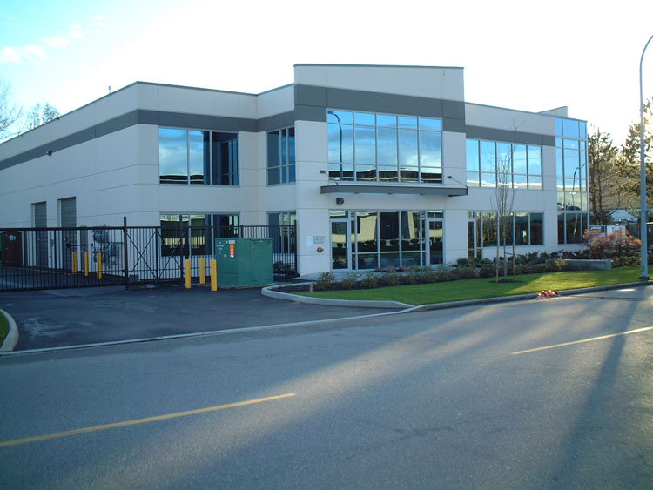
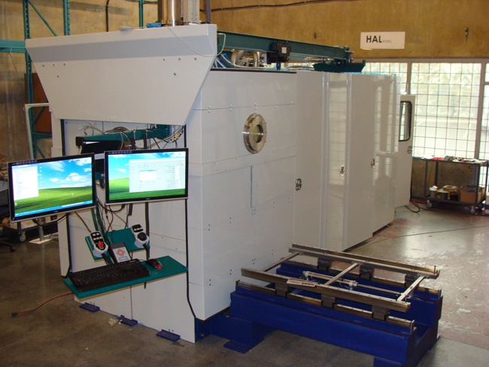
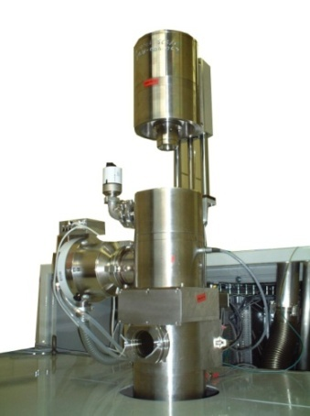
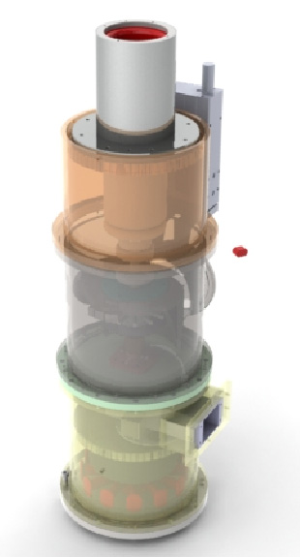
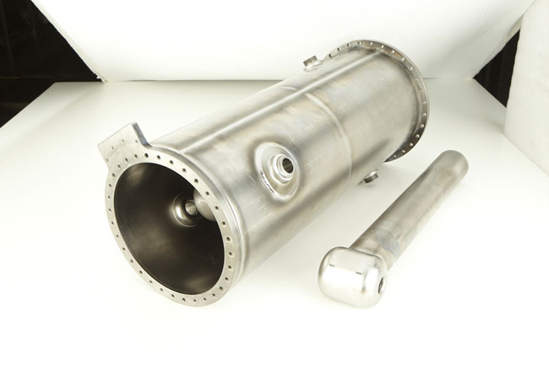
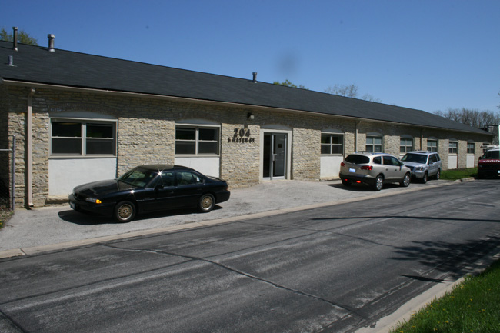
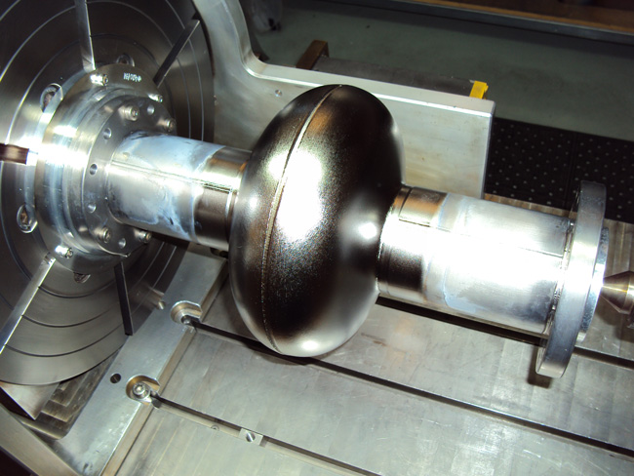
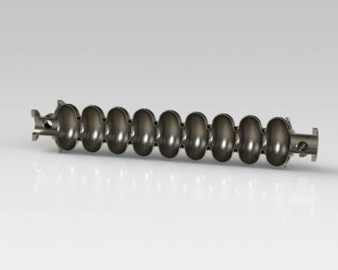
Introduction
PAVAC Industries Inc.
12371 Horseshoe Way, Unit 105
Richmond, BC
V7A 4X6, Canada
Phone 1 (604) 231 0014
Fax 1 (604) 326 9078
Electron Beam
SRF-Cavities
PAVAC produces Electron Beam Machines (EBW, EB-PVD...) and fabricates SRF cavities.
PAVAC Energy Corp.
204 S. Water Street
Batavia, IL,
60510, USA
Phone 1 (630) 326 9012
Fax 1 (630) 326 9078

Slide 4
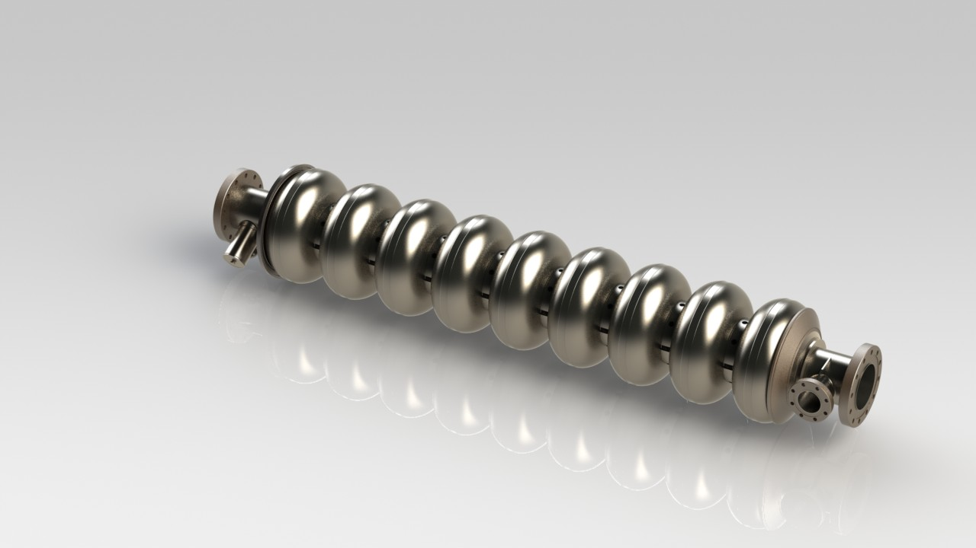
Production Definitions
In hardware design, a prototype is a "hand-built" model that represents a manufactured product to visualize and test the design.
Mass production (or serial production) is the production of large amounts of standardized products.

Slide 5
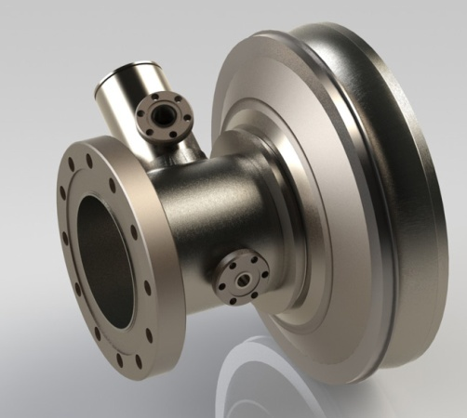
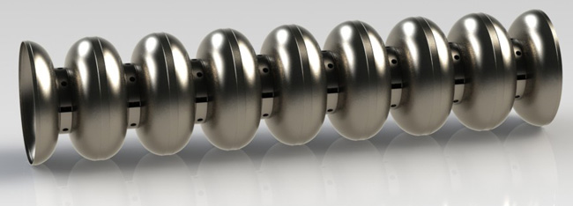
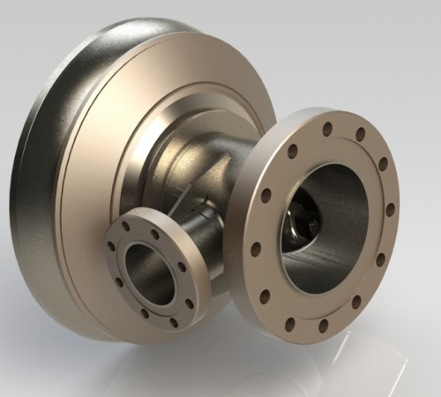
Cavity Structures
Long End Cell:
15 Welds
Center Section:
31 Welds
Short End Cell:
17 Welds
Total EB Welds in a 9 cell cavity: 65

Slide 6
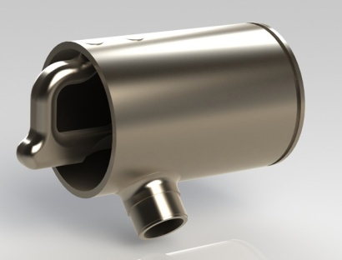
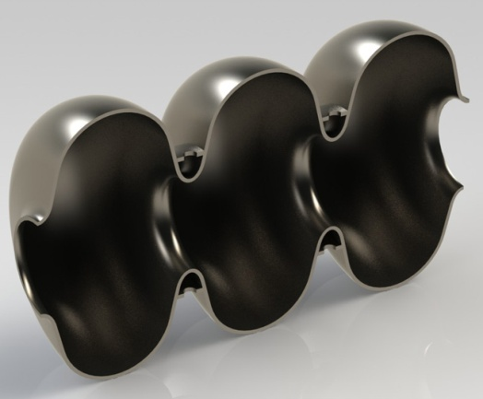
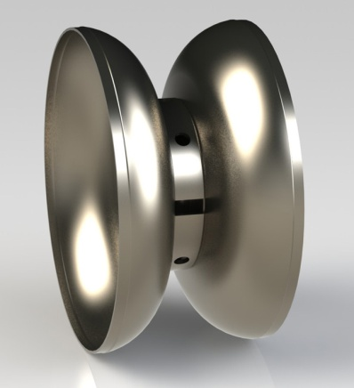
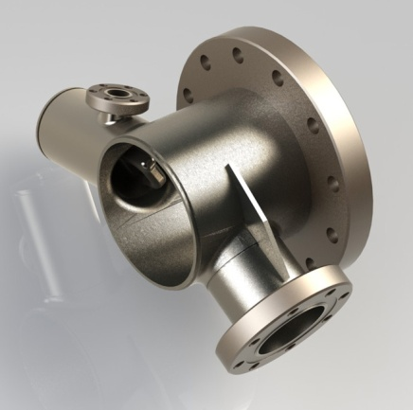
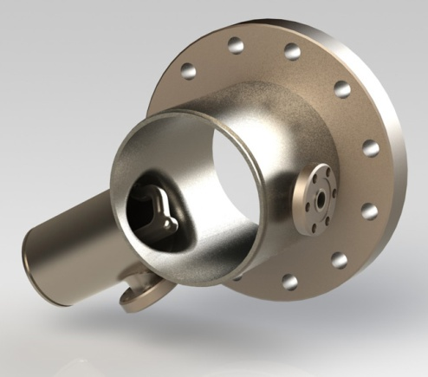
Cavity Elements
HOM
3 x SMARTBELL
DUMBELL
COUPLER TUBE
TUNER TUBE
Simplifying assembly methods and procedure steps
Optimization of fixtures for faster assembly and minimizing alignment errors
Improvement of quality and reduction of cost
Elimination of unnecessary production steps (if possible)

Slide 7
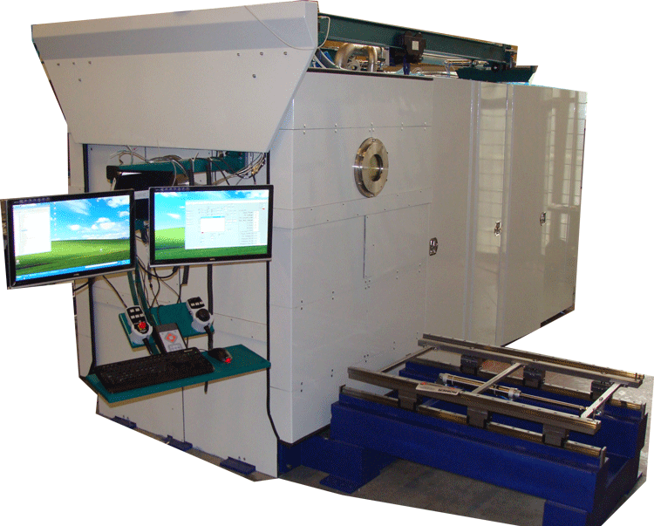
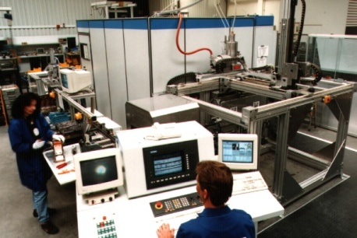
EB - Production Systems
Small – Medium Chamber
70% of 1.3GHz cavity welds
Fast pump down (30sec)
Easy part loading
Short setup times
Operation entry user level
Large Chamber
100% of 1.3GHz cavity welds
Long pump down (30 – 60 min)
Complex part loading
Complex setup
Operation advanced user level
High Speed Production
70% of 1.3GHz cavity welds
No pump down (5-10 sec)
Automatic part loading
Complex setup
Operation advanced user level

Slide 8
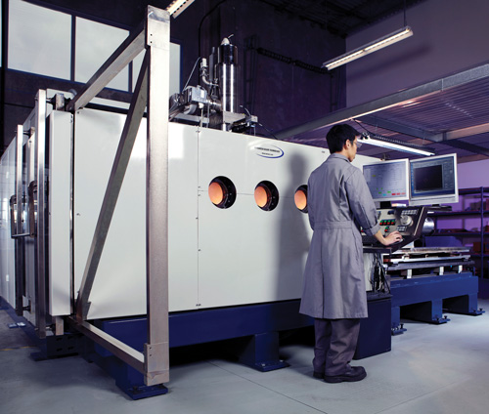
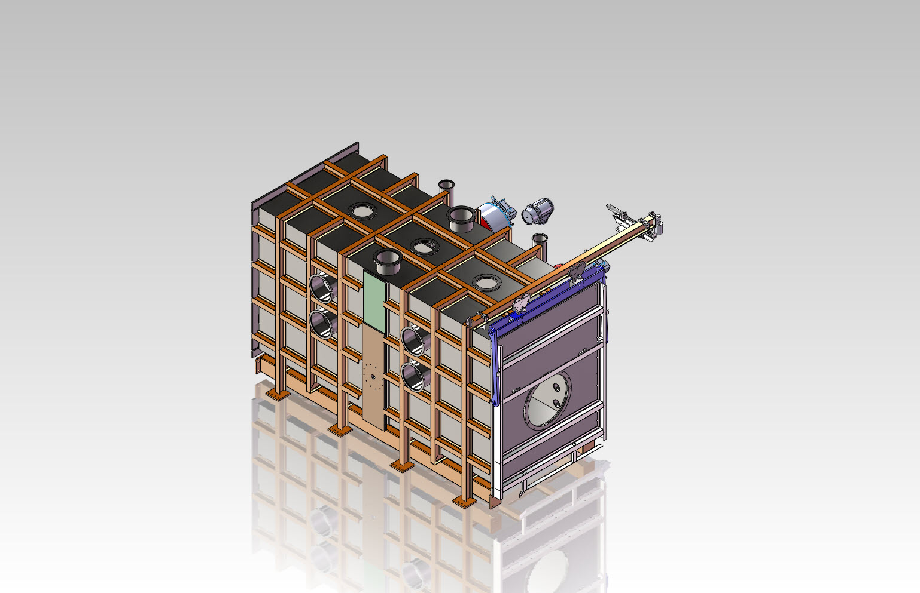
EBW-Large Chamber
Chamber dimension:
Length 3800mm
Height 1950 mm
Depth 1500 mm
Target: Prototype production “fits all needs”
Not designed for fast cycles and short production runs
Operation complex due to flexibility of machine

Slide 9
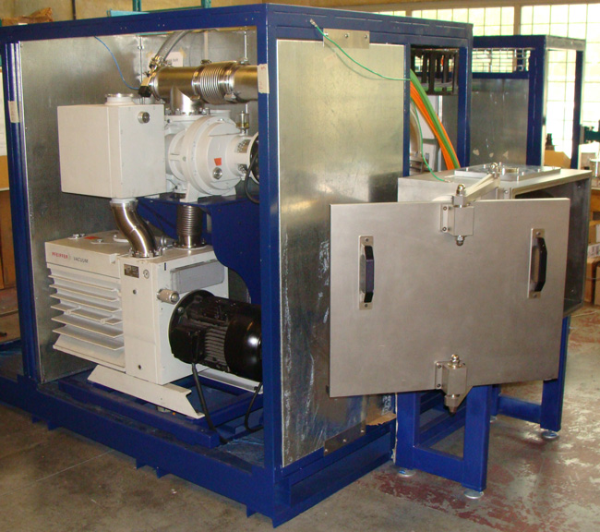
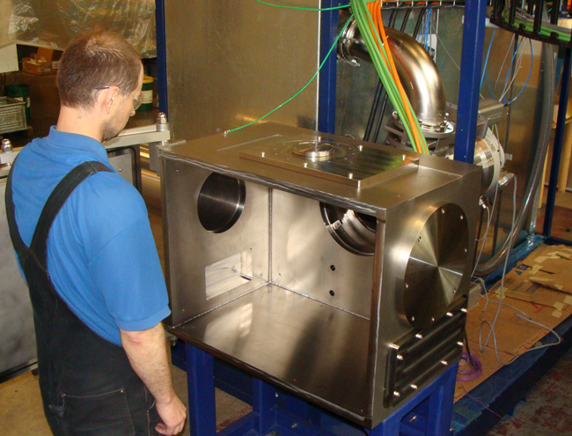
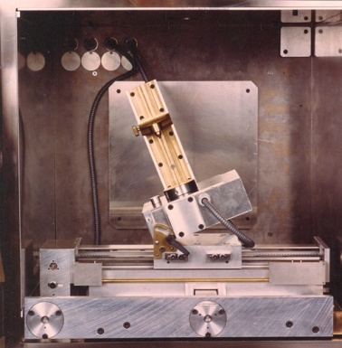
EBW-Medium Chamber
Pump down to weld pressure 30 seconds
Single (simple) task tooling and process controls
Changing setup is easy
Operation entry user level

Slide 10
Process Optimization
 | LARGE CHAMBER |  | MEDIUM CHAMBER
 | COMPLEX PROCESS | SIMPLIFIED PROCESS | SIMPLIFIED PROCESS SPECIAL EBW
LOADING/ASSEMBLY TIME | 120 | 20 | 5
PRE-WELD TEST | 25 | 5 | 2
VACUUM TIME | 60 | 60 | 2
LAST CHECK | 10 | 15 | 2
EBW | 12 | 4 | 4
COOLING | 45 | 10 | 5
AIR | 10 | 10 | 1
UNLOADING | 30 | 5 | 2
MINUTES | 312 | 129 | 23
HOURS | 5.20 | 2.15 | 0.38
For producing cavity elements, a dedicated medium size chamber EBW is more economical in operating costs and capital investment.
Therefore, costs for parts are lower and production yield can be increased due to shorter production time.
Note:
Cavity welds impact each other in complex setups. Thus, more QC checks are required.

Slide 11
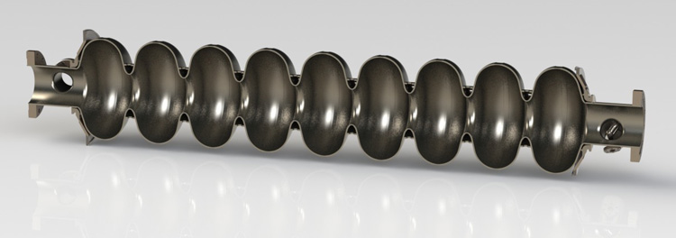
Weld Performance
Weld performance is related to the quality of tools and machines used during production. Some features to consider:
  Machine accuracy and repeatability
  Weld joint detection – tracking

Slide 12
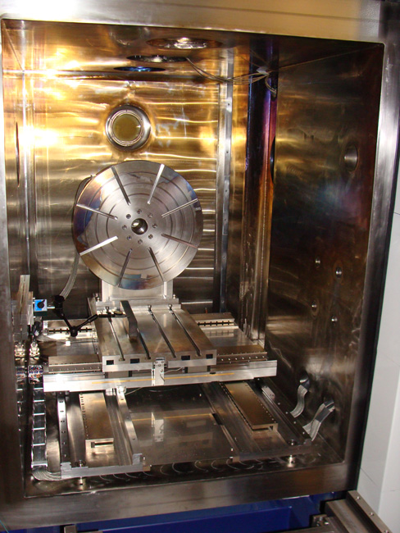
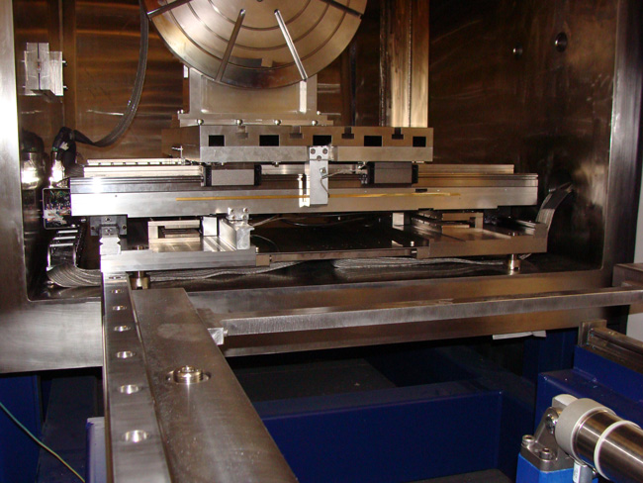
  Accuracy and Repeatability
PAVAC uses AC linear motors combined with linear scales. Linear motors have no contact and, therefore, lubrication is not required.
Linear scales have a resolution of 0.001mm and allow a repeatability of less than 0.005mm.
The increased machine accuracy allows a better positioning of the beam for welding.
In order to form a consistent under bead in cavity areas, the beam requires a positioning accuracy of plus/ minus 0.025mm. Therefore the machine requires for control purposes a 10 times higher process resolution, which is 0.0025mm.
Linear Scales

Slide 13
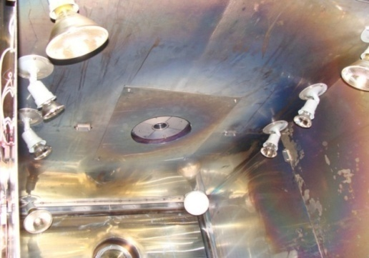
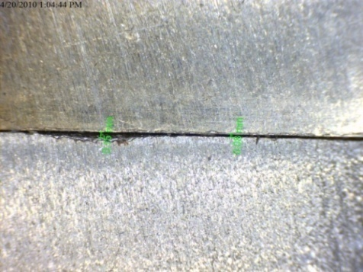
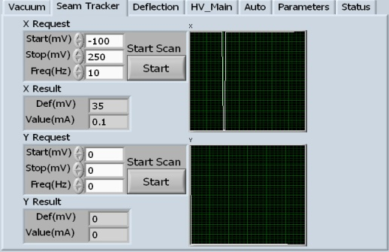
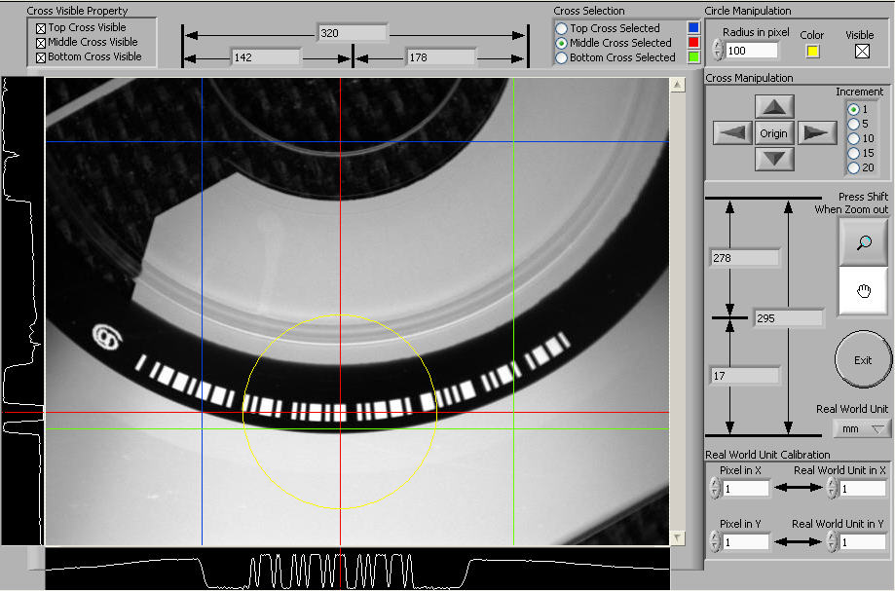
Weld Gap Detection
CCD Camera + Machine Vision
Machine Vision System takes real time CCD images and processes data and displays key information for user.
Reflective Electrons
Seam tracker (electron trap) mounted isolated in chamber
Software analysis the returned electrons and finds the gap.
Under Development
X-Ray Detection
X-Rays from electron beam show structural changes on X- ray chip below weld parts. X- ray image (array) transferred to Machine Vision software for processing.
e
X-Ray CCD

Slide 14
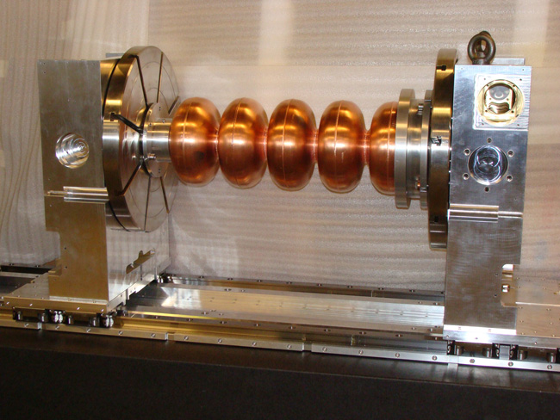
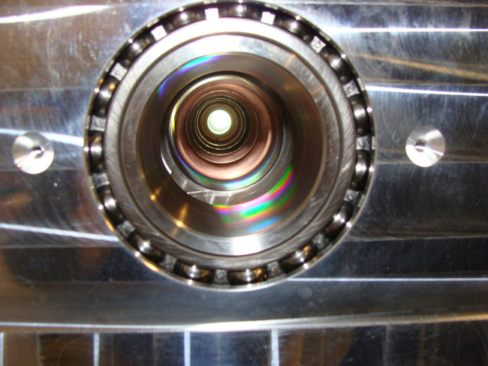
Vacuum Inside Cavity
Smart fixtures for better alignment and faster weld assembly
Vacuum pressure inside the cavity during weld procedures requires optimal tool design

Slide 15
Summary
Prototyping and production strategies differ from each other and require to change machine and process requirements
Single-simple jobs are preferable to complex setups
Production concepts will allow to lower costs for cavity components and increase production yields
PAVAC continues to use its own EBW systems for cavity production and to improve machine functionality

