Slide 1
Preparing RI for the Mechanical Manufacturing and Surface Preparation of 300 XFEL Cavities
Michael Pekeler
RI Research Instruments GmbH
Friedrich-Ebert-Str. 1
51429 Bergisch Gladbach

Slide 2
Core Competences and Markets
Quality Management according to DIN EN ISO 9001:2008, KTA
    Technologie
    RF, Accelerator
    Superconductivity
    Cryogenics
    Vacuum
    Integr. System Control
    Specialized Manufacturing
    Surface Treatment
    System Integration
Products / Services
Linear Accelerators,
RF Cavities, Couplers
SRF Accelerator Modules
Electron and Ion Sources
Beam Diagnostic Elements
Particle Beamlines
Precision Manuf. Components
Markets
Fundamental Physics
Applied Research
Medical/ Particle Therapy
Energy/ Nuclear
Advanced Technology Industry
  Including:
  Inspection,
  Solar,
  Live Science
physics layout – engineering – design – manufacturing – assembly – testing – service
Visit us at the booth and take one of our new brochure to learn more about our capabilities and accomplished projects. RI is a project oriented company.

Slide 3
RI Research Instruments GmbH
Company Organisation (January 01, 2011)
Managing Directors Dr. Michael Peiniger
Hanspeter Vogel
Dr. Burkhard Prause
Secretary Heidi Lohmar
Operational Safety
Stefan Bauer
Quality Management
Michael Kitzig
Business
Superconducting RF,
Cryogenics,
Special Manufacturing Projects
Dr. Michael Pekeler
Marketing
Sales
Engineering
Project Management
Business
Normal Conducting RF,
Accelerators,
Systems
Dr. Christian Piel
Marketing
Sales
Engineering
Project Management
Manufacturing
Stefan Bauer
Manufacturing Logistics
Turning
Milling
Electrical
Surface Treatment
Joining Technology
Assembly, Testing
Finance
Tassilo Börner
Accounting/
Finance Control
Commercial
Project Management
Human Resources
IT/Systems
Engineering Design
Dr. Kai Dunkel,
Dirk Schmitz
RI employs about 100 people, 60 manufacturing specialists, 30 physicists and engineers, 10 employees with administrative or commercial/financial duties

Slide 4
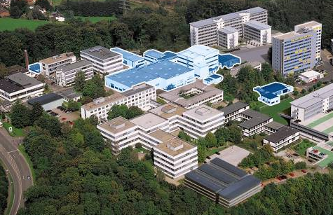
RI Research Instruments GmbH, Bergisch Gladbach
Advanced Technology Devices and Turn-Key System Supplier for Research, Industry and Medical worldwide
A former activity of ACCEL Instruments GmbH
51% of shares by Bruker EST, Inc.
Management holding a significant equity stake of the company
More than 25 years history in superconducting and normal conducting RF cavity manufacturing through Siemens, ACCEL and RI
RI Research Instruments GmbH
at the Technologiepark Bergisch Gladbach, 15 km away from Cologne

Slide 5
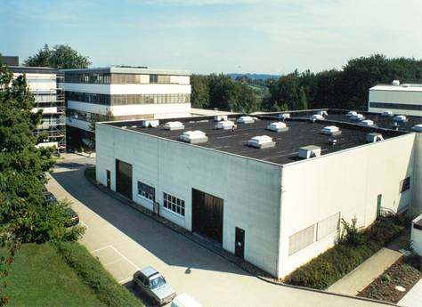
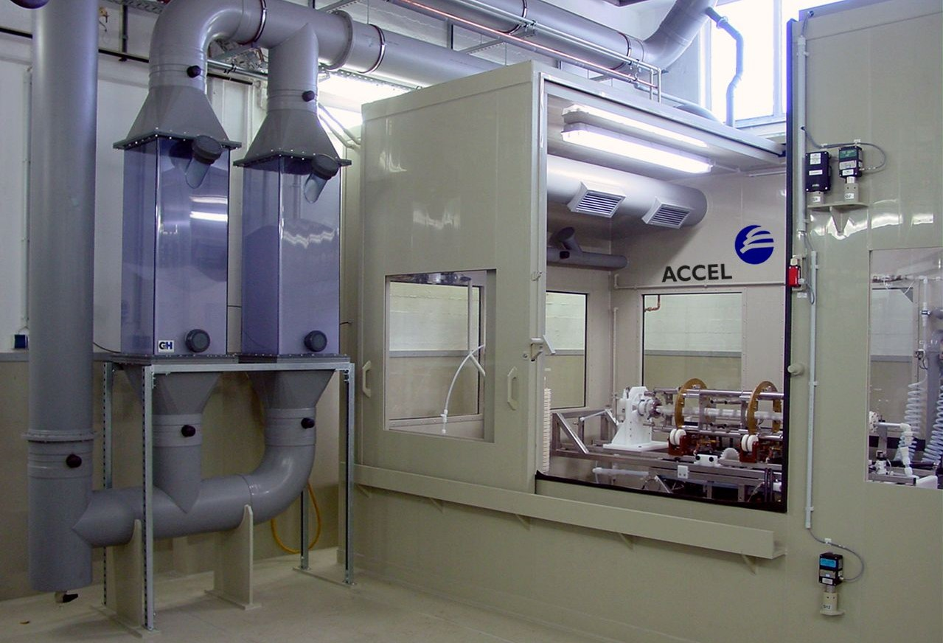
Manufacturing premises of RI (before XFEL project)
2 Electron beam welding machines
2 Vacuum brazing furnaces
11 Turning machines
10 milling machines
1 clean room class 100 (40 sqm)
Assembly space (1500 sqm)
Leak checking
Pressure test
RF measurement and tuning
Cold test facility (1 MeV)
TIG welding
3 US degreasing bathes
1 BCP facility
1 EP facility
Main building for turning, milling, brazing, EB welding, assembly, clean room, RF measurments, dimensional control, leak check

Slide 6
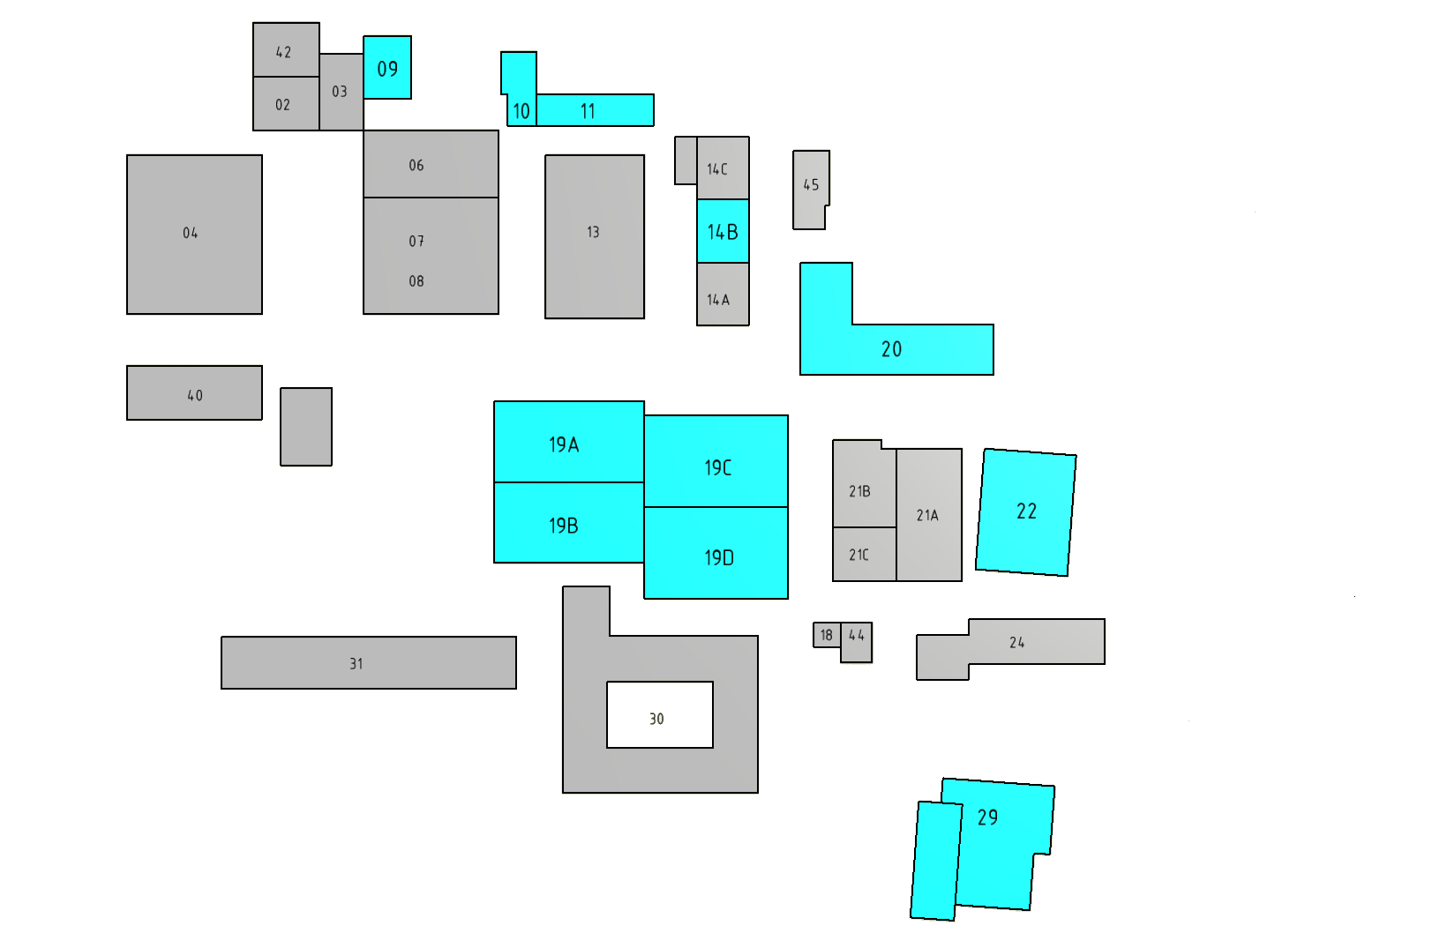
Buildings rented by RI at the Technology Park in Bergisch Gladbach
FAT of cryo modules
BCP plant
Grinding facility
14 B TIG welding
19 A Turning
19 B Milling, dimensional control
19 C RF measurement, other assembly
19 D Brazing, EB, 800ºC , leak test
20 Office
22 Receiving, storage
EP, degreasing, grinding

Slide 7
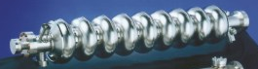
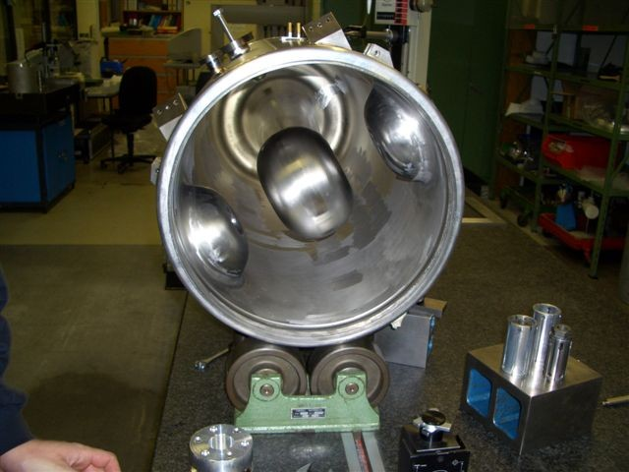
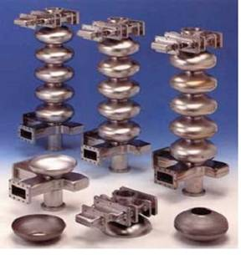
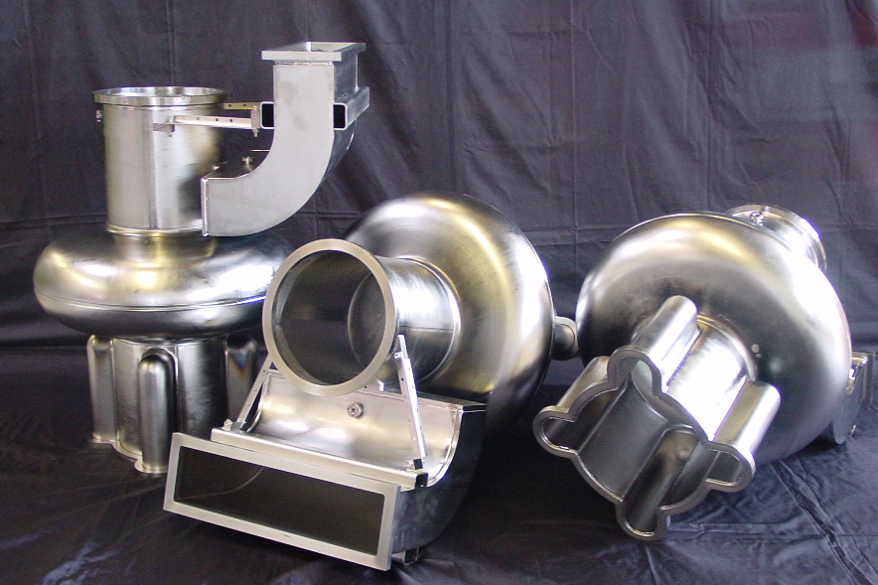
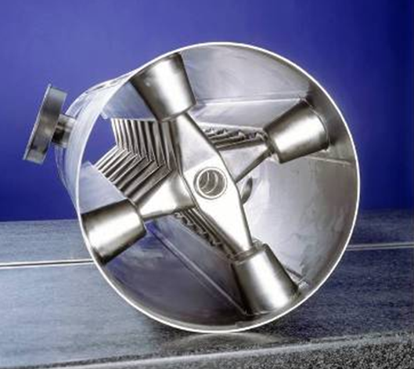
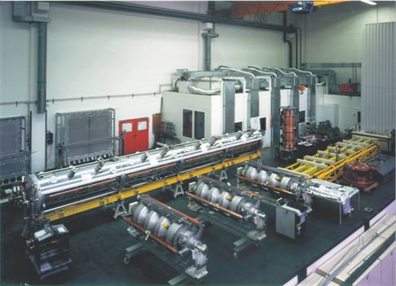
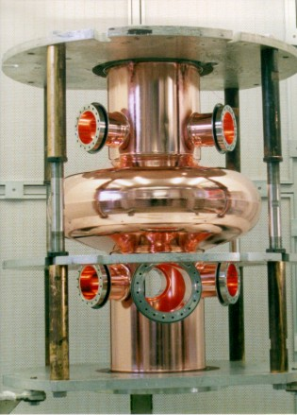
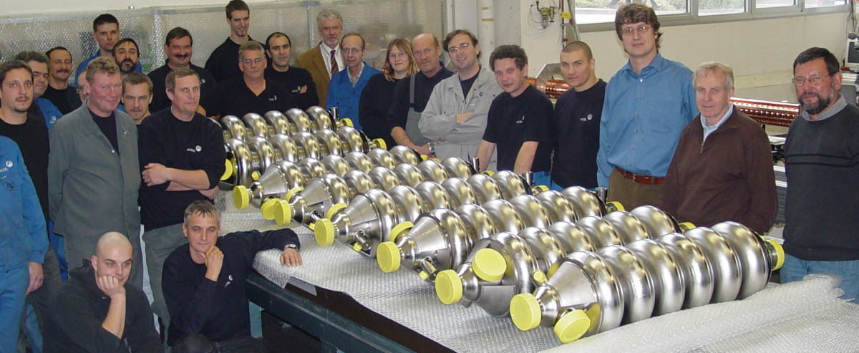
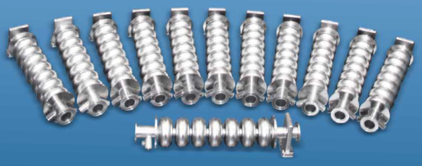
Superconducting cavities – prototypes, small series, larger series production
1200 SRF Cavities produced so far, about 40 SRF cavities/year in average over the last 25 years

Slide 8
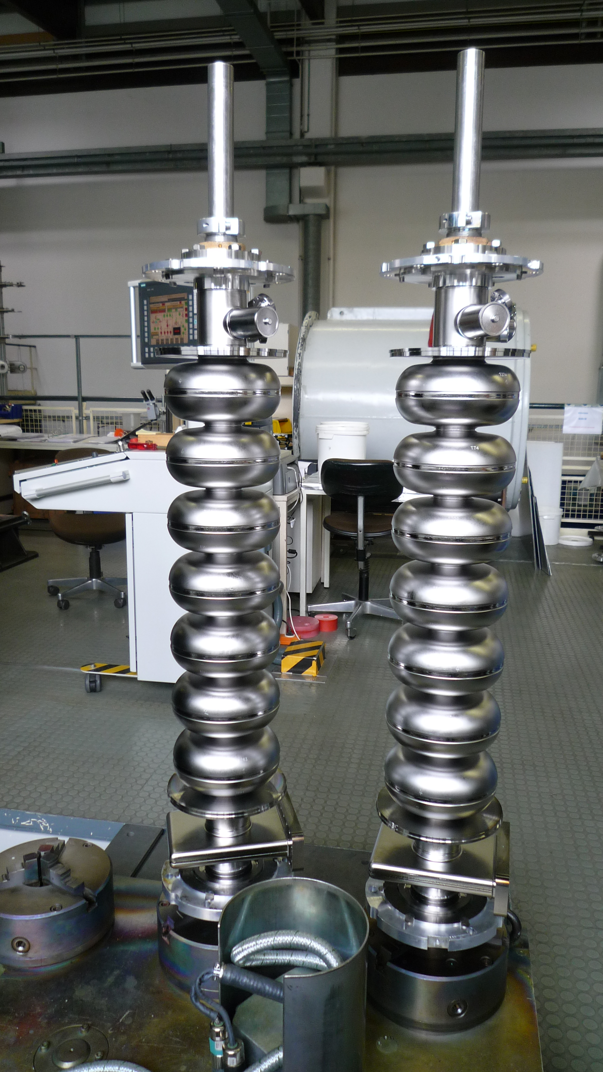
RI production capability for JLAB upgrade cavities
RI’s scope included purchasing of niobium, cavity manufacturing, bulk chemistry and RF tuning (fundamental mode and HOM couplers).
RI received an order for 86 pieces 1.5 GHz 7-cell cavities in July 2009
The niobium was at RI premises in November 2009.
Original schedule:
First article to be delivered in June 2010, last cavity to be delivered middle of 2011
Achieved schedule:
First article delivered July 2010, 84 cavities delivered in November 2010, one year after niobium supply, 2 last cavities delivered in March 2011 (lack of niobium material, additional material had to be ordered for the last two cavities).
Schedule improved by 2 shift operation on turning, milling and electron beam welding machines.

Slide 9
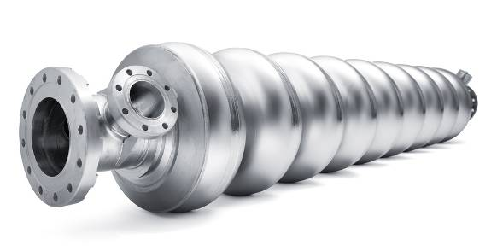
European XFEL cavity production at RI
Order for 300 cavities received from DESY in September 2010
Niobium and
helium vessel supplied by DESY
RI scope:
Mechanical manufacturing of cavity, respecting the pressure vessel code
Complete Surface preparation and helium vessel welding
Shipping to DESY under vacuum and “ready for vertical test”
Extensive documentation and QA is crucial and will ensure that cavities are manufactured and treated according to detailed DESY specification. No performance guarantee.
DESY:
Cavities will be cold RF tested at DESY (vertical test) with helium vessel already welded
After successful test, DESY will ship the cavities under vacuum to CEA for module assembly

Slide 10
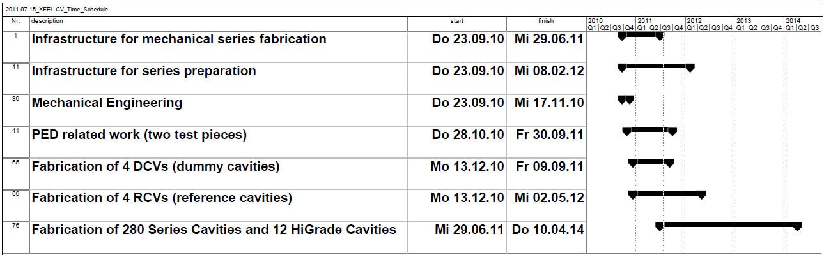
European XFEL cavity production time schedule
Two test pieces for pressure vessel qualification
Four dummy cavities stay at RI for implementing infrastructure
Four reference cavities, will be treated and tested at DESY first, if test is ok, then mechanical manufacturing of series cavities can start. The reference cavities will then be retreated by RI in RI infrastructure. If test also ok, the series surface preparation can start
Status: Dummy and reference cavities on track
First series material will arrive End of July at RI
Mechanical Infrastructure finished
Infrastructure for series preparation on schedule

Slide 11
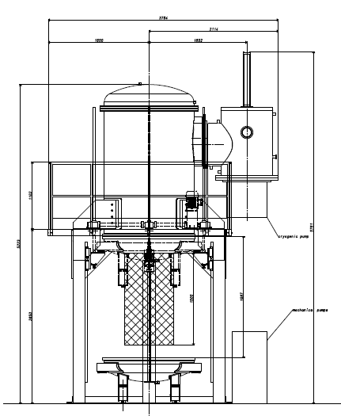
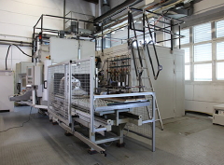
New infrastructure at RI for XFEL production
60 kV EB welder from Pro Beam
Replaces our old small EB welder
Pallet system
Lock chamber (1E-3 mbar)
Weld chamber (1E-6 mbar)
Turbo pumps
800°C all metal annealing furnace
from TAV, Italy
Diameter 800 x 1500 high
4 cavities in vertical position per run
Cryo pump
One more turning machine
One more milling machine
Two 120°C baking chambers
4 pumping stations including RGA for SRF cavities and dry leak checker
Tuning machine and HAZEMEMA (half cell measurement machine) supplied by DESY

Slide 12
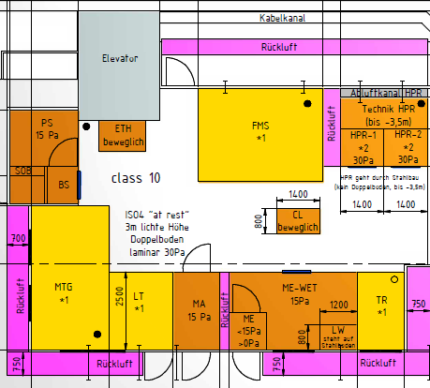
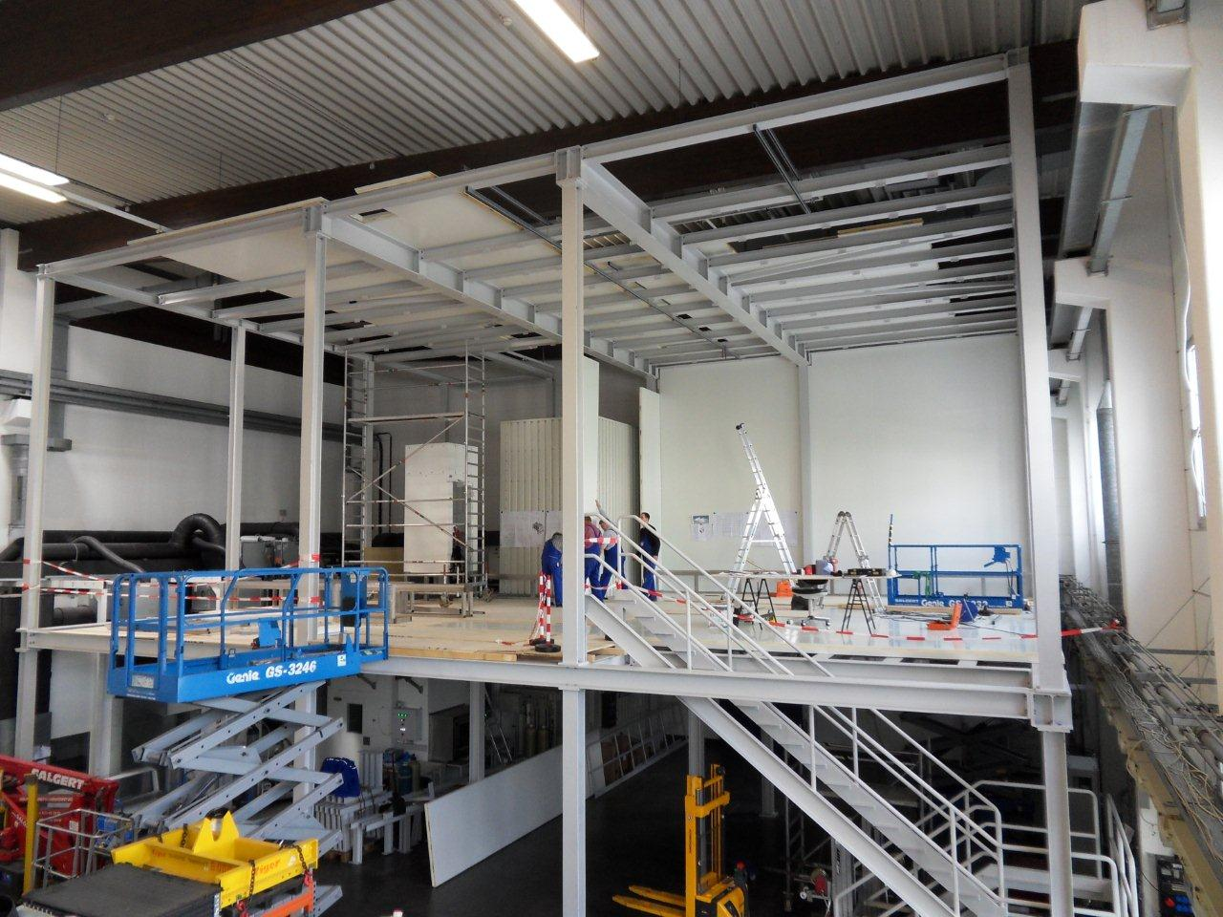
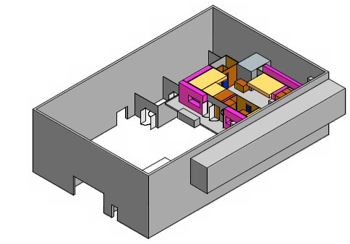
New clean room at RI for XFEL cavity surface preparation
120 sqm ISO4 clean room
2 HPR systems including UPW system
2 assembly spaces
1 leak checking area
2 rinsing stations
1 ethanol rinse
1 personal lock
1 area for cavity drying

Slide 13
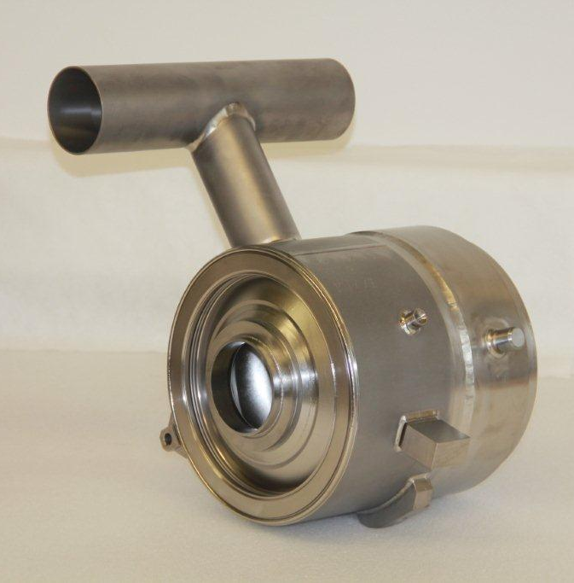
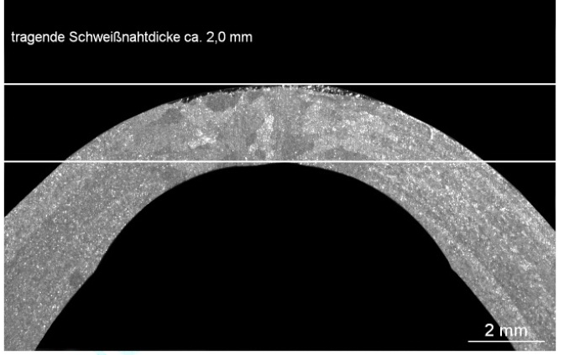
Test pieces for pressure vessel code verification
The cavity must be produced according to European pressure vessel code
DESY and TÜV Nord have worked out a „simple“ qualification procedure
Test piece (2 cell with helium vessel, without end groups), representing all pressure bearing parts is built using exactly the same manufacturing methods and welding parameters, that will be later used in the series production
Test piece parts are dimensional controlled and welds are inspected by X-rays, visual control and leak check (witnessed by TÜV Nord)
Pressure test
Cut test piece, micrographs of welds by TÜV Nord.
During the series, RI applies exactly the same welding procedures as during the test piece production
TÜV Nord might want to inspect some welds by visual control
Pressure test on cavities might be witnessed by TÜV Nord.
RI will produce 2 test pieces:
Test piece one: EB welding machine 1 and TIG welder 1
Test piece two: EB welding machine 2 and TIG welder 2
First test piece finished
Micrograph of test piece iris weld

Slide 14
The XFEL cavity
surface preparation recipe
1
Outside BCP
Weighting, US-degreasing, Electropolishing (110 µm), rinsing
Cleanroom (1 x HPR, ethanol rinse, drying, weighting)
800 °C annealing
Tuning
Electropolishing (40 µm), rinsing
Cleanroom (1 x HPR, ethanol rinse, assemble blank flanges, leak check, 6 x HPR, drying, install FMS (field measurement system), leak check)
Check field profile (ev. tuning)
EB welding of ring and bellow
TIG welding of helium vessel
Cleanroom (disassemble FMS, install antennas (pick-up, HOM. High Q for vertical testing), leak check, 6 x HPR, assemble last flange, leak check and RGA
120°C baking, leak check
Transport under vacuum to DESY for vertical test
10
3
7
12
11
8
5
4
9
6
2
6 Transports between RI buildings necessary

Slide 15
Outlook: Mechanical manufacturing
and surface preparation capabilities
 | XFEL |  |  |  | post XFEL
Recources (mechanical) | Shifts | Working days | For 200 cavities/year | Installed at RI for XFEL | Shifts | Working days | For 600 cavities/year | Additional needed at RI
Turning machine | 2 | 5 | 5 | 5 | 3 | 7 | 7,5 | 3
Milling machine | 2 | 5 | 1 | 3 | 3 | 7 | 1,5 | -
Dimensional control place | 2 | 5 | 1 | 3 | 3 | 7 | 1,5 | -
Metal working station | 2 | 5 | 1 | 3 | 3 | 7 | 1,5 | -
BCP barrel | 2 | 5 | 1 | 1 | 3 | 7 | 1,5 | 1
Degreasing bath | 2 | 5 | 1 | 3 | 3 | 7 | 1,5 | -
EB welding machines | 2 | 5 | 1,5 | 2 | 3 | 7 | 2,5 | 1
Leak checker | 2 | 5 | 0,5 | 3 | 3 | 7 | 1 | -
RF control | 2 | 5 | 0,5 | 1 | 3 | 7 | 1 | -
Grinding place | 2 | 5 | 0,5 | 2 | 3 | 7 | 1 | -
Press | 2 | 5 | 0,5 | 2 | 3 | 7 | 0,5 | -
 | XFEL |  |  |  | post XFEL
Recources (preparation) | Shifts | Working days | For 200 cavities/year | Installed at RI for XFEL | Shifts | Working days | For 600 cavities/year | Additional needed at RI
Degreasing bath (clean room | 2 | 5 | 1,5 | 2 | 3 | 7 | 2,5 | 1
Ethanon rinse | 2 | 5 | 0,5 | 1 | 3 | 7 | 1 | -
BCP outside bath | 2 | 5 | 0,5 | 1 | 3 | 7 | 1 | -
Leak check station, clean room | 2 | 5 | 1 | 1 | 3 | 7 | 1,5 | 1
Tuning machine | 2 | 5 | 0,5 | 1 | 3 | 7 | 1 | -
Clean room assembly | 2 | 5 | 2 | 2 | 3 | 7 | 3 | 1
EP station | 2 | 5 | 1 | 1 | 3 | 7 | 1,5 | 1
800 °C oven (4 cavities per run) | 3 | 7 | 0,5 | 1 | 3 | 7 | 1,5 | 1
HPR | 2 | 5 | 2 | 2 | 3 | 7 | 3 | 1
Drying places | 2 | 5 | 4 | 8 | 3 | 7 | 12 | 4
EB welding | 2 | 5 | 0,5 | 0,5 | 3 | 7 | 0,5 | -
120°C Oven | 3 | 7 | 2 | 2 | 3 | 7 | 3 | 1
Leak check, pressure check | 2 | 5 | 0,5 | 1 | 3 | 7 | 0,5 | -
TIG welding | 2 | 5 | 1 | 1 | 3 | 7 | 1,5 | 1
Basis : 75% on time

Slide 16
Challenges in mechanical
Manufacturing and surface treatment
Mechanical manufacturing
All working steps are good established at RI (about 100 cavities produced before within the last 15 years)
The main resources for mechanical manufacturing are:
Turning, EB welding, BCP and degreasing and grinding before EB welding
There are 62 EB welds and 75 different turning steps on the XFEL cavity
This work has to be piped through limited turning machines and only 1 or two EB welding machines
Therefore logistics to generate a constant cavity output is the main challenge beside keeping the quality standards high in two or three shift operation
Surface preparation
Not so much experience with the individual preparation steps at RI
Close collaboration with DESY during the first preparations of reference cavities and series cavities is mandatory
The work flow through the different stations and the clean room seems to be smooth, logistics manageable (diploma work in progress, mechanical engineering production planning, Fachhochschule Aachen)
The main challenge will be to establish and maintain a high quality of the work and find the right parameters to measure and control the quality

Slide 17
Summary
RI is good prepared for XFEL cavity production
Infrastructure for mechanical manufacturing is completed
Infrastructure for surface preparation will be installed at the end of the year
One test piece for pressure vessel code is finished, second running, dummy cavities and reference cavities mechanically finished in September
First material for series fabrication expected end of this month from DESY
Upgrade to 600 cavities per year production seems possible, requires probably 24/7 operation
Experience learned from XFEL production will be very fruitful for future even larger scale projects like ILC

Slide 18
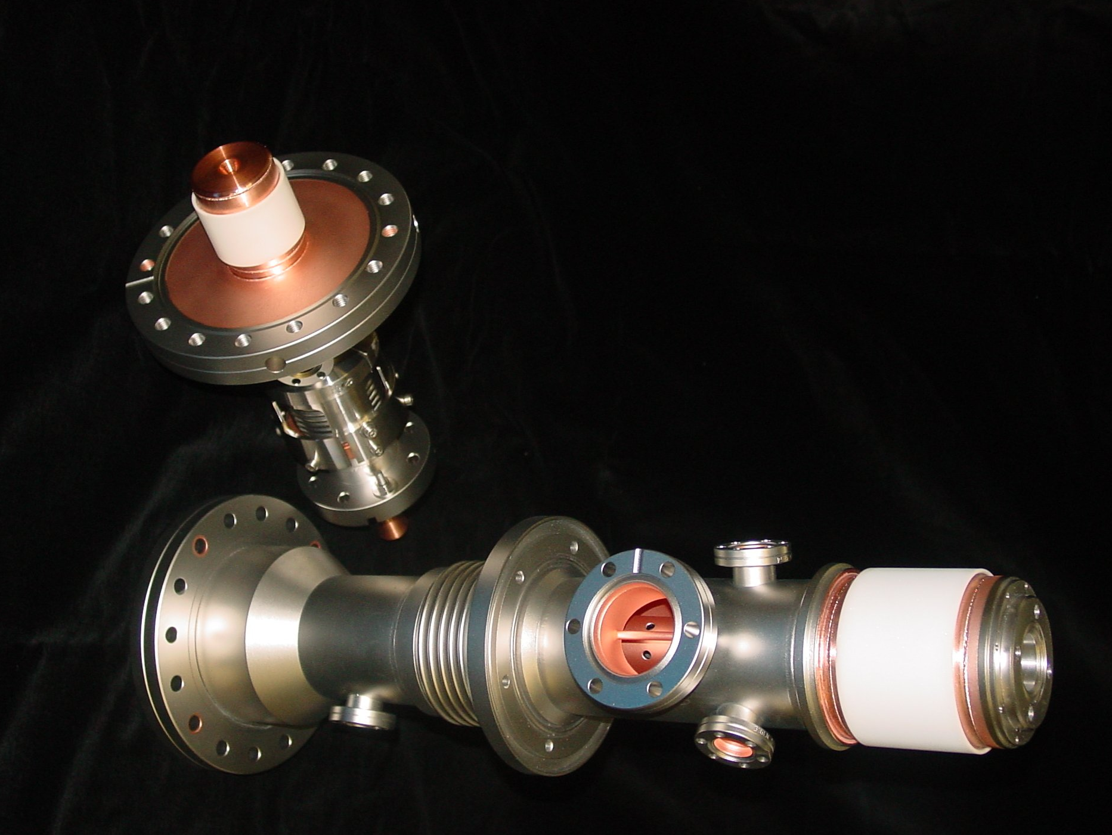
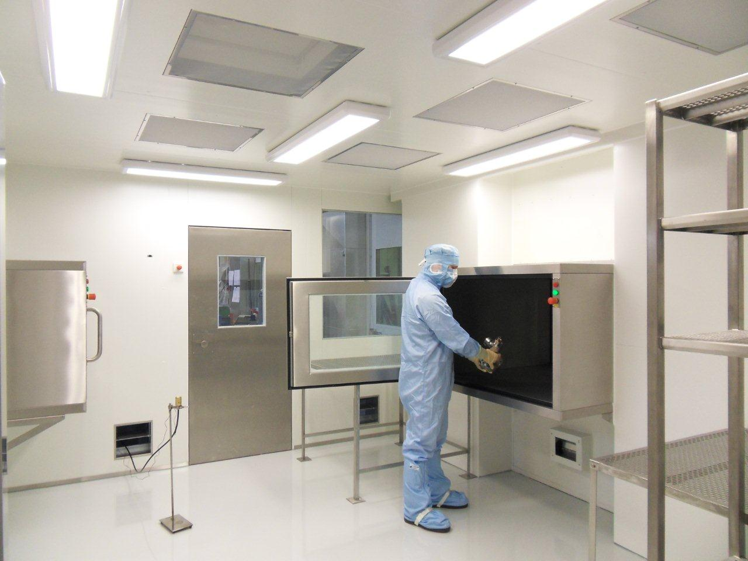
Production of RF couplers for European XFEL
The consortium TED/RI will produce all couplers for the XFEL.
The contract was received from LAL, France in July 2010.
Working share between RI and TED:
TED: Mechanical manufacturing and copper plating of outer and inner conductors
RI: Mechanical manufacturing of ceramic windows (brazing, TiN coating), EB welding of cold and warm part (windows with outer and inner conductors)
RI: push rod, waveguide box
TED: capacitor, tuning drive
RI: Clean room assembly for RF conditioning
The RF conditioning of the couplers is done at LAL
New ISO 4 clean room for coupler cleaning and asembly
TTF III coupler produced in 2007

