Slide 1
DR BTR Close Out
“All our final decisions are made in a state of mind that is not going to last.”
Marcel Proust

Slide 2
The TDR Baseline
Scenarios to consider (definition)
  5 Hz “standard running” nb = 1312 bunches
  10 Hz “alternate mode” nb = 1312 bunches
Luminosity upgrade scenario
  5 Hz running with nb=2625 bunches
3.2 km ring
  baseline: two rings (electron / positron) space + mandatory CFS support for a third
  luminosity upgrade: construct second e+ ring (if needed)
Already decided TLCC

Slide 3
The TDR baseline
Lattice: DTC1 ring (based on TME cell)
All e-cloud proposed mitigation techniques for positron ring
  electron ring vacuum likely to diverge
  design work focus on positron ring (resources)
  do some simulation work for e- ring (tune footprint)
  Evaluate cost-breakdown for e+ ring vacuum solution once available
    what can we leave out for e- ring

Slide 4
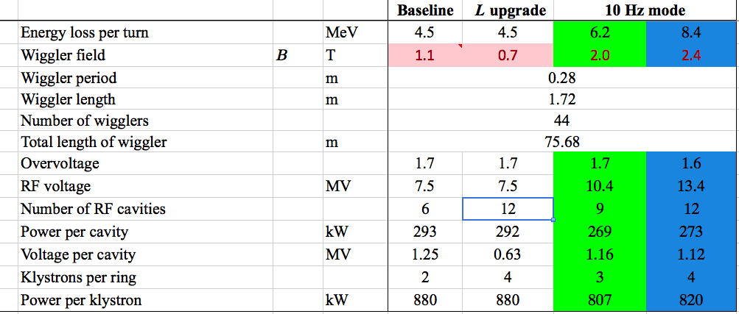
TDR Baseline
Needs update
See next slide
RF Parameters (ILC-EDMS)
based on Guiducci presentations from BAW-2 and ALCPG’11

Slide 5
DTC lattice parameters options
Significant change from previous slide

Slide 6
RF Parameters
For design work (remainder TDR) focus on 12 cavities solution
  lumi upgrade
  10Hz operation
Final cost (and parameter!) adjustments to be made in October
  Likely we will downgrade cavity/klystron count to support only 1312 bunches
  scale cost accordingly
  Additional cavities/klystrons for 2625 bunches will be added during upgrade.
CFS baseline must include support for upgrade in initial construction
  Large tunnel
  Mechanical / electrical CF

Slide 7
CFS Criteria
Initial estimates have been made
  Based on ‘high power’ requirement ring, three rings?
  criteria / drawings in EDMS
Outstanding: power/cooling requirements for DC bus solution
  First estimate mid-August (meeting at FNAL)
  AC power distribution (alcoves) needs review
CFS civil cost by end of July 2011
Second iteration (review) Jan/Feb 2012
  scale requirements/costs as required

Slide 8
Costs
Nearly everything by October 2011
Vacuum system early 2012
  depends on availability of KEK-B estimates/numbers
Magnets – based on existing models
  assume the bores remain the same as in RDR
  supports?
DC bus system
  Conceptual estimate exists for 6km ring
  Need help from P. Bellomo to update
Instrumentation – addition of vacuum will change
RF costs – needs review of unit estimates!

Slide 9
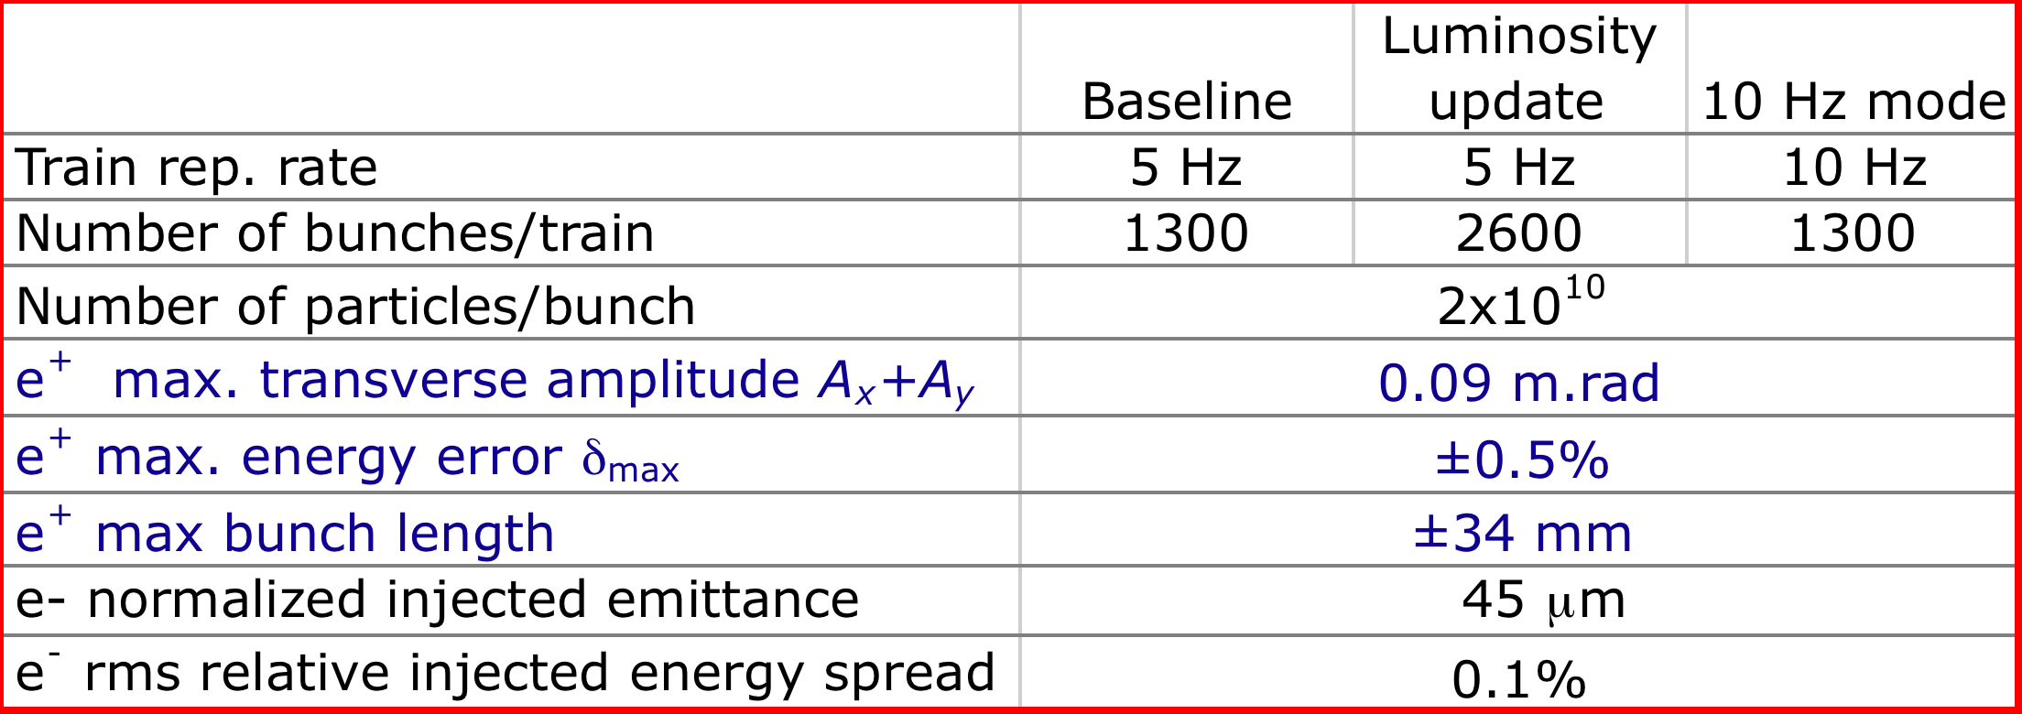
e+ longitudinal acceptance
From RDR
Check with positron source

