Slide 1
FONT5 Board Tests
D. R. Bett

Slide 2
Summary of Tests
ADC noise tests (boards #1 and #2)
Sample number vs. ADC counts
Low signal level ADC test
5 MHz ramp @ 50 mV
Histogram of measured samples
DAC tests
Custom firmware to ramp DAC output
Trim DACs

Slide 3
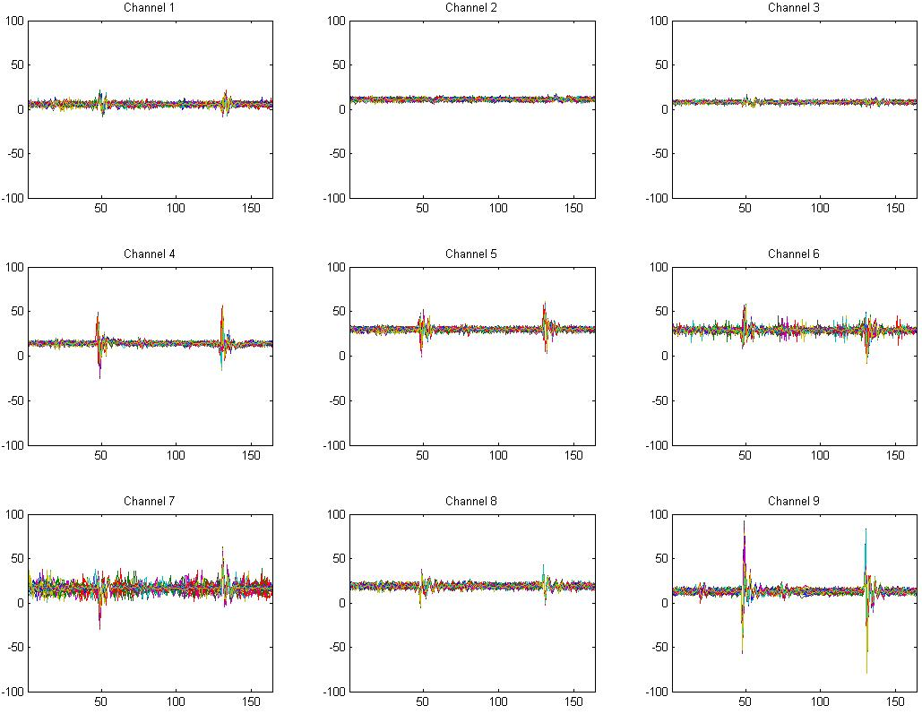
Board #2 – no inputs, 250 triggers

Slide 4
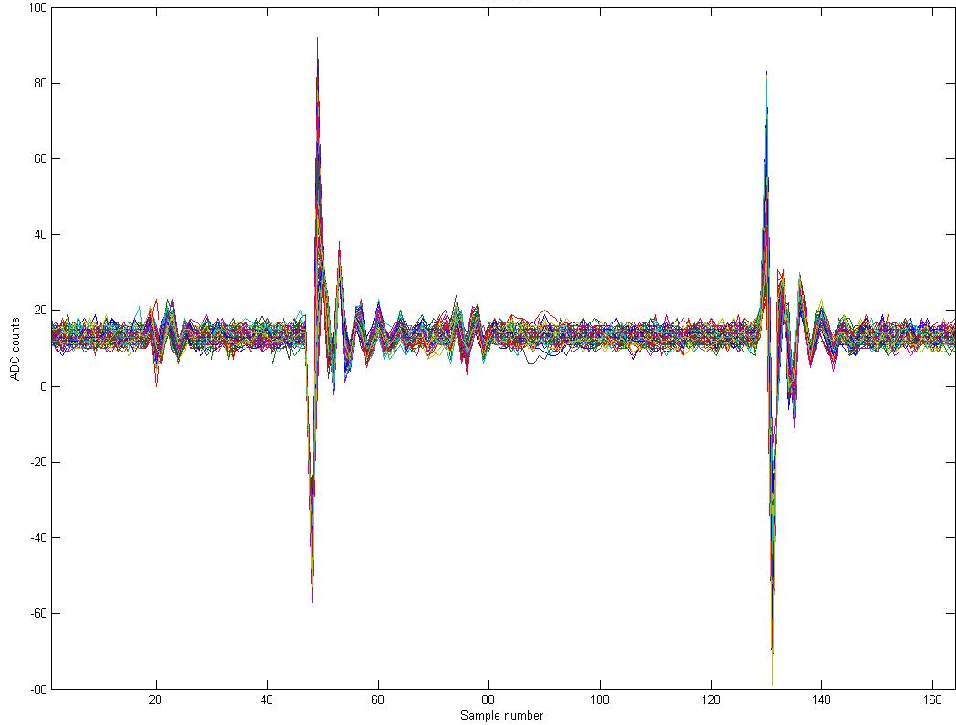
Board #2 – Channel 9

Slide 5
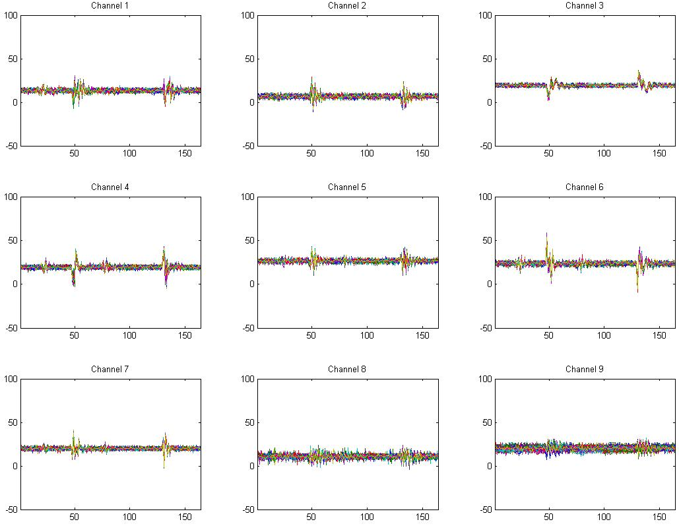
Board #1 – no inputs, 250 triggers

Slide 6
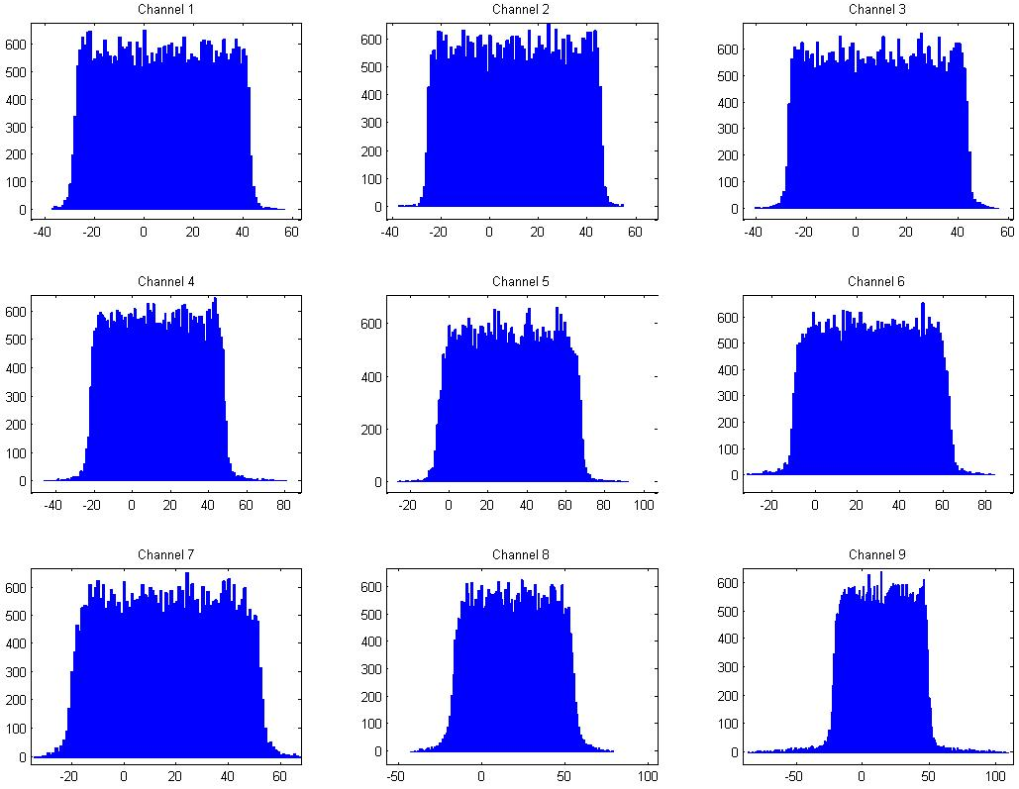
Board #2 – 5 MHz ramp @ 50 mV

Slide 7
DAC Tests (Board #2)
Custom firmware with ChipScope interface
DAC ramped according to parameters:
Initial value
Final value
Increment
Results:
full range (0-8191), increment = 400
low range (0-127), increment = 1

Slide 8
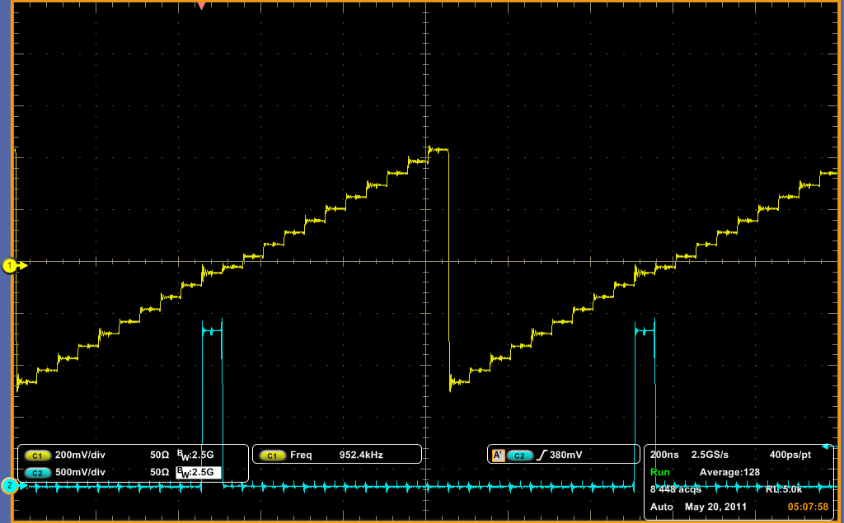
0-8191 @ 400 / cycle
20 cycles @ 40 MHz

Slide 9
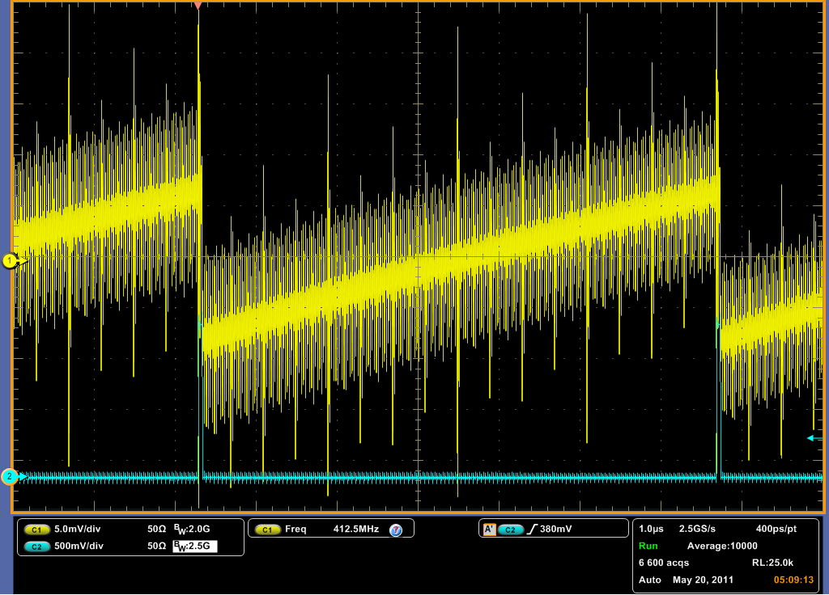
0-127 @ 1 / cycle
128 cycles @ 40 MHz

Slide 10
Trim DACs
Latest (?) version of Rob’s GUI crashes when attempting to load the trim DACs
(on either board)

Slide 11
Conclusions
ADC noise on Board #2
significant (~100 counts) on channel 9
ADC “stuck bit” tests
no evidence
DAC tests
not clear what source of noise is
Trim DACs
need Rob to check his GUI

