Slide 1
ILC Activities at Cornell
June 7, 2011
Temp and Current vs. Time

Slide 2
Cavity testing: ILC cavity 9-cell A9
The cavity was VEP’d 25 micron with 17 volts;
To improve Q value by increasing EP voltage from 14 to 17.
The temperature < 22 °C.
Temp and Current vs. Time

Slide 3
The cavity quenched at 25.5 MV/m.
The OST data suggests the cavity quenched at cell#1, the first bottom cell, equator region.
The next plan of this cavity is optical inspection

Slide 5
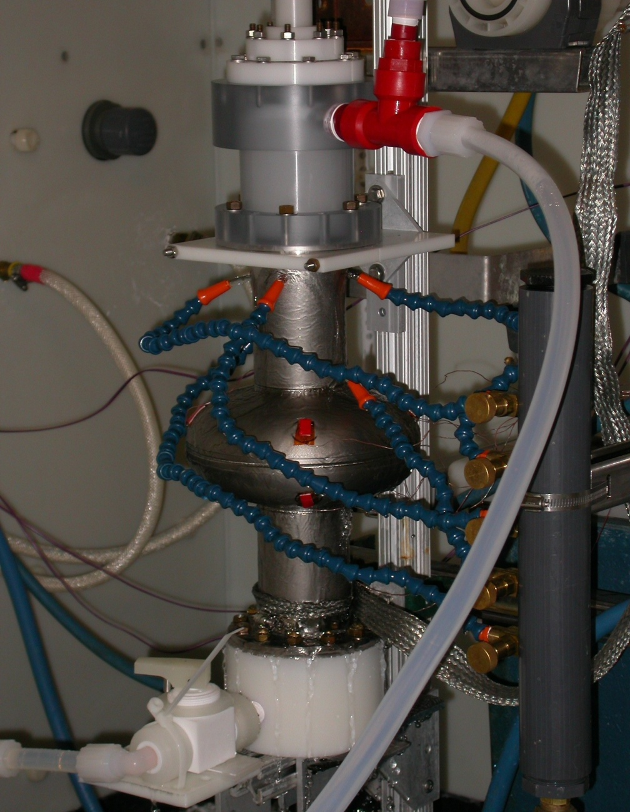
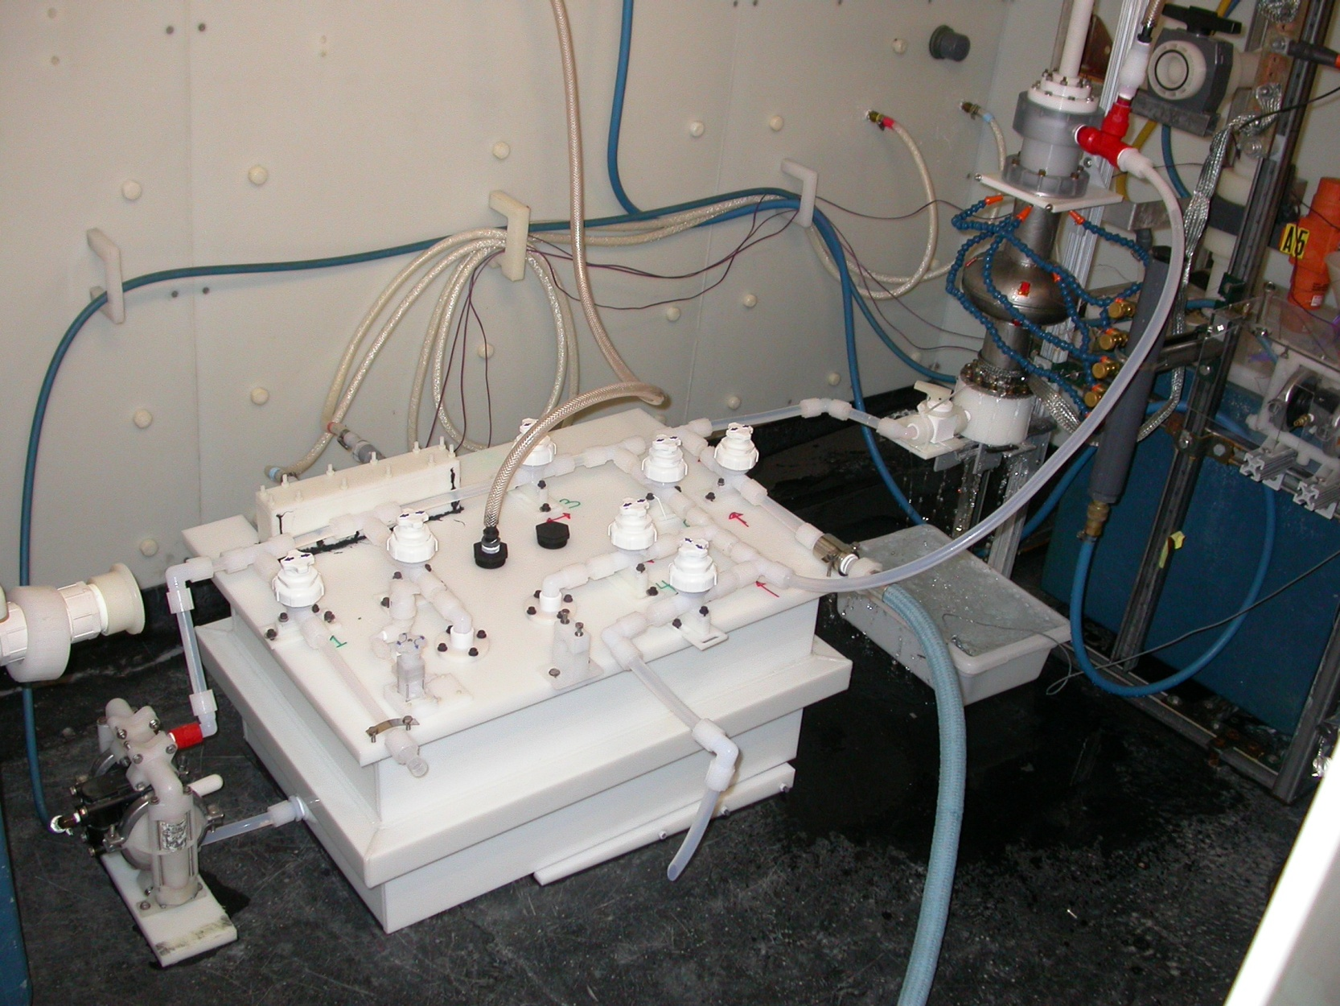
VEP system at Cornell University with Recirculation
VEP 2.1: Recirculation

Slide 6
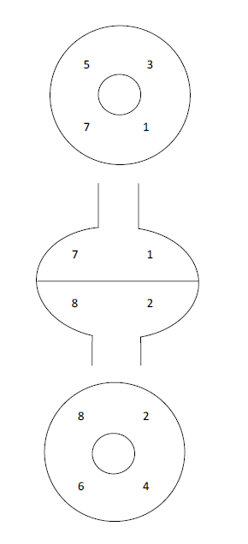
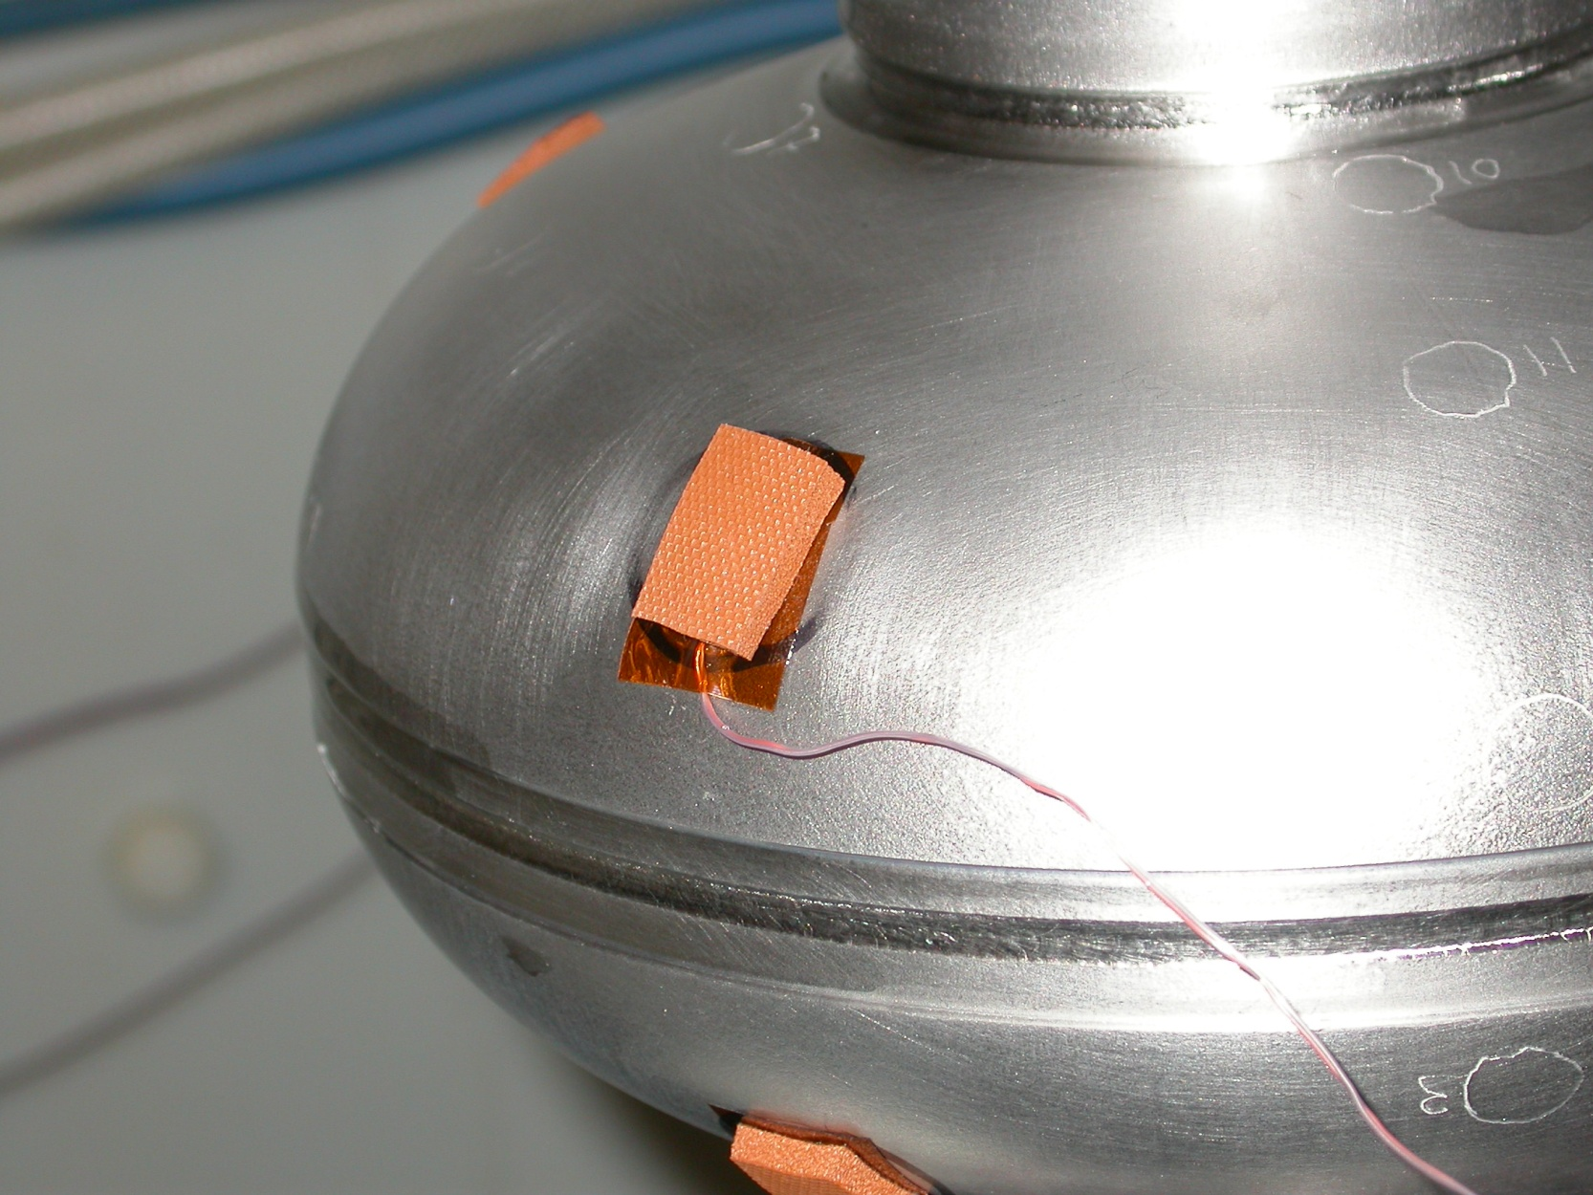
Temperature Oscillations:
Experimental Setup
Resolution of thermocouples: 0.02°C
Agitation: 0.85Hz
Acid Recirculation(1Hz)
Location of thermocouples ->
60 second window
Sample rate of
  TC: 1.5 Hz
  Current: 5 Hz
Thermometers

Slide 7
Temperature Oscillations: Asymmetry
VEP of AES2-1
Temperature Oscillations: Bottom Cup Temperature Oscillations: Top Cup

Slide 8
Interpretation
Frequency of top ≈ 2 * frequency of bottom
No obvious correlation between temperature & electrolyte motion
Upper cup
  T increase correlated for Type 1 & Type 2 current spike
Lower Cup
  T increase correlated with Type 2 current spike
  T decrease correlated for Type 1 current spike
Meter stick for VEP development
  Top and bottom oscillations must be identical
Further analysis on temperature/current correlation

Slide 9
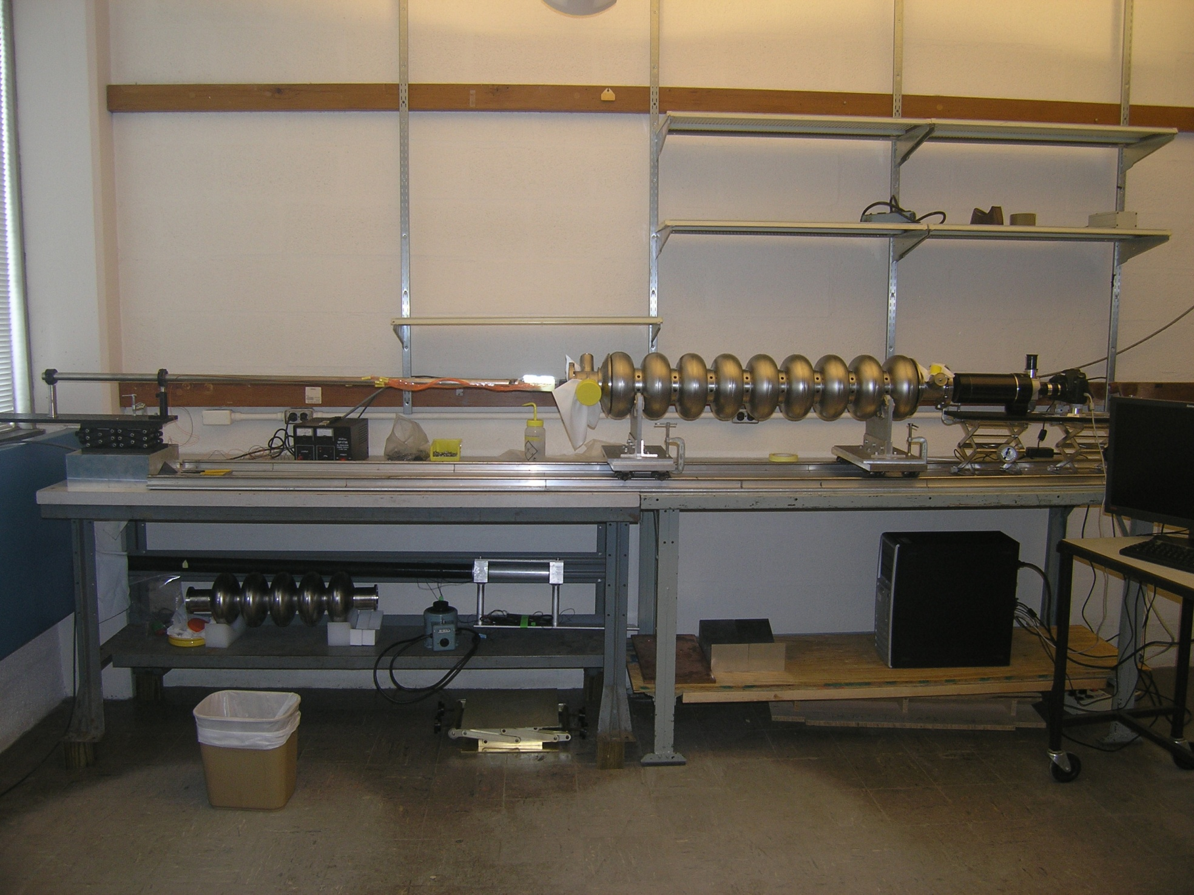
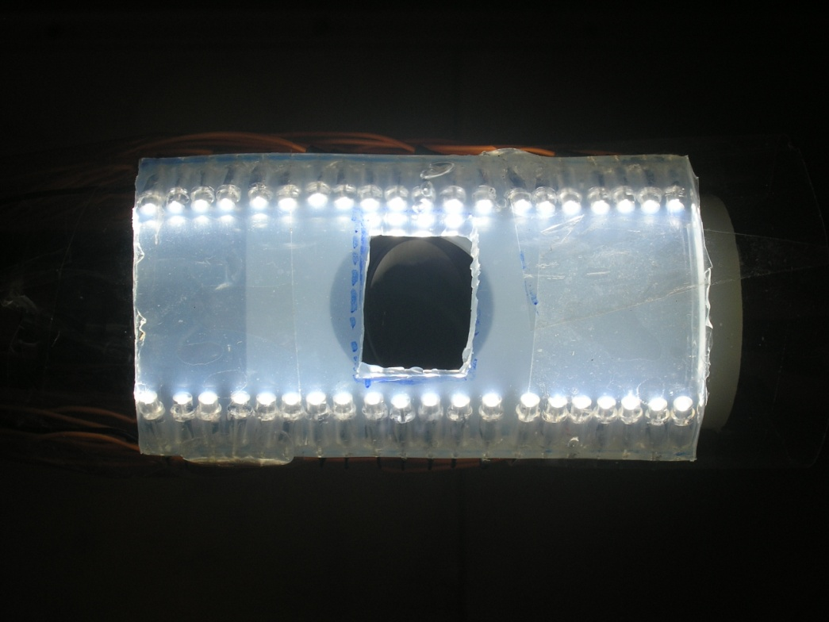
Optical inspection at Cornell University
A new camera
LED Lighting
A new 21.1 megapixels digital camera
The resolution of system is 5 micron.
A new bright lighting source (40 LED bulbs)
By changing different arm and head, this system is able to make surface replica.

Slide 10
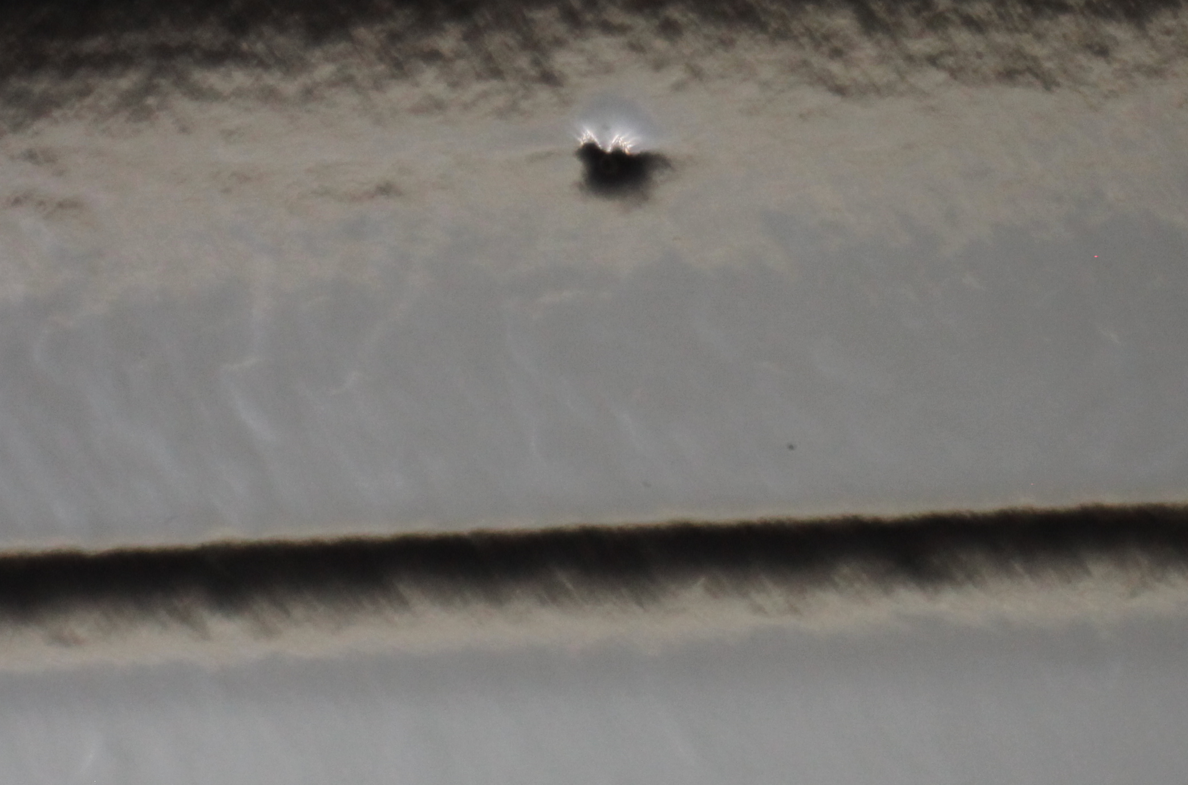
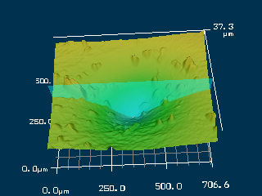
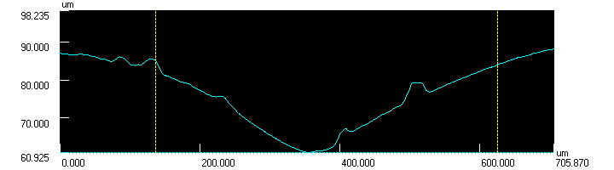
Cavity inspection result and surface profilometry scanning
Optical inspection image from AES5 cell#1
3D surface scanned on replica by Laser confocal microscope at Fermilab
The cavity quenched at 25MV/m
the profile of pit
A pit was found in ILC 9-cell cavity AES5 cell#1, 90 micron in depth,
700 micron in diameter.

Slide 11
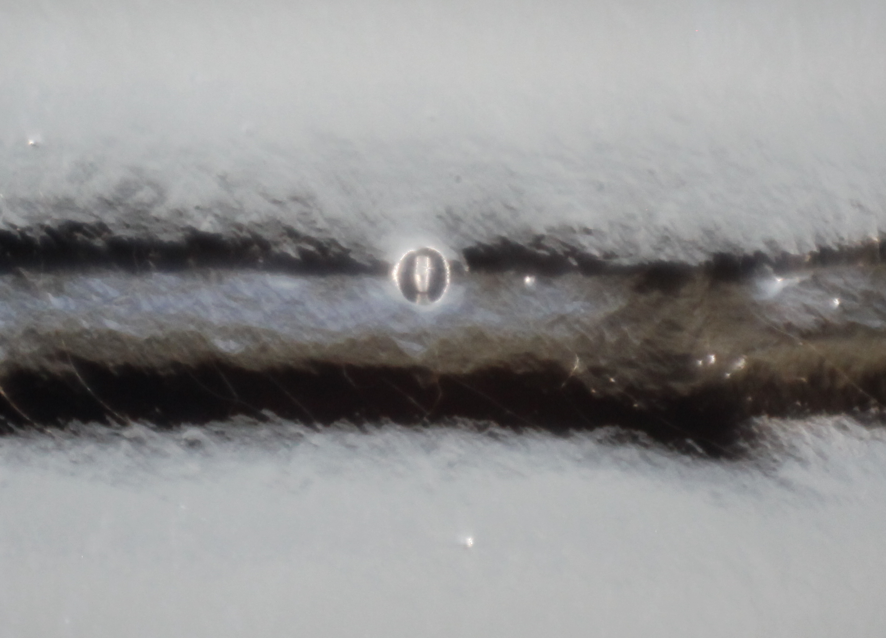
Optical inspection image from A10 cell#4
500um
The cavity quenched at 23MV/m

Slide 12
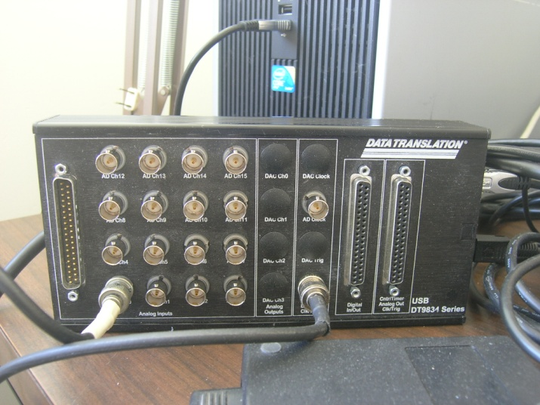
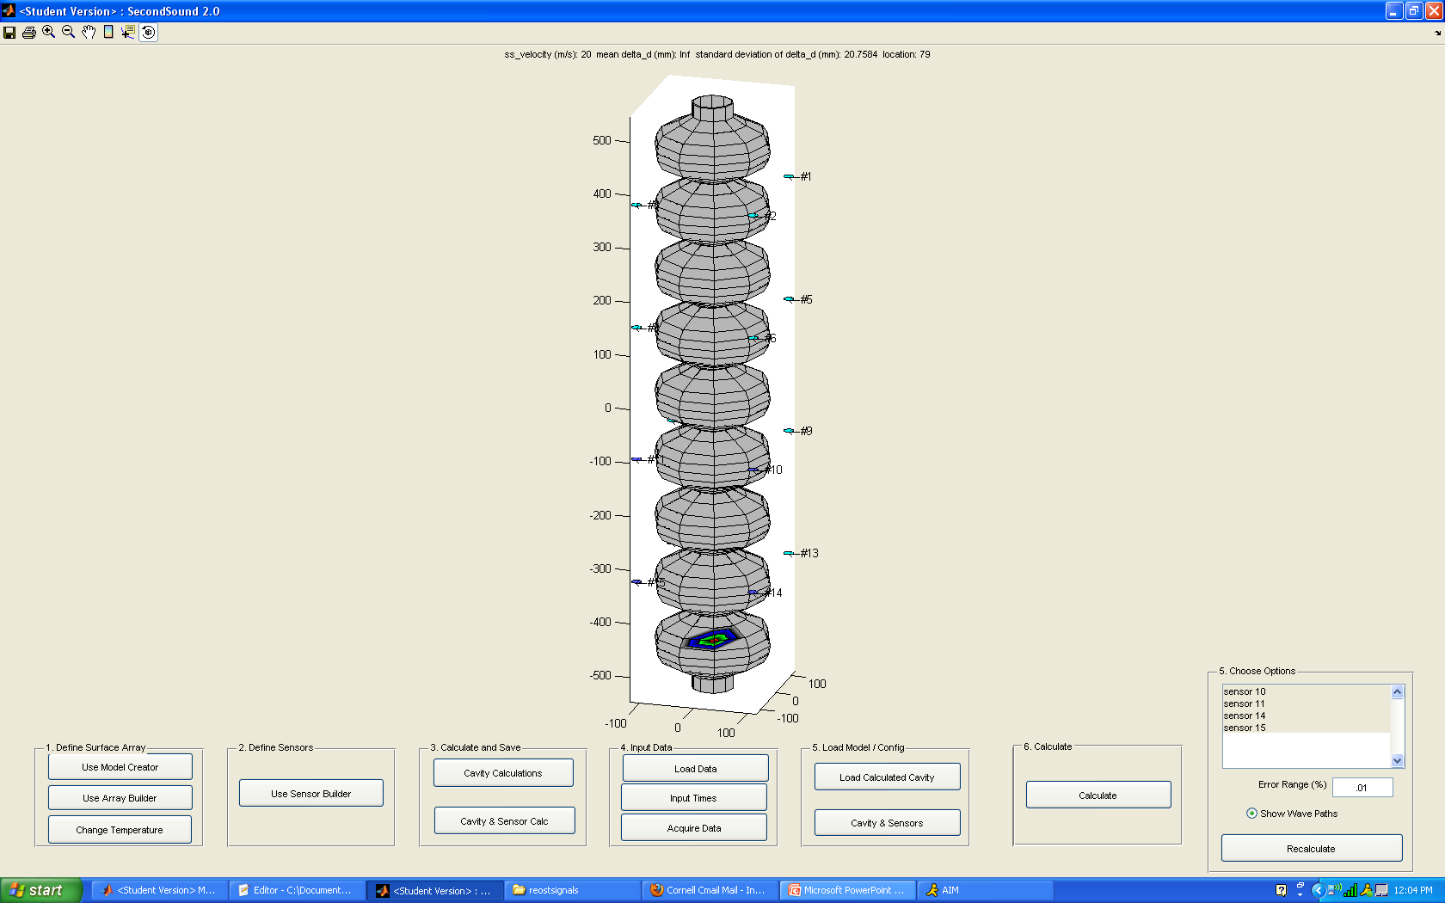
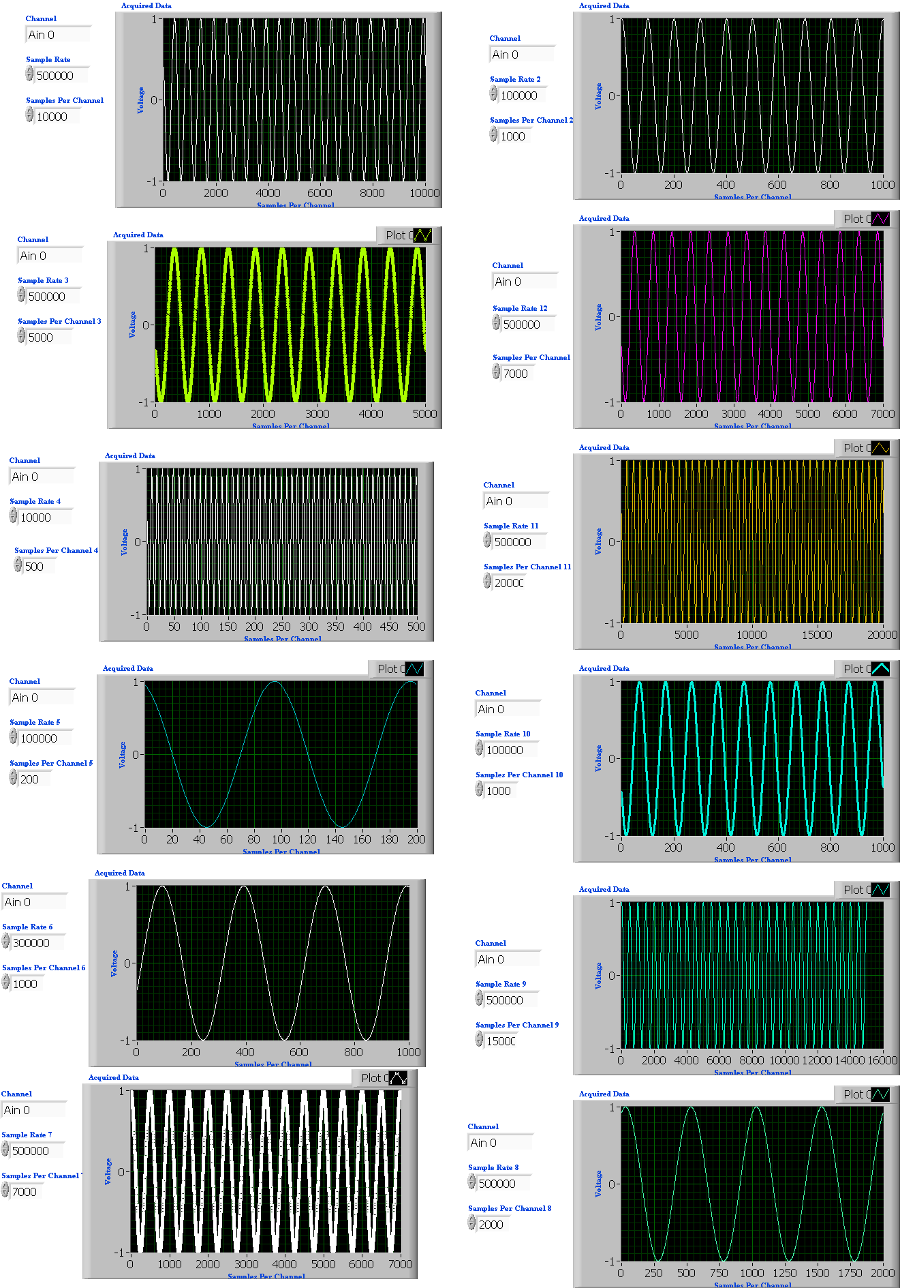
OST system at Cornell
During the latest 9-cell cavity test, the 16 OST sensor shows clear signal, the program helps to calculate the quench location
In the future, we will use 16 channels data acquisition card to capture signal simultaneously

