Slide 1
Americas Report
C.M. Ginsburg (FNAL)
for the FNAL/ANL, JLab, and Cornell (no report this time)
cavity teams
S0 Meeting 7.June 2011

Slide 2
JLab Status
RG
May 31, 2010

Slide 3
9-cell Cavities
TB9AES011 in process of treatment and testing
JLAB LG#1 RF test following re-HPR completed with reduced field emission
  Cavity quench limited at 24 MV/m
  OST data analysis and dual-mode excitation measurements to be completed
DESY seamless 9-cell cavity RF test following light EP completed
  Highest gradient reached 18 MV/m. OST predicted a quench location in cell#4
  Optical inspection of quench location under way
TB9NR001 light EP on hold due to shortage of replica material
TB9AES006 at FNAL for mechanical polishing
Expecting a 9-cell cavity from IHEP for vertical test

Slide 4
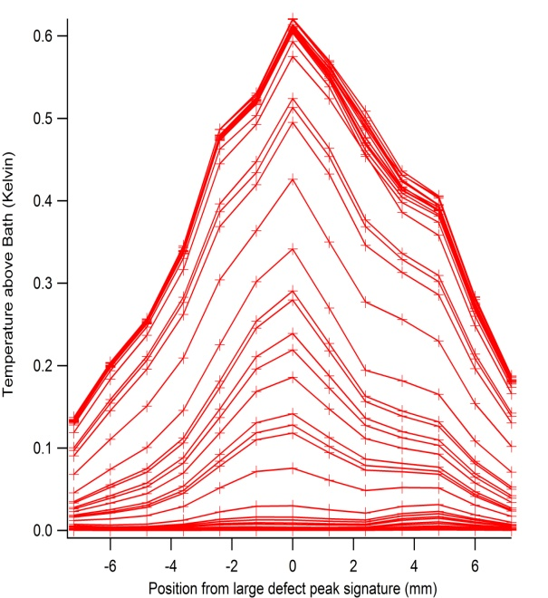
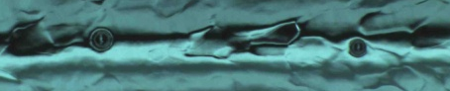
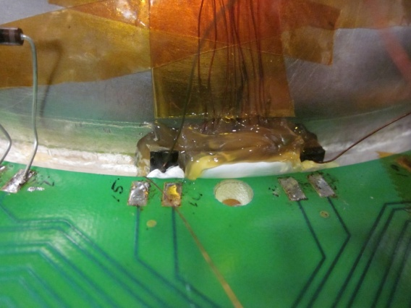
Instrumentations for
Quench and Field Emission Studies
Experiments with Hamamatsu diodes (received from KEK) placed at locations near cavity started for “at-cavity” X-ray monitoring
High-resolution local thermometry apparatus tested with natural defects in cell #5 of TB9NR001
  Twin defects (4mm apart) were resolved (graph and images shown)
  Next step is to measure a controlled defect in a 1-cell cavity

Slide 5
FNAL/ANL Update
CM1 tests ongoing
Plans underway for CM2 assembly – will affect other work
Horizontal test stand
  Vacuum studies and remediation successful, as shown on TB9RI018
  TB9RI019 was successfully tested, and TB9RI018 with two cooldowns is completing the test this week
Vertical qualification
  Several 1-cell tests in pursuit of general R&D and vendor qualification
  First test of the new batch of AES 9-cell cavities occurred
    TB9AES013 reached 17 MV/m after standard EP processing with localized quench and potential feature seen in optical inspection before final EP
    These cavities had light BCP at AES and most show pitting
    Two more are in process: one at JLab for standard EP/test, the other tumbled
  TB9RI026 (localized grinding at KEK) – good performance
    Standard EP at FNAL/ANL: initially 29 MV/m then 20 MV/m after FE event
    @KEK: local grinding, tuning >98% flatness, 20-30um EP, HPR, drying, and flanged in the clean room air.
    HPR, vertical test prep done at FNAL/ANL
    VT 13.May: 36.6 MV/m Q0=7E9; low-field Q0~1.35E10; FE-free; quench limitation (2nd sound implicates cell 5)
  AES002 (dressed) – being 120C baked at JLab after dressed-EP
  TB9RI022 (6th pass, 5th light EP) was qualified
    VT 24.May 2011: 37.9 MV/m with low FE Q0= 8.8E9
  Next plans: TB9AES012 and TB9ACC012 (tumbled)

Slide 6
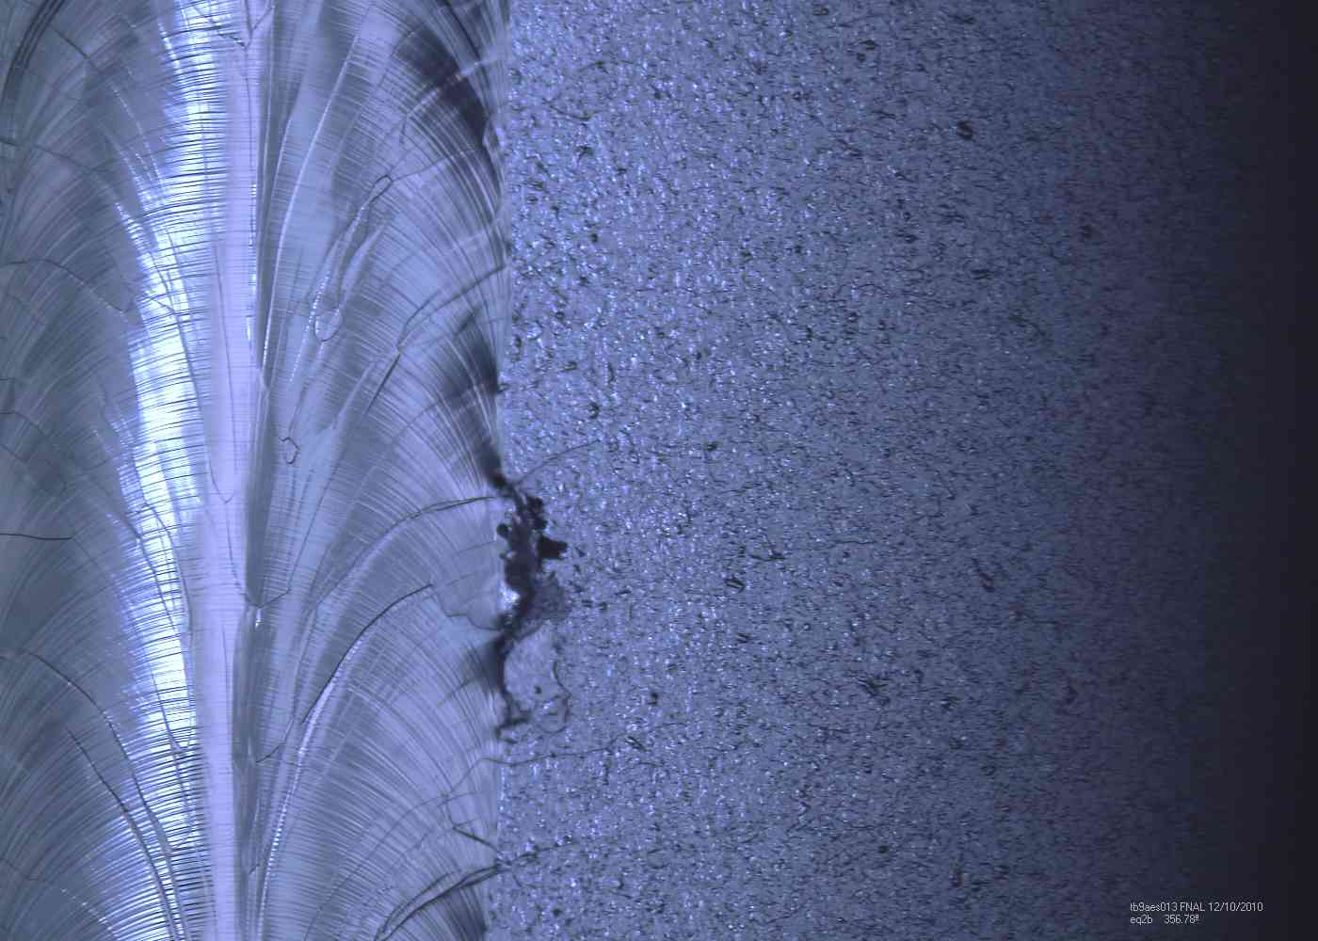
TB9AES013 quench location
Shown as-received (before EP)

Slide 7
Scenario 1: “best performance” CM2
Now
  Five HPR and HT preps
  TB9RI018
  TB9AES009
  TB9AES010
  TB9AES008
  TB9ACC016
Four more good horizontal tests
TB9RI019
TB9RI018
TB9RI024
TB9RI027
ACCEL8(31 MV/m) and TB9AES007(33 MV/m) will also be HPR’d as backup

Slide 8
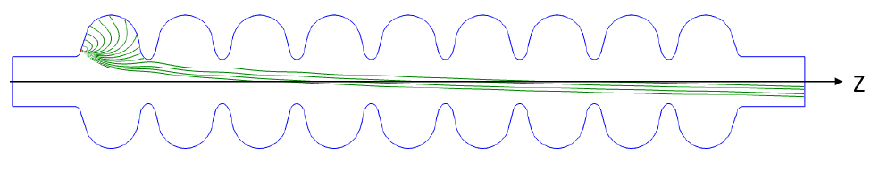
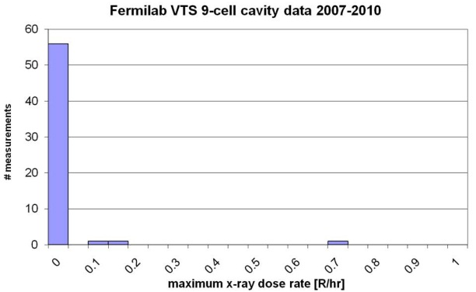
FNAL field emission studies
Simulations made for radiation safety of vertical test stand (VTS1)
Fishpact for field emission model
MARS (GEANT) for particle transport through material
According to the described model, the predicted dose rate under the external shielding is < 0.250 R/hr 90% of the time.
The measurements are well within this value, to within the limited statistics.
Rakhno et al.
SATIF-10 (June 2010) http://lss.fnal.gov/archive/2010/conf/fermilab-conf-10-246-apc-td.pdf
IPAC10 (May 2010) http://www-spires.fnal.gov/spires/find/hep/www?j=CONFP,C100523,WEPEC056

Slide 9
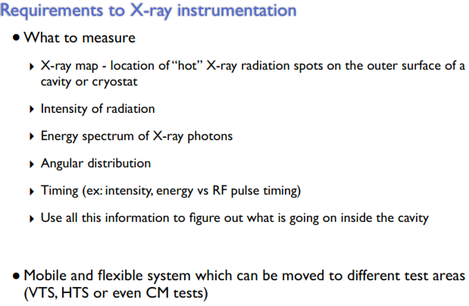
FNAL field emission studies
Several detectors under study:
•“Slow”
High rate flux measurement
Sensor can be in LHe
Readout electronics ~30ft away, “warm”
•“Fast”
Single photon detection
Potentially measure photon energy
Preamp near sensor … “cold”
Primary issue: reliability and reproducibility
Sukhanov, Mukherjee

