Slide 1
Dark Current in high gradient cavities
Field emitted current shows non-linear increase as gradient is raised – roughly following ‘Fowler-Nordheim’ scheme.
Field emission sites are defects: (e.g. scratches) or contaminants.
A field emission point is a ‘diode’ →
  dark current is ‘bunched’
A bunched beam will radiate harmonics of the fundamental (up to ω ~ 1/bunch length)

Slide 2
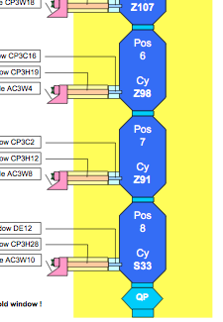
2nd / 3rd harmonic
fp
hom2
hom1
fp
hom2
hom1
fp
hom2
hom1
Experiment:
  compare amplitude of harmonics above & below the FE threshold
Check both HOM pickups and field probe for 2.6 / 3.9 GHz
  cavity 7 (PXFEL3) CMTB appears to have been contaminated (string assy?) → low FE thres.
→ signal easily seen
Cavity 7 – low FE threshold

Slide 3
2nd/3rd harmonic change:
above – below FE threshold:
  requires a change Klystron output by 20%
Conclusion:
  a strong signal; seems to respond above/below FE
  but questions (modeling needed):
    2.6/3.9;
    reduction (Cav7-Hom1)?
Voltage increase | Cav6 HOM1 | Cav7 – FP | Cav7 – HOM2 | Cav7 – HOM1 | Cav8 FP
2.6 GHz | 8db (x2.5) | 8dB (x2.5) | 0dB | 3dB (x1.5) | -4dB
3.9GHz | -2dB | 2dB | 18 dB (x7.5) | -7.5dB | 3dB

