Slide 1
FONT5 Board Tests
D. R. Bett

Slide 2
Summary of Tests
ADC noise tests, low signal level test
  Switched to LT firmware (no ring clock)
DAC test
  Changed scope bandwidth to 25 MHz
Trim DACs
  Rob fixed DAQ

Slide 3
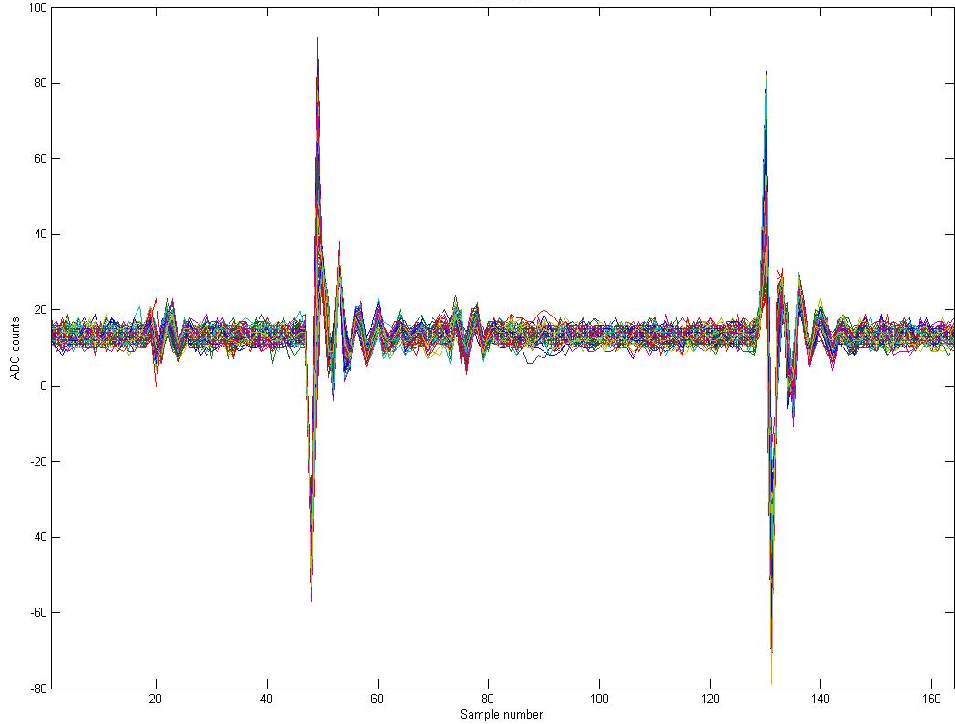
Board #2 – Channel 9
Usual firmware
½ ring clock period

Slide 4
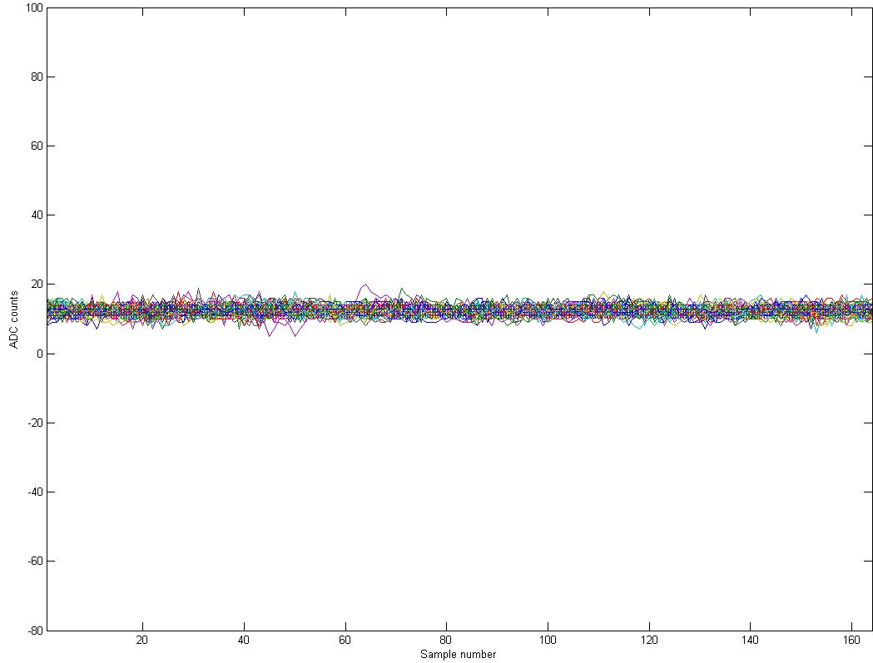
Board #2 – Channel 9
Long Train firmware

Slide 5
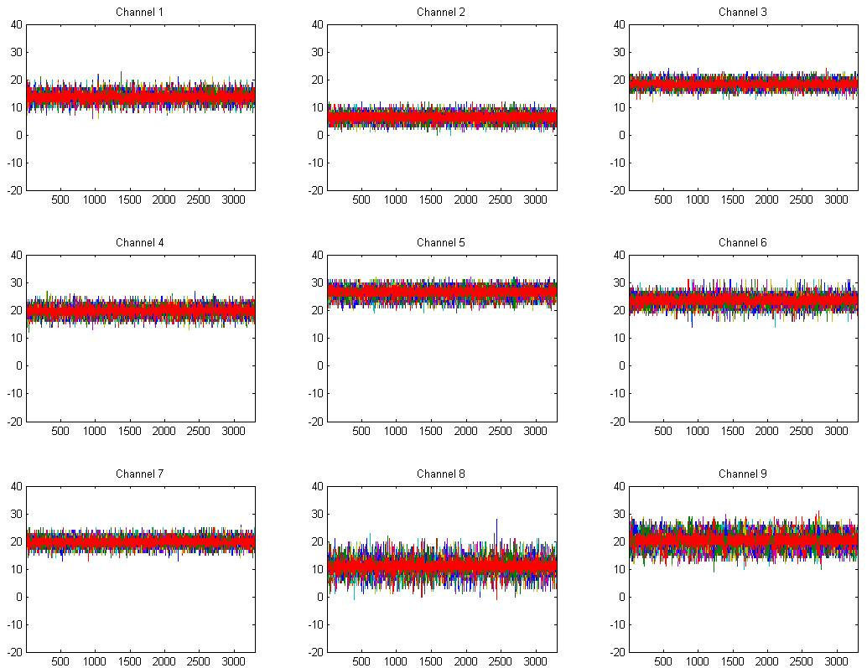
Board #1

Slide 6
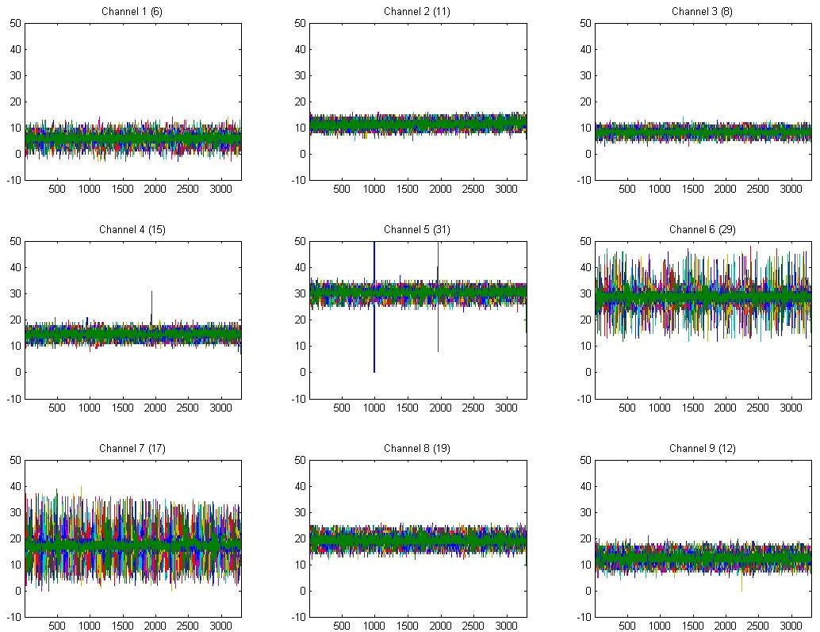
Board #2

Slide 7
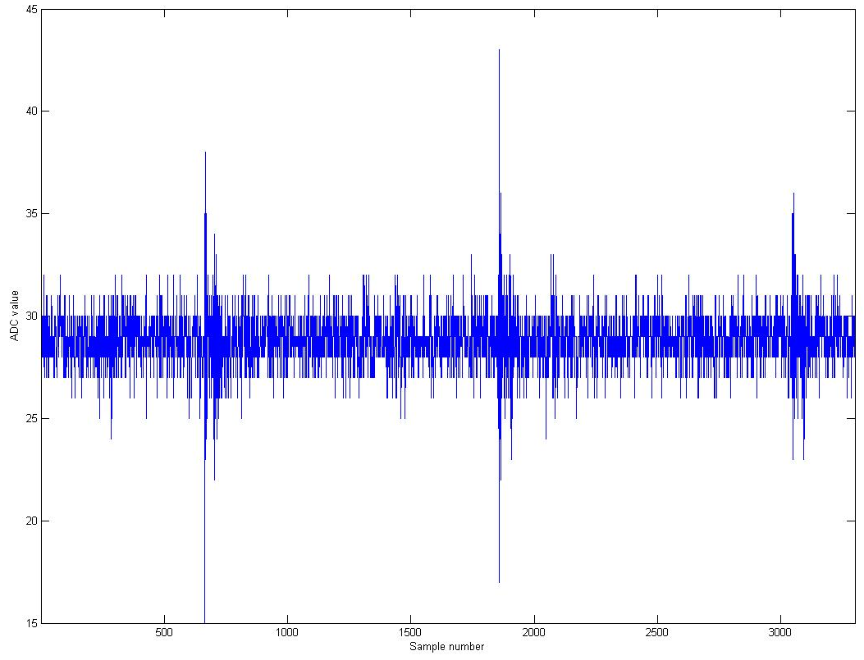
Board #2 – Channel 6, Trigger 1
Long Train firmware
~ 3 µs

Slide 8
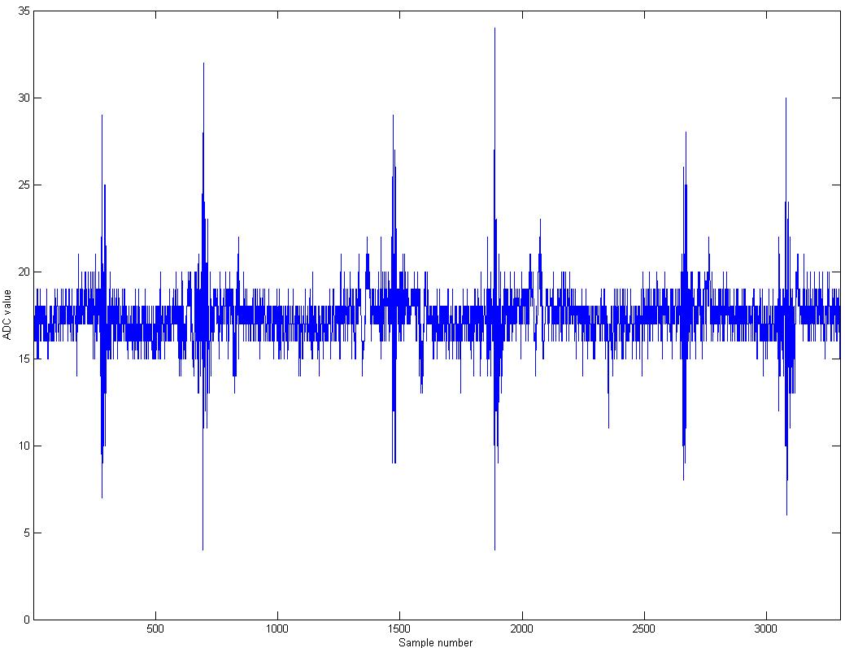
Long Train firmware
Board #2 – Channel 7, Trigger 1

Slide 9
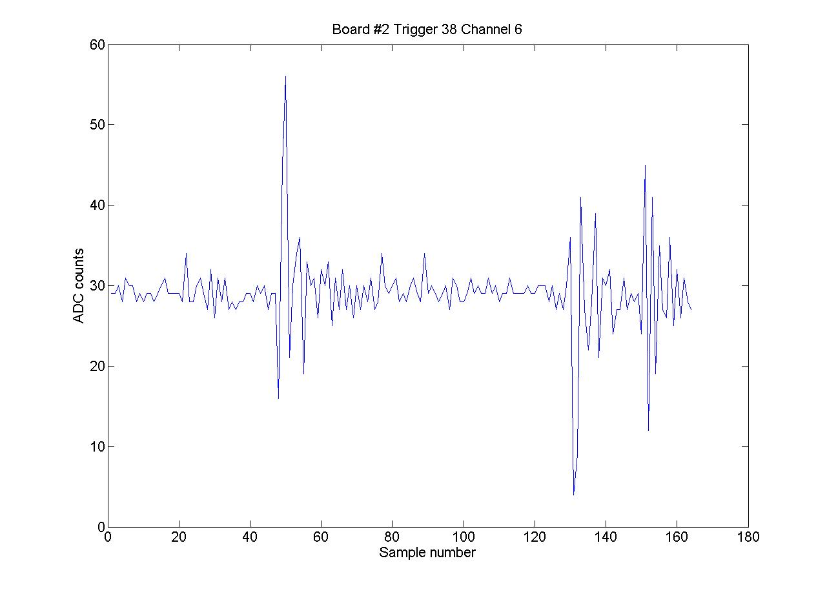
Usual firmware
“travelling” noise
½ ring clock period

Slide 10
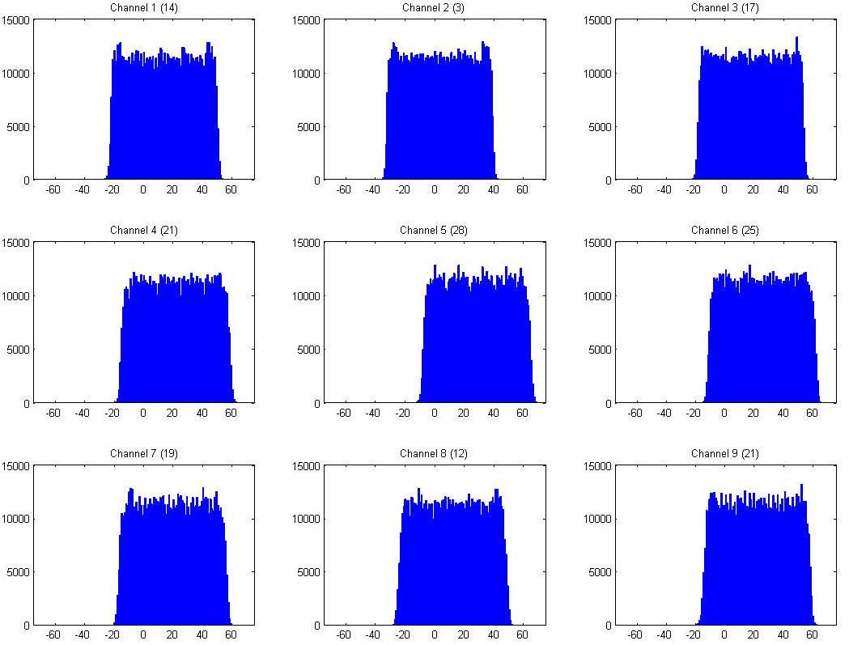
Board #1

Slide 11
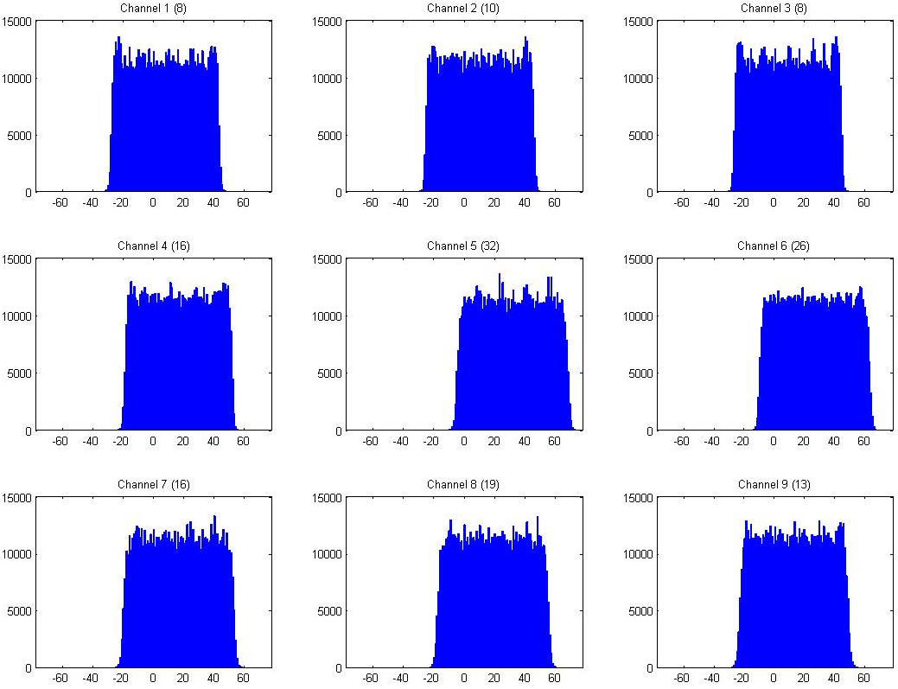
Board #2

Slide 12
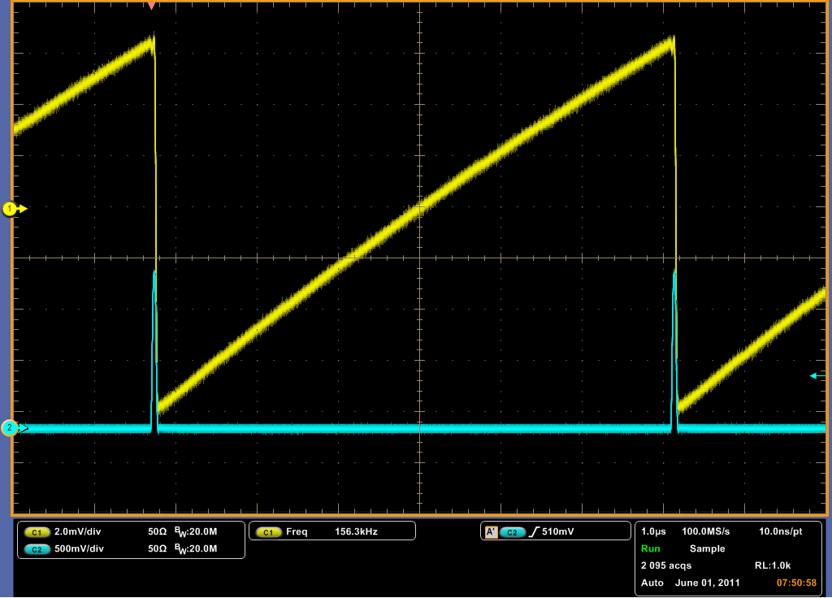
Bandwidth → 25 MHz
127
0

Slide 13
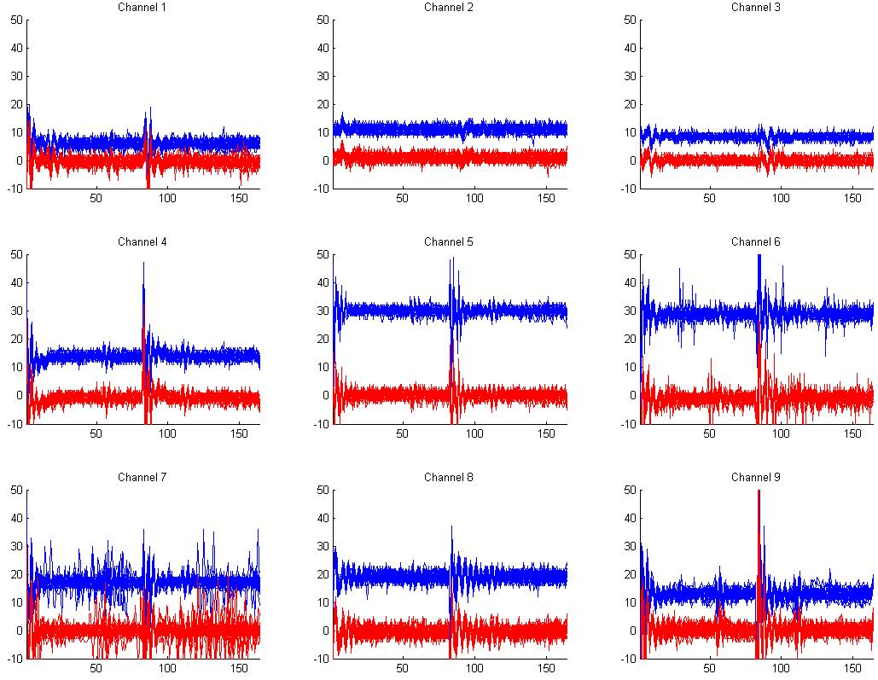
Board #2 (usual firmware)

Slide 14
Conclusions
ADC noise on Board #2
  Removing ring clock eliminates “stable” noise
  “Intermittent” noise remains on channels 6 & 7
DAC tests
  Realistic bandwidth looks fine
Trim DACs
  Misunderstanding in DAQ corrected

