Slide 1
ILC CFS AND GLOBAL
SYSTEMS MEETING
CONVENTIONAL FACILITIES
AND SITING GROUP
GENERAL STATUS UPDATE
V. Kuchler

Slide 2
Overview
  Preparation for the Damping Ring TBR
  First Impressions of the KEK Tunnel Configuration Study
  International Large Detector (ILD) Collaboration Meeting
  Update on Interaction Region Consulting Activities

Slide 3
Preparation for the DR TBR
  A One-Day Mini-Workshop for Damping Ring Criteria was Held on June 2 at Fermilab
  M. Palmer Attended in Person and S. Guiducci Attended via Webex for Most of the Morning Session
  E. Paterson Attended via Webex for the Afternoon Session
  Discussion Focused on Three Major Areas
    Damping Ring Layout and Dimensioning
    Mechanical Criteria and Equipment
    Electrical Loads and Equipment

Slide 4
Preparation for the DR TBR cont.
  Several Fundamental Conditions were Established
    In the RF Straight Section
      RF Equipment will Take Up the Majority of Floor Space
      Personnel will NOT Occupy the Equipment Cavern During Beam On Conditions
      M. Palmer will Generate an Equipment Layout for the Equipment Cavern
    There will be a Need for a Thermal Insulation Barrier Between the Equipment Alcove and the Beam Enclosure in the RF Straight Section – This Could Also Serve as the Needed Radiation Shielding as well (Equivalent of ¼” Steel + ¾” Lead)
    Beamline Spacing
      Centerline to Centerline Vertical Spacing Between Adjacent Damping Rings will be 1.3 m
      Initial Positron Beamline will be 0.9 m Above the Finished Floor
      Tunnel Diameter May be Reduced to 5.0 or 5.5 m dia.

Slide 5
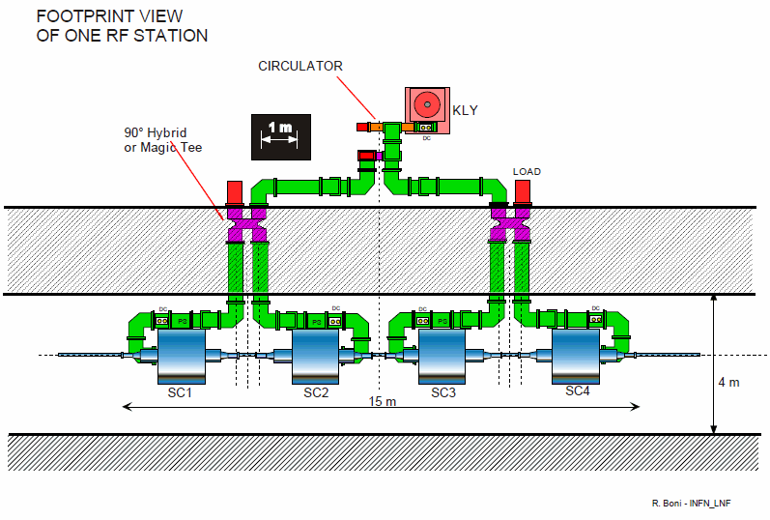

Slide 6
Preparation for the DR TBR cont.
  Several Fundamental Conditions were Established
    Temperature Requirements
      Temperature in Operating Beam Tunnel 77º – 87º F Range with a Stability of +/- 0.18º F
      Wiggler Sections will Need to be Enclosed for Temperature and Alignment Stability Including Cooling of Support Stands
    Magnet Power Supplies
      There will be 100 – 150 Power Supplies in Each 900 m Arc
      Power Supplies will be Connected to a Water Cooled Buss
    Injection/Extraction Straight
      Two Smaller Alcoves will be Needed
      Alcove will Likely be ~10 m Wide with Beamline Approximately in the Middle of the Enclosure with Aisles on Both Sides
    Two Shafts are Still Required – One Large Diameter, One Smaller Diameter – Both Positioned on the Inside of the Damping Ring
    Several Adjustments to the Mech/Elec Criteria Spreadsheet were also Established

Slide 7
Preparation for the DR TBR cont.
  M. Palmer will Provide an Equipment Layout for the RF Alcove
  Emil will Make the Necessary Adjustments to the Mech/Elec Spreadsheets and Exchange Them for Review with M. Palmer and S. Guiducci
  CFS will Prepare Updated Drawings and Add to Updated Criteria Sheets for a Final Review by CFS and Damping Ring Groups Prior to the TBR at Frascati in July
  Once Verified at the Frascati Meeting, the CFS Criteria will be Posted on the EDMS System

Slide 8
KEK Tunnel Configuration Study
  Consultant Study was Completed in JFY10
  A. Enomoto Provided a Presentation to KEK at the End of May, 2011
  During the ILD Collaboration Meeting in Paris, CFS Met with A. Yamamoto to Review Atsushi’s KEK Presentation
  Atsushi will Provide a Similar Presentation to the CFS Group on June 14
  Some Questions Still Need to be Addressed
    Per Meter Tunnel Unit Costs Appear to Be Provided but it is Unclear How Underground Cavern and Alcove Costs are Included
    Also how are Horizontal and Vertical Access Enclosures Included

Slide 9
ILD Collaboration Meeting
  CFS, MDI, ILD and SiD Groups were Represented
  5/22 (Sunday) was an MDI/Detector Meeting
  5/23-5/25 was the ILD Collaboration Meeting
    Good Presentations and Discussion of CFS/Detector Interface
    Re-Established the Need for Platforms for Both Detectors
    Also Affirmed that Both Detectors are Self-Shielding and Therefore No Shielding Wall is Required
    A Clear Zone of 15 m from Beam Centerline is Required for Magnetic Field Impact
    Y. Sugimoto Provided a Presentation on the Asian Mountain Site Interaction Region and Horizontal Access issues
  T. Lackowski and J. Osborne Provided Presentations for the IR Regions in the Americas and European Regions Respectively

Slide 10
Progress with IR Region Consulting
  ARUP UK Representatives Attended the ILD Collaboration Meeting and a Full Afternoon was Devoted to Presentations and Discussion with the CFS, ILD and SiD Attendees
  Two of Four Proposals will be Funded at this Time
    Task One – Detector Platform Design
      Americas Region will Fund This Task
      Task will Include Concrete Platform Design and a Review of Options for Platform Movement
      Criteria for Deflection and Positioning, Maximum Acceleration Forces and Movement Cycles will be Included in the Analysis
    Task Two – Rock Behavior Model/Study
      European Region will Fund This Task
      Model will be Based on CERN Geology and IR Region Design
      At a Later Date, a Similar Model can be Pursued for the Americas and Asian Regional Conditions

