Slide 1


Initial IP Feedback Study
Mikey Davis
09 June 2011
1/12

Slide 2
Initial IP Feedback Study
The IP feedback system would correct jitter nr IP
To calculate the required power for such a system
Need to know the jitter around the IP
Need to know kicker specifics
Stewart says the jitter scales with the β func.
Mikey Davis
09 June 2011
2/12

Slide 3
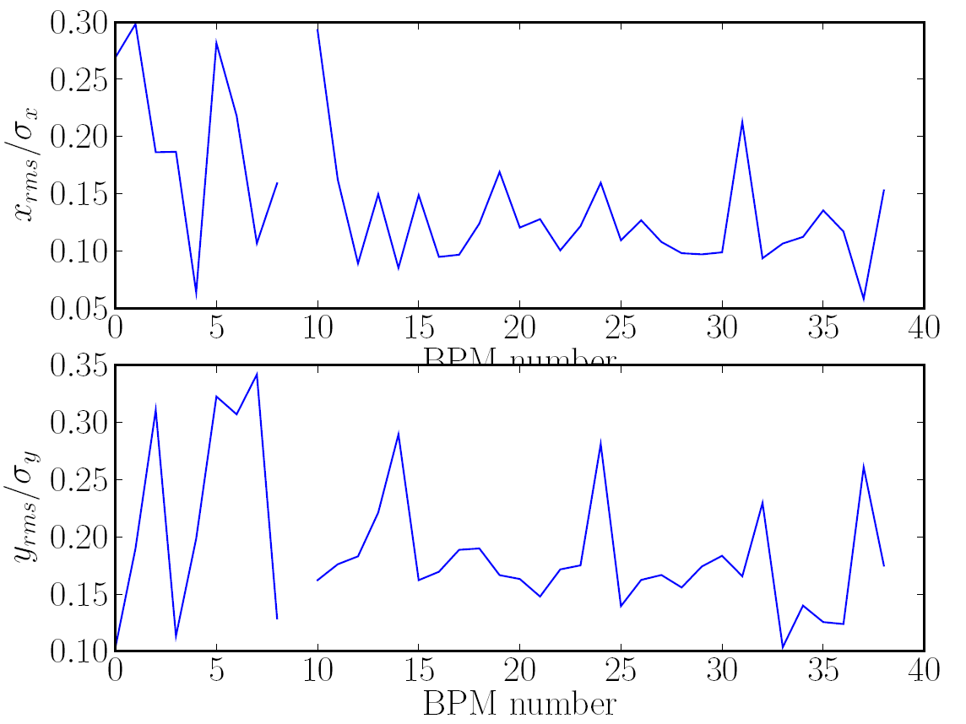
Initial IP Feedback Study
Mikey Davis
09 June 2011
3/12

Slide 4
Initial IP Feedback Study
Mikey Davis
09 June 2011
4/12

Slide 5
Initial IP Feedback Study
Mikey Davis
09 June 2011
5/12

Slide 6
Initial IP Feedback Study
Mikey Davis
09 June 2011
6/12

Slide 7
Initial IP Feedback Study
Mikey Davis
09 June 2011
7/12

Slide 8
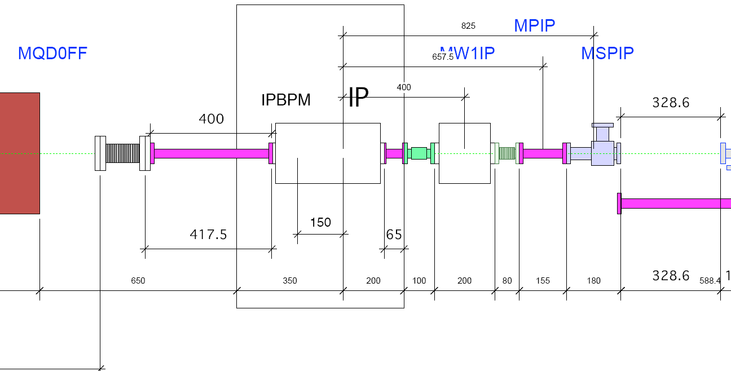
Initial IP Feedback Study
Mikey Davis
09 June 2011
8/12

Slide 9
Initial IP Feedback Study
FF Quad C Band Cavity IP BPMs IP
Mikey Davis
09 June 2011
9/12

Slide 10
Initial IP Feedback Study
Assume 15cm stripline kicker.
There are several places where this could fit in
Assume 10mm aperture (max jitter 200μm)
Using basic approximation for kicker power
Strips surround by uniform dielectric so Linear field
Match so it can be terminated into 50 Ohms
Mikey Davis
09 June 2011
10/12

Slide 11
Initial IP Feedback Study
Mikey Davis
09 June 2011
11/12

Slide 12
Initial IP Feedback Study
Mikey Davis
09 June 2011
12/12

