Slide 1
A brief report of tth
A.Miyamoto, 21-July-2011
Problems reported previously
  Memory leak in generating ttH samples ➔ solved. more than 50k events possible.
  Fragmentation problem
    Energy sum of charged, gamma, NH. Consistent with Whizard ( ttH→ bbn1e1xyh), but number of particles are different.
    solved by using subroutine py6frm for PS and fragmentation of particles from tt.
      H are decayed by pythia
      ttZ→ bbffffff. bbffff by py6frm. ff from Z are handled by py2frm
      ttbb → bbffffbb. bbffff by py6frm. bb ( gluon →bb) by py2frm.
      ( bb from gluon are treated as a color singlet)

Slide 2
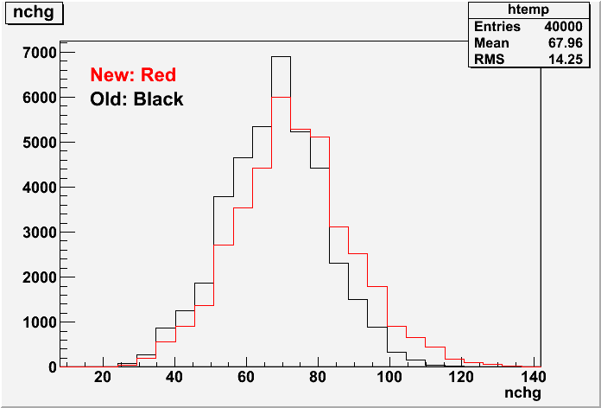
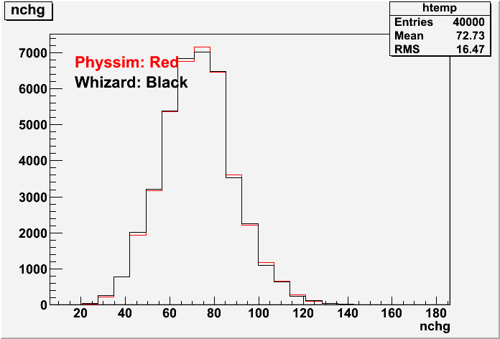
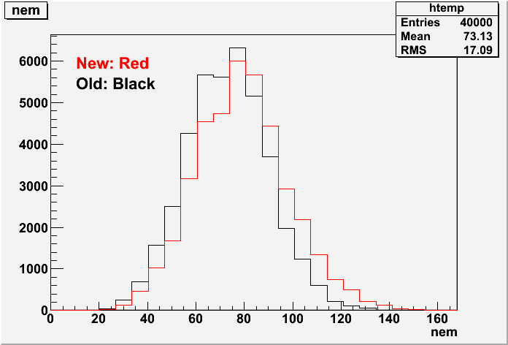
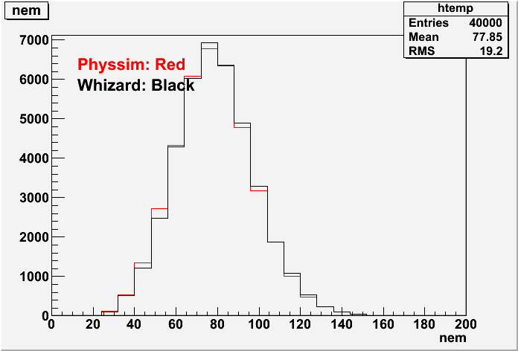
#Charged
Previous
#Charged
New
#γ
Previous
#γ
New

Slide 3
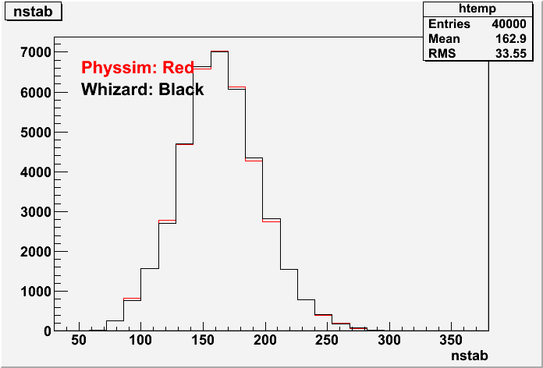
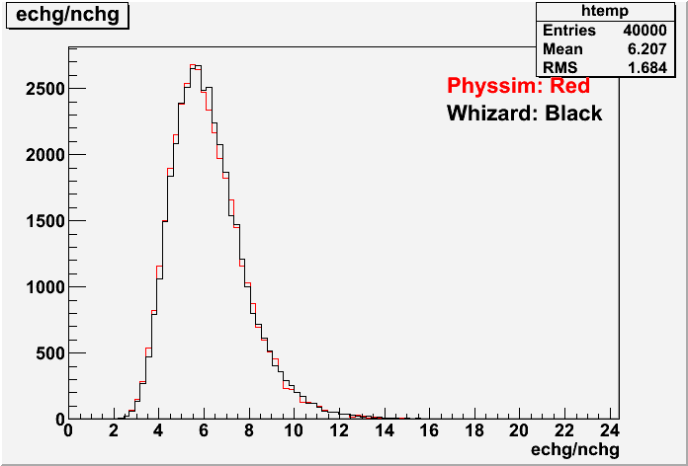
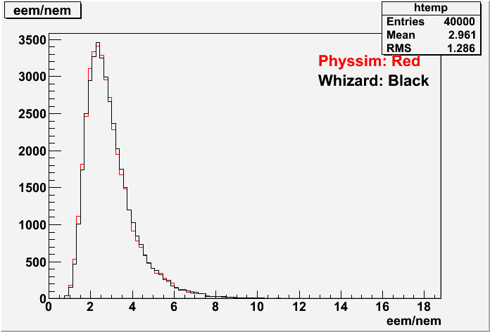
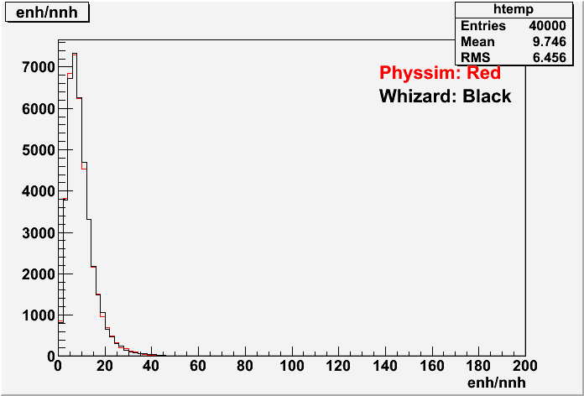
# stable
particles
< E_{charged} >
< E_{γ} >
< E_{neutral} _{hadron} >

Slide 4
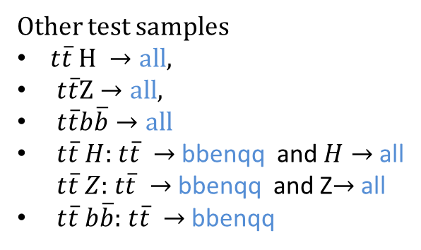
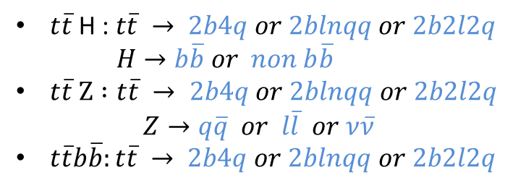
Produced test samples.
$t\overline{t}$H : $t\overline{t} → 2b4q or 2blnqq or 2b2l2q$
$H→b\overline{b} or non b\overline{b}$
$t\overline{t} Z :t\overline{t} → 2b4q or 2blnqq or 2b2l2q$
$$Z→q\overline{q} or l\overline{l} or ν\overline{ν}$$
$t\overline{t}b\overline{b}:t\overline{t} → 2b4q or 2blnqq or 2b2l2q$
Other test samples
$t\overline{t} H →all,$
$t\overline{t}Z→all,$
$t\overline{t}b\overline{b}→all$
$t\overline{t} H:$ $t\overline{t} →$bbenqq and $H→$ all
$t\overline{t} Z:$ $t\overline{t} →$bbenqq and Z$→$ all
$t\overline{t} b\overline{b}:$ $t\overline{t} →$bbenqq
Beam pol. e⁻_{L} e⁺_{R} and e⁻_{R}e⁺_{L}
Number of events in each samples: ~50k events ( 0.02% events, Pythia failed hadronization )
Integrated luminosity: 8 ~ 250 ab⁻¹
ProcessID: p106001 to p106052
(see http://www-jlc.kek.jp/~miyamoto/CDS/processIDdict/process_info-upto200k/)
Sample info: http://www-ilc.kek.jp/~miyamoto/CDS/1000
GRID location: lfn:/grid/ilc/users/miyamoto/CDS/generated/1000
I asked the ttH analysis group in ILD to check samples.
e+e- → tt will be necessary. I’d like to try to generate by Whizard.

Slide 5
hepsplit
A small program to split a large stdhep file to many files with small number of events.
Useful to run jobs on many GRID sites.
Usage:
Command format
hepsplit [options]
Options
--infile [infile] : (D=input.stdhep) Input stdhep file name
--outprefix [ofile] : (D=output ) Prefix of output file. File names will be
output_NNN.stdhep, where NNN=0~999
--maxread [N] : (D=0) Number of read recors, <= 0 to the end
--nw_per_file [N] : (D=300) Number of events in each output file.
--write_begin_record : (D=1) Output begin record in each file or not. (0,1)=(No, Yes)
Soure code is at http://www-jlc.kek.jp/~miyamoto/CDS/tools/HepSplit.tar.gz
hepsplit.cxx and GNUmakefile are included.

