Slide 1
2011 WHCAL testbeams at SPS H8
Three testbeam periods
7 days in June: energies up to 50 GeV
7 days in July: energies up to 300 GeV
5 days end of this month: energies up to 300 GeV
Erik van der Kraaij - CERN LCD
September 15th, 2011

Slide 2
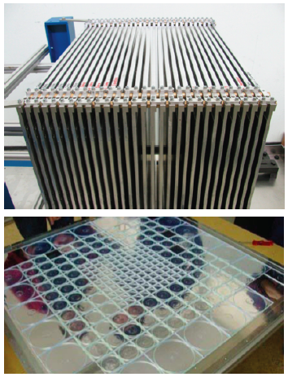
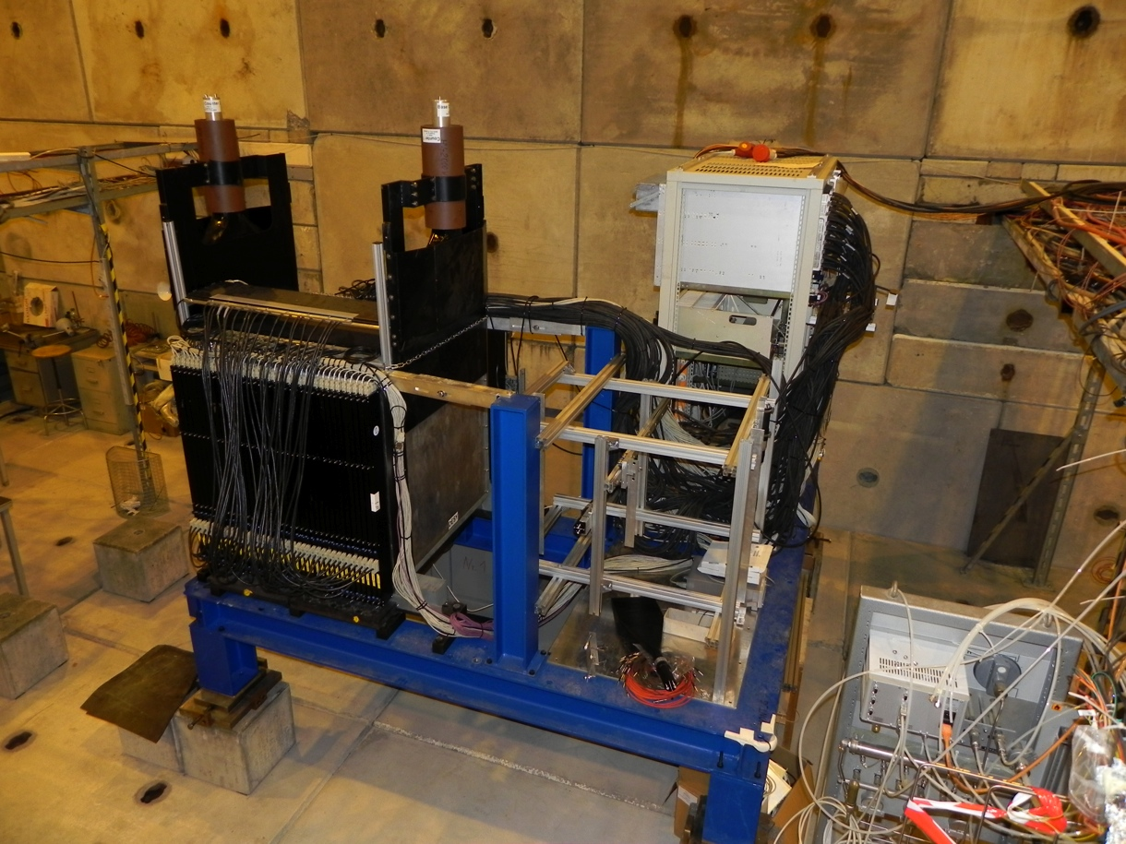
Tungsten HCAL prototype
Main purpose: Validation of Geant4 simulation for hadronic showers in tungsten
Current HCAL setup has 38 W layers.
Including active material this is ~4.8 λ
While being installed in SPS H8
Scintillator tiles 3x3 cm² (in centre)
Read out by SiPM

Slide 3
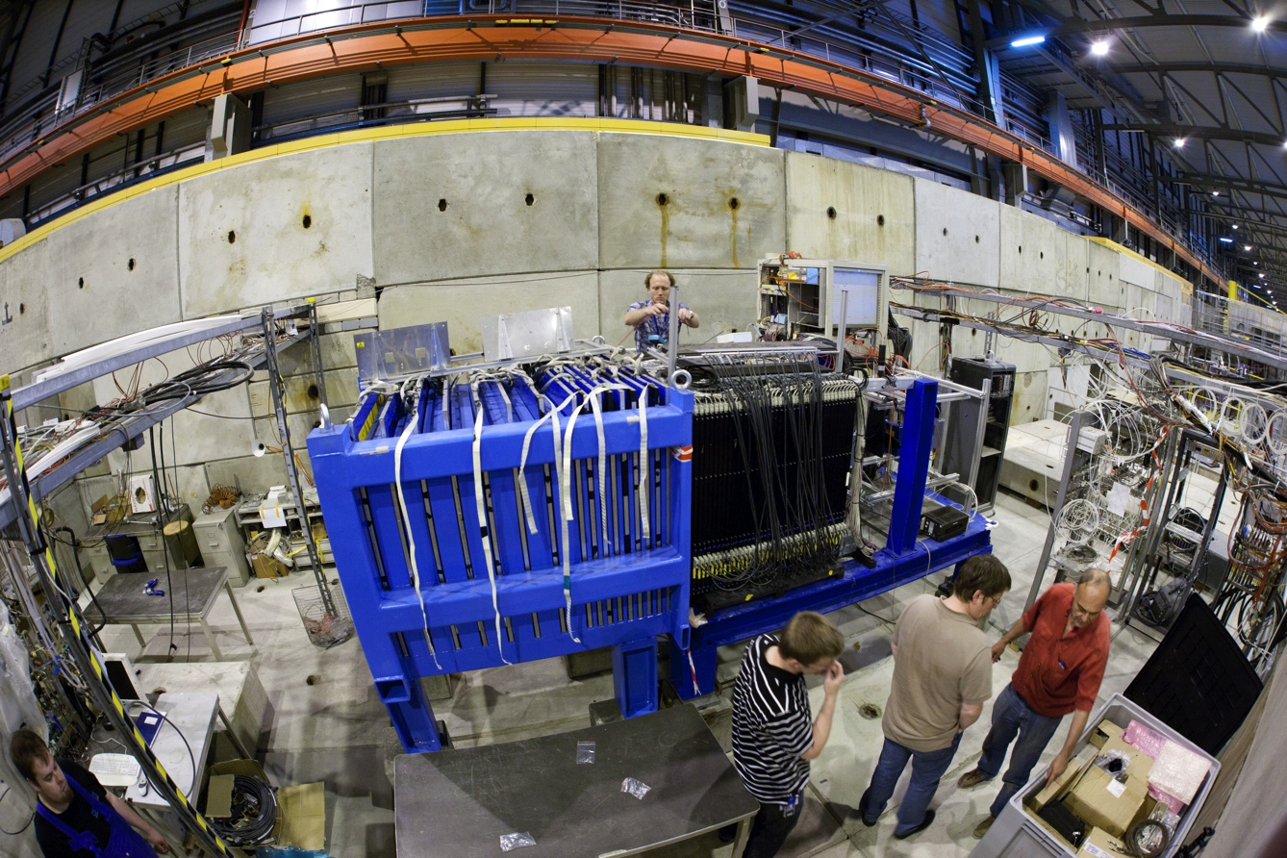
Tailcatcher for high energies
Installation started immediately after the end of June run.
  Installed and commissioned in 10 days available before July run.
  Only the LED system for calibration does not function
Steel/scintillator-strip sandwich calorimeter with 16 layers (~5.5 λ)

Slide 4
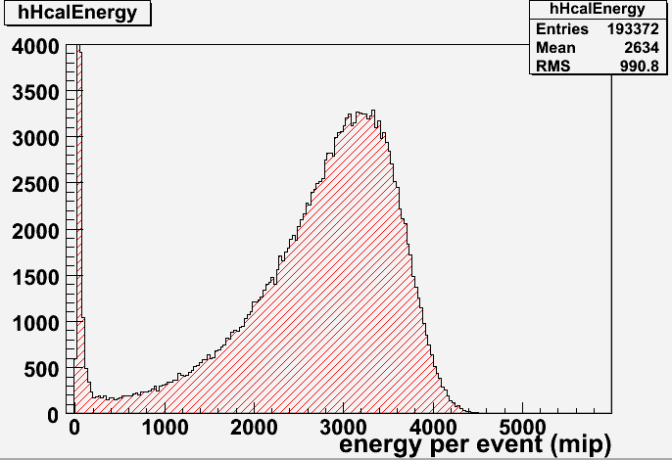
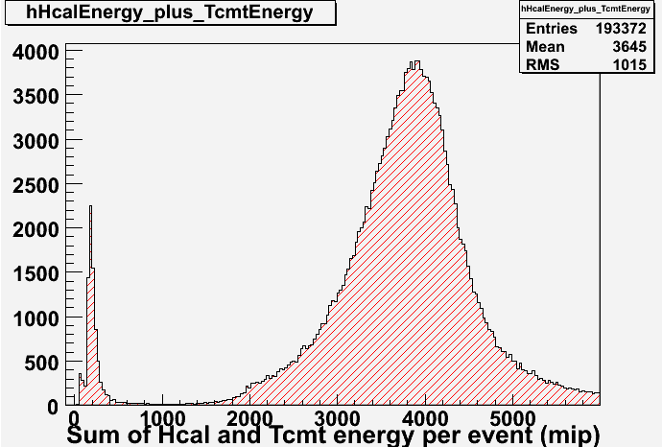
Containment and leakage for 250 GeV
Energy sum only AHCAL
Energy sum AHCAL and TMCT
Here we see clearly that for high energies the tailcatcher is needed to contain the leakage beyond the HCAL.

Slide 5
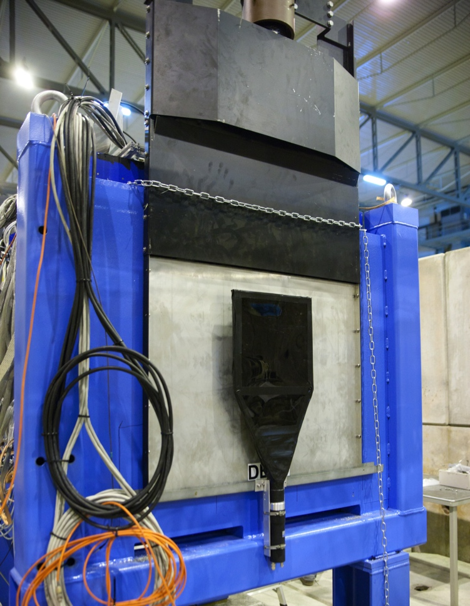
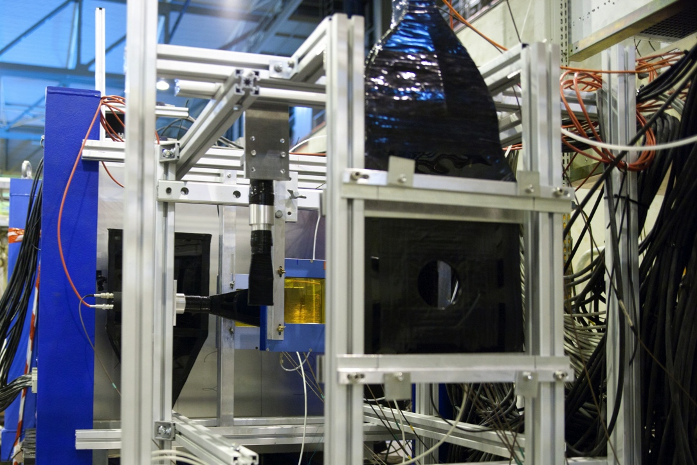
Trigger setup
Two 80x80 cm² scintillators, one before and one after the calorimeter, are also mounted. Unfortunately not efficient at lower part of detector.
Extended with two 30x30 cm² to scan over full surface for muons.
20x20 cm² with a hole of 8 cm for vetoing,
to be used in the offline analysis.

Slide 6
Hold scan - New fitting procedure by J. Dietrich
Iterative procedure in which a useful range is found to be fitted:
Example: run361217 mod #9

Slide 7
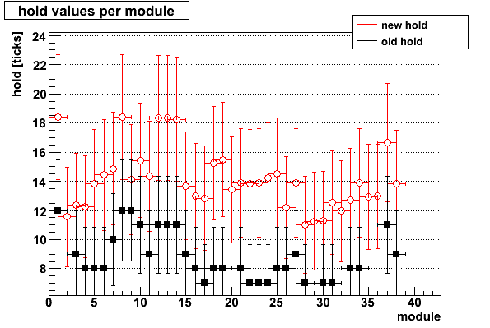
Hold scan
At the PS-T9, we shifted all holdvalues by -8 ticks (see ‘old hold’)
With the new scan that shift seems to have been too much
(see ‘new hold’).
New fit results seem more stable, implemented ‘new hold’ values for each module.

Slide 8
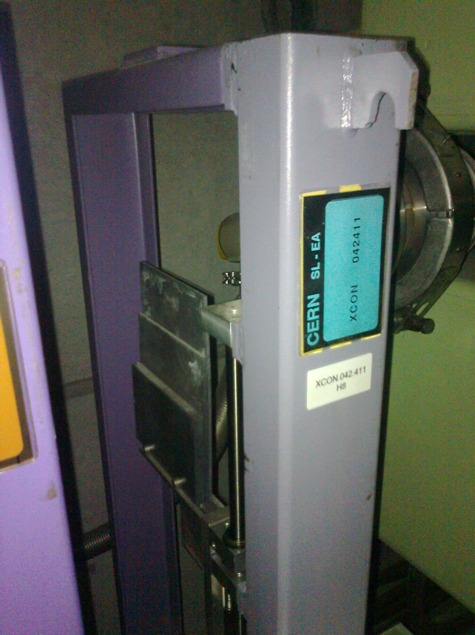
Setting up a beam in SPS-H8
SPS aims 400 GeV primary beam at a target.
Both H6 and H8 beam start after this target. These two secondary beams are linked in energy by the wobbling magnet settings.
Most of the time we ran with wobbling of +180, -180 or -300 GeV.
In the beam line we can produce a tertiary beam at lower energy by inserting secondary target:
400 mm Cu target for hadron production
6 mm Pb target for e+- production.
The "hadron" beam is actually a mixed beam consisting of e+, mu+, pi+, p+
Can be stripped of the e+ with an absorber of 4 mm, 8 mm or 18 mm thick Pb.

Slide 9
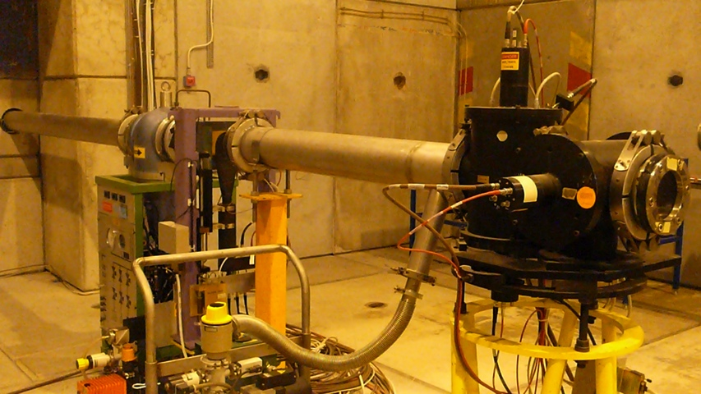
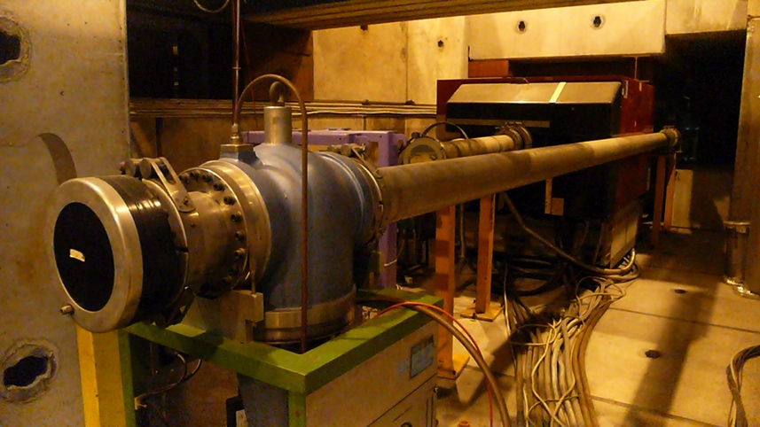
Particle identification
H8 beam line has two Cherenkov chambers for particle ID.
The information was that they are 100% efficient from 30 mb onwards.
  This unfortunately turned out to be wrong. We put the pressure slightly above the pion threshold, to be efficient for electrons (no electrons in the pi sample).
  Some 10%-30% of pi in the e-+ sample.
  We had dedicated electron runs in July period.
Chamber A
Chamber B

Slide 10
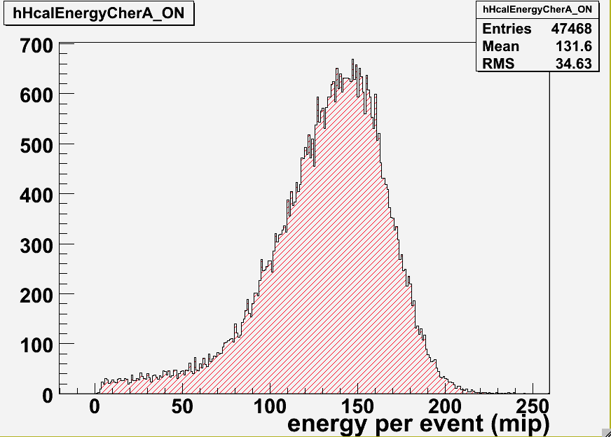
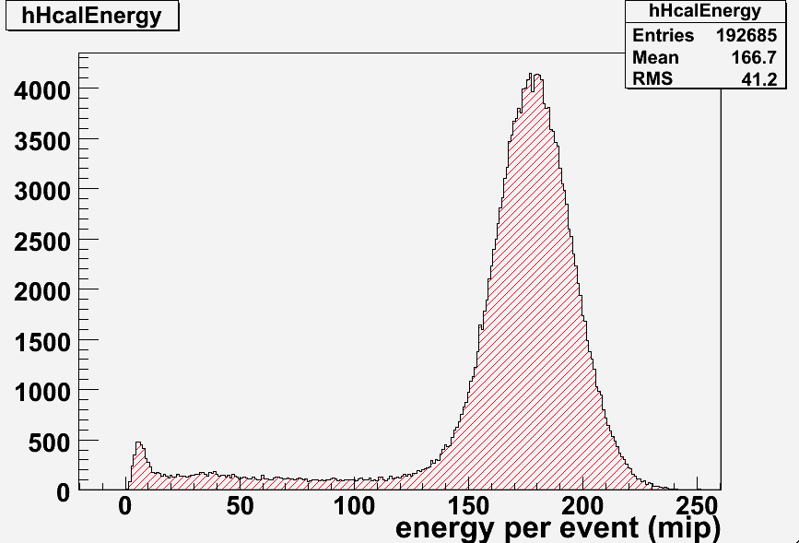
Material and air along the beam
Electrons are very sensitive to material in the beam
10 GeV e⁻ signal from June run,
With 80m air and some material in beam
10 GeV e⁻ signal from July run.
Material in the beam minimized
Vacuum beam pipe installed

Slide 11
Low energy scan – June run
Unfortunately we could only get a very broad & low intensity beam in the first days of June run. Scanning the low energies with tertiary beam was extremely slow.
  With H6 agreed that for the last day of June run we got control of the secondary beam.
Set so-called wobbling of secondary beam to -20, -30, and -50 GeV
  At such low energies, -10 or -25 GeV particles can also be found from the primary target.
With no secondary target the intensity is much higher
  Full scan with negative polarity was done in 30 hours!
Total #events taken: ~ 5 Million.

Slide 12
High energy scan – July run
With the secondary beam at -180 GeV we set up tertiary beams at lower energies. Rates again too low:
Beam rate @ -100 GeV: 300 counts/spill
Unlike first week, there was not the option of setting up wobblings of lower energies.
Tested selecting lower energy particles directly from the secondary beam
Beam rate @ -100 GeV: 3200 counts/spill
Yet this is not how it is supposed to be done at the H8 beamline
Theoretically, for these high energies, the optics are not able to select particles with different energies immediately from the focal point on the primary target.
As we would never be able to go through our program
with 300 counts/spill, we tried it out →

Slide 13
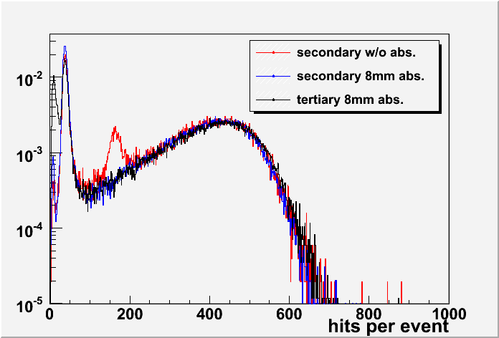
Tertiary vs secondary beam
Check of secondary beam quality: contamination
-100 GeV beam
muon
electron
pion
run # | fraction pedestal | fraction muons | fraction pions
tertiary | 10% | 25% | 65%
secondary | 0% | 35% | 65%

Slide 14
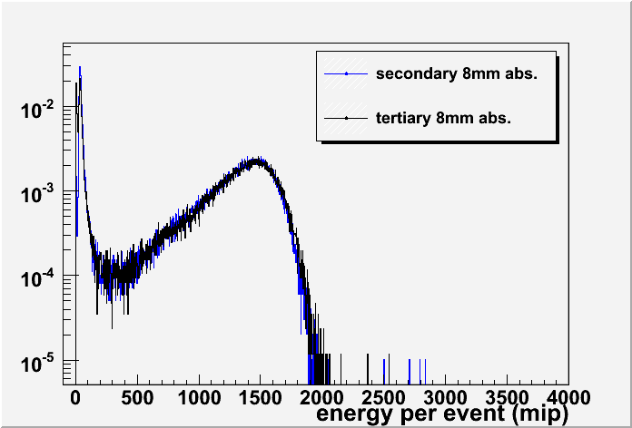
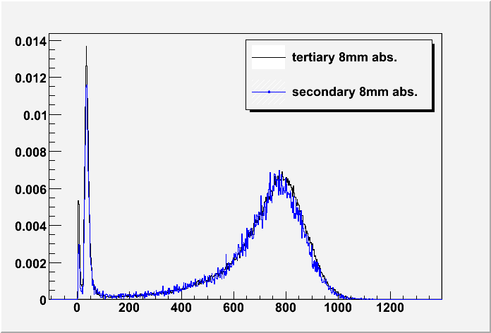
Tertiary vs secondary beam
Check of secondary beam quality: energy
1
-100 GeV
-50 GeV
Two energy points crosschecked between tertiary and secondary beam
Same energy distribution
Even though it is unclear where exactly the particles are created, the particles have the correct energy.

Slide 15
Data taken
AHCAL:
# events
π⁻ : 16 energy points in range from 10 to 300 GeV 11.4 M
π⁺ : 5 energy points in range from 10 to 50 GeV 2.7 M
e⁻ : 6 energy points in range from 10 to 40 GeV 1.2 M
μ : large 80x80 triggers 2.1 M
30x30 triggers, in lower 1/3 of detector area 0.3 M
Analysis is ongoing, got delayed because of CDR
T3B:
The same events in sync with AHCAL, plus ~4 M standalone events.
(see backup slide for all energy points)

Slide 16
Program for September/October run
From 27/9 to 12/10 we have a combined CALICE run in SPS-H8
  27/9 to 3/10: W-HCAL
  3/10 to 12/10: SDHCAL
Program for W-HCAL:
  Positive charge at selected energies 50 GeV ≤ E ≤ 300 GeV
  Muons with 30 x 30 cm² scintillator in 9 positions.
  Large samples of events (10⁶) at 50GeV, 60GeV and/or 80GeV
  to get high statistic Kaon samples (N_{K} / N_{π} ≈ 2-5%)

Slide 17
Conclusion & outlook
Detector performed well.
  Tailcatcher commissioned and operational. Except for LEDs.
Beam operation took some time to learn, but went very well once understood, even with unconventional settings for secondary beam.
2011 program with scintillator AHCAL almost finished and completed.
Plan for next year is to test tungsten HCAL with gaseous readout.
  Due to slow neutrons from W, energy resolution of a W-HCAL with gas readout might not be the same as with scintillators. This needs testing.

Slide 18
Backup

Slide 19
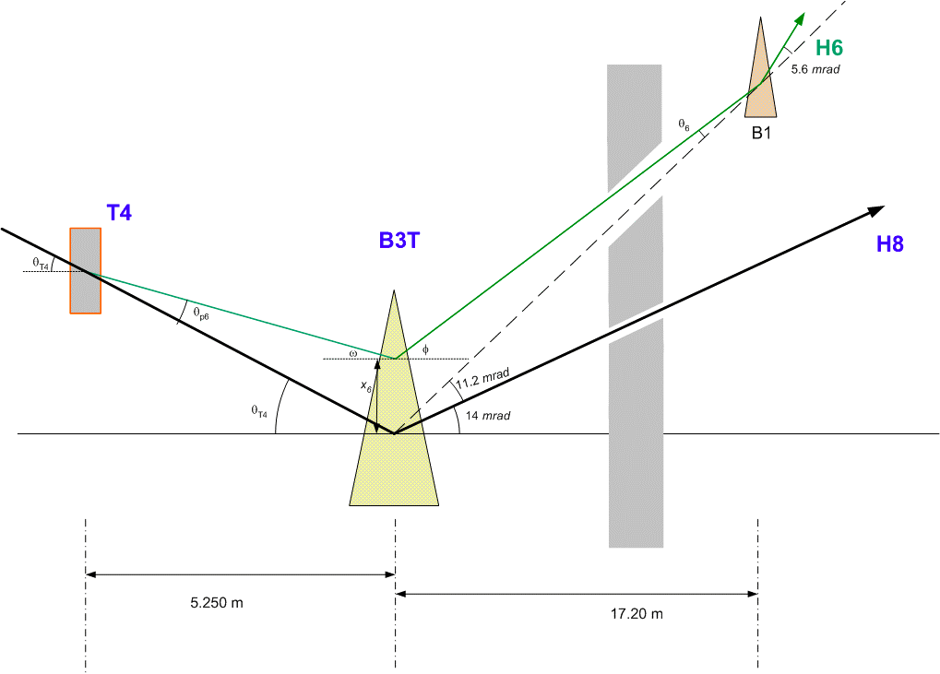
Wobbling
Top view of the end deflection of the beam in the wobbling
As the H8 does not have a horizontal bending magnet, the H8 beam energy is set by the wobbling: E_{wobbling}.
TAX
Primary target

Slide 20
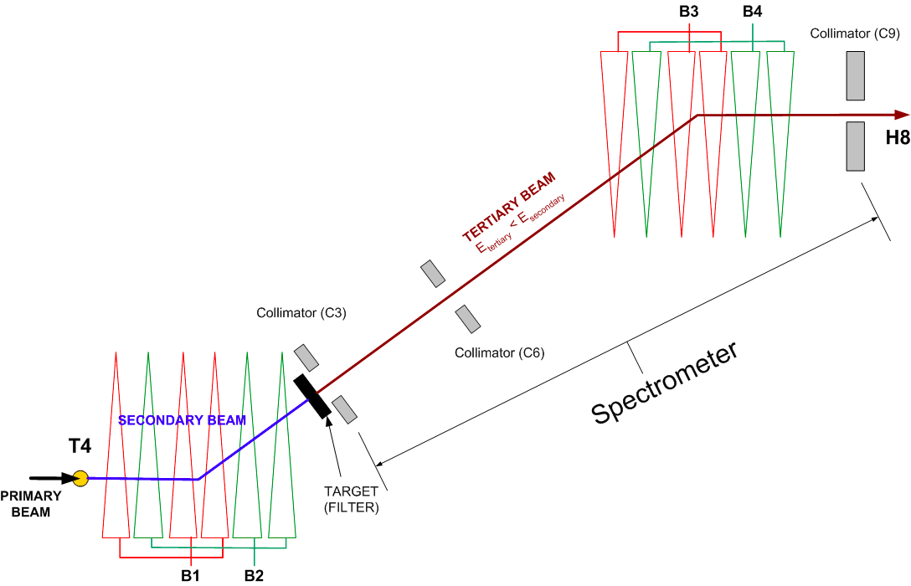
H8 secondary beam
Side view of the deflection of the beam to the surface.
Bending magnets B1,B2,B3 and B4, and quadrupoles must be set to E_{wobbling} to propagate particles up to the North Hall.
wobbling
Collimators C3 & C9 (horizontal slits, move vertically) are in the focal points of lenses along the same beamline: act as Δp slits.

Slide 21
H8 tertiary beam
Adding a target creates a new spectrometer at lower energies.
Intensity is however 10x too low for us. Would never take enough events in 1 week.

Slide 22
H8 spectrometer
What we did: set B1, B2, B3 and B4 and quadrupoles to settings for particles with energies different than E_{wobbling}.
We do see particles, yet it’s not sure where they originate from.
(primary target? TAX?)
wobbling

Slide 23
Data taken
E[GeV] | # evts[k] | # evts[k] | # evts[k]
 | June | July | total
π⁻
-10 | 212 | 100 | 312
-15 |  |  | 202
-20 | 517 | 243 | 760
-25 | 240 |  | 240
-30 | 630 |  | 630
-40 | 200 |  | 200
-50 | 490 | 1465 | 1955
-60 |  | 403 | 403
-80 |  | 804 | 804
-100 |  | 604 | 604
-120 |  | 604 | 604
-150 |  | 1476 | 1476
-180 |  | 602 | 602
-200 |  | 840 | 840
-250 |  | 892 | 892
-300 |  | 813 | 813
Total π⁻ |  |  | 11337
E[GeV] | # evts[k] | # evts[k] | # evts[k]
 | June | July | total
π⁺
20 | 237 |  | 232
25 | 221 |  | 221
30 | 305 |  | 305
40 | 1716 |  | 1716
50 | 261 |  | 261
Total π⁺ |  |  | 2735
e⁻
-10 |  |  | 200
-15 |  |  | 220
-20 |  |  | 200
-25 |  |  | 200
-30 |  |  | 200
-40 |  |  | 201
Total e⁻ |  |  | 1221
μ
10x10 |  |  | 417
80x80 |  |  | 2110
lower 1/3 |  |  | 299
Total μ |  |  | 2826

Slide 24
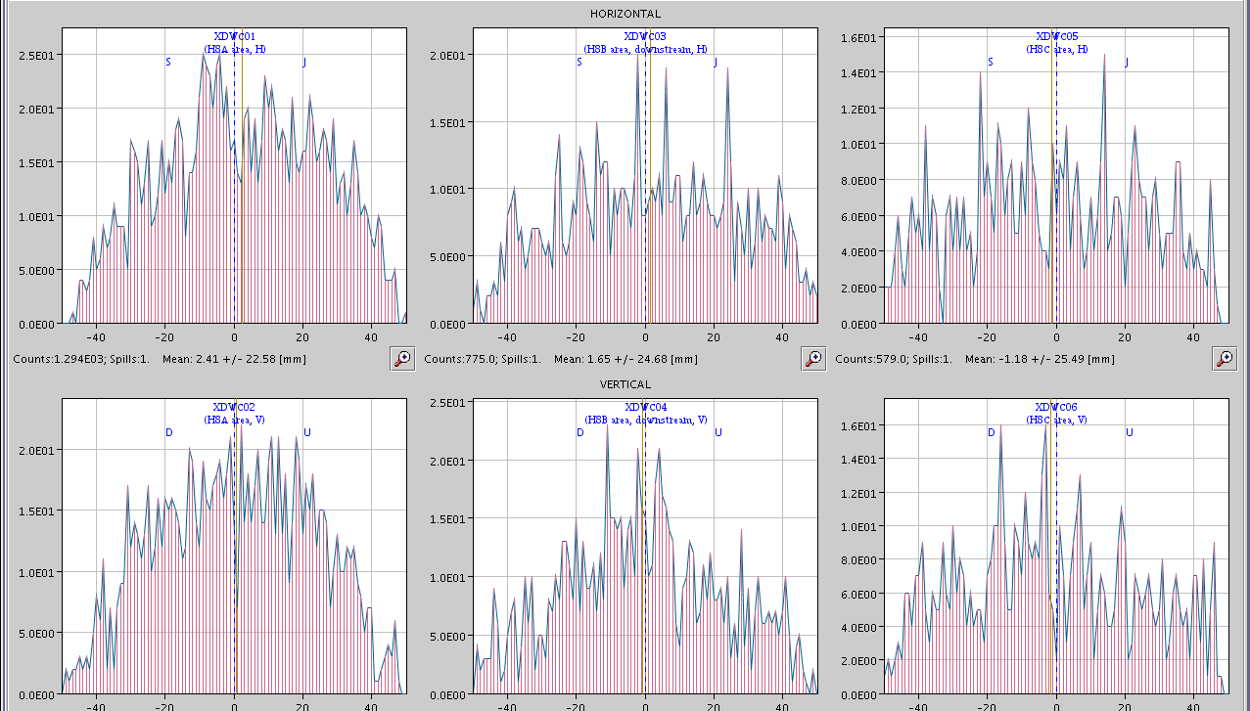
Beam profile: 20 GeV
Wire chamber
#1
Wire chamber
#2
Wire chamber
#3
H
V
Very broad & low intensity beam, we could not get it more focused.

Slide 25


Particle identification
2 Cherenkov threshold counters
Absorber : 4mm, 8mm, and 18mm Pb (strip of electrons)
Cherenkov A 130m up
Cherenkov B 70m up

Slide 26
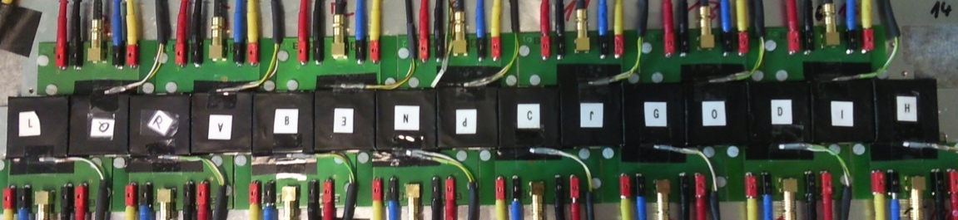
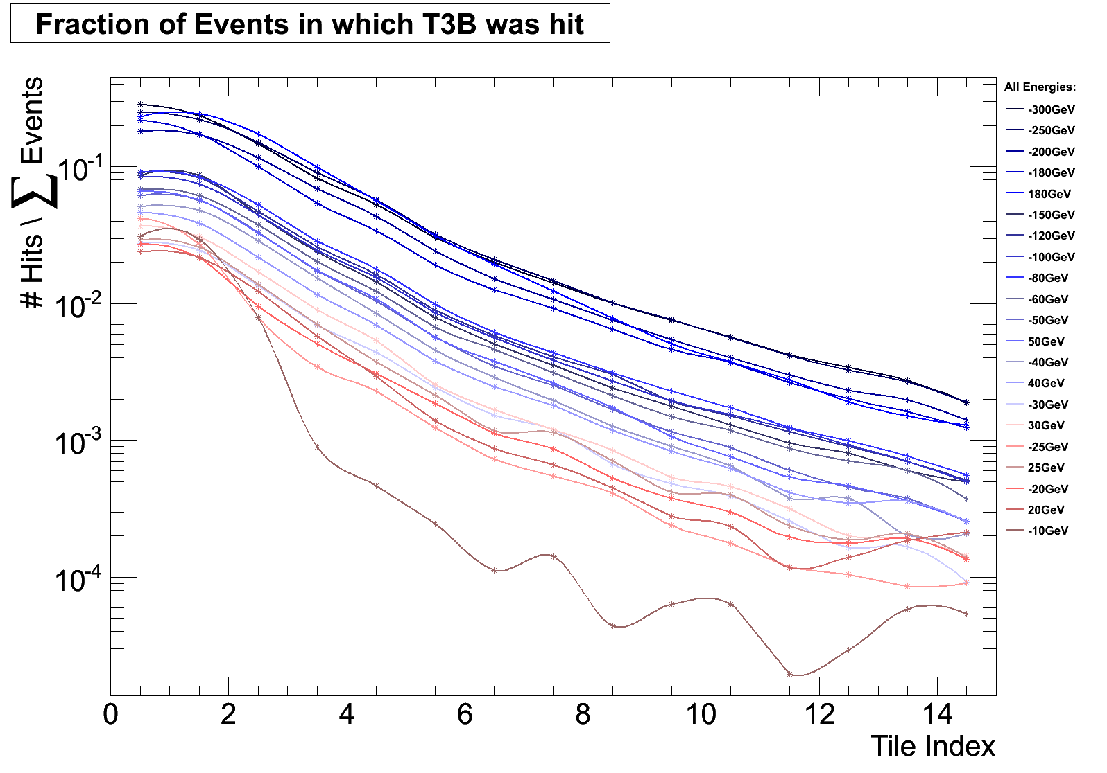
The T3B experiment
T3B is positioned behind the CALICE W-HCAL
Measures time development in hadronic shower
New trigger system enables
high rate standalone acquisition (10kEv/Spill)
stable oscilloscope synchronization
Quite some leakage for > 40GeV
→ nice for T3B
Fraction of Events in which T3B was Hit.
All Energies: 10(pink) to 300GeV(dark blue)
T3B took a nice Data Sample

