Slide 1




Testbeam plans 2012/13
Roman Pöschl
LAL Orsay
CALICE Collaboration Meeting Heidelberg September 2011

Slide 2
Some boundary conditions
To be taken into account :
- FNAL shutdown 3/12 – 2/13
- CERN shutdown 2013 - 2014 (?)
- DESY available all the time and flexible
(Ideal for tests with small setups)
Detailed planning i.e. of CERN and FNAL is naturally not in our hands

Slide 3
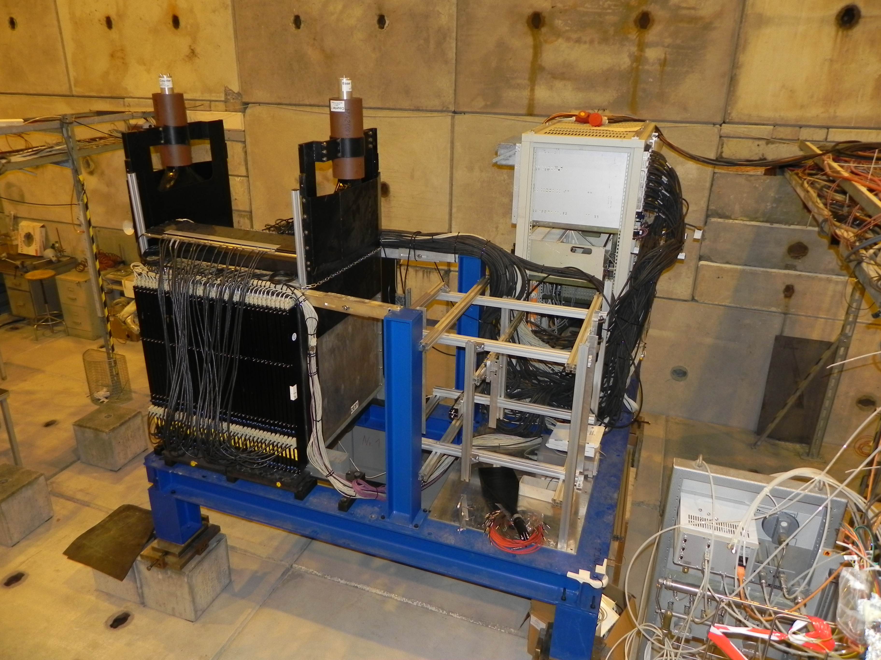
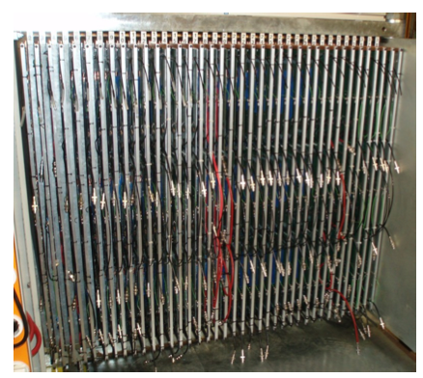
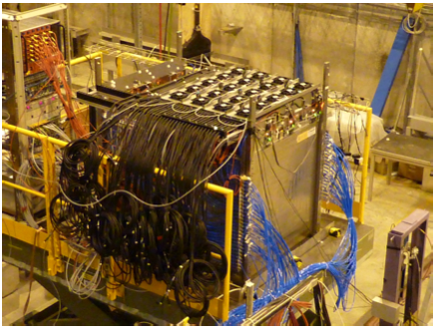
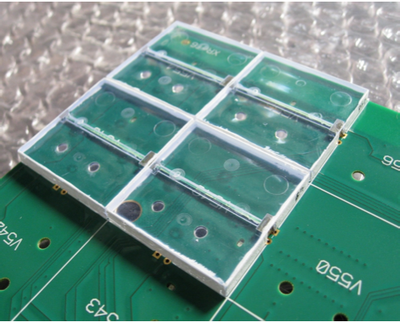
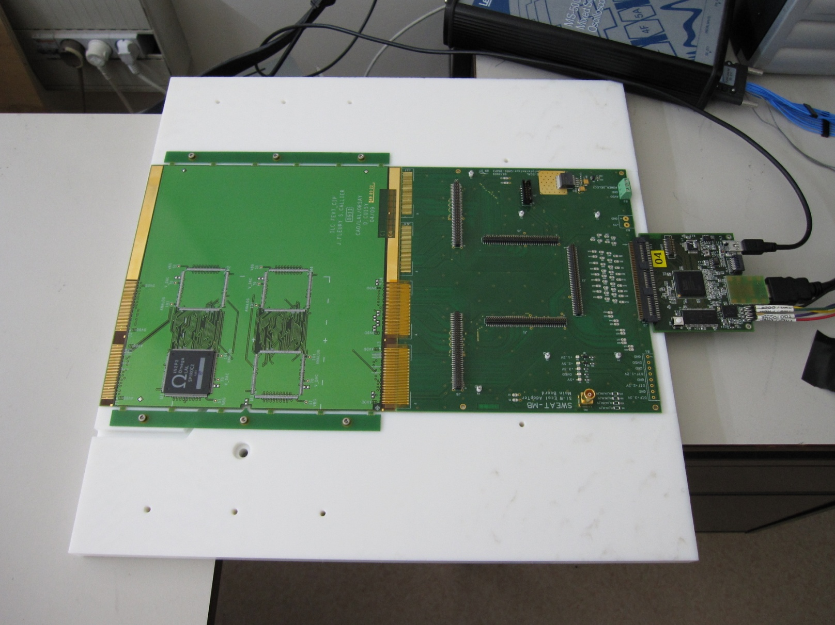
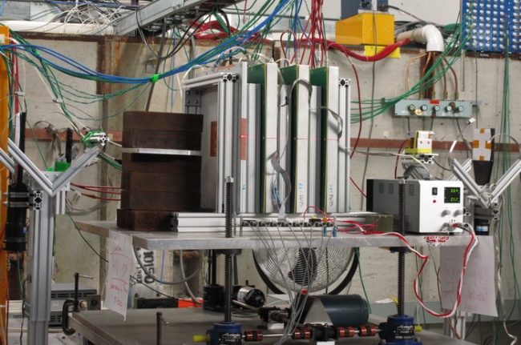
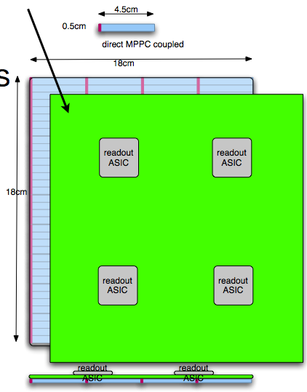
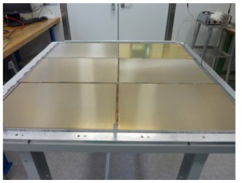
Prototypes. Prototypes ...

Slide 4
SiW Ecal
- Progresses in ASU development/construction will be accompanied by
beam test efforts
Priority to achieve viable and lasting technical solution over rush
to have a full size calorimeter.
Keywords : Wafer technology, challenging SKIROC circuits, flat ASUs
Long slabs
Short terms plans are driven also by French ANR funding
- Will make as much as possible use of (flexible) DESY beam test
Tests in magnetic field (General response, power pulsing) may require
beam time at CERN (!?), magnets elsewhere ?
Irradiation tests are may be an option
- Expect to have up to 10 equipped ASUs at the end of 2012
most likely conservative technology
- Switch to aggressive technology in 2012/13
DESY test beam should be fine also in 2013

Slide 5
Scint Ecal
Timeline:
2011 Design phase
2011 – 2012 production phase
Beginning 2012: Test in Japan
2012 Installation in 'EUDET Module'
Structure (SiW Ecal)
2012 Beam test in multi layer
Structure with SiW Modules

Slide 6
GEM plans
Phase II (late 2011 – early 2013): 33cm x 100cm unit chamber
development and characterization
Begin construction of 2 unit 100cmx33cm chambers, one with kPiX and one with DCAL
Bench test with sources and cosmic rays and beam tests
Construction of 100cmx100cm plane
→ Unlikely to have beam test before FNAL 2012 shutdown
CERN is an option?
Phase III (Early 2013 – mid 2014): 100cmx100cm plane construction
Construct 6 unit chambers with DCAL for two 100cmx100cm planes
Characterize 100cmx100cm planes with cosmic rays and beams
→ In time for reopening of FNAL beam lines

Slide 7
Technological prototype of AHCAL
First tests of second generation AHCAL layers
We expect about 2 layers
Would try to reproduce T3B data as proof of principle: run with tungsten
Few days towards the end of 2012 run can be done at PS or SPS
DESY Testbeam as default facility
Integration into tungsten stack (see later)

Slide 8
SDHCAL Micromegas
- Continuing program with a small number of layers
→ New layers will be examined
Tests of power pulsing, spark protection
1 week standalone in 2012
- Integration into SDHCAL stack
Two or more layers into SDHCAL stack

Slide 9
GRPC SDHCAL
- Continuation of 1m3 program which have started in 2011
SDHCAL is essential part of e.g. ILD DBD !!!
- Request to apply for 2x4 weeks at SPS in 2012
It is however essential that one period is scheduled at the
very beginning of 2012

Slide 10
W-Hcal program
Importance to have data with scintillator and gas
→ Scintillator sample fairly complete, convince whether more data needed
- CALICE has one stack and two sets of RPCs
TB identified that in 2012 we should concentrate on running with the DHCAL RPC
A run plan could look like
- Spring setup at PS T7
- One week in PS T9
- Take 2x two weeks at SPS
- Runs in combination with a SiW Ecal would be desirable but is 2nd priority
Looks unlikely/impossible that this can be realised
Manpower limited and persons are working on technological prototype

Slide 11
Summary of plans/requests for 2012
CERN SPS:
2x4 weeks for SDHCAL running at SPS (one in very early 2012)
2x2 weeks of tungstene program with DHCAL RPC
Optional 1 week to complete the scintillator program with tungsten
1 week for Micromegas running
Comment : Should strive for parallel running in H6 and H8 line
Keyword wobbling => Could optimise beam energies by ourselves
1 week SiW Ecal tech. prototype in magnetic field
(Should happen in first half of 2012)
=> Total (up to) 14 weeks at SPS in 2012
CERN PS :
2 week at PS T9 for commissioning of W-stack with RPCs
+ setup time ain T7 beam line
CERN requests 2012 : Organisation of beam test workshop
Proposal by Ilias of CERN
No news since but TB is favorable of such workshop
→ Relaunched Ilias and will try to push for it
May avoid bad surprises as in 2011
DESY :
Alltogether about 4-6 weeks with Ecals and AHCAL techno. prototypes

Slide 12
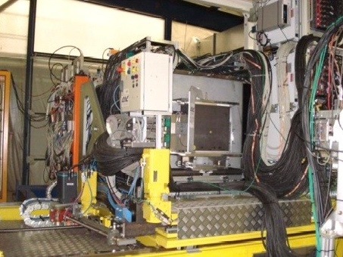
Movable stage and TCMT
Stage at FNAL since spring 2008
- Will be brought back to Europe
During winter 2011/12
- Needs repair work and maintenance
Requests from W-Program and SDHCAL
TCMT :
CALICE disposes two TCMTs, one at FNAL and one at CERN
Need both TCMTs at CERN in 2012
→ Organisation of transport needed

Slide 13
Summary
- 2012 very rich program at all fronts
Need to find good balance between interests, duties and timescales
Major objectif 2012 : ILC Detector DBD
Needs emphasis on technological development and understanding of technologies
- CERN 2012
Organisation of beam test workshop to get overview on request from other
- 2013 looks still a bit unclear
Plans for Ecals, AHCAL tech. prototype and GEMs
No realistic scenario for major, i.e. combined, beam test
Could anyway only take place at FNAL

