Slide 1
Study of
SC Quadrople in Cryomodule
Reported by
Akira Yamamoto
Cryomodule Webex Meeting, June 20, 2011

Slide 2
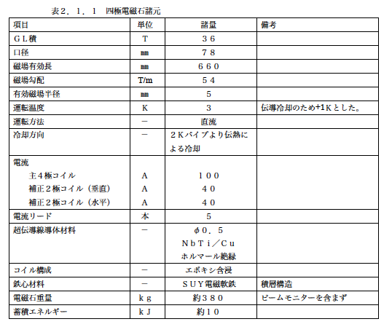
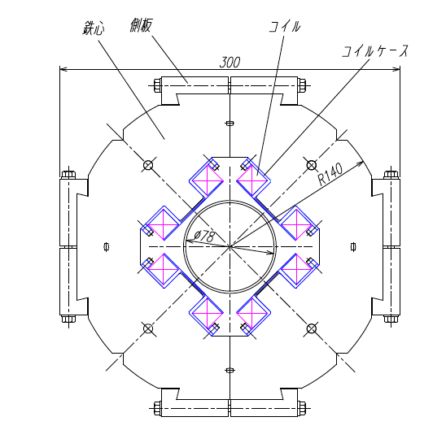
Conduction-Cooled Quadrupoles
Magnet itself, originally designed by V. Kasikhin (Fermilab)

Slide 3
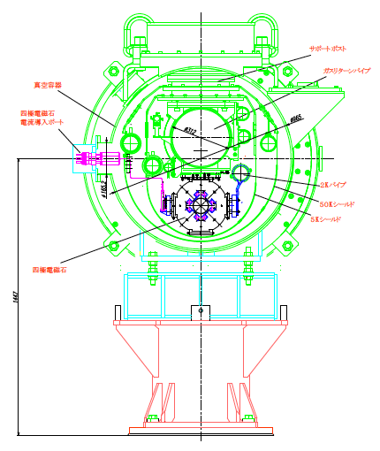
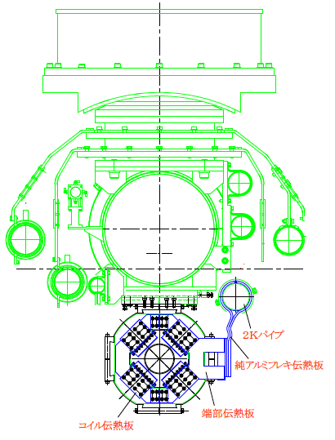
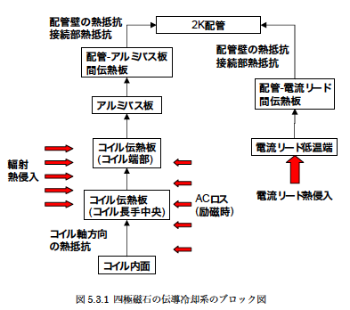
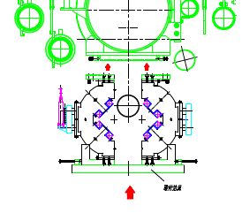
Conduction Cooling Concept
Cooled through pure-Al strip from 2K LHe line

Slide 4
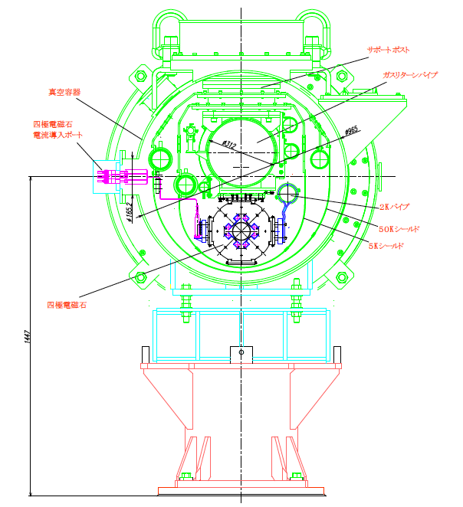
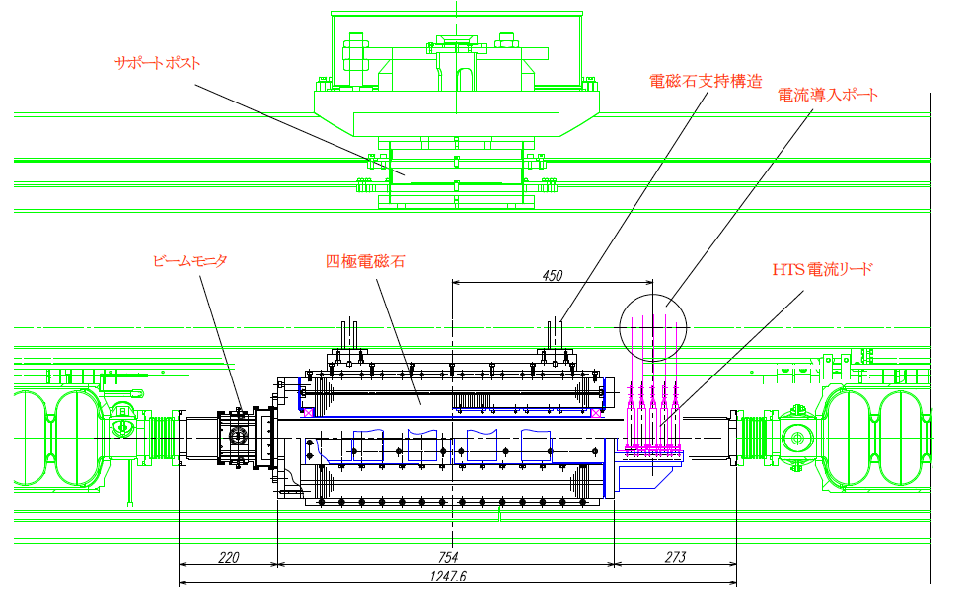
SC Quadrupole in Cryomodule
Suspended by GRP

Slide 5
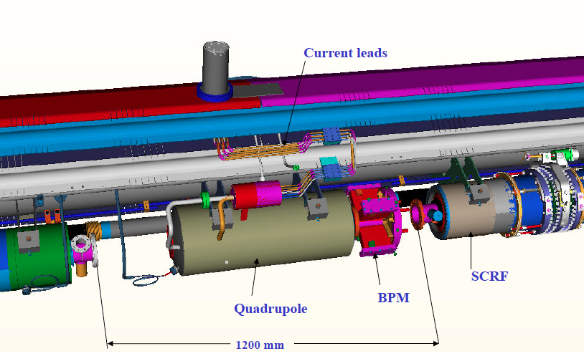
Current design for connection
Quadrupole package located at axial center

Slide 6
A Proposal / Revival
9 4 + Q +4 9
8 8 Q 8
Independent stand-off at bottom, mechanically free from GRP,
Solid pipe work (without bellows) at down stream end
Minimize additional piping work
  Not full additional interconnect : not (3 +1 full) but (3 + alpha) interconnect,

Slide 7
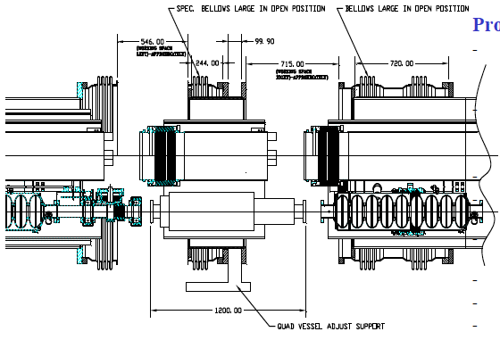
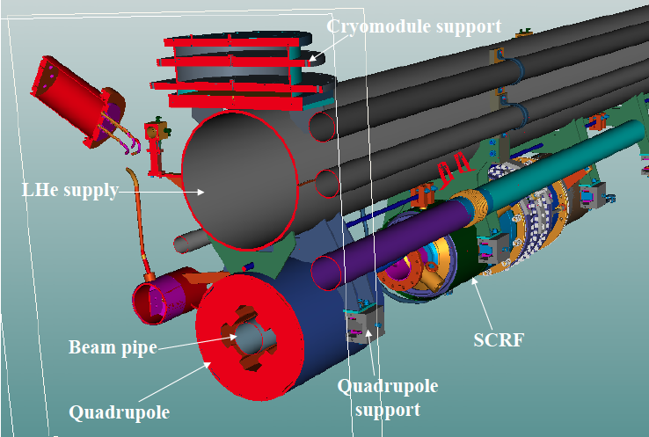
Thinking about a cost-effective connection
We could eliminate flexible/bellows connection one-side, with simple extension of solid pipes
We would like to seek for a smart/sophisticated solution with expert’s contribution.
Another possibility is to place Q in every 4 cryomodules (instead of every 3 cryomodule)

Slide 8
Advantage/Disadvantage and
Necessary Study/Work
Advantage:
  Single cryomodule design and manufacturing
  Independent work between RF and Magnet
  Easier and direct alignment including BPM, in installation in case of keeping conductive cooling magnet,
Disadvantage:
  Additional interconnect work
Necessary study/work/communication
  Smart and sophisticated interconnect design and work including connection of beam-pipe,
  Discussions and consensus in ILC-GDE SCRF group
  Visit and discussion with key persons
    7/5: INFN (Milano), 7/22: Fermilab, 7/24, Workshop, 7/25 ~ SRF,

