Slide 1
Establishing the TDR Baseline
Goals for the Workshop
Nick Walker for the project management
DESY BTR 24.10.11

Slide 2
Towards the TDR
Importance of establishing community consensus for the TDR baseline
  similar to 2005 process for the RDR
Strongly based on seven proposals made in SB2009 document Dec. 2009.
Builds on the high-level decisions made (four themes) identified for Top-Level Change Control
  September 2010 BAW (KEK)
  January 2011 BAW (SLAC
Decisions (by Director):
  Average gradient and support of gradient spread
  Single ML tunnel and associated HLRF solutions
  Reduce beam-power parameter set (smaller DR etc.)
  Relocation of e+ source to central campus (including low-energy running)

Slide 3
Beyond TLCC
Next-level of change control
  design changes have been proposed since the RDR
  results of on-going R&D
  results of TLCC decisions (SB2009)
Need to comprehensively review these changes and formally accept them as baseline
  cost impact
  performance impact
Final decision rests with the PMs
  after consultation with the community
risk!

Slide 4
BTRs
July 2011 INFN Frascati
  Damping Ring
October 2011 DESY
  Electron source
  Positron source
  RTML (including bunch compressor)
  BDS / MDI
  Central region integration (general)
January 2012 KEK
  Main linac and SCRF technology
March 2012 CERN
  CFS (global)

Slide 5
Key aspects to BTRs
Comprehensive review of proposed design
Focus on changes with respect to RDR
  “change control”
  Attempt to make key design decisions where necessary
Review CFS requirements
Review of cost
Prepare baseline documents for EDMS

Slide 6
Focus points for this review
PM generated list of RDR modifications
  http://ilcagenda.linearcollider.org/materialDisplay.py?materialId=slides&confId=5222
  (goes beyond just this review)
Quite comprehensive but not exhaustive
  Attempt (by PMs) to capture a list of issues that need attention
  Not all of equal weight
Our hope is this list will be covered during this workshop

Slide 7
Review Deliverables
Documents !! which reflect our decision decisions
  parameter tables, tables, drawings etc.
Action items for remaining work
  Hopefully mostly documentation
  Plans for dealing with remaining issues

Slide 8
Review Structure
Basic format for each AS
  Comprehensive review of design
  Focus on identified key aspects
  CFS requirements
  Costs

Slide 9
Key cost driver
CFS BTR contributions
  6 (!) each talks; one for each of the four AS, one on central region integration and a summary
Each AS talk will cover:
  layout for each sub-section, shaft/surface criteria, mechanical / electrical criteria
  e.g. BDS doglegs, aborts, muon, detector hall, service tunnel, shafts…
Central Region integration talk (Thursday AM)
  Central region CFS region criteria derived by combining criteria from each AS
  to include overall tunnel / beamline locations, shafts, support areas, primary mech/electrical

Slide 10
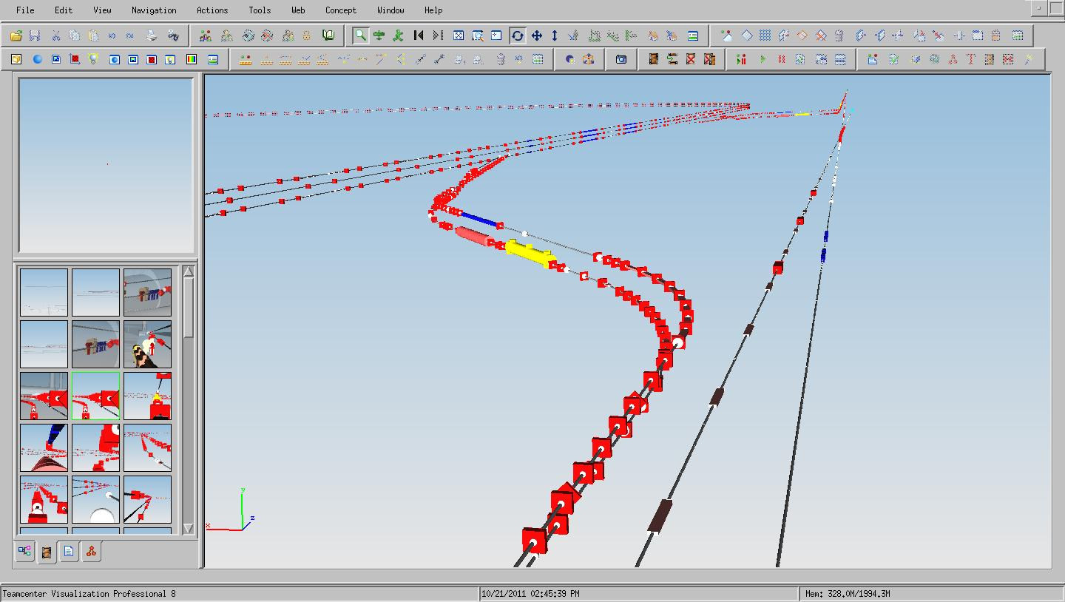
PLTR Area
DR
RTML
e- to IP
e+ to Dump
e+ to DR

Slide 11
Design Integration
Design Integration at DESY has started
Goal: Complete and Consistent Lattice
  available during TDP2, i.e., now
  as input to Tunnel Layout and CFS Design
  with feedback from CFS for optimization (e.g. tunnel diameters)
The key to a design with consistent
  Accelerator Design
  Conventional Facilities Design
  Cost Estimate#
Virtual Reality Room Demonstration of complete ILC model can be arranged → Benno List
Benno List - DESY

