Slide 1
ILC SOURCES/RTML/BDS + MDI TECHNICAL BASELINE REVIEW
CFS REQUIREMENTS for RTML
CONVENTIONAL FACILITIES
AND SITING
V. Kuchler

Slide 2
Overview
  Criteria Development
  Drawings
  Mechanical and Electrical Criteria
  Remaining Issues

Slide 3
Criteria Development
  Several Meetings were Held
    CFS Weekly Webex Meetings
    Face to Face Workshops
    Numerous Email Exchanges
    Parallel Sessions at Major Workshops
  Criteria Document has been Developed for the RTML
  Mechanical and Electrical Criteria were Developed Based on a Common Set of Questions Contained in the Criteria Document
  Full Mechanical and Electrical Design will be Available by December 2011

Slide 4
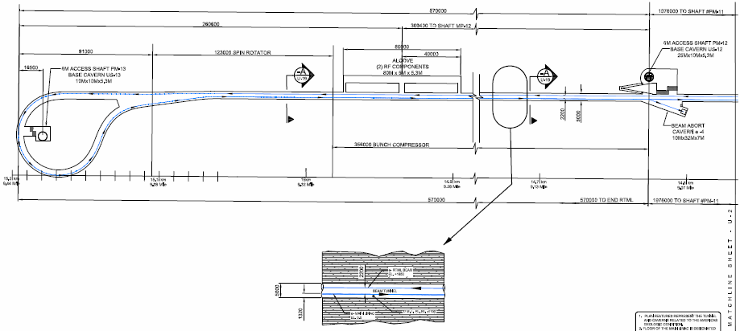
e- 4
RTML Tune Up Dump
Plan View at RTML e- Turn Around Loop

Slide 5
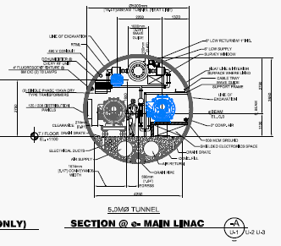
RTML Position (Ht) is Determined by KCS Equipment

Slide 6
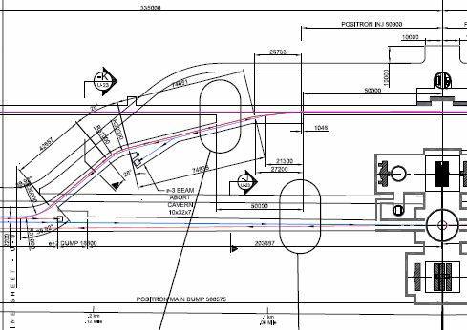
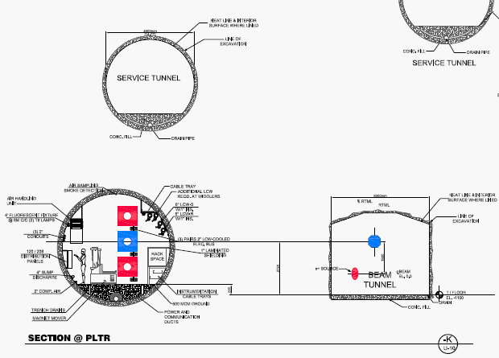
e- 3
EDRX Tune Up Dump
Plan View at PLTR/Damping Ring

Slide 7
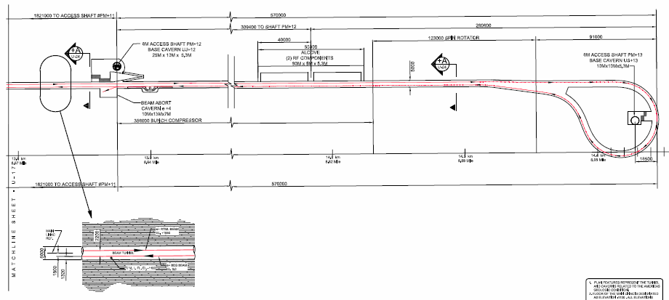
E+ 4
RTML Tune Up Dump
Plan View at RTML e+ Turn Around Loop

Slide 8
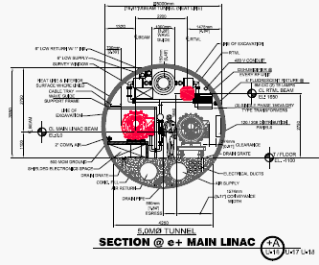
RTML Position (Ht) is Determined by KCS Equipment

Slide 9
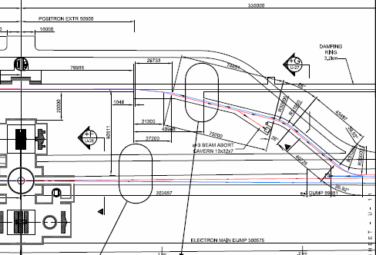
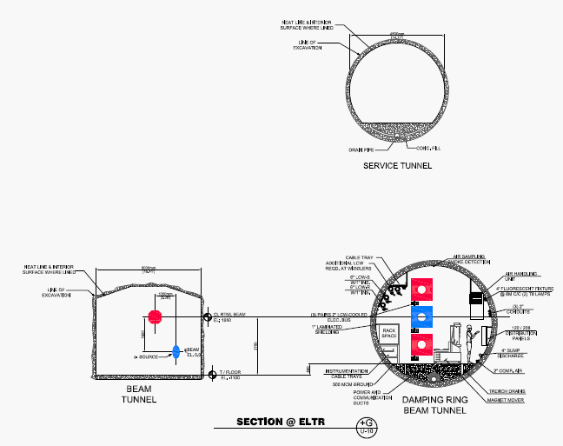
e- 3
PDRX Tune Up Dump
Plan View at ELTR/Damping Ring

Slide 10
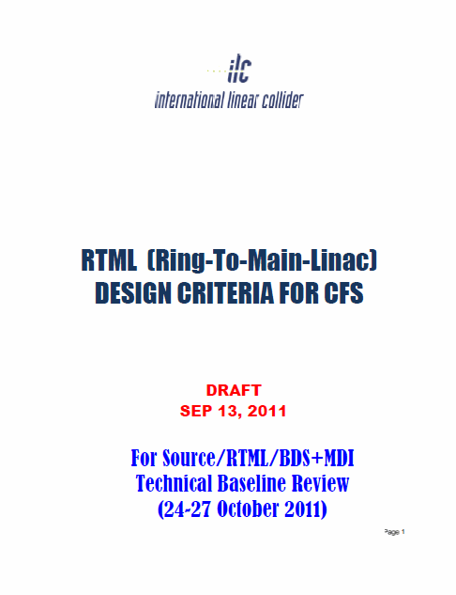
Cover Sheet for the
CFS Mechanical and
Electrical Design Criteria Document

Slide 11
Mechanical & Electrical - RTML
The Total Load is Currently Reduced to 1.6MW (Technical Components Only), Updated on Sep 13, 2011. This Accounts for 1% of the Total Technical Load. (About 89% Thermal Load to Water)
Approximately 90% of this Load is Located at the RTML Ends, and the Rest are in the PLTR & ELTR
There are no Requirements for Tight Stability. Space Temperature is Expected to be About 104F
The CFS Electrical Service Terminates at Panelboards Equally Distributed in the Service Tunnel
The CFS Process Water Terminates with Valves at the Pipe Header, with Equally Sized Skids Located in the Service Tunnel Based on Combined Loads in the Central Region

Slide 12
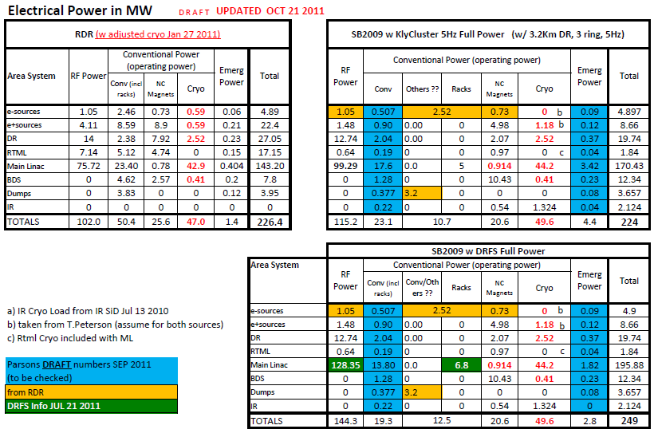

Slide 14
CFS RTML Summary
  In General RTML Criteria is Well Understood
    Overall Equipment Layout
    Mechanical and Electrical Criteria
  There Remain Details that Still Need Clarification
    Specific Boundary Points Between Adjacent Area Systems
    Physical Size of Small Dumps
    Location and Physical Size of RF Equipment in Alcove
    Final Decision on One vs Two Bunch Compressors
  At This Time, Changes to the Mechanical and Electrical Criteria are not Anticipated
  Final Updates to CFS Drawings will be Completed Prior to the CFS BTR In March at CERN
  TDR Drawings and Criteria will be Entered into EDMS After Validation at the CFS BTR

