Slide 1
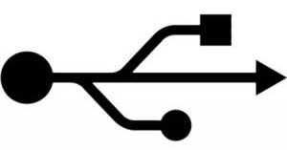
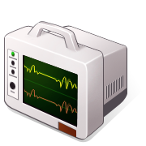
1
S1
2
ATF local
3
4
A IN
B IN
A IN
B IN
A IN
B IN
5
7
8
Y2
Y2
SUM
SUM
SUM
P2
M2
P3
M3
LO IN
DIF
LO IN
DIF
LO IN
DIF
Y1
Y1
ADC 1
F1
ADC 2
ADC 3
ADC 4
ADC 5
ADC 6
ADC 7
ADC 8
ADC 9
RS232
AUX IN A
AUX IN B
A IN
B IN
A IN
B IN
A IN
B IN
FST CLK
10
1
2
tunnel
LO IN
SUM
LO IN
SUM
LO IN
SUM
DIF
DIF
DIF
control room
Φ
Φ
Φ
Φ
Φ
Φ
Φ
Φ
KEY
ATF local
F2
ADC 1
Amplifier
ADC 2
ADC 3
ADC 4
ADC 5
Power supply
ADC 6
ADC 7
ADC 8
2-way splitter
ADC 9
RS232
1
S2
AUX IN A
2
ATF local
Delay module
3
Φ
AUX IN B
4
Φ
Phase shifter
90°
FST CLK
Φ
USB control
module
mechanical
control
357 MHz
2.16 MHz
LO
TRIGGER

