Slide 1
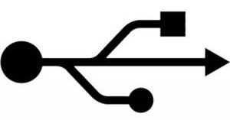
1
S1
ATF local
2
3
4
A IN
B IN
A IN
B IN
A IN
B IN
M1
M2
M3
A IN
B IN
A IN
B IN
A IN
B IN
5
7
8
Y2
X2
Y2
X2
Y2
X2
1
10
2
SUM
SUM
SUM
P1
P2
P3
SUM
SUM
SUM
LO IN
DIF
LO IN
DIF
LO IN
DIF
Y1
X1
Y1
X1
Y1
X1
LO IN
DIF
LO IN
DIF
LO IN
DIF
ADC 1
F1
ADC 2
ADC 3
ADC 4
ADC 5
ADC 6
ADC 7
ADC 8
ADC 9
RS232
AUX IN A
AUX IN B
FST CLK
tunnel
control room
Φ
Φ
Φ
Φ
Φ
Φ
Φ
Φ
ATF local
KEY
Amplifier
Power supply
Delay module
Φ
Φ
Phase shifter
90°
Φ
USB control
module
mechanical
control
357 MHz
2.16 MHz
LO
TRIGGER

