Slide 1


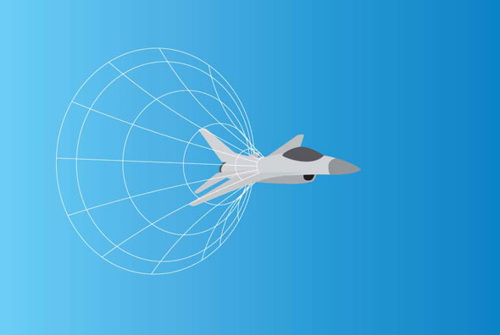
Čerenkov Timing Simulations in Geant4
Chris Nicholson
Supervisor: Mike Albrow
Symmetry Magazine Aug 09

Slide 2
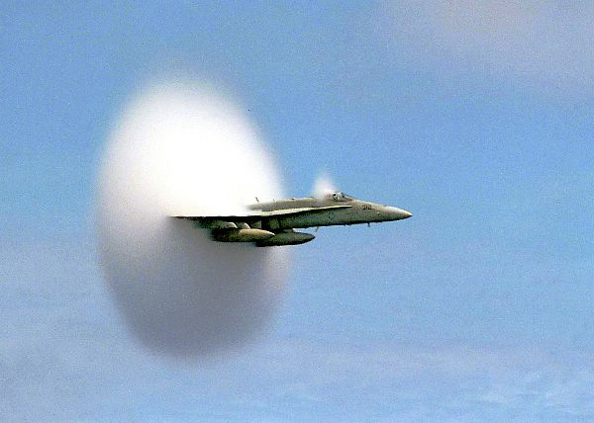
Background
Čerenkov radiation produced by ‘faster than light particles’ in a medium : ultra-relativistic protons in quartz.
http://sadjadi.org/Cerenkov/boom.jpg

Slide 3
Background II
Exclusive two photon production.
Possibility of Higgs from top quark loop.
Require very fast timing resolution to determine which two protons are a pair.

Slide 4
Method
Geant4 Simulations & Root analysis
  Compare with results from test beam measurements
  Look at:
  Dispersion
  Absorbtion
  SiPM efficiency
  Materials
  Test beam measurements

Slide 5
To Investigate
How much light reaches detector? More than quartic?
Various effects: dispersion vs.
path length; angle of incidence
changes for square geometry.
Can blue catch up with red?
Different materials
Red light filter
Aiming for ps resolution

Slide 6
Schedule
Familiarise with Geant4 & Root code from Moriah’s project (last summer)
Tutorials to improve knowledge
Change geometry to L-bar and run simulation and analysis
Analysis of test beam data
Compare to test beam results

