Slide 1
Electrical Properties of MPPC/SiPM/GMAPD’s
Adam Para
June 24, 2011

Slide 2
Motivation
MPPC/SiPM/GMAPD are avalanche diodes biased in the reverse direction and operated in a Geiger mode (so we think)
Their behavior depends on the electrical properties of a cell: resistance and capacitance, hence it is important to measure these properties for different detectors we are trying to understand
Detectors:
  1 mm x 1 mm, 20μ pixel 025U, 50μ pixel 050U, 100μ pixel (100U)
  3 mm x 3 mm, 50μ pixel, 050PX

Slide 3
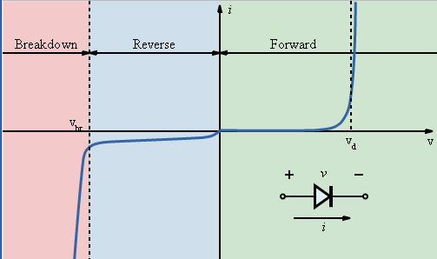


Ideal Diode (Shockley)
Current in the forward direction, where
thermal voltage
saturation current

Slide 4
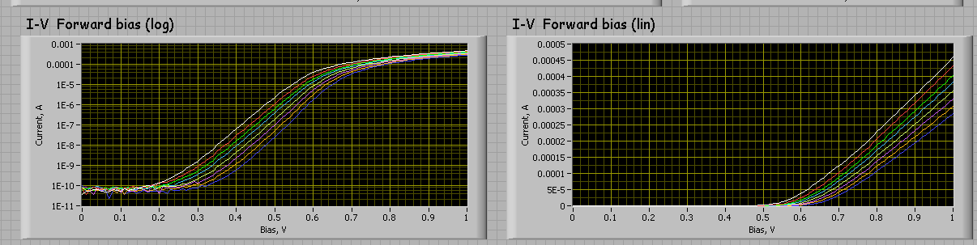
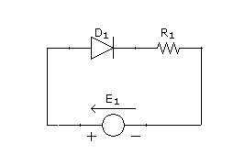
I-V Curve for a Real Detector
We have a quenching resistor in series with the diode

Slide 5
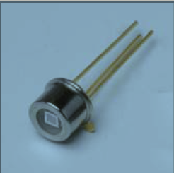
Hamamatsu 025U
1 mm x 1 mm, 1600 pixels

Slide 6
the same data in a linear and logarithmic scale
I-V characteristics measured at temperatures from -60C to +50C
Shockley equation provides a very good description of the measured I-V curves over 5 orders of magnitude
slopes of the lines on a linear plot => total resistance
Assuming the parasitic resistance is small, the quenching resistance R_{q}=N_{pixel}xR_{dev}
slopes of the lines on the log plots => thermal voltage
vertical offset on the logarithmic plot => saturation current
all parameters change with temperature

Slide 7
I-V Diode Only

Slide 8
Quenching Resistance
Quenching resistor gets smaller as the temperature rises (polysilicon!)
Non-linear dependence of the quenching resistance on temperature

Slide 9
Thermal Voltage
fitted values of the thermal voltage change linearly with temperature, as expected
quenlity factor n very close to 1 (1.04)

Slide 10
Saturation Current
Saturation current varies by 10 orders of magnitude.
Presumably related to dark pulses rates

Slide 11
Hamamatsu 050U
1 mm x 1 mm, 400 pixels

Slide 14
Hamamatsu 100U
1 mm x 1 mm, 100 pixels

Slide 17
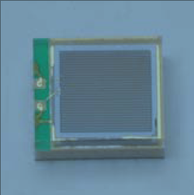
Hamamatsu 050PX
3 mm x3 mm, 3600 pixels

Slide 20
Comparison of detectors

Slide 21
Quenching Resistance
50U and 100U have very similar quenching resistor
25U has about twice as big
50PX has the resistor 50% higher then 50U

Slide 22
Thermal Voltage
25U, 50U and 100U have ‘the same diode’
50PX diode seems to be somewhat different

Slide 23
Saturation Current
25U, 50U and 100U have ‘the same diode’
50PX diode seems to be somewhat different

