Slide 1
SCRF Monthly WebEx Meeting
June, 29, 2011
Report from PMs (15 min.)
  GDE SCRF related meeting plan in 2011~2012 (PMs)
  SCRF webex meeting plan for a Series of topical discussions on each subject (A.Y.)
  SCRF Cavity Industrialization workshop, Chicago, July 24
  LCWS Gradana meeting plan (to be discussed later),
  S1-Global Progress Report in cooperation with KEK and ILC-GDE (A.Y.)
  ILC Cryomodule design to be unified with a 8-cavity-string and independent Q (A.Y.)
  Update of SCRF Industrialization Model and Diagram
Report from TA Group Leaders
  Cavity Gradient R&D: R. Geng
  Cavity Integration: H. Hayano
  Cryomodule: P. Pierini
  Cryogenics: T. Peterson
  HLRF: S. Fukuda & C. Nantista
  ML Integration: C. Adolphsen
Special Discussions (30 min.)
  HLRF-KCS R&D progress and Preparation for Technical Design Report (C. Nantista)
  Granada, LCWS, meeting and SCRF agenda (J. Kerby, H. Hayano, C. Nantista, P. Pierini

Slide 2
Meeting Schedule related to SCRF (2011~)
Month | Day | Place | Meeting
2011 May | 4 →6 19-20 | Web Taipei | Monthly meeting ILC-PAC (SCRF: R&D report by R. G. and H.H.; Industrialization by A.Y.)
June | 1 6-8 29 | Web DESY Web | Monthly meeting FLASH-9mA workshop Monthly meeting (HLRF-KCS discussion)
July | 24 27 | Chicago Web | Cavity industrialization WS, SRF2011 (25~29) Monthly meeting (Cavity-Integration/Cryomodule-Assembly)
August | 24 | Web | Monthly meeting (Cryogenics)
Sept. | 5-9 21 26-30 | San Sebastian Web Gradana | IPAC-2011 Monthly meeting (ML Integration and LCWS preparation) LCWS-GDE (ILC-CLIC collab.) meeting
Oct. | 19 | Web | Monthly meeting
Nov. | 14-15 16 | Prague Web | UKC-PAC Monthly meeting
Dec. | 5-8,(8-9) 14 | Beijing Web | TTC meeting ( ILC-SCRF meeting) Monthly meeting
2012, Jan. | 11 19-20 | Web KEK | Monthly meeting SCRF TDR Preparation Review & WS
Feb. | 8 | Web | Monthly meeting

Slide 3

The 2nd workshop on SCRF Technology and Industrialization for the ILC
as a satellite meeting of SRF 2011
Date: July 24, 2011, (8:30 ~ 16:00)
Place: Chicago
Agenda:
  Introduction
  Reports from SCRF cavity/cryomodule industry
  Reports from SC material vendor
  Comments from Regional Hub-laboratory
  Discussions on the ILC SCRF industrialization model
Note:
  Open for everybody,
  Industrial participation anticipated

Slide 4
Agenda Proposed
8:30 , Opening with Chair person -- Mark / Camille
08h30-09h15. Welcome, Introduction, Purpose. --Akira. 45 minutes
09h15-10h10 and 10h25-12h15 165 minutes total. Cavity Industrial Partners
J. Sredniawski AES, ILC SCRF Dressed Cavity, An Industrial Cost Estimate Update”
T.L. Grimm, C.H. Boulware, J.L. Hollister, A.A. Kolka Niowave, “Niowave’s Industrialization Plan”
10h10-10h25 Coffee Break
R. Edinger Pavac , “Utilization of Industrial Electron Beam Processing in Order to Optimize Fabrication of SRF Cavities in Larger Quantities”.
M. Pekeler RI “Preparing RI for the Mechanical Manufacturing and Surface Preparation of 300 XFEL Cavities”
S. Ishii MHI “Study of industrialization and factory layout for SCRF cavity production”
T. Semba Hitachi “Study of industrialization and factory layout for Cryomodule assembly”
Lunch 12h15-13h15
13h15-14h35 80 minutes Material Industry Partners
H. Zhao OTIC, Ningxia, “Progress and Future Capability in Production of Material for SCRF Cavities”
H. Umezawa Tokyo Denkai . “Nb-sheet production status and future prospect”
T. Nelson ATI / Wah Chang , “Status and future prospect for superconducting material (TBC)”
Bernd Spaniol Heraeus/Plansee, ”Progress and capability of Nb Seamless Pipe and Sheet Production”
Coffee Break
14h50-15h30 40 minutes Laboratories
B. Kephart FNAL “Progress and Plan for SCRF cavity industrialization (TBC)”
H. Hayano KEK, “Industrialization Studies in the KEK Cavity Fabircation Facility (CFF)”
15h30-16h00 30 minutes Summary and Discussion
Camille/Mark

Slide 5
An Invited Talk in SRF-2011
July 25, Monday
Title:
  “Advances in ILC SRF Development for ILC “
Presenter:
  Akira Yamamoto
Outline (proposed)
  Cavity Gradient R&D and Fundamental research
  Cavity-string test: Flash, S1-Global, NML, progress
  Preparation for SCR industrialization
  Design updates in Technical Design Phase
I would thank, in advance, all collaborator for their kind cooperation to prepare for the talk

Slide 6
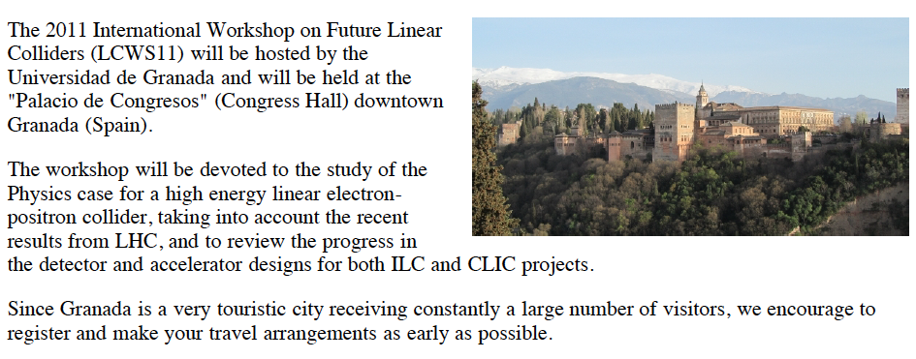
LCWS 2011: Granada, Spain
September 26-30, 2011

Slide 7
Subjects to be discussed on SCRF at Joint ILC-CLIC Meeting
Gradana, Sept. 25^29, 2011
TDR preparation
  Progress reports, and further discussions
    Sub-section writers/editors’ participation anticipated
    Contents to be discussed, today
    Interim process to prepare for the SCRF TDR preparation review to be held at KEK on Jan. 19 – 20.
SCRF R&D
  Progress of TDP R&D
  R&D Plan for 1 TeV upgrade

Slide 8
Agenda for WWS-GDE Meeting, Granada,
September, 26- 30, 2011
Day 1:
  Plenaries--PMs baseline design after BAWs
  Task leader summaries of current status, description of chapters of TDR, parameters as they know them, needs. up to 1 hour each.
  They could start by reading the RDR and associated cost estimate and talking about what has been changed, improved, etc.
Day 2; 3; 4 (half-day)
  Small working groups on text, discussions on interfaces, discussion of machine design parameters that are falling through the cracks or things that need to be drawn up in following 6 months.
  Preliminary inputs to cost chapter. Agreement on models to be used for production. Maybe a couple of talks on system tests as they educate the technical portions of the text.
  These could be done in a small group settings, or via webex. Creation of decent outline for TDR. Placeholders for figures, etc.
Day 5:
  summary; plenaries as required.

Slide 9
SCRF Parallel Session and
Subjects to be discussed
1. TD report preparation
Part-1:
1) 9-cell cavity Gradient R&D progress to meet requirement for TDR
2) Cavity-string R&D progress
3) SCRF accelerator test facility progress with FLASH
4) SCRF cavity and cryomodule industrialization technology and industrialization models.
Part-2:
1) ML Accelerator design
including beam dynamics, alignment tolerance, tracking tune-ability with steering,
Part 3:
1) Future prospect toward 1 TeV with cost-effective ways
including cavity gradient and Q0 improvement, and cost-effective fabrication technology
2. Special technical topics (preparation for TTC WG)
1) S1-Global results and analysis
2) NML status and plan
3) PXFEL progress and analysis
4) Cavity-string gradient degradation issues,

Slide 10
Proposal for S1-Global Progress Report and Discussions in TTC meeting
to organize a one-day full working group dedicated to cryomodule and cavity-string assembly test
including S1-Global, NML, and PXFEL cavity-string test specially focuding on cavity gradient degradation, tuner, and coupler issues, in a part of TTC, and
to organize a separate one day meeting (may be one afternoon (12/8) and one morning (12/9) in the folloiwing day
to discuss specific ILC-GDE oriented issues, (such as what should be our baseline in TDR).
As a further possibility, we may include HLRF and LLRF issues related to S1-Global in the separate meeting
(because of the limited time in the TTC meeting).

Slide 11
Study of
SC Quadrople in Cryomodule
Reported by
Akira Yamamoto
Cryomodule Webex Meeting, June 20, 2011

Slide 12
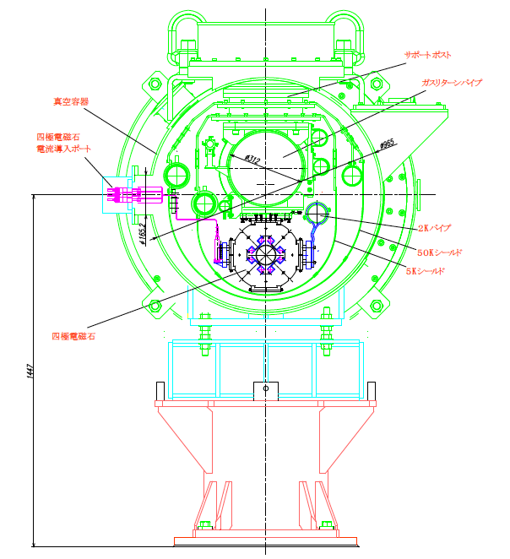
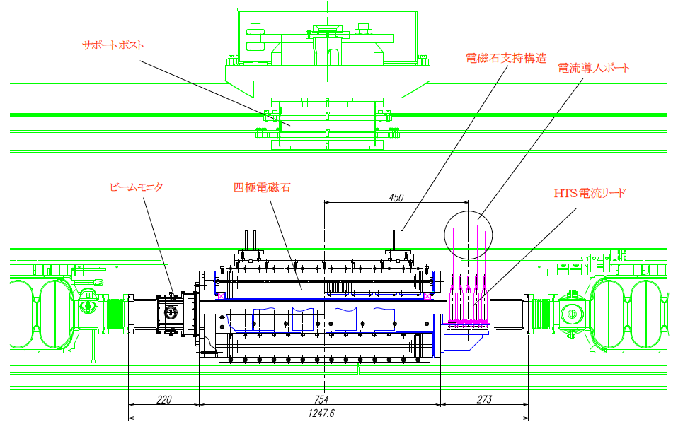
SC Quadrupole in Cryomodule
Suspended by GRP

Slide 13
A Proposal / Revival
9 4 + Q +4 9
8 8 Q 8
Independent stand-off at bottom, mechanically free from GRP,
Solid pipe work (without bellows) at down stream end
Minimize additional piping work
  Not full additional interconnect : not (3 +1 full) but (3 + alpha) interconnect,

Slide 14
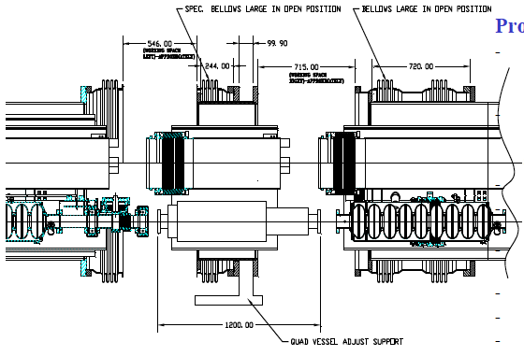
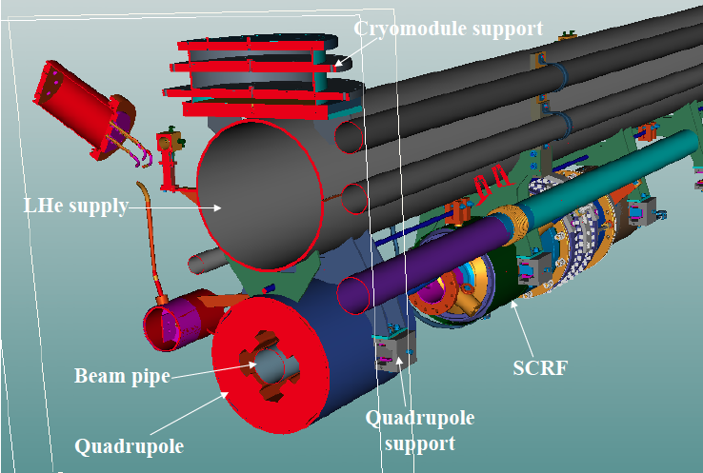
Thinking about a cost-effective connection
We could eliminate flexible/bellows connection one-side, with simple extension of solid pipes
We would like to seek for a smart/sophisticated solution with expert’s contribution.
Another possibility is to place Q in every 4 cryomodules (instead of every 3 cryomodule)

Slide 15
Advantage/Disadvantage and
Necessary Study/Work
Advantage:
  Single cryomodule design and manufacturing
  Independent work between RF and Magnet
  Easier and direct alignment including BPM, in installation in case of keeping conductive cooling magnet,
Disadvantage:
  Additional interconnect work
Necessary study/work/communication
  Smart and sophisticated interconnect design and work including connection of beam-pipe,
  Discussions and consensus in ILC-GDE SCRF group
  Visit and discussion with key persons
    7/5: INFN (Milano), 7/22: Fermilab, 7/24, Workshop, 7/25 ~ SRF,

Slide 16
A Possible ILC-SCRF Industrialization Model
ILC Host-Lab
Technical Coordination
(for Lab- Consortium)
Regional Hub-Lab:
A
Regional Hub-Lab:
E, & …
World-wide
Industry responsible to
‘Build-to-Print’ manufacturing
by
Cavity/Cryomodule Fabricators
Sub-component Suppliers
Material Venders
Regional Hub-Lab:
B
Regional Hub-Lab:
D
Regional Hub-Lab:
C: responsible to
Hosting System Test and
Gradient Performance
Note 1:
-Regional hub-laboratory responsible to any regional procurement to be open for world-wide industry’s participation
- Industry may deliver any regional laboratories through procurements above
: Coordination link
: Procurement link

Slide 17
backup

Slide 18
Sharing Responsibility
Regional hub-laboratories to
  Primarily support the ILC host-laboratory in cooperation with other laboratories,
  be responsible with cryomodule performance
  host cold, RF performance test facility,
  may host cavity-string/cryomodule assembly facility and work on it through contract.
  handle prrocurements of sub-components and cavity and cryomodule hardware assembly
- Industry
  be responsible to fabricate the sub-components, cavity assembly, according to ‘built-to-print’ specification, with minimum acceptance criteria

Slide 19
Procurement Policy/Guideline
Bid is open for international bidding, and
Any company around the world may participate the procurement to be organized by any hub-laboratories,
  if the company pass a qualification process authorized by consortium of regional hub-laboratories.

Slide 20
Build-to-Print Manufacturing
To be contracted with minimum acceptance criteria such as,
  dimension
  RF performance at room temperature,
  high-pressure code inspection test and report,

Slide 21
Flexible Industrialization Models Required
Subcomponents and material
  may be procured more flexibly according to industrial availability and market/competition
  Do not need to concern regional balance in manufacturing.
Assembly and integration
  Cryomodule assembly may be an important issue to seek for best efficient work.
    Need more communication with industry and laboratories
    A technically corresponding person from CERN anticipated

Slide 22
An European Industry Response
RI has responded to our ‘Request for Information’
Major response (with no study-contract):
  Cost saving for 20 % fraction of production within 6 years, as a simple extension of the EXFEL experience
  Full responsibility in manufacturing with no-consortium considered. If necessary, industrial purchasing shall work well to get specific sub-component, such as tuner, coupler and others
Specific contract to be required for further industrial study for larger and deeper industrial study.

Slide 23
Possible Actions suggested
Industrial study to be contracted with EU companies
  R.I. , Zanon, and/or B. Noel
Communication with specific companeis
  Such as EBW machine, as SST in Germany which recently delivered a machine to KEK,
Comunication with laboratories
  CERN (?), CEA/Saclay (7/1) , and INFN (7/4~5),

Slide 24
Visiting Companies in Progress
 | Date | Company | Place | Technical sbject
1 | 2/8 | Hitachi | Tokyo (JP) | Cavity/Cryomodule
2 | 2/8 | Toshiba | Yokohana (JP) | Cavity/Cryomodule, SCM
3 | 2/9 | MHI | Kobe (JP) | Cavity / Cryomodule
4 | 2/9 | Tokyo Denkai | Tokyo (JP) | Material (Nb)
5 | 2/18 | OTIC | NingXia (CN) | Material (Nb, NbTi, Ti)
6 | 3/3 | Zanon | Via Vicenza (IT) | Cavity/Cryomodule
7 | 3/4 | RI | Koeln (DE) | Cavity
8 | 3/14, (4/8) | AES | Medford, NY (US) | Cavity
9 | 3/15, (4/7) | Niowave | Lansing, MI (US) | Cavity/Cryomodule
10 | 4/6 | PAVAC | Vancouver (CA) | Cavity
11 | 4/25 | ATI Wah-Chang | Albany, OR (US) | Material (Nb, Nb-Ti, Ti)
12 | 4/27 | Plansee | Ruette (AS) | Material (Nb, Nb-Ti, Ti)
13 | 5/24 | SDMS | Sr. Romans (FR) | Cavity
14 | 7/6 | Heraeus | Hanau (DE) | Material (Nb, Nb-Ti, Ti)

Slide 25
RDR to TDR
Re-visit of SCRF in RDR
  Outline and contents
Plan proposed for SCRF in TDR
  Chapter 1: TD Phase R&D
  Chapter 2: RDP Reference Accelerator Design

Slide 26
Technical Update in ML and SCRF
RDR to TDR
Sybhect | RDR | TDR
ML Integration | Twin tunnel 5 Hz operation 31.5 MV/m (fixed) | Single tunnel 10 Hz –alternate operation 31.5 MV/m +/-20%
Cavity | 35 MV/m with yield 80 % | Yield plot evaluation R&D goal: 35 MV/m at 90% Production :35 +/-20% spread
Cavity Integration |  | Plug compatible design Mag. shield inside (proposed) Industrialization
Cryomodule | w/ 5 K shield Quadrupole w/ LHe cooling | w/o 5 K bottom-shield (proposed) Conduction-cooled magnet
Cryogenics
HLRF / LLRF | RDR/RF-unit configuration | KCS or DRFS configuration RDR RF Backup option
1 TeV path |  | Alternate shape (LL) Hydro-forming, Large-grain

Slide 27
Main Linac and SCRF in RDR
Chapter | Contents
1. Overview | 1,1 Introduction 1.2 Superconducting RF (3 pages) 1.3 The ILC baseline design 1.3.6 Main Linac (3 pages)
2. Acc. Description | 2.6 Main Linac (10 pages) 2.6.1 Overview 2.6.2 Beam parameters 2.6.3 System description 2.6.4 Accelerator physics issue 2.6.5 Accelerator components
3. Technical Systems | 3.4 Klystrons (4) 3.5 RF distribution (4) 3.6 Cavities (8) 3.7 Cryomodules (5) 3.8 Cryogenic systems (7) 3.9 Low level RF controls (7) 2.10 Instrumentation (9)
4. CF & Siting …

Slide 28
1. Overviews
Section
1.2 SCRF |  | Cavity and cryomodule outlook Cavity gradient (Q vs G) status Cavity assembly and preparation process
1.3 ILC Baseline design | 1.3.6 Main Linac | - Functional requirements - System description Challenges

Slide 29
2. Accelerator Descriptions
2.6 Main Linac | 1. Overview
 | 2. Beam parameters | -Nominal beam parameters (table)
 | 3. System description | RF unit (RF unit figure/table, Cryomodule cross s) Linac layout
 | 4. Accelerator physics issue | Optics Beam dynamics Operation
 | 5. Accelerator components | Cavities and Cryomodule Quad package Vacuum system Beamline components (table)

Slide 30
3. Technical Systems (3.4, 3.5)
3.4 Klystrons | Overview
 | 2. Technical description | L-band klystron Damping ring klystron
 | 3. Technical issue | L-band klystrons
 | 4. Cost estimation
 | 5. Components | (1.3 GHz, 650 MHz klystron table)
3.5 RF Distribution | 1. Overview
 | 2. Technical description | RF unit diagram Wave guide circuit configuration
 | 3. Technical Issues | Wave gude Tap-offs, curculators, and tuners
 | 4. Cost estimation
 | 5. Components | - Components table

Slide 31
3. Technical Systems (3.6, 3.7)
3.6 Cavities | 1. Overview
 | 2. Technical description | Cavity design Cavity fabrication (design parameters) Cavity processing Peripheral components Cavity performance requirements Alternative cavity designs
3.7 Cryomodules | 1. Overview
 | 2. Technical description | - Cross section figure
 | 3. Technical issues | The cryomodule -- structual description, heat-load table Quadrupole/corrector/BPM package Damping ring and beam delivery CMs Shipping of cryomodule
 | 4. Cost estimateion
 | 5. Table of CM types

Slide 32
3. Technical Systems (3.8)
3.8 Cryogenics Systems | 1. Overview | -overall cryogenics layout
 | 2. Technical Issues | Cryogenic system definition Cryogenic cooling scheme for ML -- Cooling scheme of a cryo-string -- Length and ypical arrangement -- Two-phase helium flow w/ slope - LHe management in 1.3 GHz modules Sources, DR, BDS system Heat load and cryogenic plan power -- ML heat load and cryo-plant size -- DR cryogenics -- ILC cryogenic plant size - He inventory (relative He-mass chart)
 | 3. Cost estimation

Slide 33
3. Technical Systems (3.9, 3.10)
3.9 LLRF Control | 1. 0verview
 | 2, Technical Description | - Tolerance of phase & amplitude control
 | 3. Technical Issues | Harware architecture Digital technologies Sofware architecture
 | 4. Components
3.10 Instrum. | 1. Overview
 | 2. Technical description | Beam position monitor Beam profile monitors Beam current monitors Beam phase monitors Beam loss monitors Beam feedback systems
 | 3. Technical issues | Feedback harware Layout
 | 4. Cost est. methodology
 | 5. Table of components

Slide 34
TDR Part 1: RD Phase R&D
Focus on TD Phase R&D (progress)
  An extension/update of Int. Report (IR), but more conclusive
  The basis of the technical decisions of the design baseline described in Chapter 2
    Introduction/Overview
    SCRF technology
    Accelerator systems (CESR-TA, ATF)
    Concluding (or scummary)
  SCRF Technology
    Cavity gradient (R. Geng)
    Cavity integration (H. Hayano)
    Cavity-String/cryomodule integration
      >> S1 Global, NML, (H. Hayano/E.Kako, somone(FNAL)
    SC accelerator system test >> FLASH (J. Carwardine)
    SCRF Infrastructure/facility development (each lab.)

Slide 35
TDR Part 2: ILC Accelerator Design
Focus on Accelerator Reference Design
  Equivalent (replacement) for the RDR,
    No significant change from RDR, but be updated
  Accelerator system oriented description,
    Relevant technical components be dealt with in each specific section, with better order.
    1. Introduction
    2. Overciw, layout and parameters
    3. Main Linac
    4. Sources
    5. Damping Rings
    6. RTML / bunch compressors
    7. BDS/MDI
    8.CFS
    9. TeV upgrade path
Main Linac
  Linac acc. Design
    beam dynamics , alignment, (K. Kubo, C. Adolphsen)
  SCRF Cavity/Cryomodule
    Cavity and Cavity Integration (R. Geng, H. Hayano)
    Cryomodule (P. Pierini)
    Magnet (TBD)
    Instrumentation (H. Hayano, P. Perini)
  Cryognenics (T. Peterson)
  HLRF and LLRF (S. Fukuda/C. Nantista, S. Michizono)
  ML Integration (C. Adolphsen)

