Slide 1

Design of the Timepix3
X. Llopart
7th July 2011
LCTPC collaboration meeting

Slide 2
Outline
Introduction to Timepix3
Timepix3 Analog Front-End
Timepix3 readout architecture
Conclusions

Slide 3
2 Collaborations → 21 collaborating institutes
Medipix2
INFN Cagliari
CEA-LIST Saclay
CERN Geneva
University of Erlangen
University of Freiburg
ESRF Grenoble
University of Glasgow
University of Houston
IFAE Barcelona
Mid Sweden University
MRC-LMB Cambridge
INFN Napoli
NIKHEF Amsterdam
INFN Pisa
FZU CAS Prague
IEAP CTU Prague
SSL Berkeley
Medipix3
ALMOF Amsterdam
University of Bogota
University of Canterbury NZ
CEA-LIST Saclay
CERN Geneva
DESY Hamburg
Diamond Light Source
University of Erlangen
ESRF Grenoble
University of Freiburg
University of Glasgow
ITER
University of Karlsruhe
Leiden University
Mid Sweden University
NIKHEF Amsterdam
IEAP CTU Prague
SSL Berkeley
VTT Microsystems
http://www.cern.ch/medipix

Slide 4
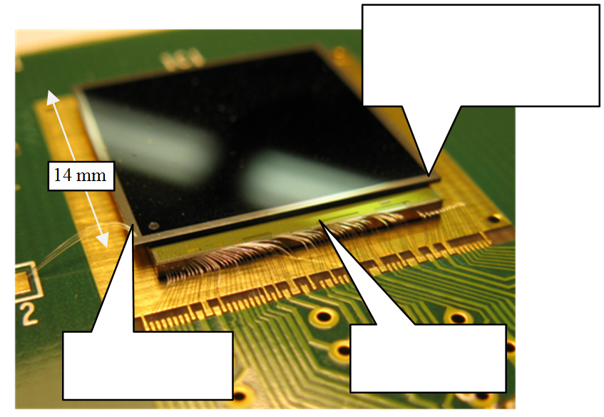
The Medipix Chips
Silicon, 3D, CdTe, GaAs, Amorphous Silicon, Gas Amplification, Microchannel Plates etc…
A philosophy of functionality built into the pixel matrix allows complex behavior with a minimal inactive region
Configurable ‘shutter’ allows many different applications
55um square pixel matrix
256 by 256

Slide 5
Development Path
Medipix1
1um SCAMOS 64 by 64 pixels
Photon Counting Demonstrator (1997)
Medipix2
250nm IBM CMOS, 256 by 256 55um pixels
Full photon counting (2002)
Analogue (ToT) and Time Stamping (ToA) (2006)
Timepix
130nm IBM CMOS, 256 by 256 55um pixels
Photon Counting, Spectroscopic, Charge Summing, Continuous Readout (2009)
Medipix3
Fast front end, Simultaneous ToT and ToA (2012)
<20 Mcounts/cm²/s
Timepix3
Future LHCb readout – Data driven 40MHz ToT 12Gb/s per chip (2013)
~500 Mcounts/cm²/s
VELOpix
65nm ? , ~20um pixels
Future Hybrid Pixel Time tagging layer for the LCD project (20??)
CLICpix
Slide from R.Plackett (Diamond LS)

Slide 6
Timepix3 Scope
Several groups in the Medipix3 collaboration have shown interested in a new version of the Timepix (2006) → Timepix3
Large range of applications (HEP and non-HEP):
X-ray radiography, X-ray polarimetry, low energy electron microscopy
Radiation and beam monitors, dosimetry
3D gas detectors, neutrons, fission products
Gas detector, Compton camera, gamma polarization camera, fast neutron camera, ion/MIP telescope, nuclear fission, astrophysics
Imaging in neutron activation analysis, gamma polarization imaging based on Compton effect
Neutrino physics
Main Linear Collider application: pixelized TPC readout
Reuse many building blocks from Medipix3 chip (2009)
Timepix3 is an approved project by the Medipix3 collaboration with an assigned budget (2-engineering runs)
Design groups: NIKHEF, BONN, CERN

Slide 7
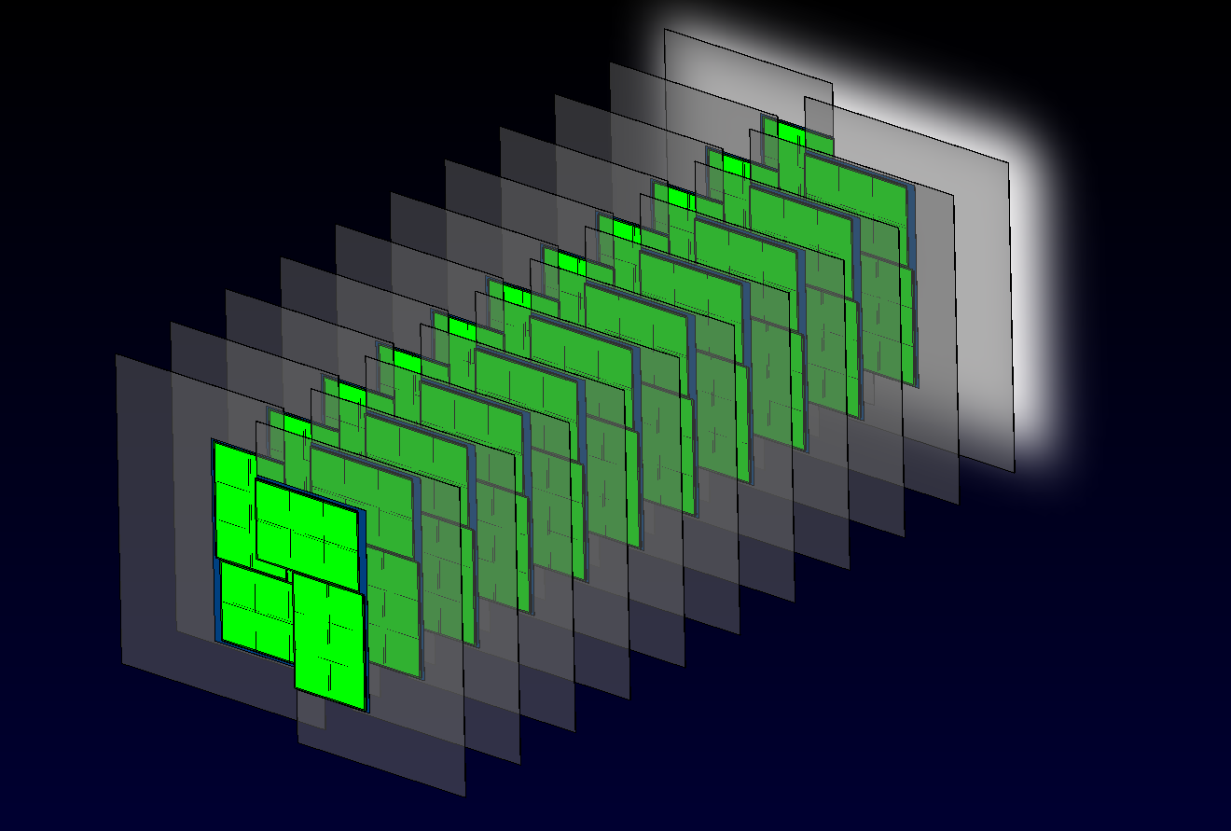
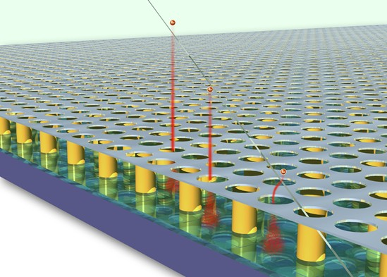
Required readout chips for the HEP applications
Upgrade of the LHCb VELO detector: VELOPIX
Minimum pixel size
Extremely high illumination:
up to 290 Mhits/cm²/s
Continuous data readout
Sparse data (zero suppression)
Charge measurement
Micro-pattern gas avalanche detectors: GOSSIP, TPC
Minimum pixel size
High time resolution: ~ 1ns
Wide dynamic range : ~ 100μs
Charge measurement
High sensitivity : threshold ≈ 350e-
Slide from V.Gromov (Nikhef)

Slide 8
Timepix3 Main Requirements
Matrix layout: 256x256 pixels (Pixel size 55x55 µm)
Time stamp and TOT recorded simultaneously
10 bit Energy Measurement (TOT)
Standard Resolution 25ns (@40MHz)
Energy Dynamic range up to 25.6 µs (@40MHz)
14 bits Slow time-stamp
Resolution 25ns (@40MHz)
Dynamic range 409.6 µs (14 bit)
4 bits Fast time-stamp
resolution ~1.6ns (using on-pixel oscillator running at 640MHz)
Dynamic range 25ns
Sparse Readout
Technology choice: IBM 130nm DM4-1 (as in Medipix3)

Slide 9
The Timepix3 Chip
Readout Chip | TIMEPIX3 (beginning of 2012)
Pixel size | 55 x 55 µm²
Pixel arrangement | 256 x 256 (2x4 superpixels)
Sparse readout | YES
Operating Modes | 1: TOT & TOA 2: TOA 3: Event Counting + TOT
Minimum threshold | > 500 e- (1.8 keV)
TOA resolution | > 1.5 ns
Peaking time | < 25 ns
TOT resolution | < 5% channel to channel spread
Technology | IBM 130nm DM 3-2-3 or DM 4-1-3
Power consumption ON | <700 mW (~20 μW/pixel) @1.2 V
Power consumption OFF | <10 mW (Power Pulsing)
Target floorplan | 3 sides buttable and minimum periphery
TSVs possibility | YES. Multi-dicing scheme as Medipix3
Count Rate | 20x 10⁶ particles/cm²/s
This chip will be
110 µm
Analog
Digital
Analog
220 µm

Slide 10
Timepix3: top level block diagram
128 double-columns @ 256● 55μm = 1.4cm
Pixel: 55μm x 55μm
Super Pixel: 8pixels @ 4 x 2
64 Super Pixels in a DC
128 Double Columns (DC)
Super Pixel FIFO : 2-events
DC bus: 40MHz
End-of-DC FIFO: 4-events
Periphery bus: 40MHz @ 44b
Output Serializer / FIFO
Analog Front-end
Digital Region
Readout
Control (TOKEN based)
Analog regions
(30%)
Time Stamp 14b
DAC
ToT Counter 10b
MUX
Fast Counter 4b
Double column bus
double column data bus (40MHz)
Ring oscillator (640MHz)
FIFO
MUX
Digital region
(70%)
Fast Counter 4b
ToT Counter 10b
MUX
Time Stamp 14b
DAC
8-Pixel Region
End of Column Logic
FiFO
periphery bus
Readout control
(Token based)
periphery data bus 40MHz
Data output block
DAC
Bandgap
Bias gen.
Slow control
Vcntr
(oscillator)
EFUSE
chip ID
Serializer / FIFO
Tx
RX
RX
RX
PLL
Clock
Tx
Data_out Data_in
Reset_GLB
Clock 40 MHz
8 x LVDS
Slide from V.Gromov (Nikhef)

Slide 11
Timepix3 Analog front end

Slide 12
Timepix3 pixel FE
Timepix3 and VeloPix chips can use the same front-end design
Main requirements:
Bipolar input with DC leakage current compensation
Small and low power → 55 µm x [10…20] µm and < 10 µW
TimeWalk < 25ns → Fast peaking time in Preamp and Fast discriminator (power penalty)
Full chip minimum detectable charge as low as possible (< 500e-) → 4 bits threshold tuning and low Preamp Noise (ENC)
Precise TOT measurement → Minimize Preamp Noise (ENC)
The full front-end schematic is designed (CERN and NIKHEF)
Simulation based results are shown in following slides

Slide 13
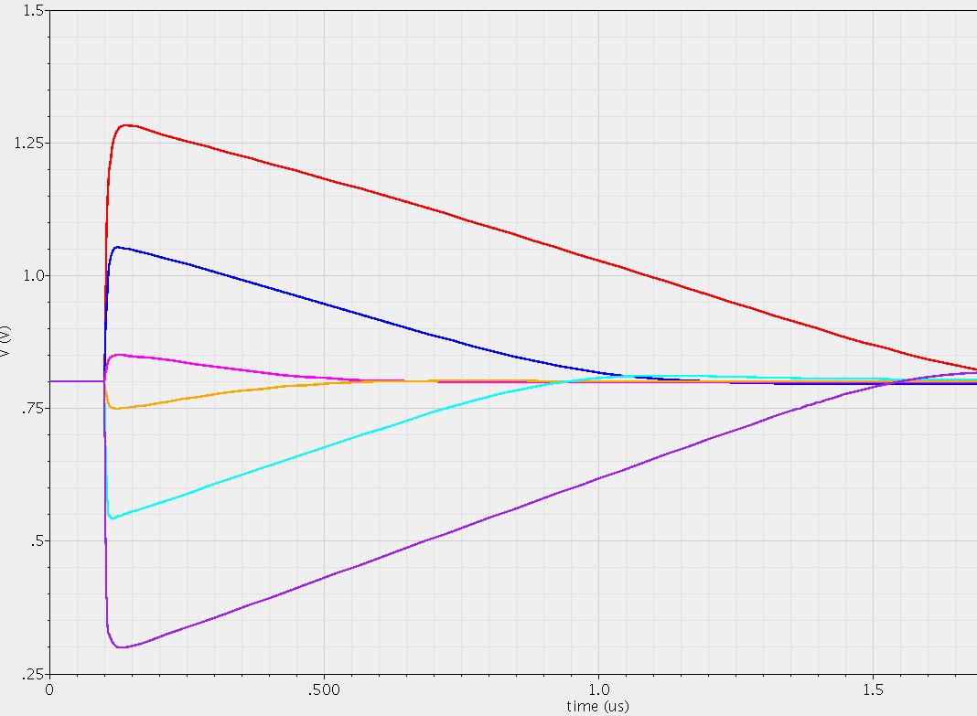
FE of Timepix3
-10 000e⁻
electrons (e⁻)
-5 000e⁻
-1 000e⁻
1 000e⁻
5 000e⁻
holes (h⁺)
10 000e⁻
The design of Timepix3 FE is based in the Krummenacher FE architecture

Slide 14
Tunable return to zero (Vout vs Ikrum)
Qin=2ke⁻
Threshold =1Ke-

Slide 15
Time-over-threshold response
Preamp Output
Qin=2Ke⁻ to 30Ke⁻ @Ikrum=10nA
Discriminator Output
Qin=2Ke⁻ to 30Ke⁻ @Ikrum=10nA
Threshold =1Ke-

Slide 16
TOT linearity and ΔTOT/TOT
Threshold=1ke⁻
Channel ΔTOT/TOT ~1.9% @10Ke-
Channel ΔTOT/TOT ~10% @3Ke-
Channel ΔTOT/TOT ~100% @1.35Ke-

Slide 17
Channel Noise and Minimum detectable Charge
Pixel noise (ENC) vs Cd[fF]
Minimum detectable charge
Target = <500e-

Slide 18
TimeWalk Simulations
Threshold=1ke⁻

Slide 19
Simulations Summary
 | Simulation Results
Pixel size | 55 µm x 55 µm
Analog pixel area | 55 µm x [10…20] µm
Pixel matrix | 256 x 256
Input charge | Bipolar (h⁺ and e⁻)
Leakage current compensation | YES
Detector capacitance (Planar detector) | < 50 fF
Peaking time | <25ns if Cd<70fF
Preamp output linear dynamic range | < 15 Ke⁻
Timewalk | <25ns [@ Qin>Threshold]
Return to zero (Tunable) | YES (ΔIkrum)
TOT linearity and range | Monotonic up to ~150 Ke⁻ @Ikrum 10nA
Return to zero full chip spread (TOT spread) | < 5%
ENC (σ_{ENC}) | 0.57*Cd[fF]+61 [e-] → ~75 e⁻ @ Cd=25fF
# Thresholds | 1
Discriminator response time | <5ns [if Qin>Threshold + 5 Ke⁻]
MC simulated Threshold spread | ~200 e⁻
Threshold spread after tuning (4 bits) | ~20 e⁻
Full chip minimum detectable charge | 6*sqrt(ENC²+Threshold_mismatch²) → ~475 e⁻ @ Cd=25fF
Pixel analog power consumption | 8.4 µW static (Preamp 3.6 µW and 4.8 µW Discriminator) 2.4 µW dynamic (only @ HIT)

Slide 20
Timepix3 readout architecture

Slide 21
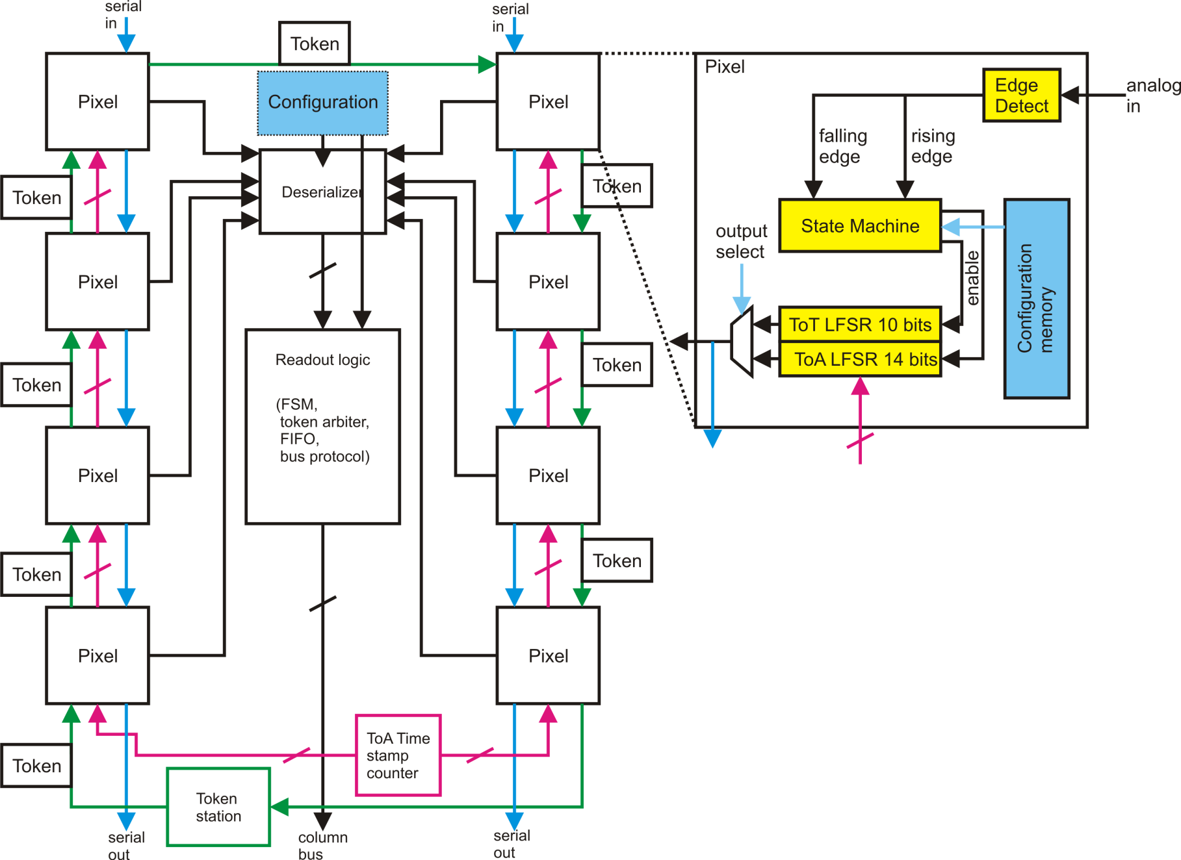
Super Pixel and Pixel
Clock-signal has to be distributed into all modules in
the super pixel.
Pixels are token arbitrated, token released when a hit
is present.
1-bit serial interface between pixels and the readout
logic.
Super pixel sends data to EoC by the column bus.
One ToA time stamp counter per super pixel (or global
time stamp bus).
Slide from T.Poikela (CERN)

Slide 22
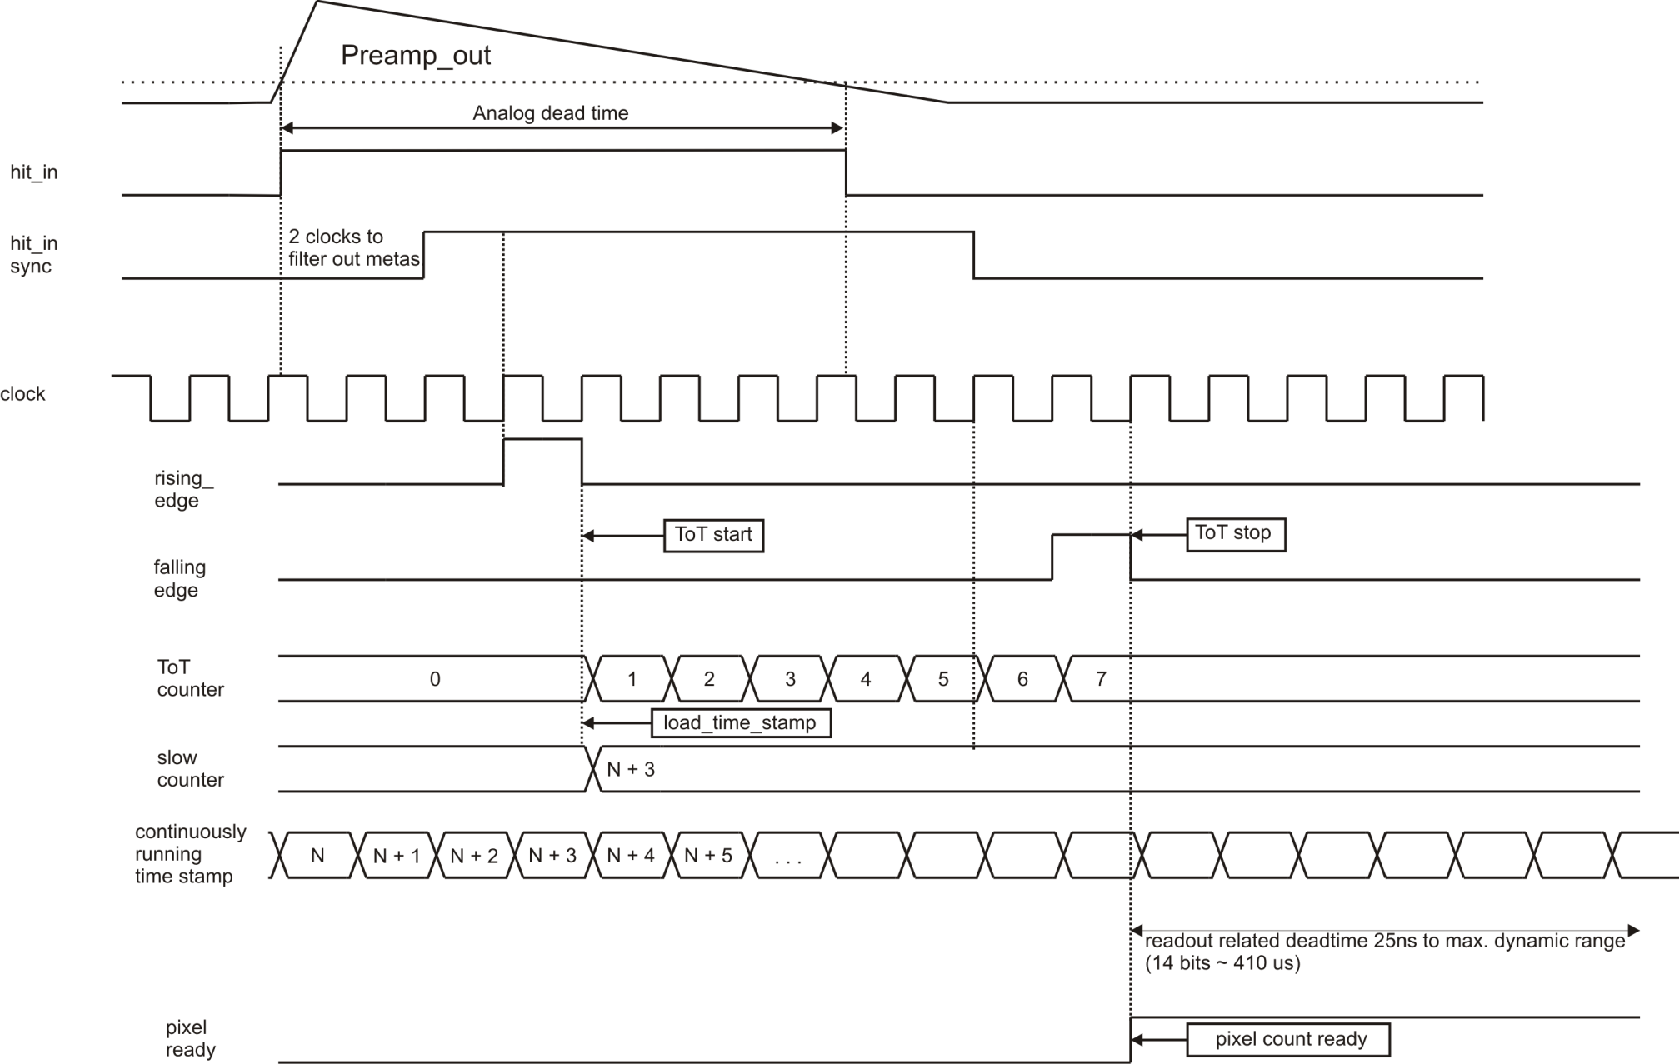
Timing Diagram of Digital Pixel
Slide from T.Poikela (CERN)

Slide 23
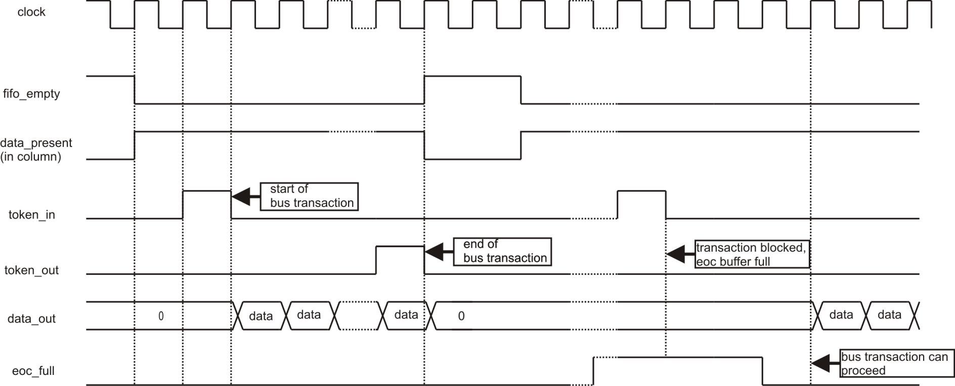
Super Pixel-to-EoC data transport
Bus protocol does not allow any data overflows in the periphery. If EoC is full, no data is transmitted.
Protocol requires a counter in the super pixel to count the number of words per bus transaction (max 3-bit counter)
Global signals in Double Column: Data bus 5b/9b (not fixed yet)
EoC Full 1b
DataPresent 1b
RefClk 1b
Reset 1b
Shutter 1b
Time stamp 14b (or implemented with local counter)
Total 10b – 28b
Slide from T.Poikela (CERN)

Slide 24
Timepix3: modes of operation
 | TOA & TOT | Only TOA | Event Count & Integral TOT
Data format | Fast Time (640MHz @ 4b) & Slow Time Stamp (40MHz @ 14b) & ToT (40MHz @10b) & Pixel coordinate (16b) | Fast Time (640MHz @ 4b) & Slow Time Stamp (40MHz @ 14b) & Pixel coordinate (16b) | Event Count(10b) & Integral ToT ( 14b) & Pixel coordinate (16b)
Double hit resolution (per pixel) | ToT + 700ns | > 450ns | -
Readout | continuous sparse data readout with zero-suppression |  | non-continuous sparse data readout with zero-suppression
 |  |  | Max counting rate < 100kHz/pixel
 | Max counting rate < 1kHz/pixel
Full chip readout time | - |  | 1.6msec
Slide from V.Gromov (Nikhef)

Slide 25
Timepix3 periphery architecture
Periphery Data Bus: 44bit @ 40MHz
DataIn
Round-robin Distributor
SyncCLK
(40MHz)
DataOut [0:7]
Link is almost full
44bit
Slow control
Control
Logic
FIFO
Mode of operation
definition
160MHz
MUX
320MHz
Configuration data (threshold DAC’s, masks etc)
640MHz
8bit
Phase
Locked
Loop
:10
8b/10b
Encoder
10bit
½ Clock delay
Data_serial_ link
Clock_serial_link
ReadoutCLK
Serializer
Shutter
Reset
Ext. Readout clock
SyncCLK
(40MHz)
Busy
Clock
1bit
Data
1bit
Two readout modes:
Encoded Clock – Data output (at 640 MHz)
Separate Clock and Data outputs (at 320MHz, 160MHz …. )
Selectable number of data links (1 to 8)
Slide from V.Gromov (Nikhef)

Slide 26
Conclusions

Slide 27
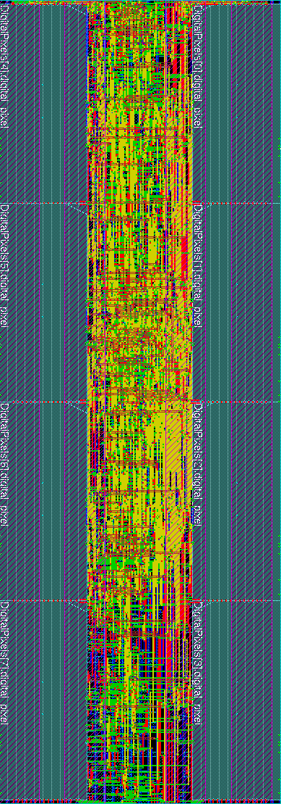
Conclusions
110 µm
The Timepix3 will be the next chip in the Medipix family
TOT and TOA simultaneously
Sparse and data driven readout
Arrival time resolution ~1.6ns
Hit rate up to 20x 10⁶ particles/cm²/s
Timepix3 design schedule is suffering from lack of manpower due to other commitments (Medipix3 and FEI4)
Submission of the Timepix3 chip is expected by beginning of 2012
220 µm
27

Slide 28
Spare Slides

Slide 29
A high density and low power Standard Cell Library

Slide 30
An high density low power 130 nm digital library
The design of the Timepix3 goes in parallel with the Medipix3.2 design
The Medipix3.2 redesign requires significant changes in the digital part of the pixel (designed as a full custom layout)
Can we use CERN default standard cell 130nm library at the pixel level?
Too big: @CERN the default library has large cells since is targeted for ~800MHz !!
Too much leakage power: @CERN the default library is not low-power
A custom made high density library (SC_130nm_XL) design has been done with the initial idea of using it in Medipix3.2 pixel but with a huge potential impact in later developments (Timepix3, Velopix…)
Main actions:
Reduce cells height → We don’t need big buffers (speed)
Keep all transistor small or minimum size (W/L=0.28/0.12)
ADD NV and PV layers → Low power transistors (no area penalty)

Slide 31
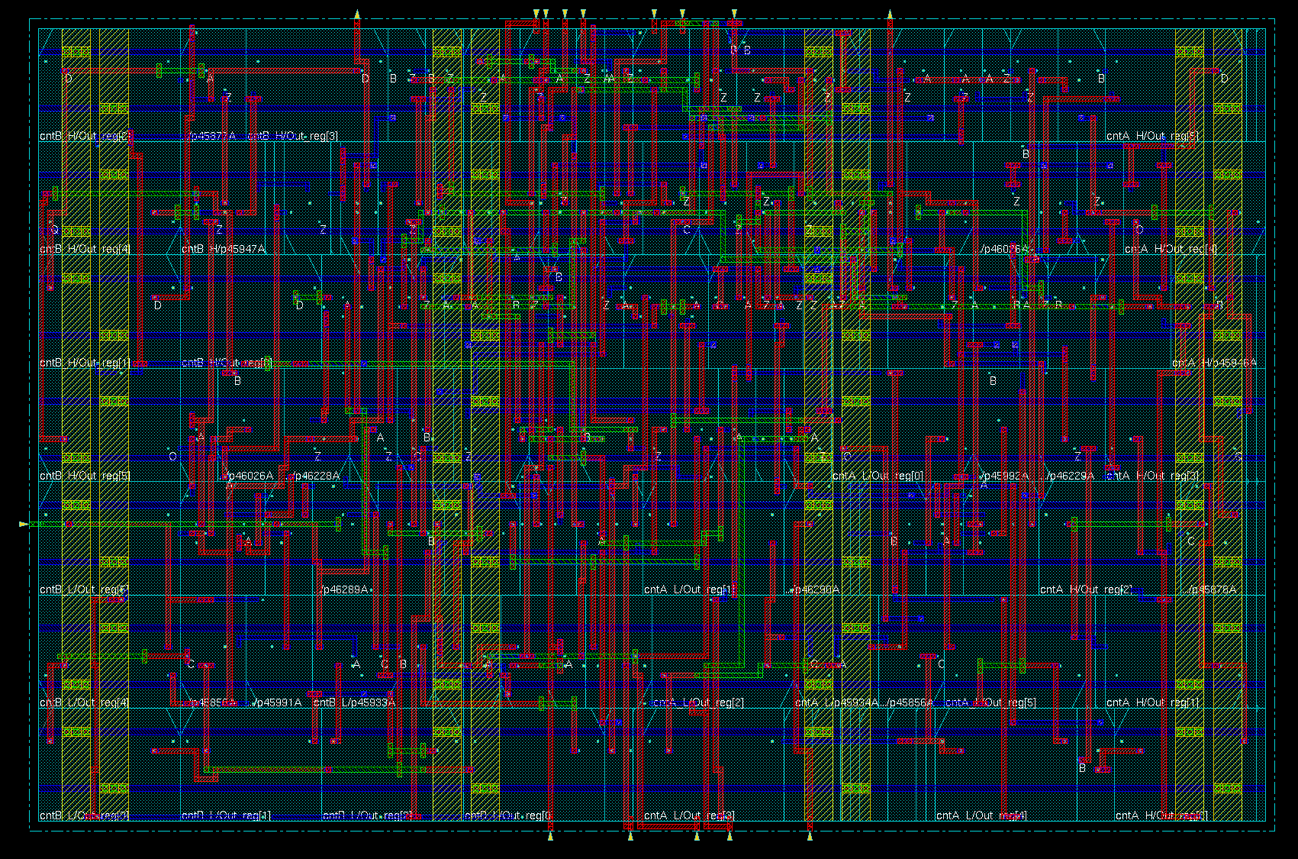
Medipix3 pixel counter (24 bits) + control logic
55 μm
Synthesized using the CERN IBM 130nm Standard Cell Library (CMOS8RF)
Area is too big (52 x 33.6) → ~60% pixel area
High static (leakage) power consumption:
VDD | Temp | Leakage in cell | leakage In Chip
1.4 V | 125 C | 22.5 μW | 1.5 W !!!
1.5 V | 25 C | 223 nW | 14.6 mW
1.6 V | -55 C | 470 pW | 30 μW

Slide 32
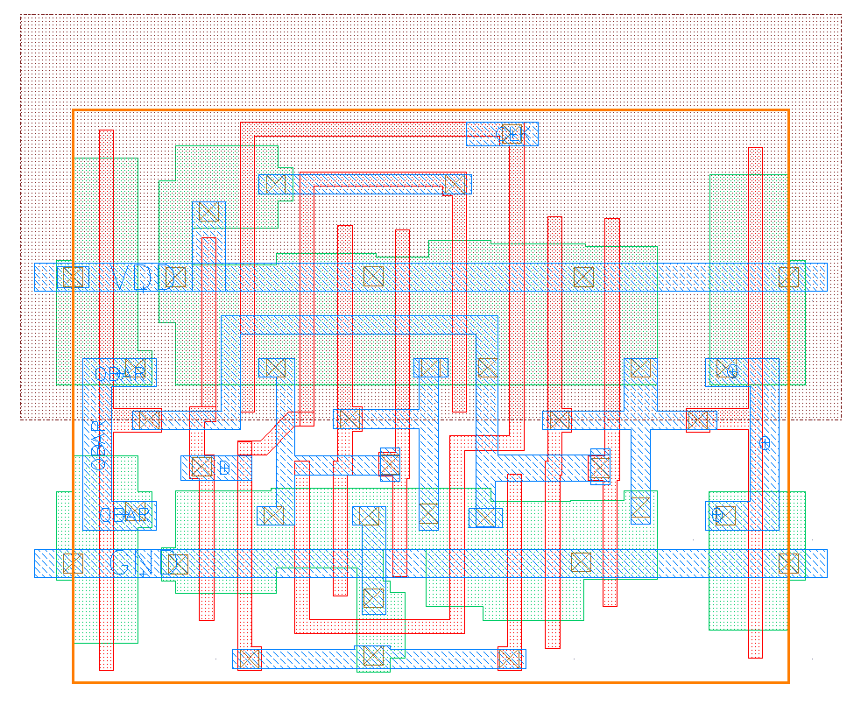
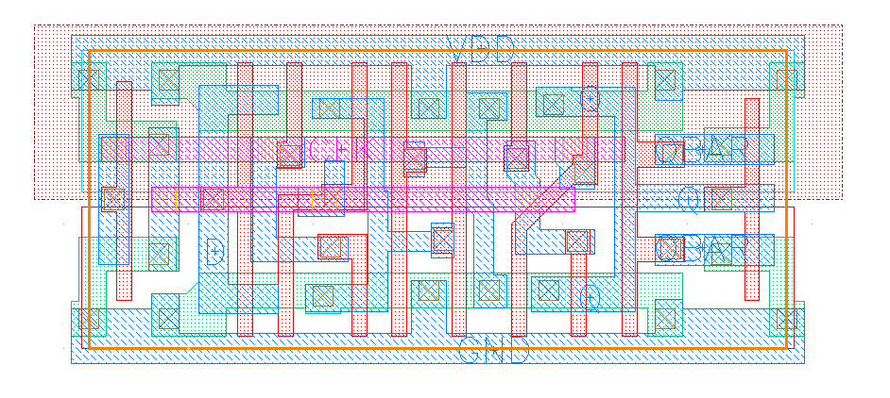
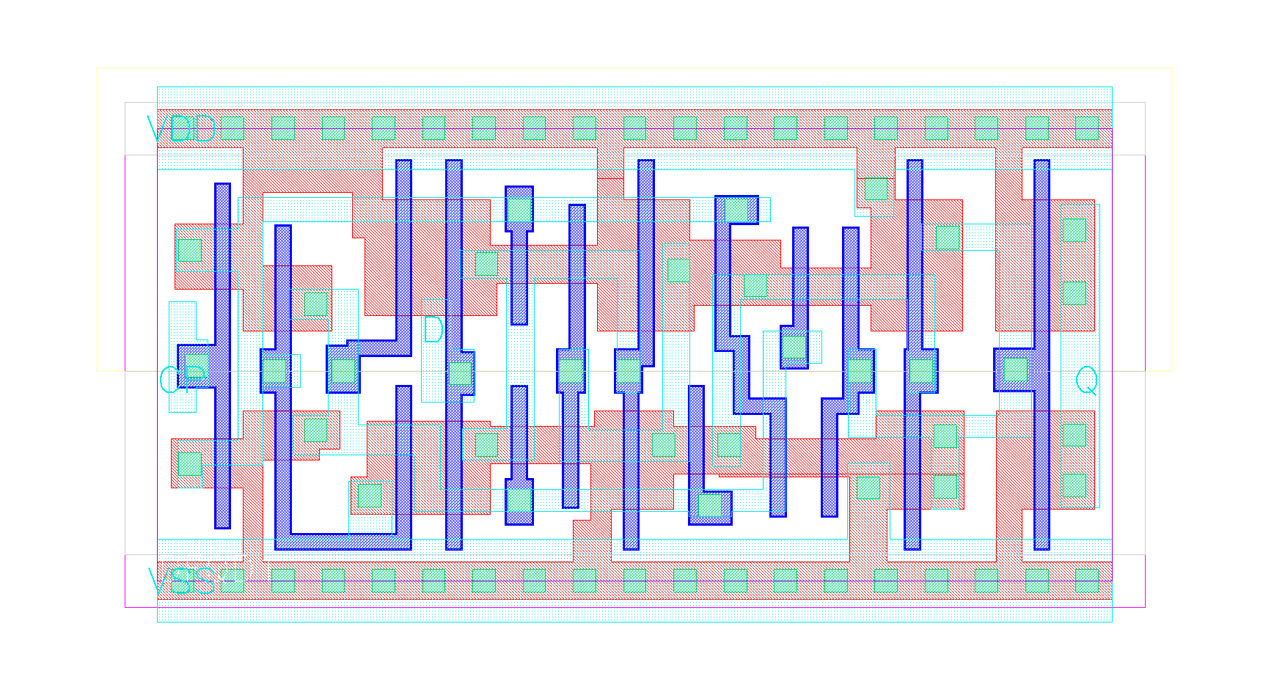
SC_130nm_XL Library
Row Height is fixed to 2.4 µm
Well Tap library
Maximum frequency <~350 MHz
Low power transistors
~45 cells are available in the library (growing fast…)
No SEU registers (so far)
Encounter Library Characterizer (ELC) has been used to fully characterize the library in different corners
Full Synopsis library
Verilog library
LEF files
6 µm
4.8 µm
Minimum DFF available in default CERN Standard Cell 130nm library
3.8 µm
5.6 µm
1.8 µm
2.4 µm
Minimum DFF In the custom made High density 130nm library
x2 smaller !!!
Minimum DFF available in a commercial Standard Cell 65nm library
x4 smaller !!!

Slide 33
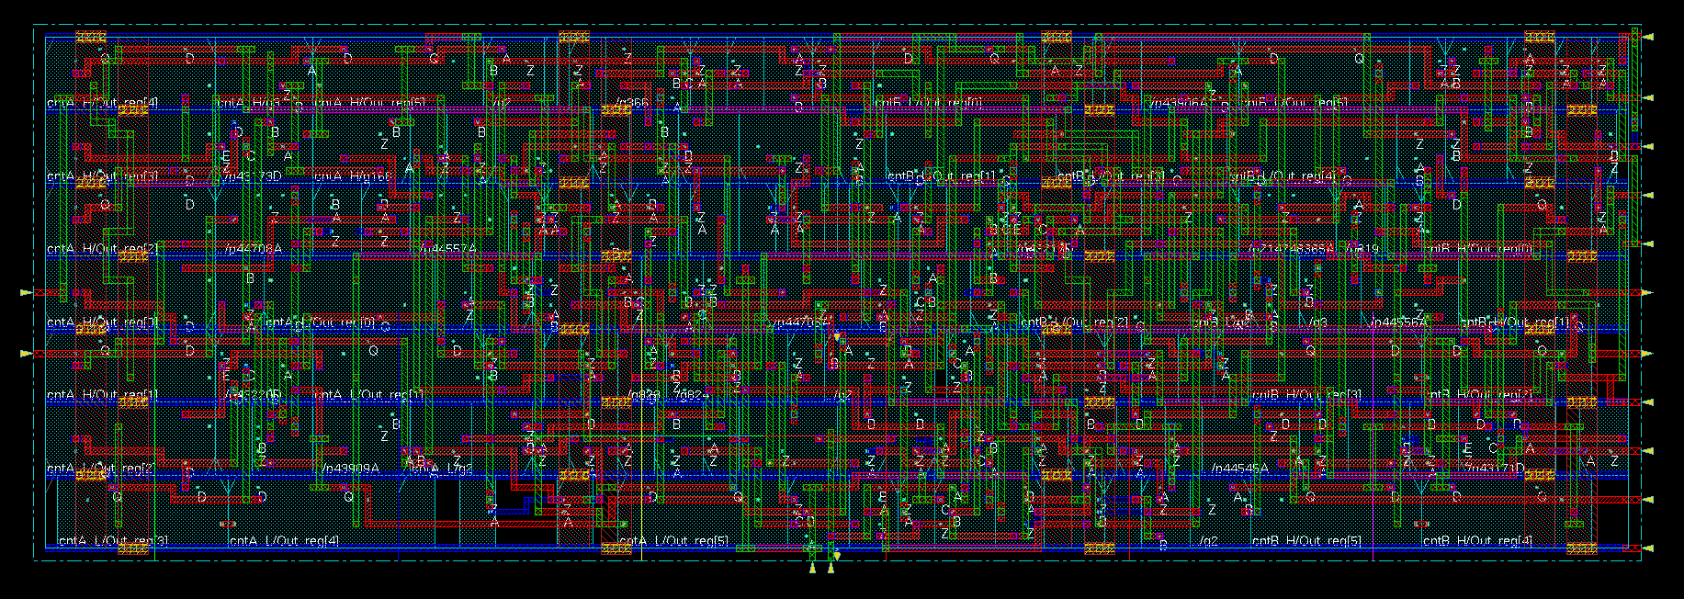
Medipix3 pixel counter (24 bits) + control logic
55 μm
Synthesized using the SC_130nm_XL library
Area (52 x 16.8) → ~29% pixel area
Low cell leakage power
VDD | Temp | Leakage in cell | leakage In Chip
1.5 V | 25 C | 2.5 nW | 163 μW
1.2 V | 25 C | 1.15 nW | 75.3 μW

Slide 34
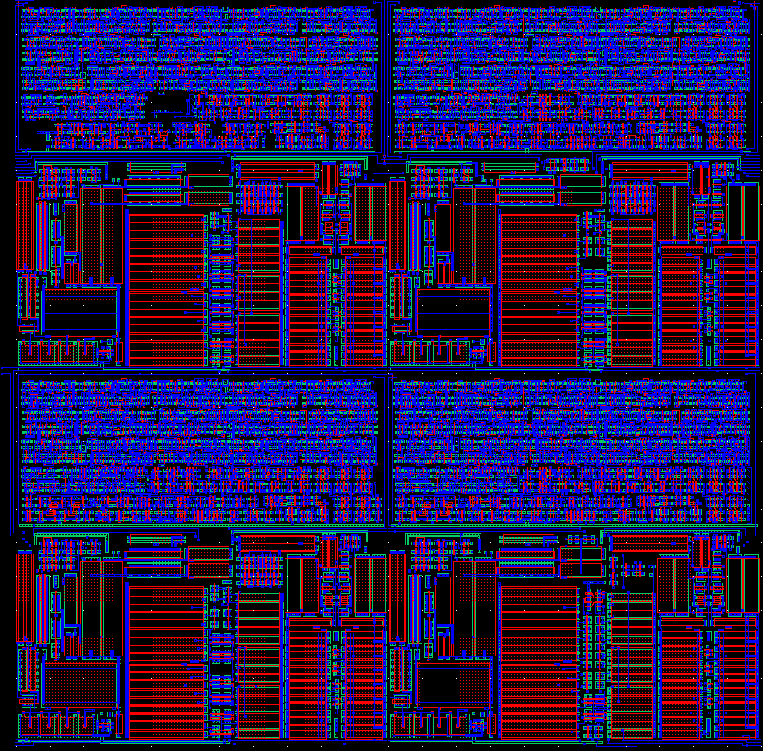
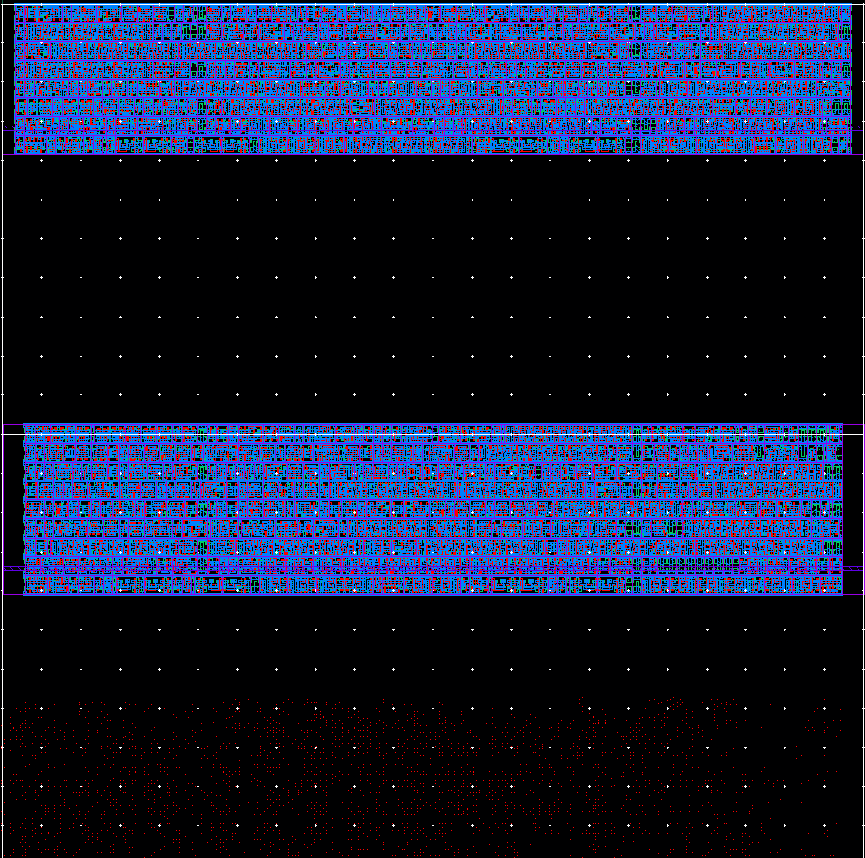
Comparison between old and new counter
Medipix3.0 (2009)
Medipix3.2 (2011) using SC_130nm_XL

Slide 35
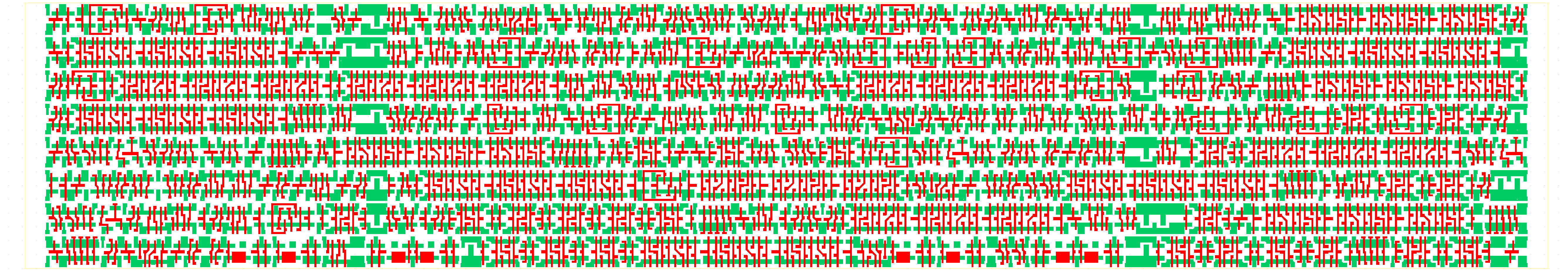
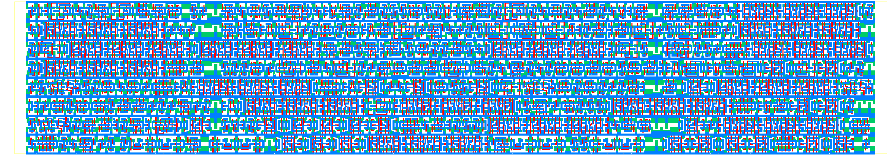

Medipix3.2 counter using SC_130nm_XL library
110 µm
19.2 µm
RX & PC
+ M1
+ M2

