Slide 1
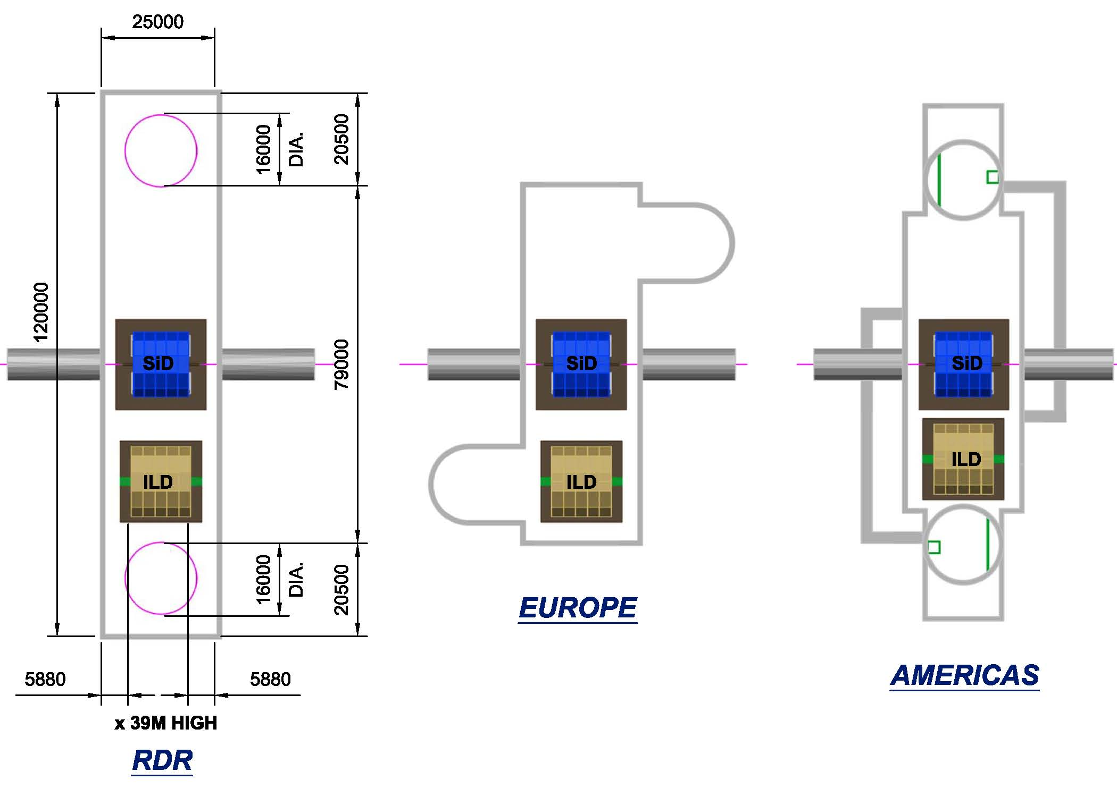

Slide 2
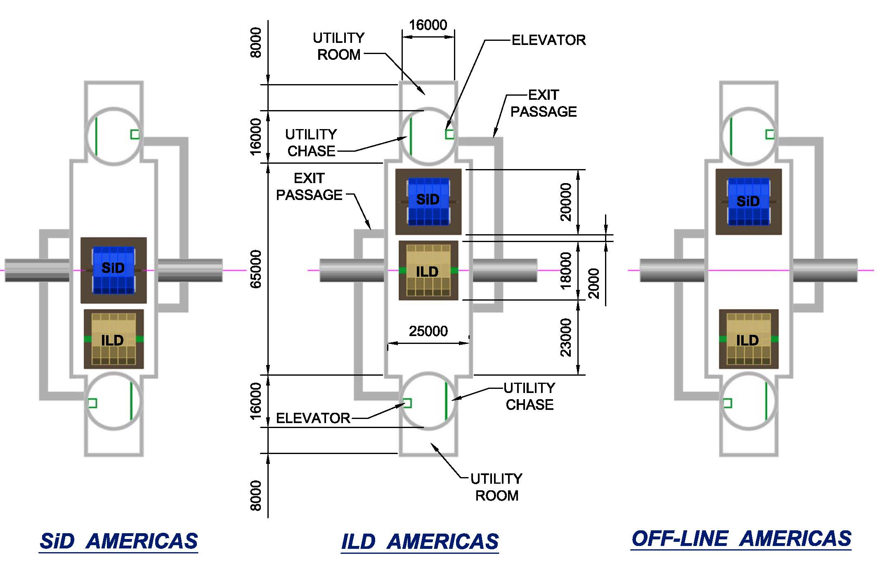

Slide 3
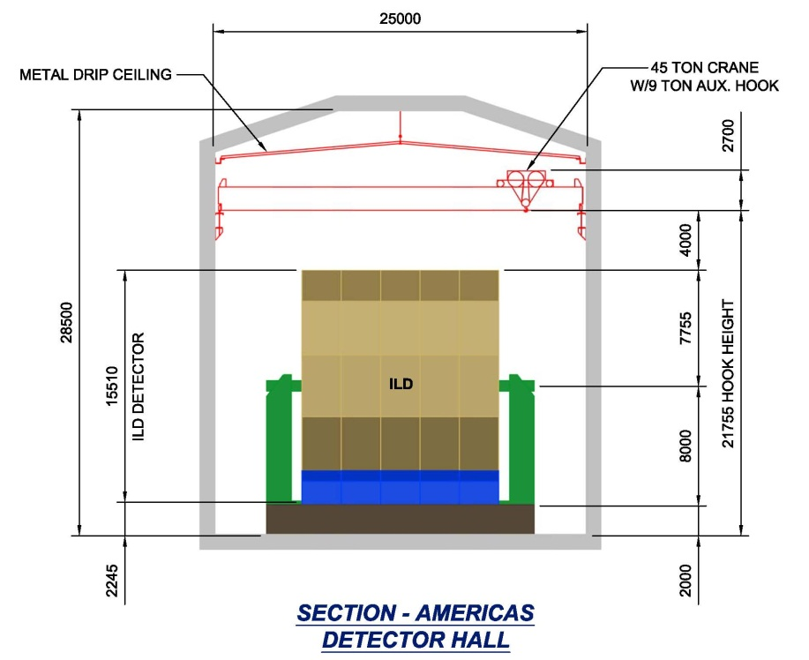
Hall roof span is a simple span
  Rock bolts provide the structural support
  Drip Ceiling provides a dry and clean space.
Walls and floor use rock bolts for structural support, concrete lined.

Slide 4
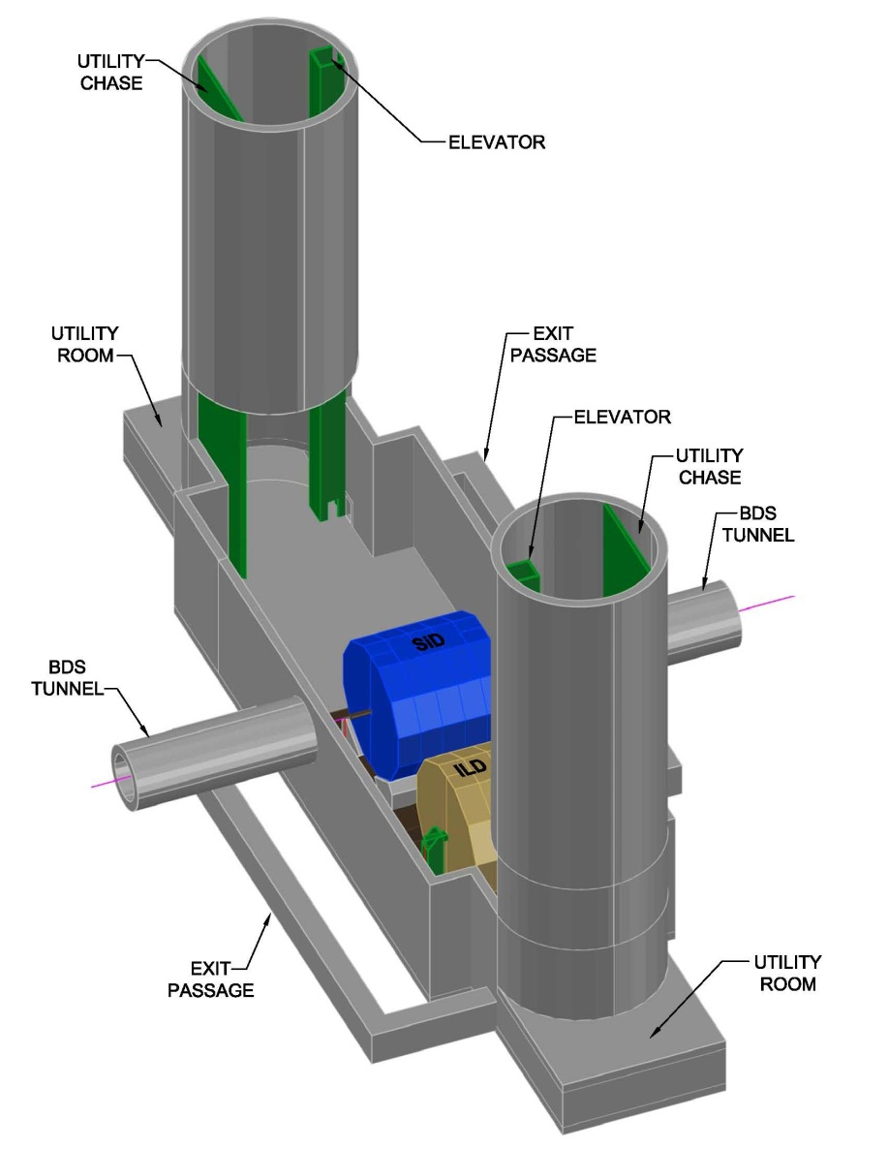
Simple rock massing
Uninterrupted roof spans and wall supports.

Slide 5
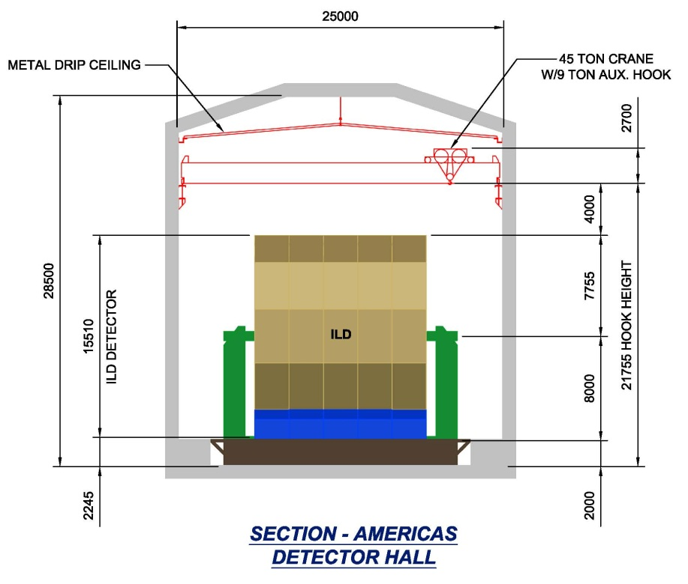

Slide 6
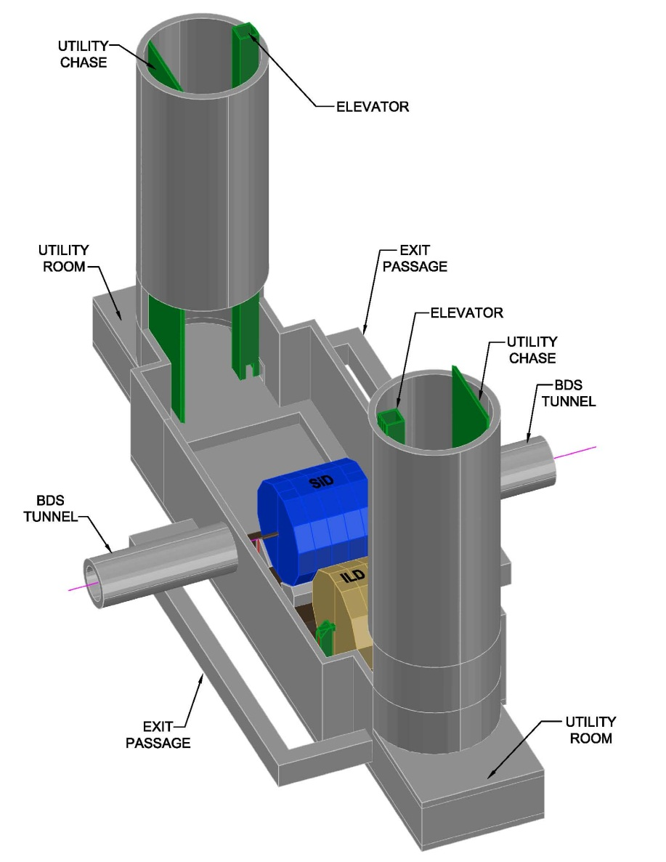

Slide 7
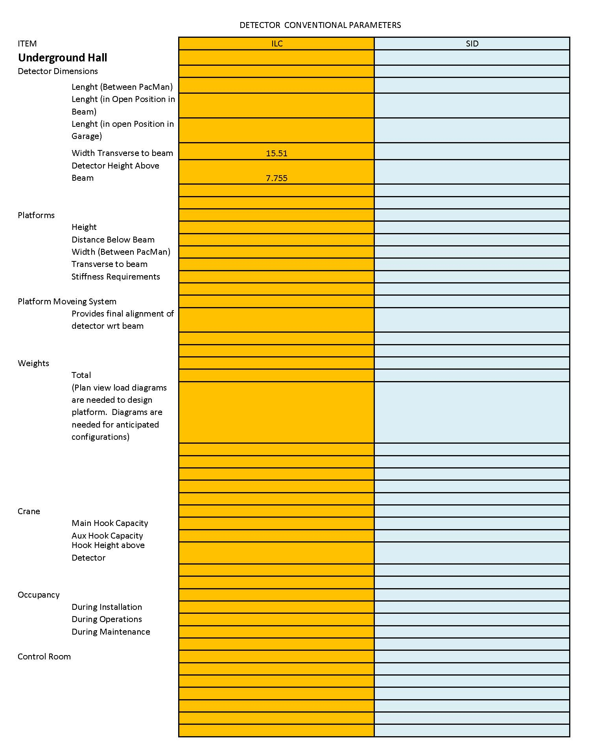

Slide 8
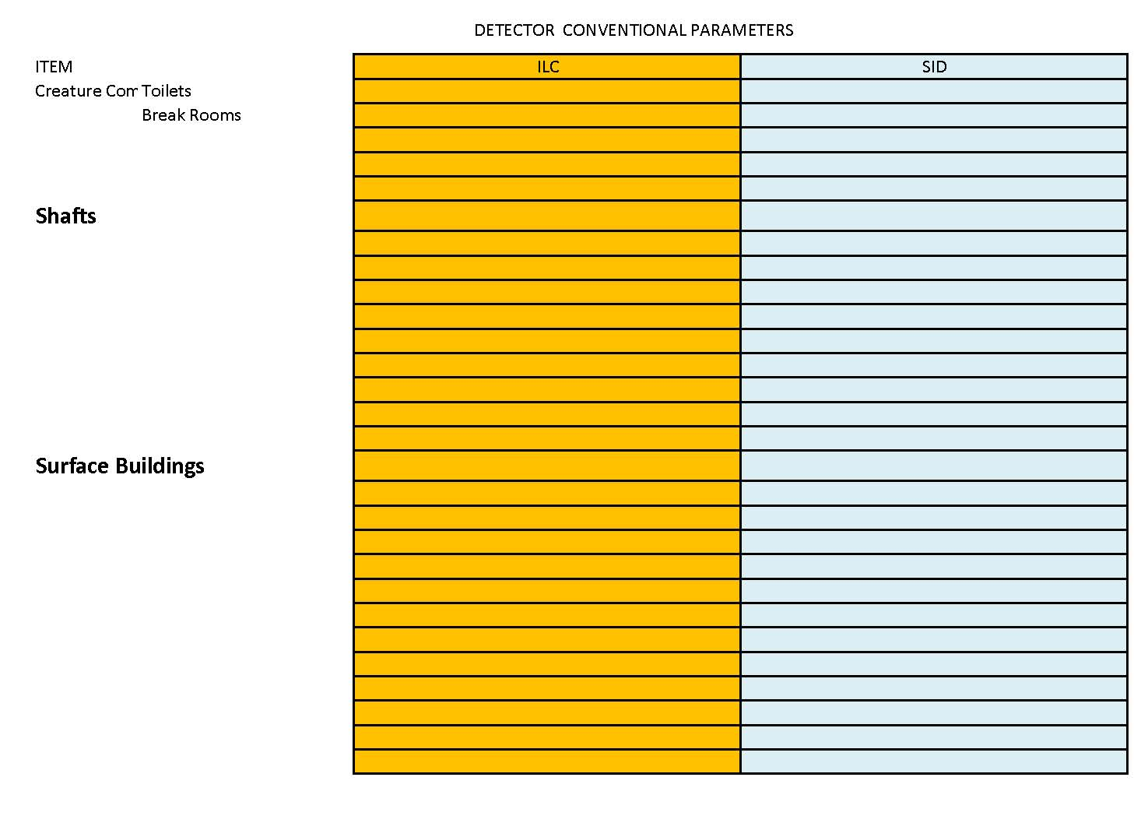

Slide 9
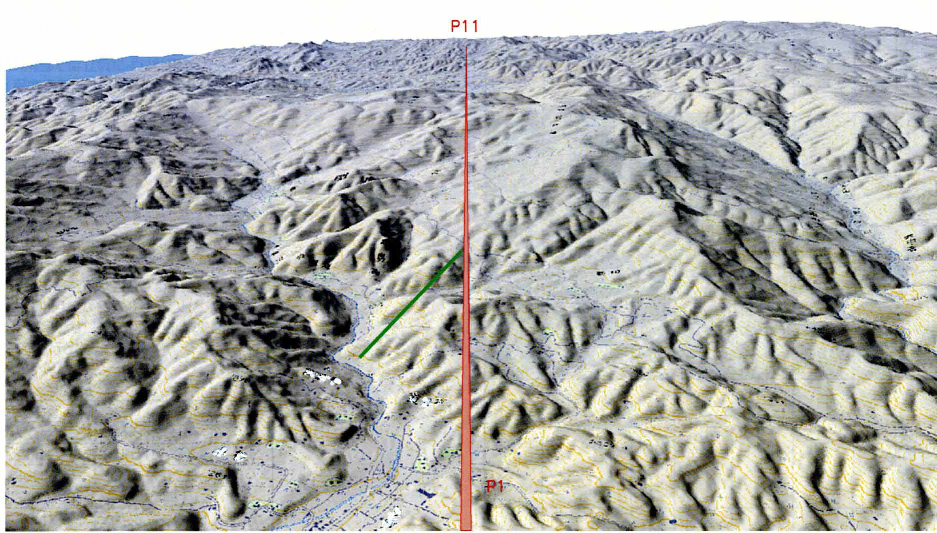
Japan - Sample site
Exp-hall
Access tunnel

Slide 10
Japan - Sample site
Enough space for
detector solenoids

Slide 11
