Slide 1
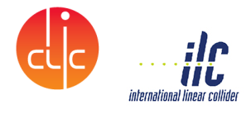
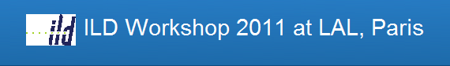
ILC CFS / CLIC CES Studies for the Interaction Region :
- An action was given at the Geneva Linear Collider Meeting for CFS to develop a more in-depth civil engineering study of the IR
- Linear Collider IR meeting at CERN held on 16 February 2011
-Design Brief for external design specialists
-Kick-off meeting with ARUP is today
-Next steps
J.Osborne (CERN) for ILC CFS/ CLIC CES

Slide 2
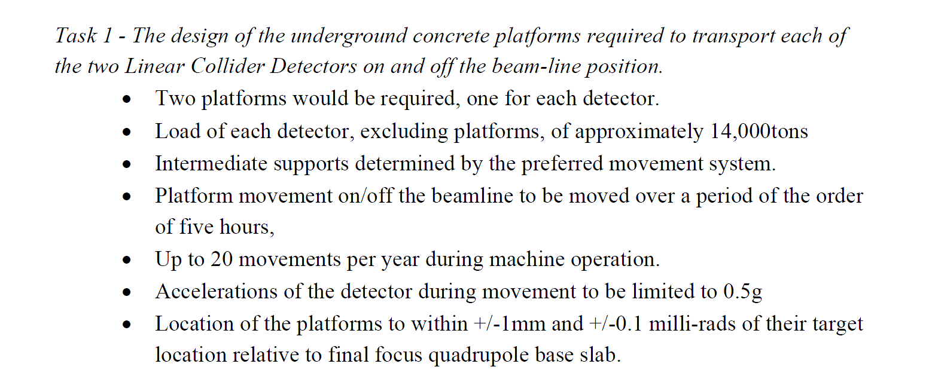
ARUP’s were asked to tender for 4 distinct tasks

Slide 3
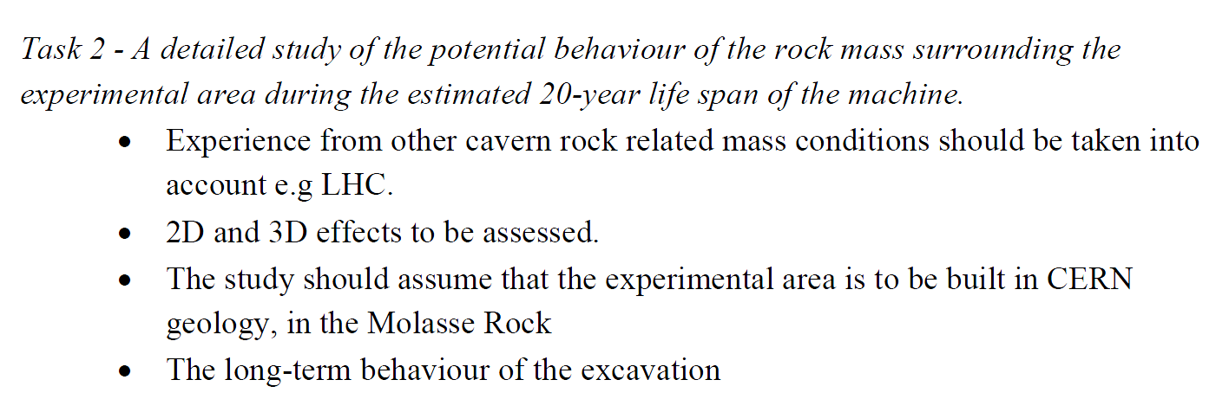

Slide 4
Next Steps
ARUP’s now ready to proceed with :
  Task 1 - funded by FNAL
  Task 2 - funded by CERN
This study will be of benefit to both ILC and CLIC projects
Design Criteria to be established at this meeting
J.Osborne (CERN) for CES

Slide 5
