Slide 1
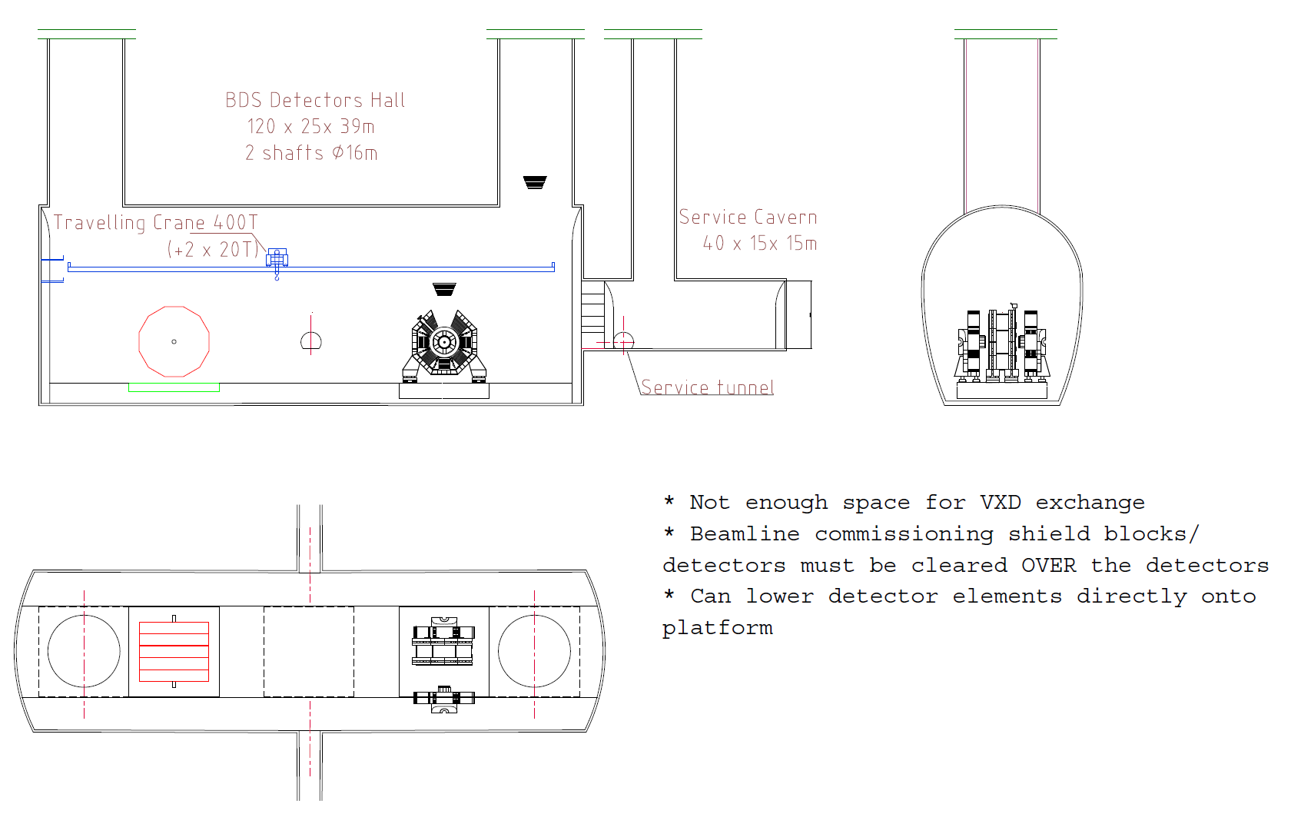
RDR Baseline

Slide 2
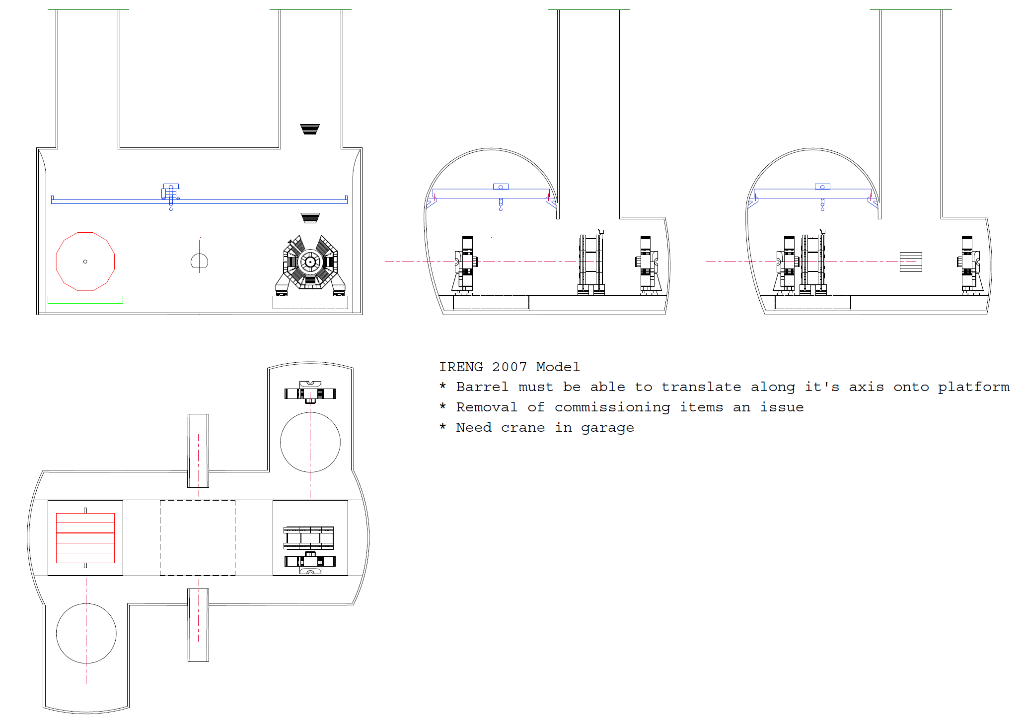
Option 1 : Zee shape, Two Shaft Off Axis

Slide 3
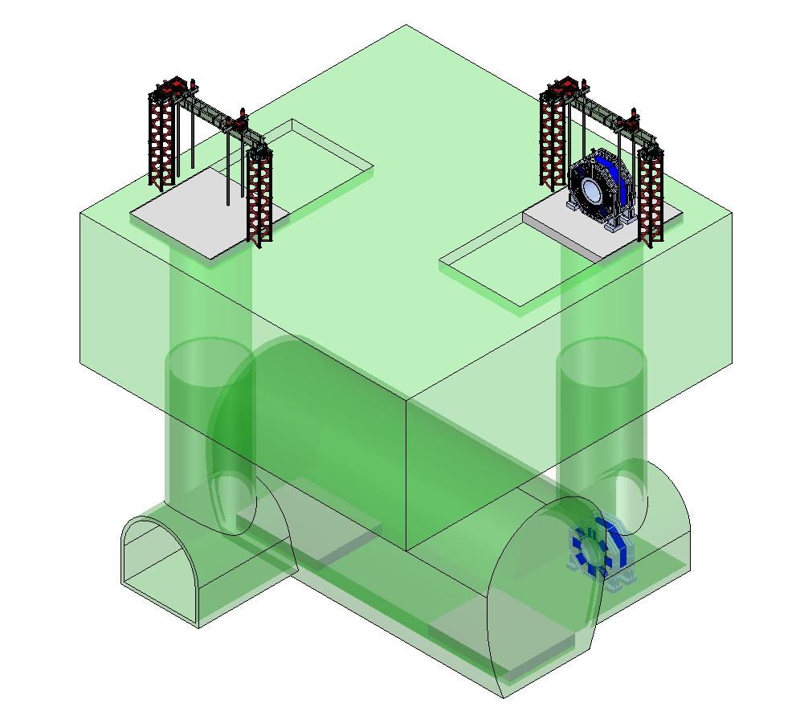
Two 4’000 Tons Gantry

Slide 4
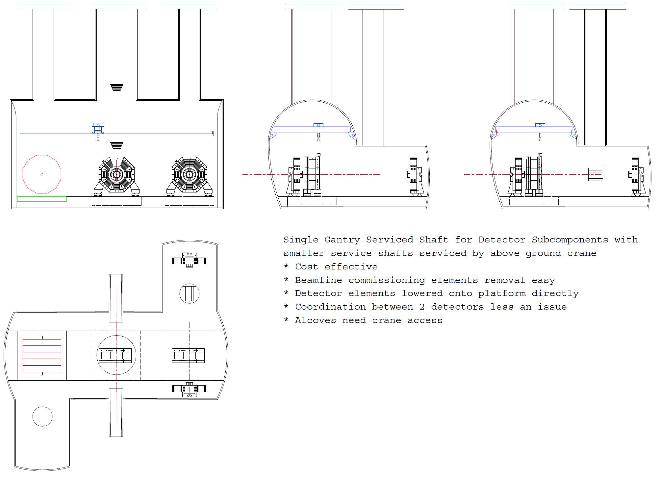
Option 2 : Zee shape,
One Shaft On Axis, Two Shaft Off Axis

Slide 5
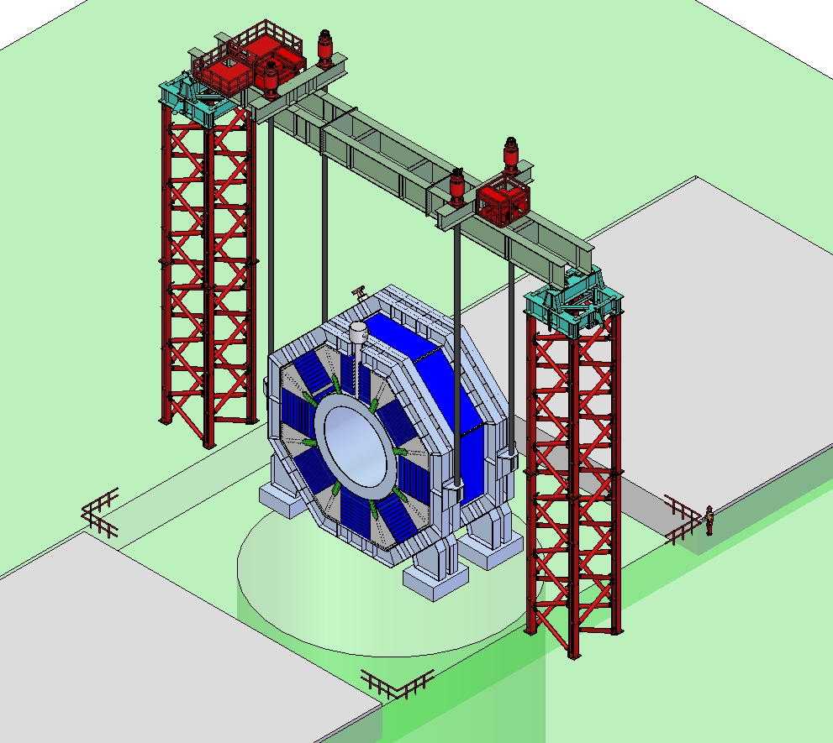
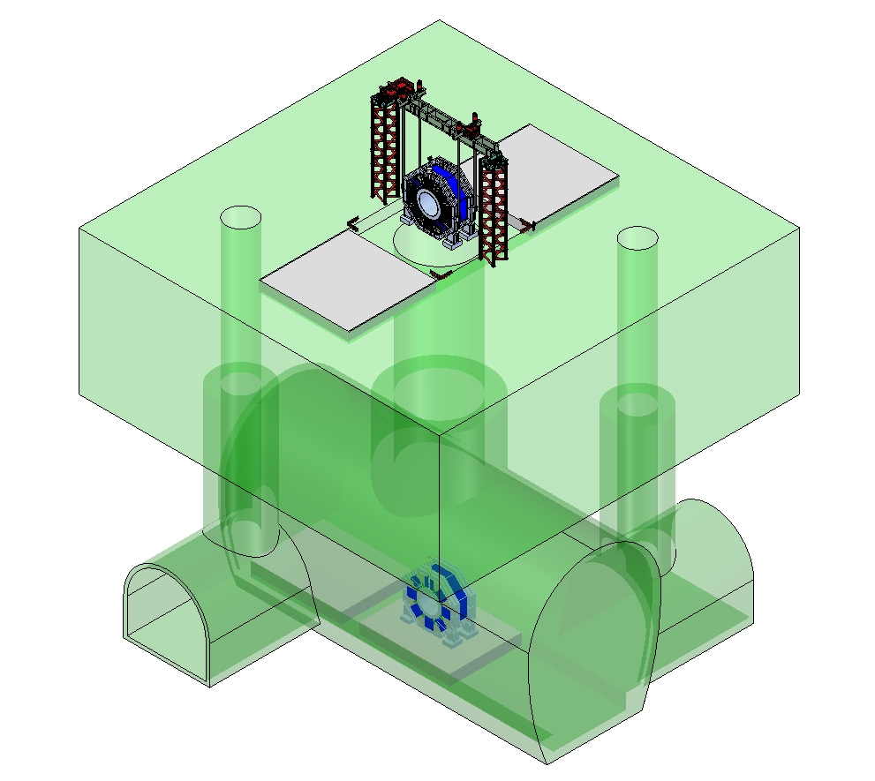
One 4’000 Tons Gantry

