Slide 1
Weekly Meeting
Edgar Nandayapa 07/01/11

Slide 4
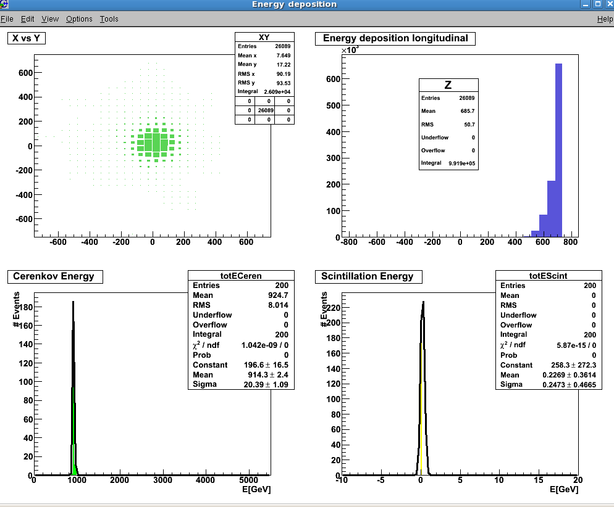

Slide 5
