Slide 1
FONT Shifts June 2011

Slide 2
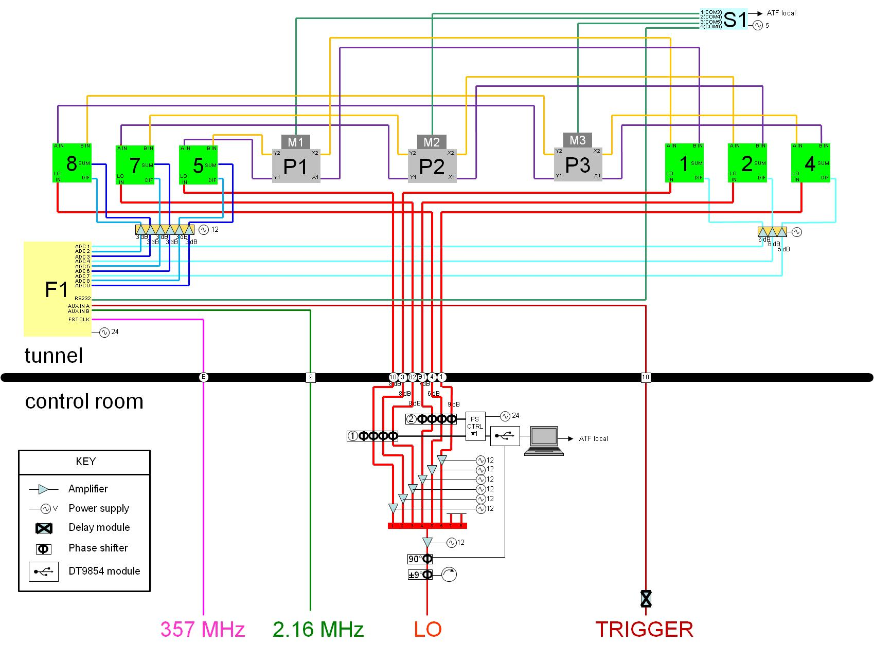
CABLE
MAP
28 June
2011

Slide 3
28 June 2011 – Shift Log
Usual preamble:
  Locate beam (set big trig delay = 117)
  Load trim DACs
  Phase LOs
  Set scan delays
Had to tweak generated 357 MHz
  Match to 1.428 GHz master signal

Slide 4
28 June 2011 – Shift Log
ACCESS
  replaced grey intermediate amplifier unit on x with NEW MiniCircuits unit
  N.B. atten. P1: 6dB, P2: 6dB, P3: 5dB
  (y, sum atten. was 3dB on all channels)
Result: reduced noise on x channels

Slide 5
28 June 2011 – Shift Log
Before useful data obtained, linac cooling water system failed.
Extended ACCESS
  Phil, Colin examined IP region
  Rob, Mikey repaired damaged RG58 cables

Slide 6
28 June 2011 – Shift Log
Beam returned @ ~7pm
Took LO phase sensitivity scans
Noticed DR instability causing huge y excursions; corrected using sextupoles
More LO phase scans + BPM calibrations
Large residuals cast doubt on P1
ACCESS to check P1, set up for next shift

Slide 7
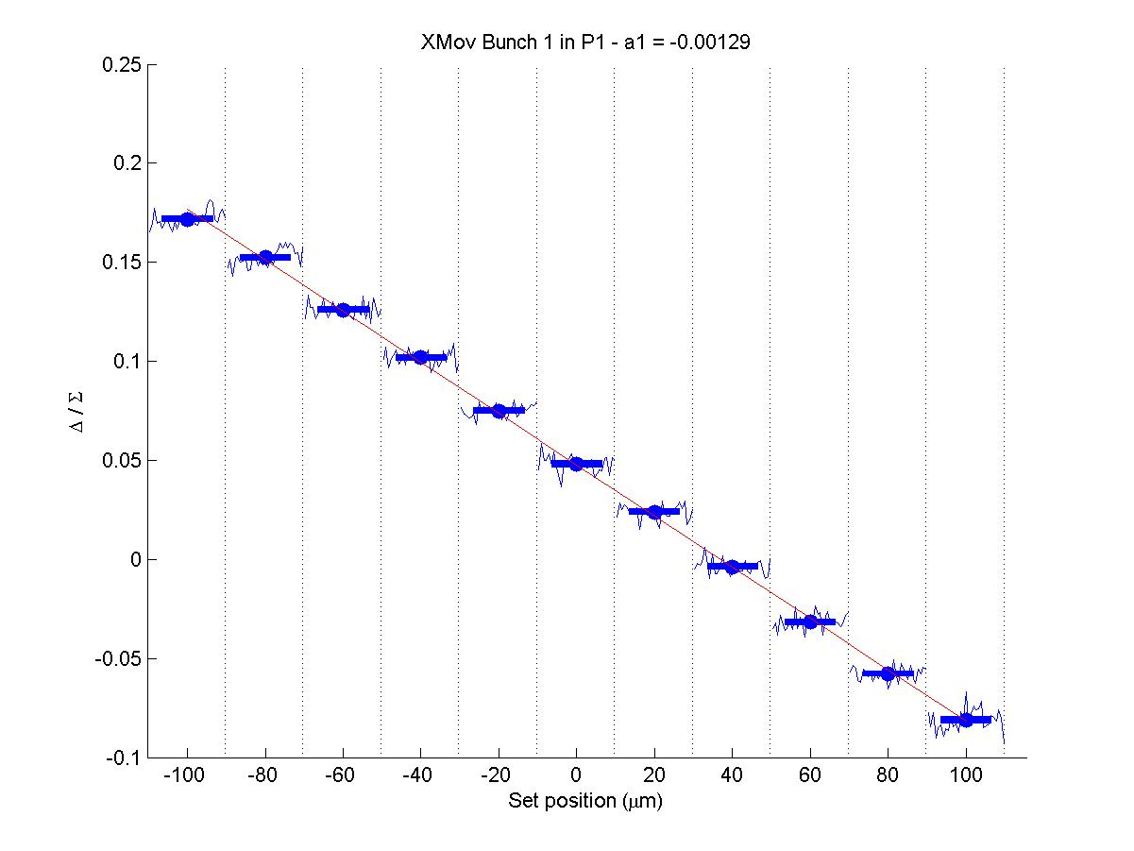
P1X = 1
-0.00129

Slide 8
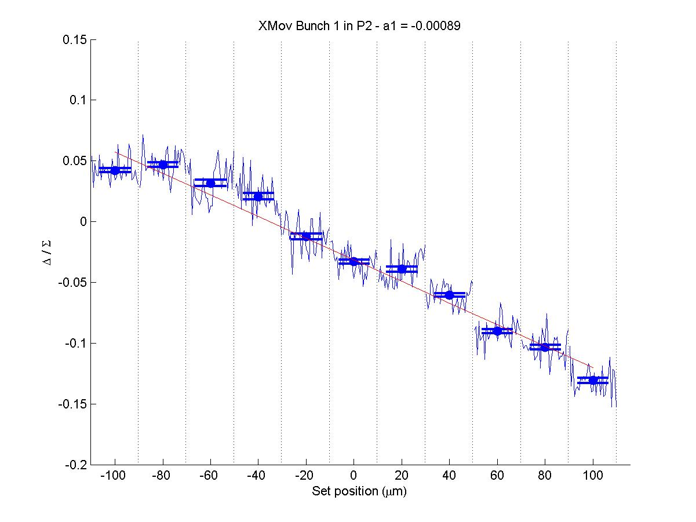
P2X = 2
-0.00089

Slide 9
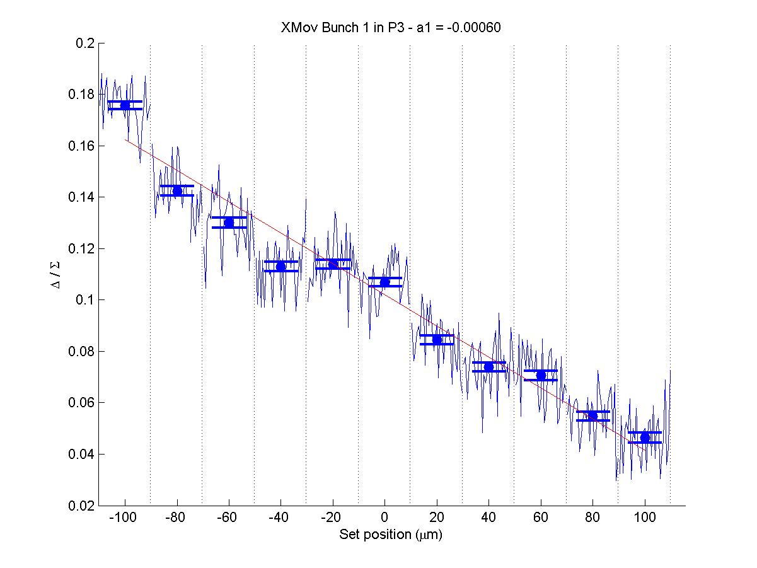
P3X = 4
-0.00060

Slide 10
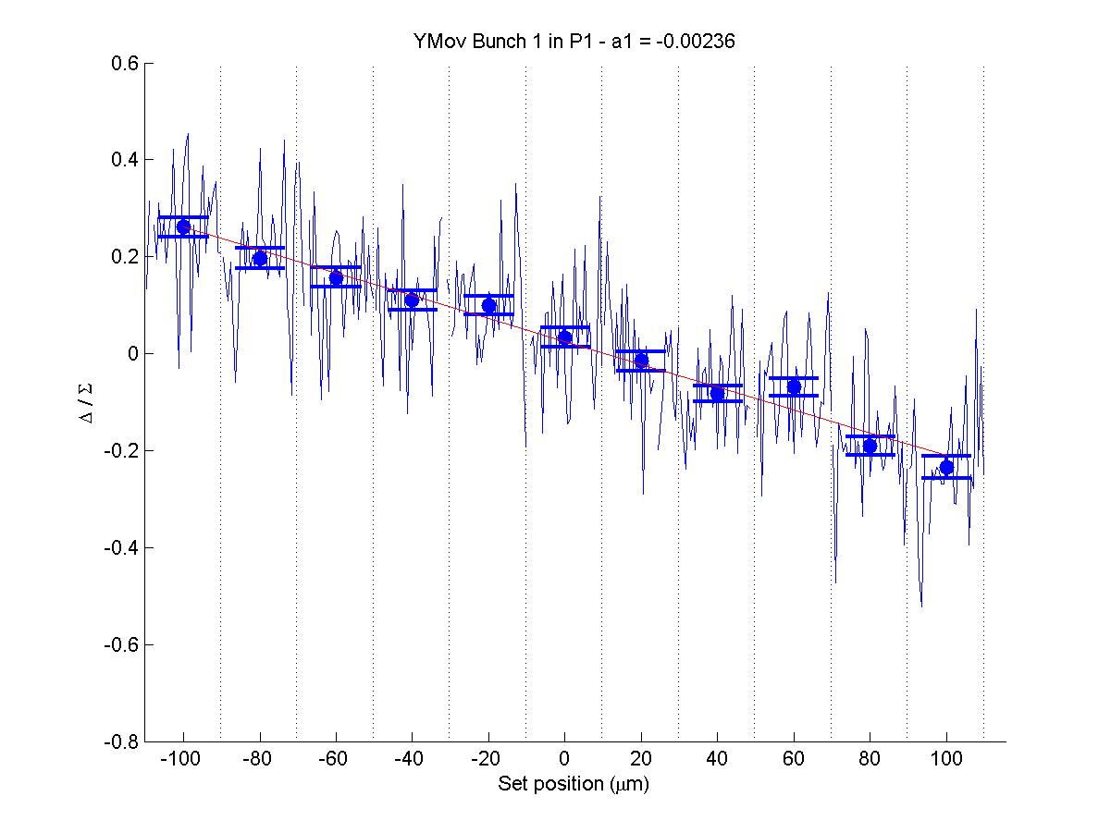
P1Y = 5
-0.00236

Slide 11
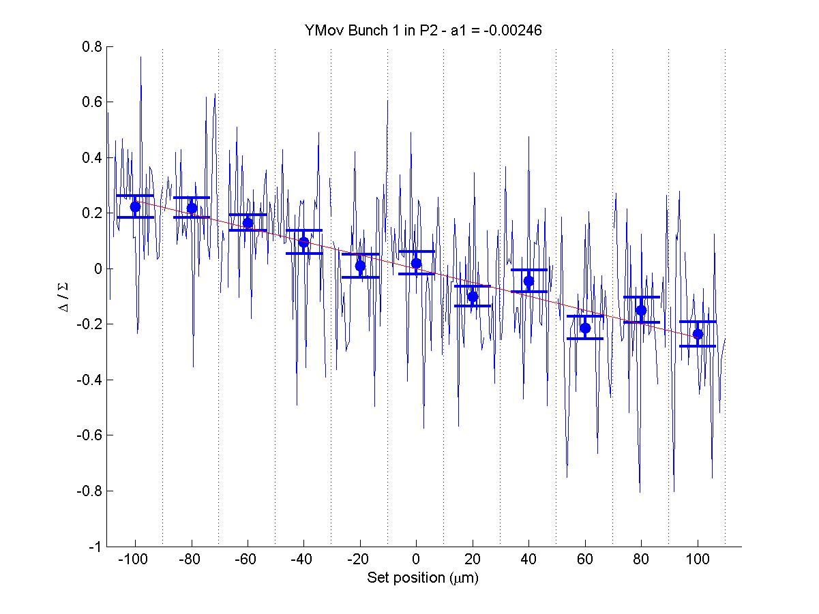
P2Y = 7
-0.00246

Slide 12
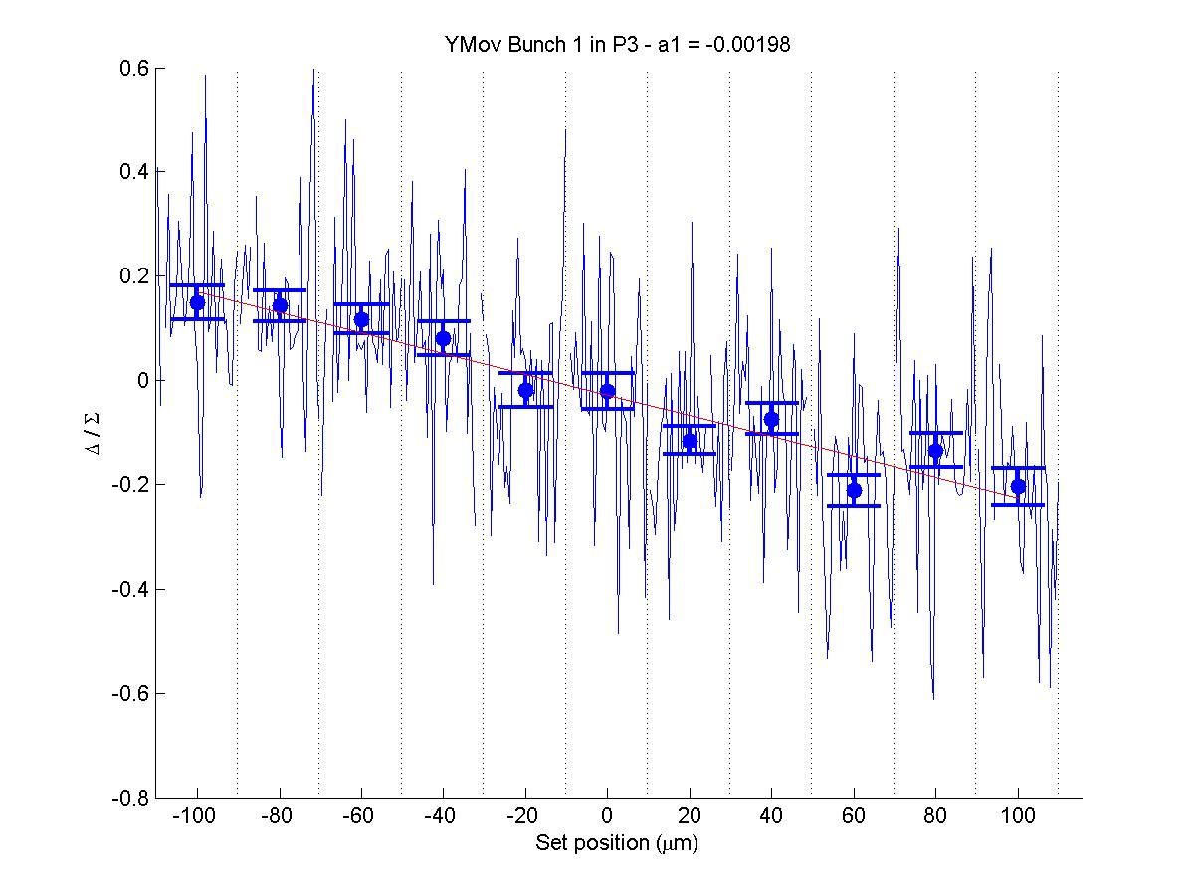
P3Y = 8
-0.00198

Slide 13
Note on these calibrations
X calibrations look “correct”, but actual constants are out
Possible causes:
  2-3 dB extra attenuation on XDIF
  XDIF, YSUM not aligned in time well enough (effect of this misalignment is scale factor)
These two effects could account for poor calibration constants yet lack of obvious deficiency with data

Slide 14
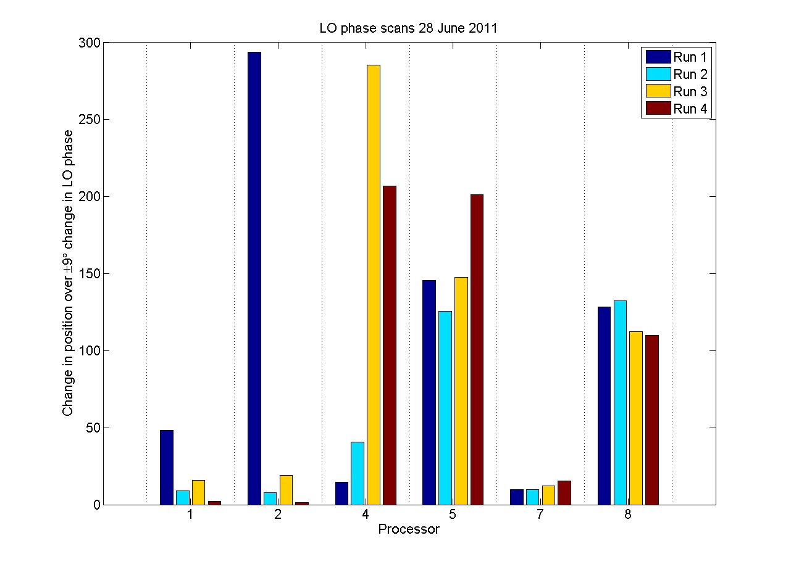
P1X
P2X
P3X
P1Y
P2Y
P3Y

Slide 15
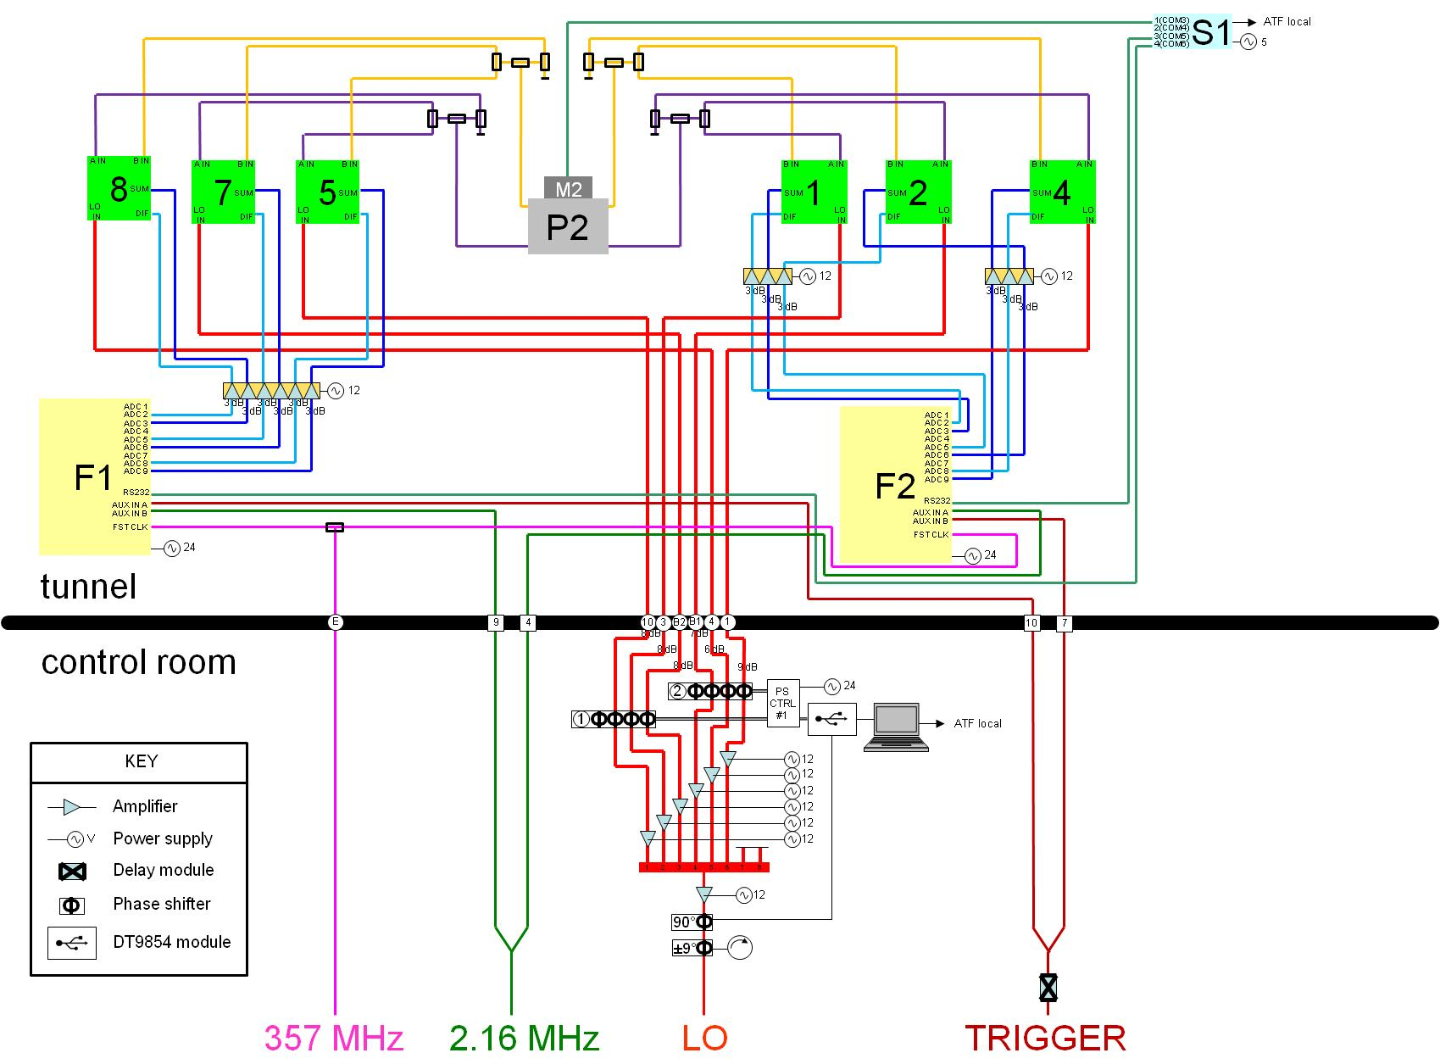
CABLE
MAP
29 June
2011

Slide 16
29 June 2011 – Shift Log
Running with both FONT5 boards
P2 outputs split 4-ways (spare terminated)
Channel assignments:
Channel no. | #1 (Y) | #2 (X)
2 | YDIF (5) | XDIF (1)
3 | YSUM (5) | XSUM (1)
5 | YDIF (7) | XDIF (2)
6 | YSUM (7) | XSUM (2)
8 | YDIF (8) | XDIF (4)
9 | YSUM (8) | XSUM (4)

Slide 17
29 June 2011 – Shift Log
New 3-channel MiniCircuits intermediate amplifiers used on X (3 dB atten. on all)
Amplifier on FONT rack provides +20 dB for 357 MHz (split in tunnel)
Routine: BPM calibrations, LO phase scan
Single BPM resolution runs
Rob’s resolution vs. position study
ACCESS to change setup back to 3 BPM

Slide 18
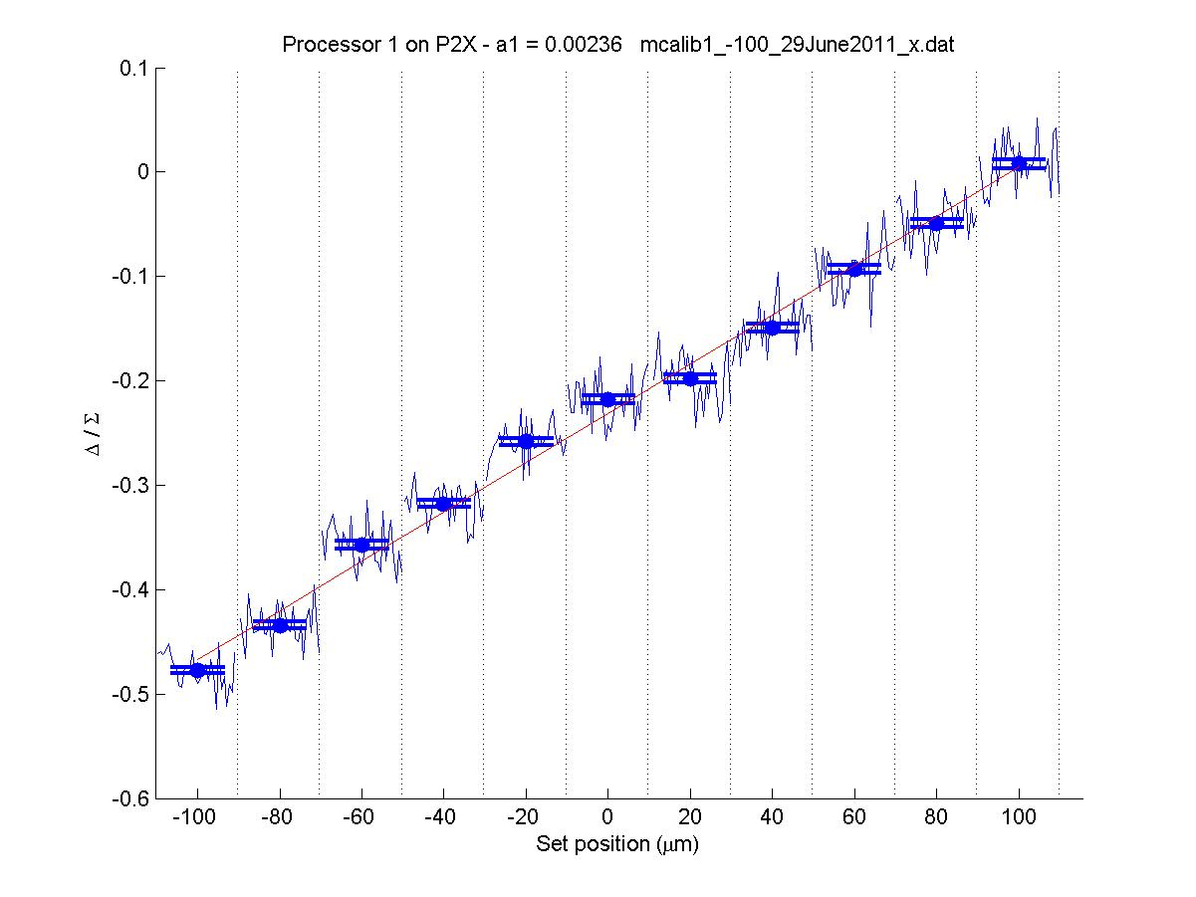
29 June 2011
P2X = 1
0.00236

Slide 19
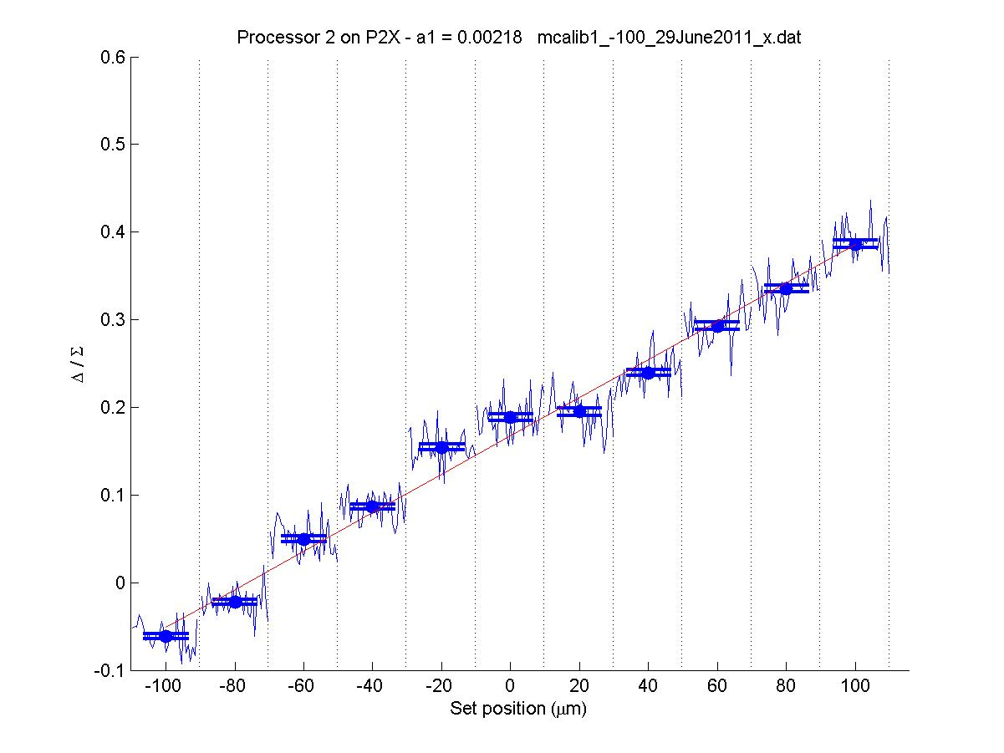
P2X = 2
0.00218

Slide 20
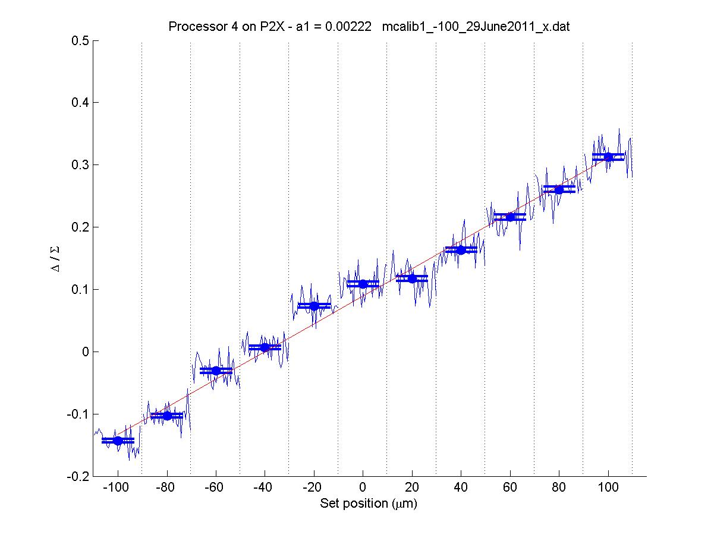
P2X = 4
0.00222

Slide 21
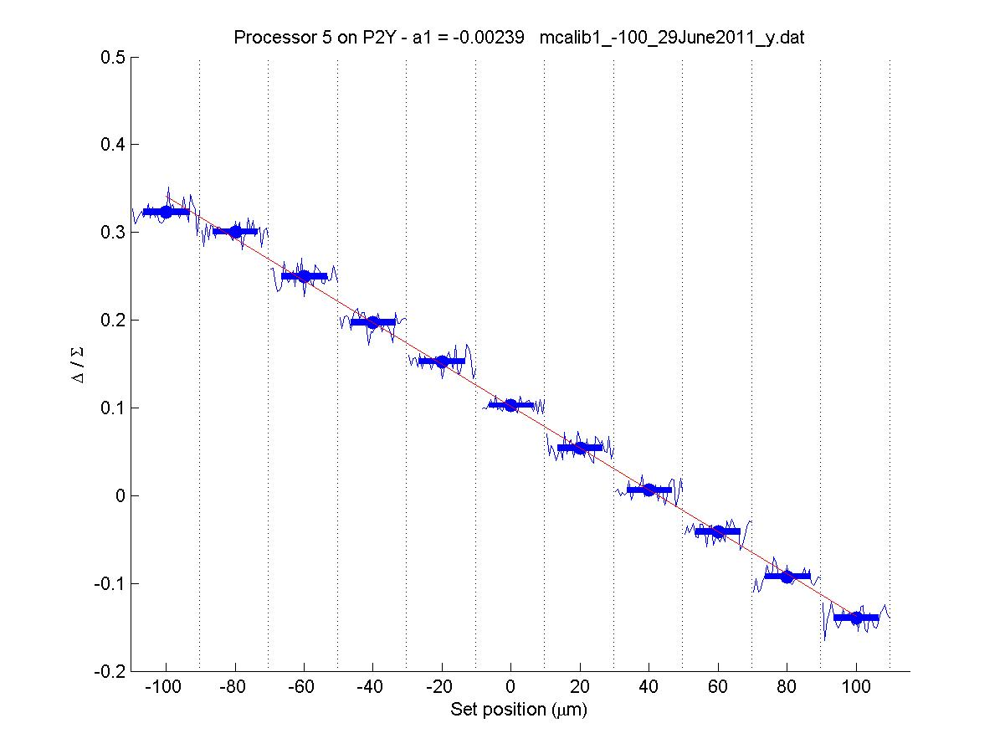
P2Y = 5
-0.00239

Slide 22
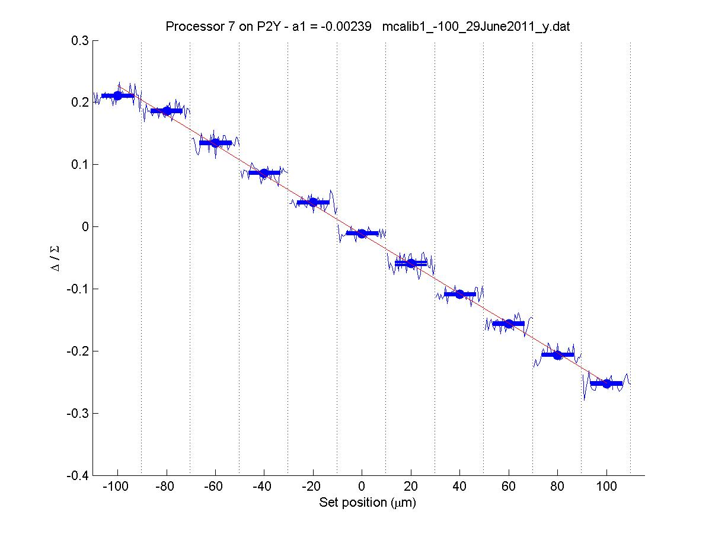
P2Y = 7
-0.00239

Slide 23
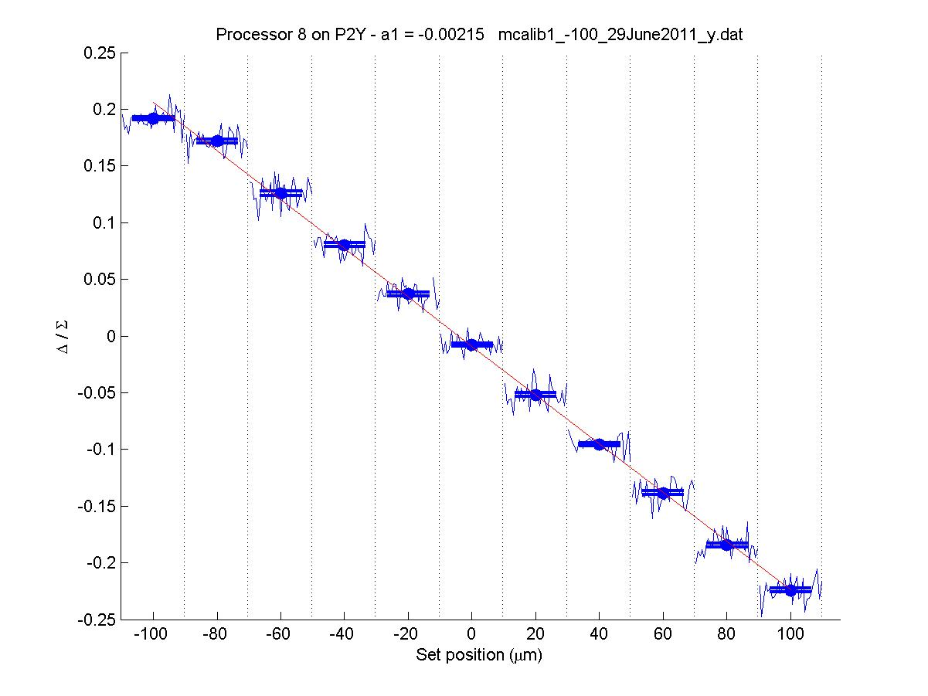
P2Y = 8
-0.00215

Slide 24
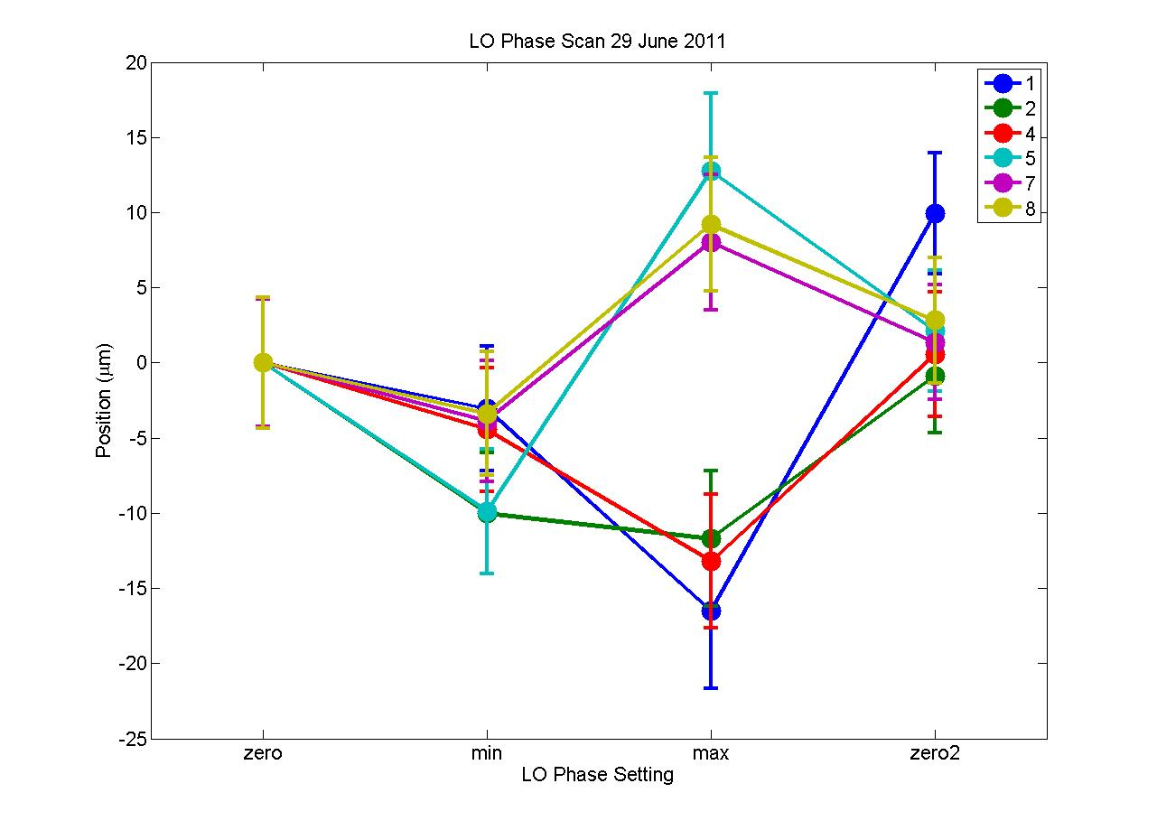

Slide 25
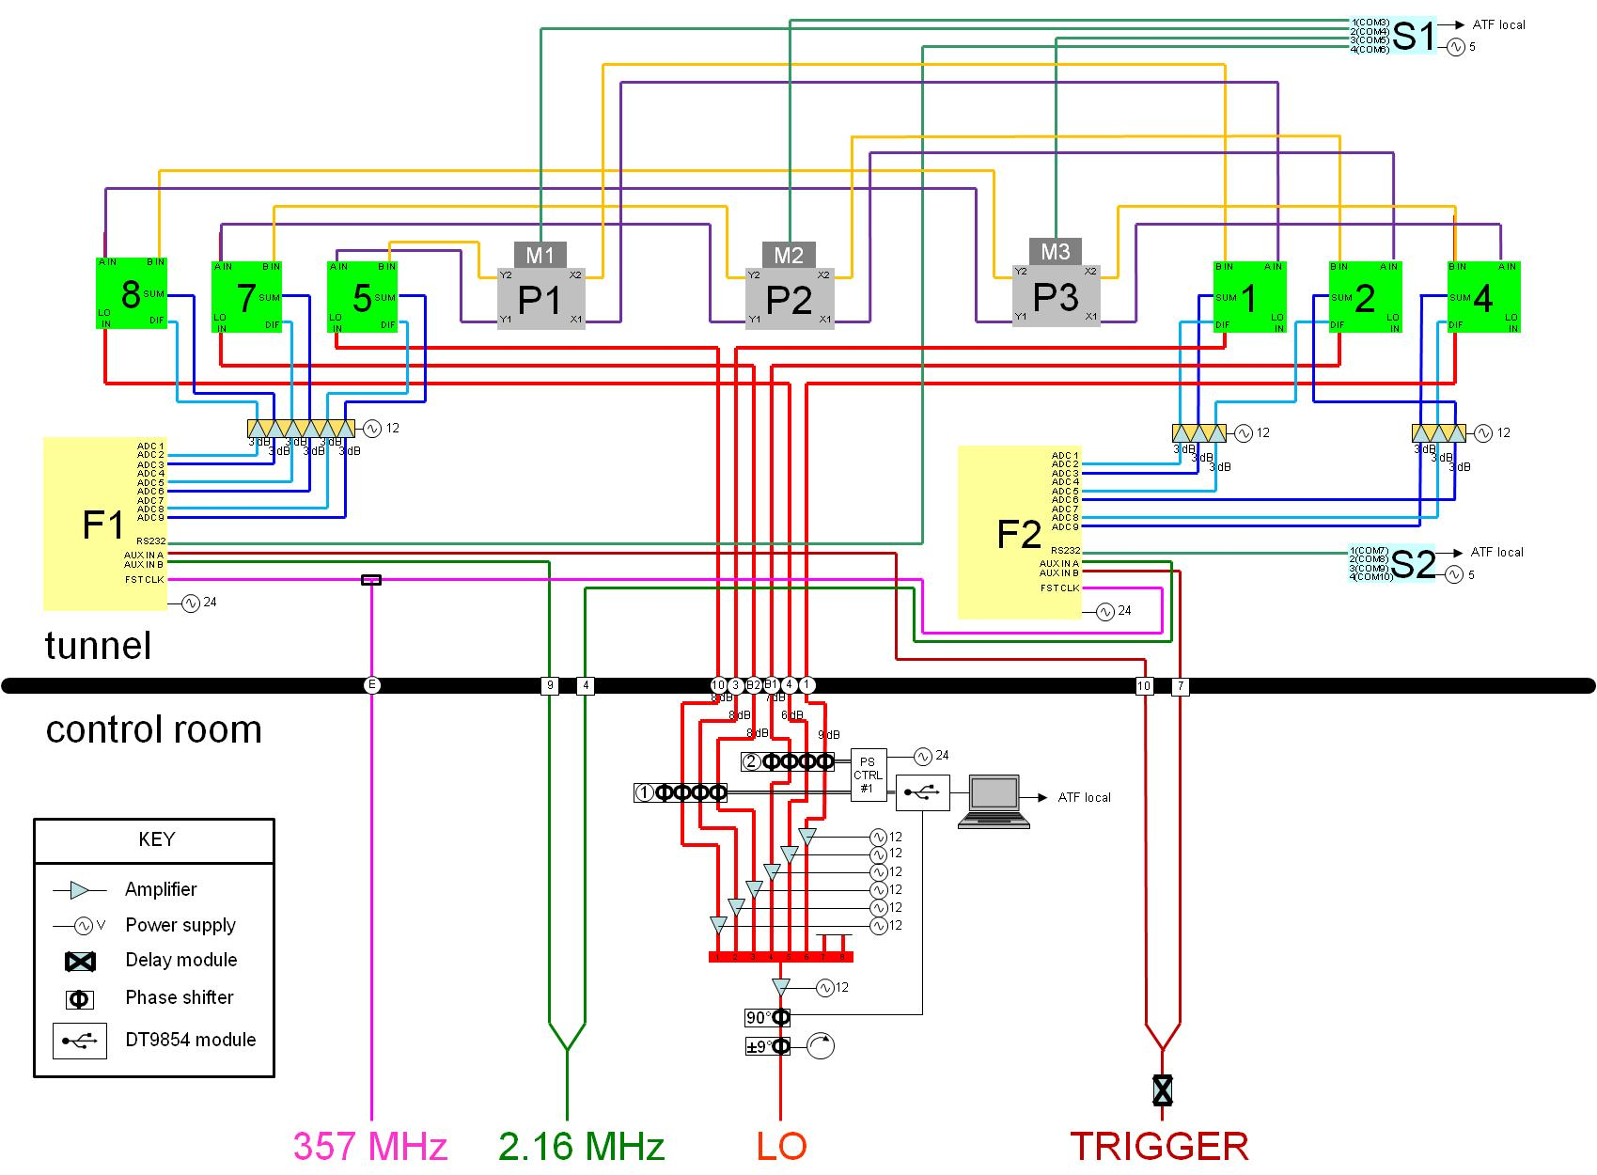
CABLE
MAP
30 June
2011

Slide 26
30 June 2011 – Shift Log
New FONT data cables put on ATF local
Routine: BPM calibrations, LO phase scan
Three BPM resolution runs
Kicker “calibrations”
ACCESS to collect equipment
  Almost all FONT kit now in Oxford

Slide 27
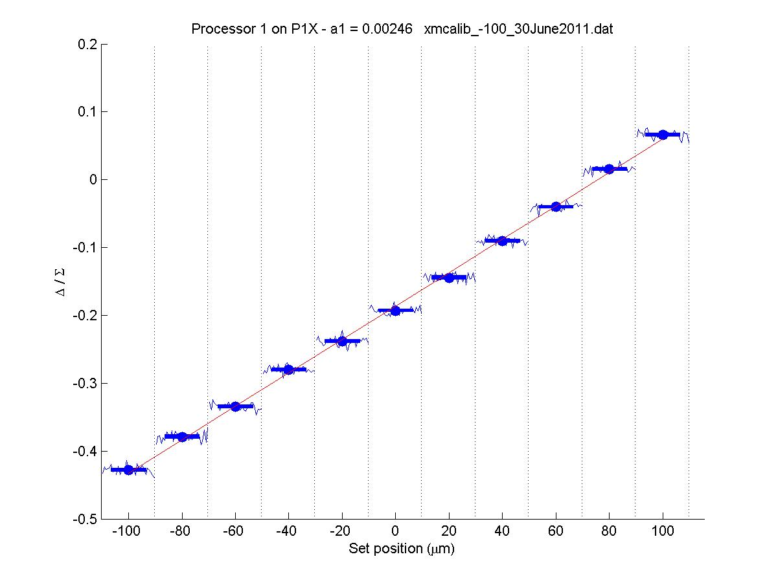
P1X = 1
0.00246

Slide 28
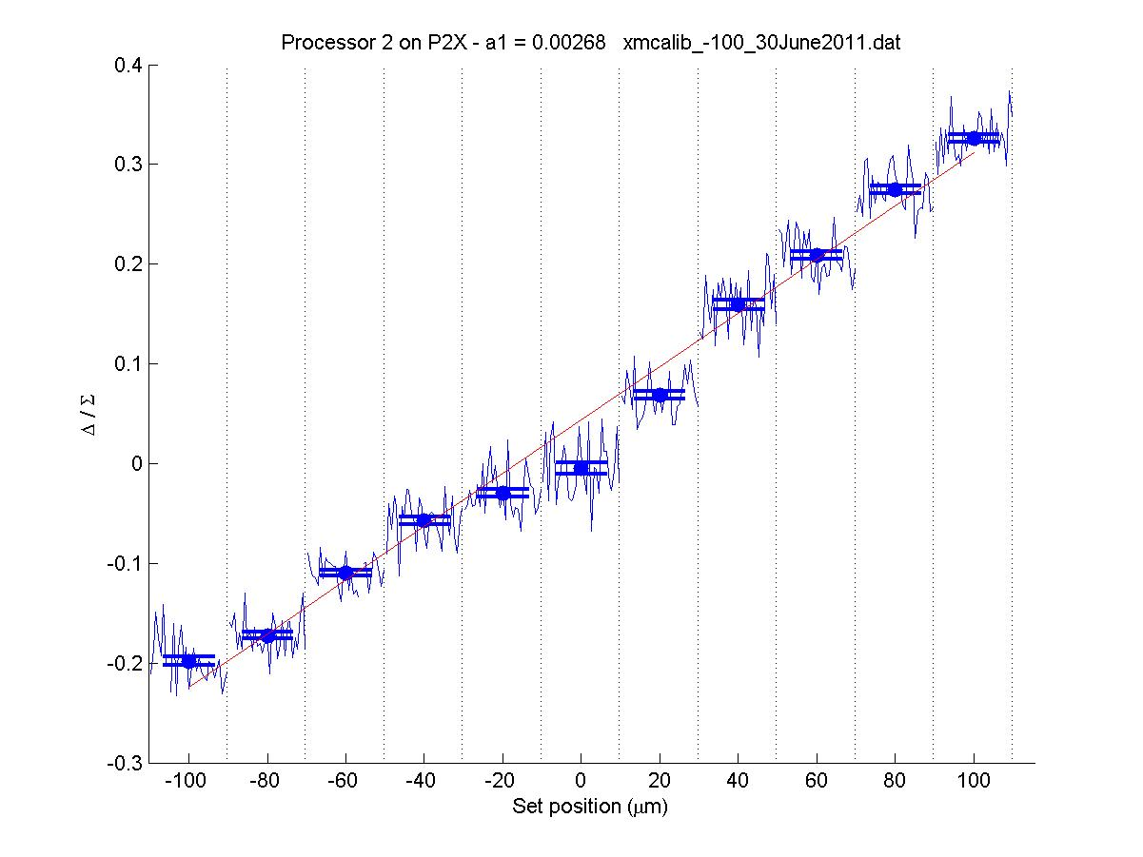
P2X = 2
0.00268

Slide 29
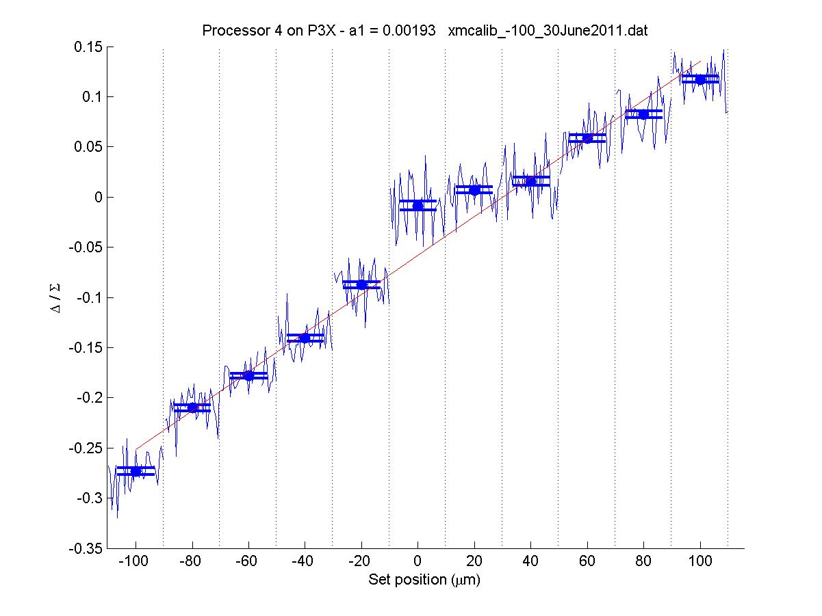
P3X = 4
0.00193

Slide 30
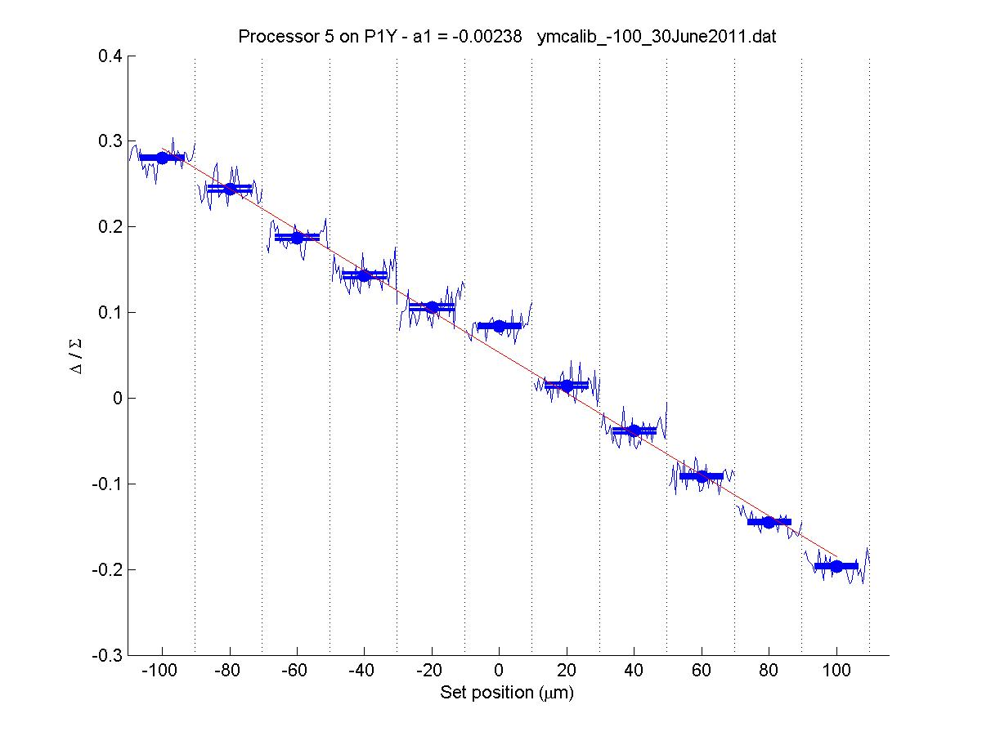
P1Y = 5
-0.00238

Slide 31
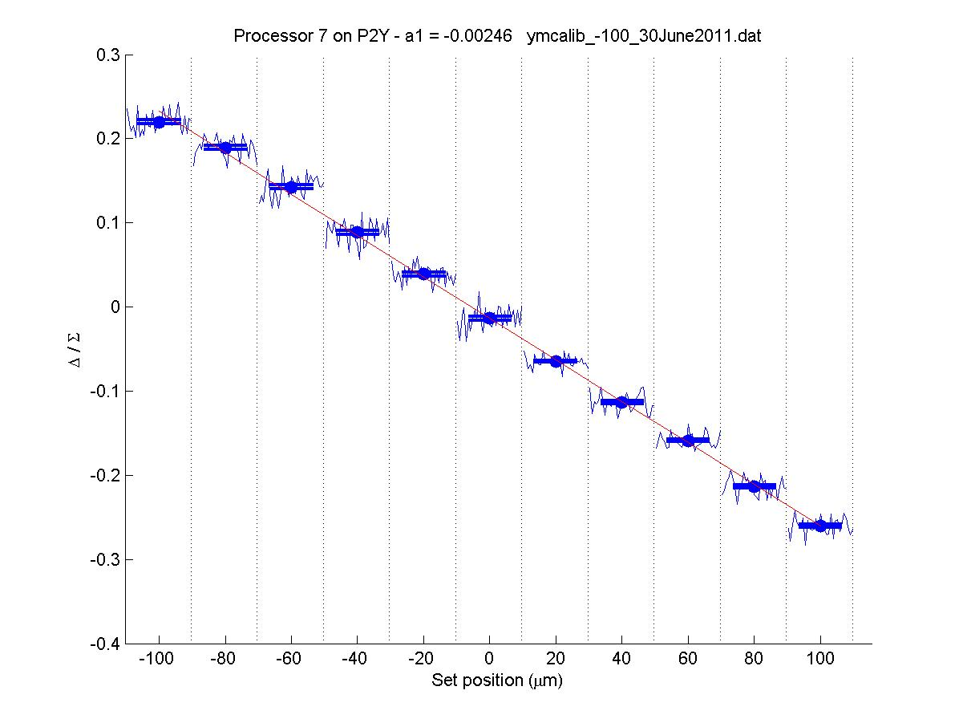
P2Y = 7
-0.00246

Slide 32
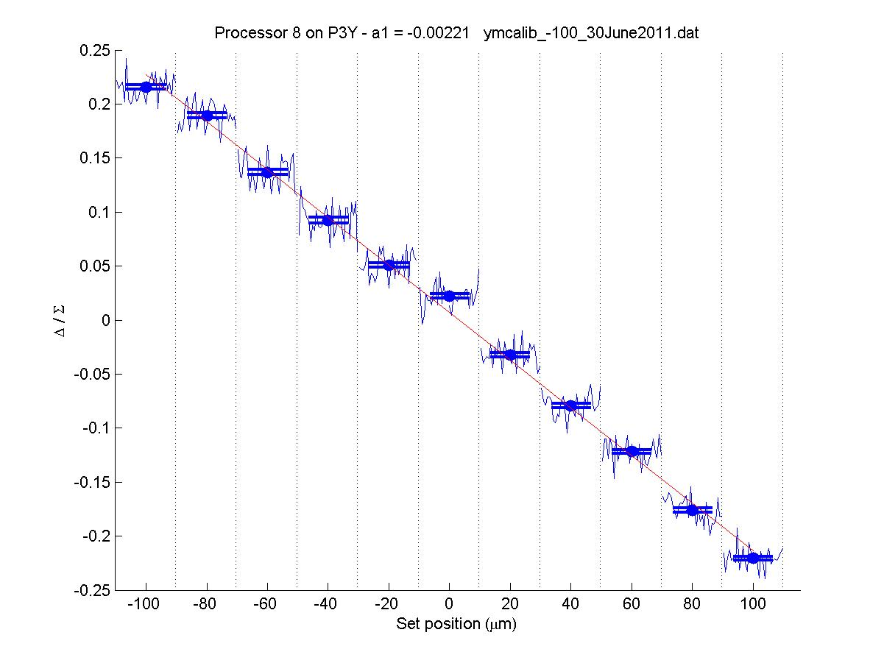
P3Y = 8
-0.00221

Slide 33
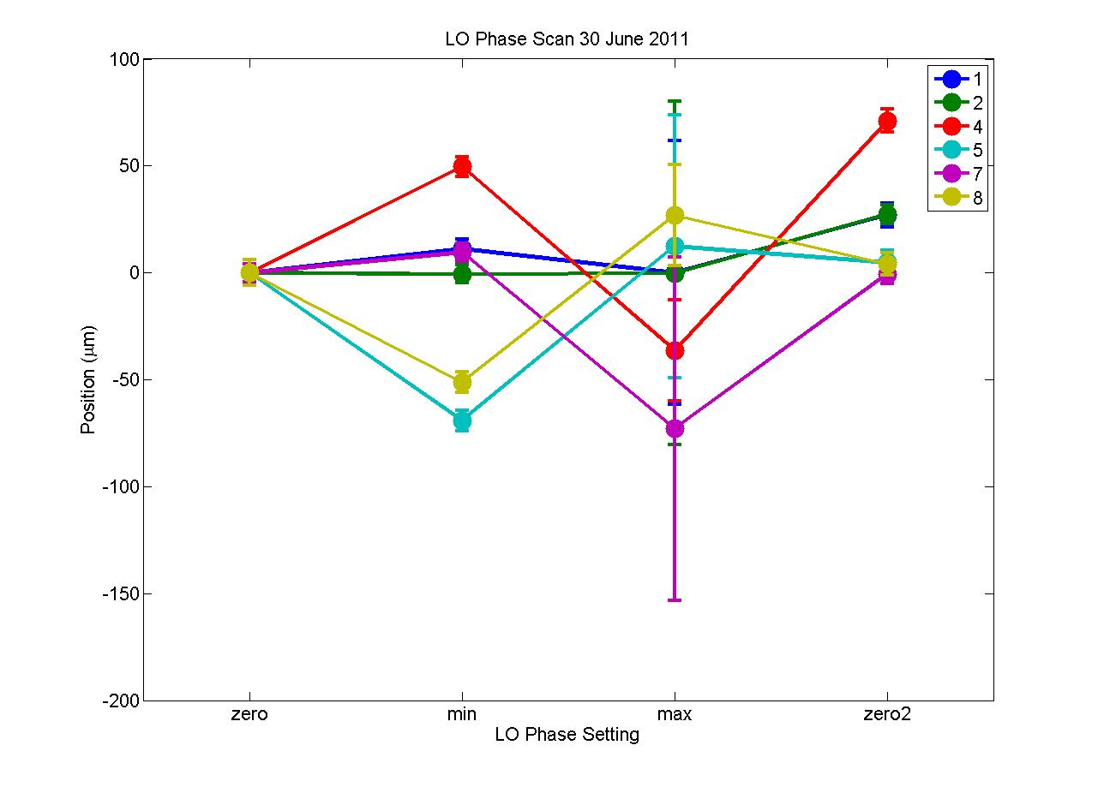

Slide 34
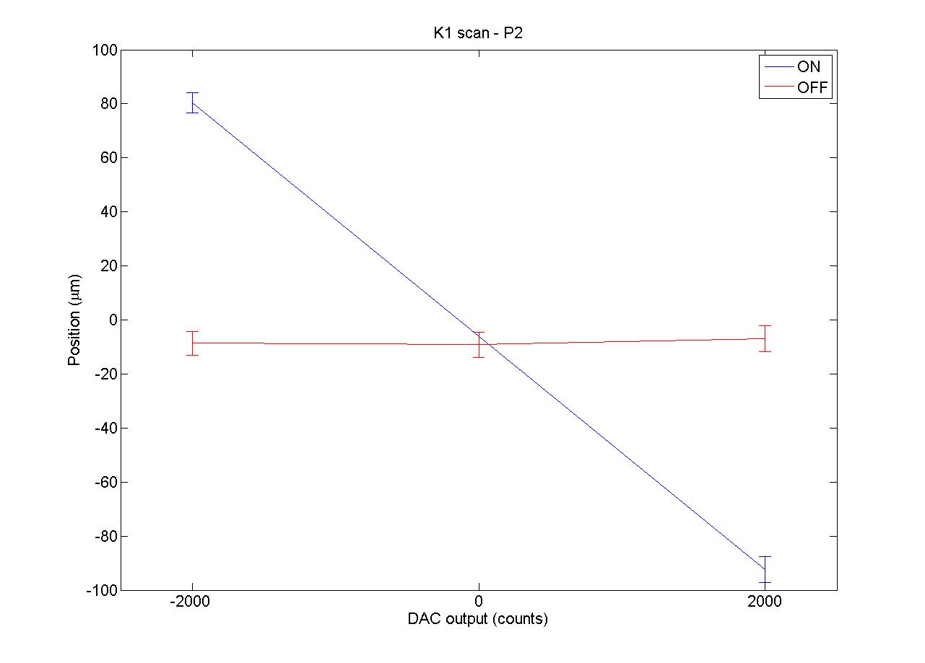
K1 in P2
170 µm

Slide 35
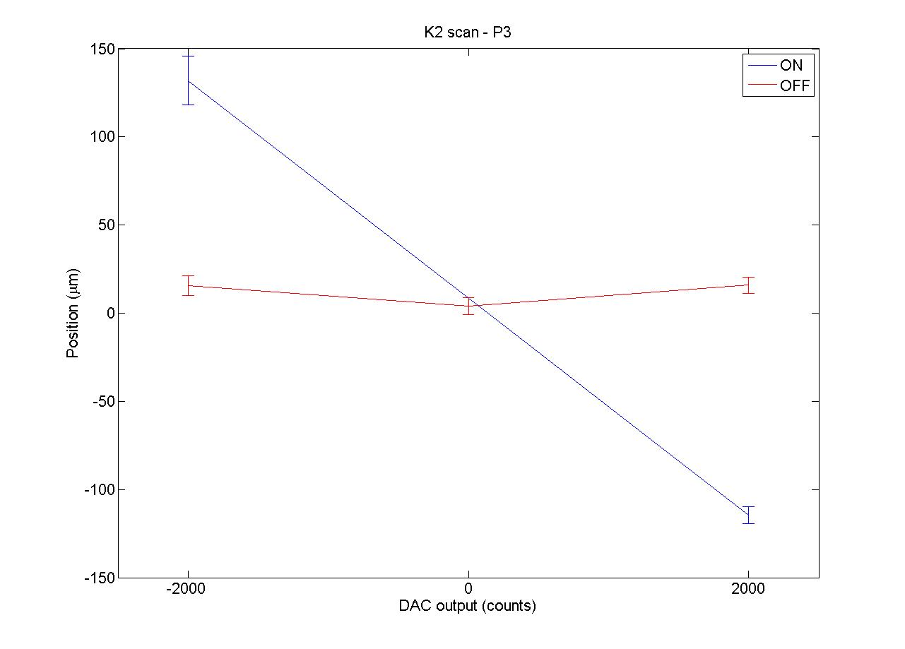
Summary
K2 in P3
250 µm

Slide 36
Summary
BPM calibrations within normal range
LO phase scans baffling
  Susceptibility to LO phase appears to vary wildly depending on BPM used
Kicker calibrations consistent

