Slide 1
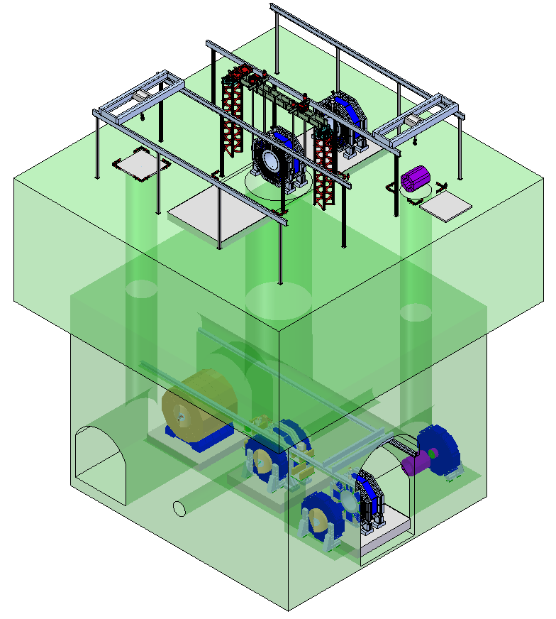
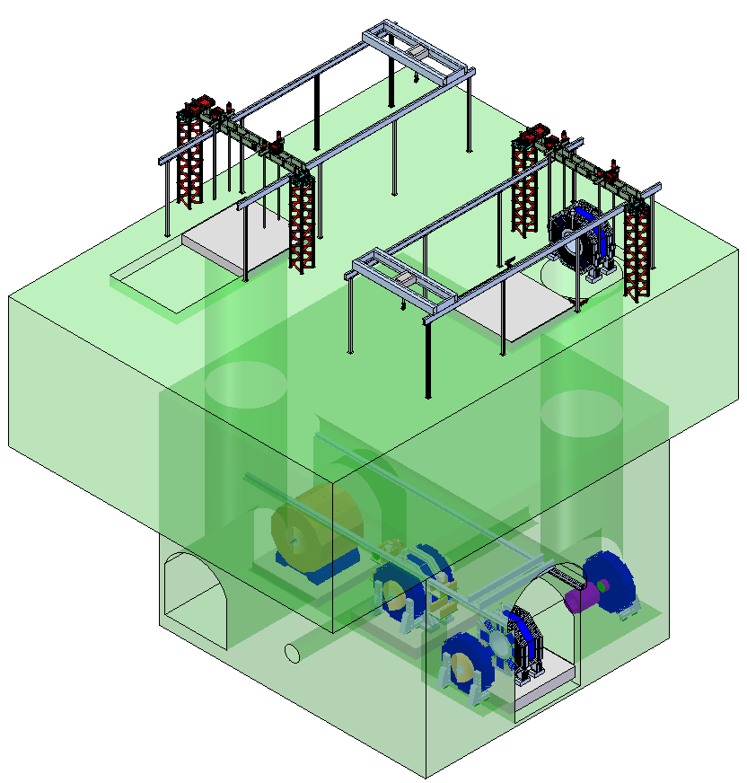
SID Layout
Concept
Marco Oriunno
Matt Swift

Slide 2
3 shaft option Iso view
4000 t Strand Jack system installed
over main 18M shaft.
400 t bridge crane works over
assembly area and 8.5M shaft.

Slide 3
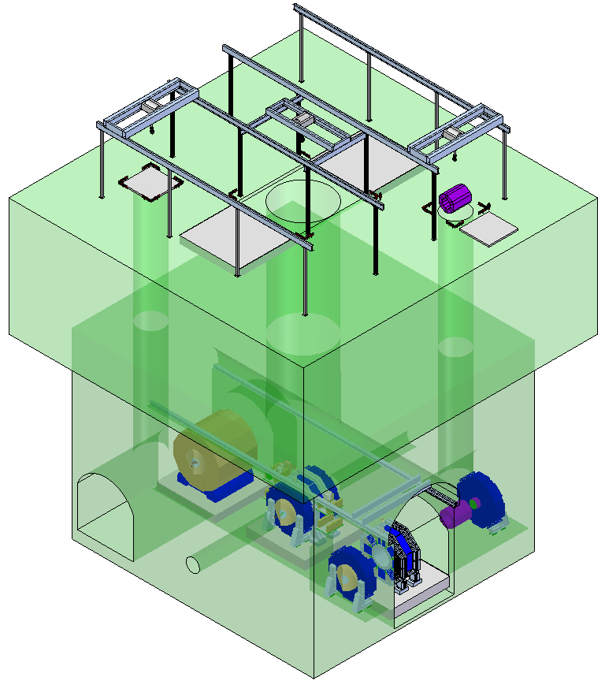
3 shaft option Iso view
Bridge crane replaces strand jacks
over main shaft.

Slide 4
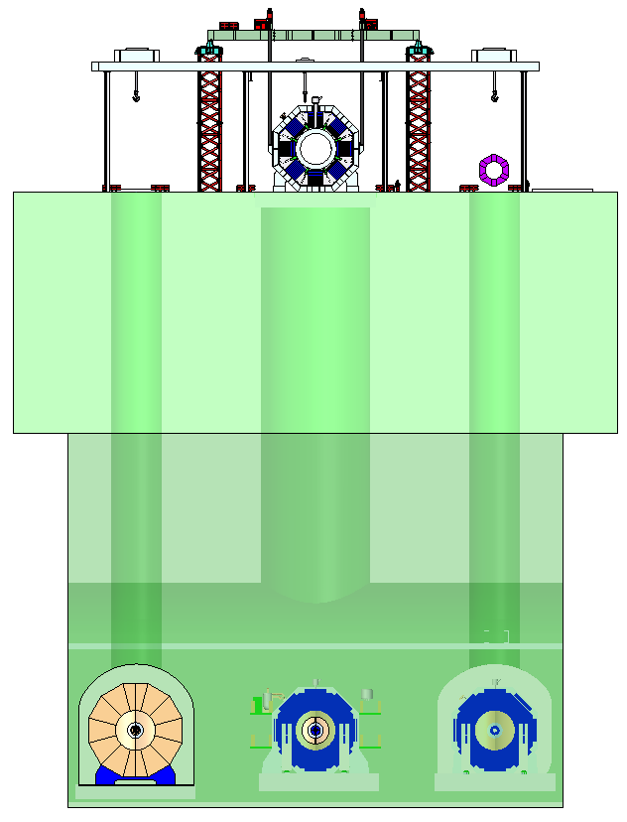
3 shaft option front view

Slide 5
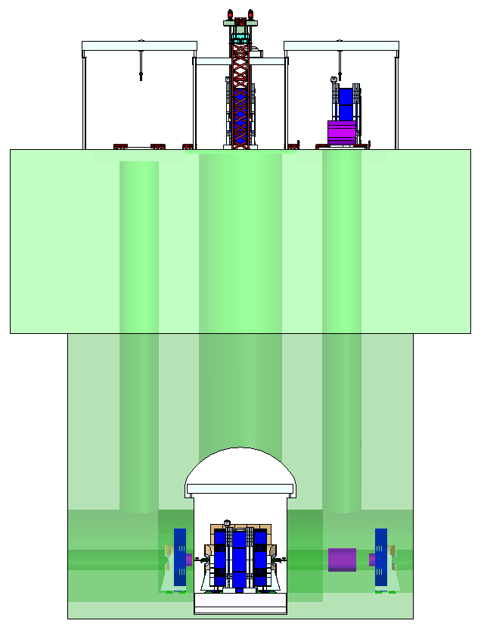
3 shaft option side view

Slide 6
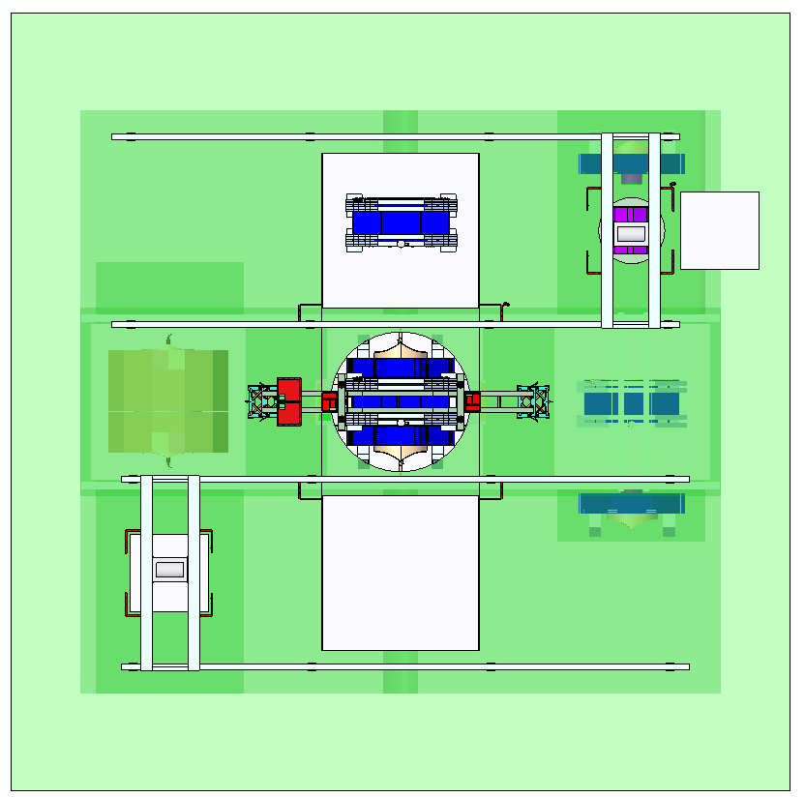
3 shaft option top view

Slide 7
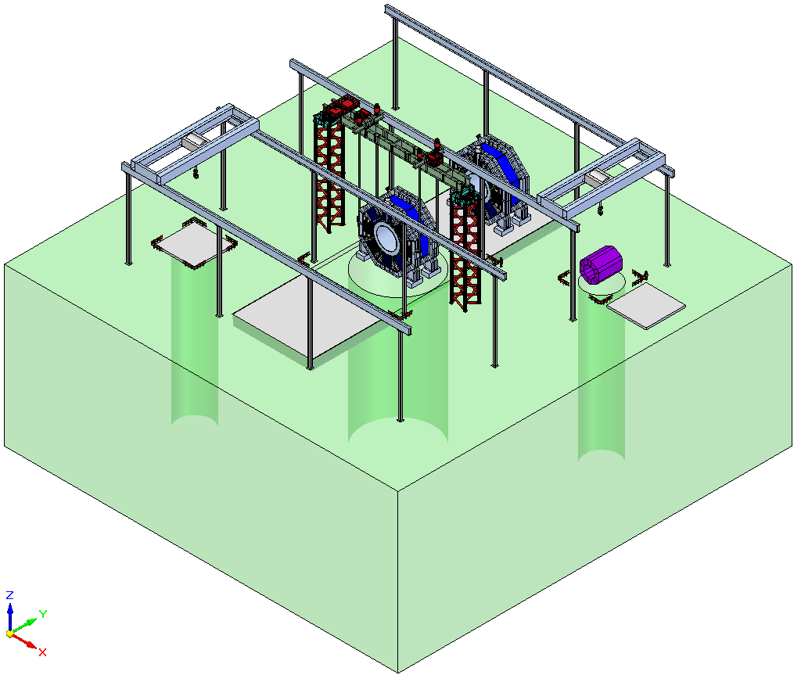
3 shaft option upper level Iso view

Slide 8
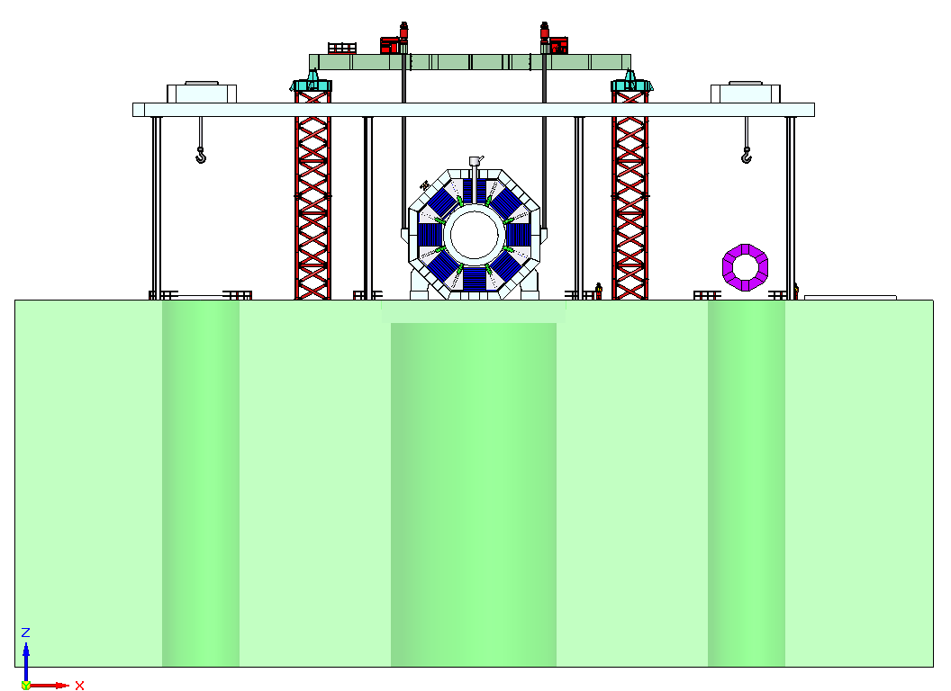
3 shaft option upper level front view

Slide 9
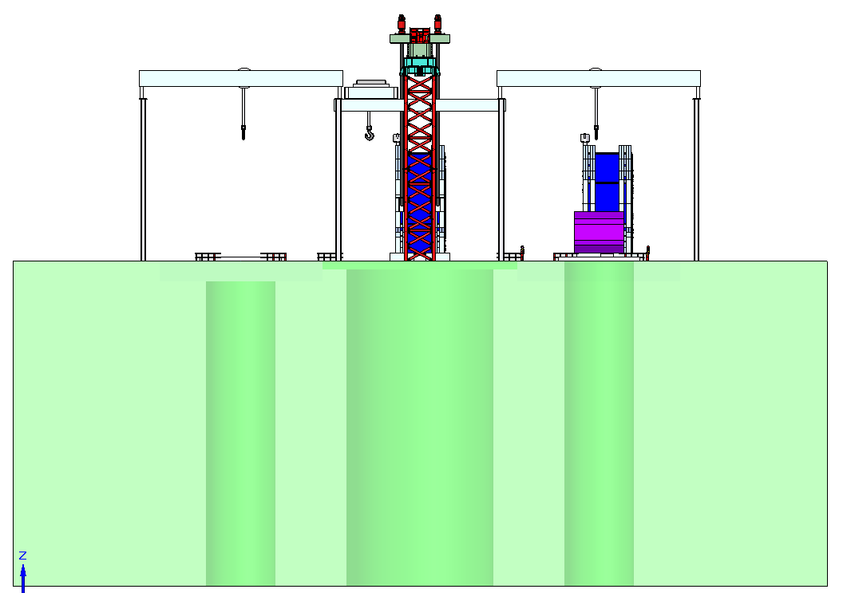
3 shaft option upper level side view

Slide 10
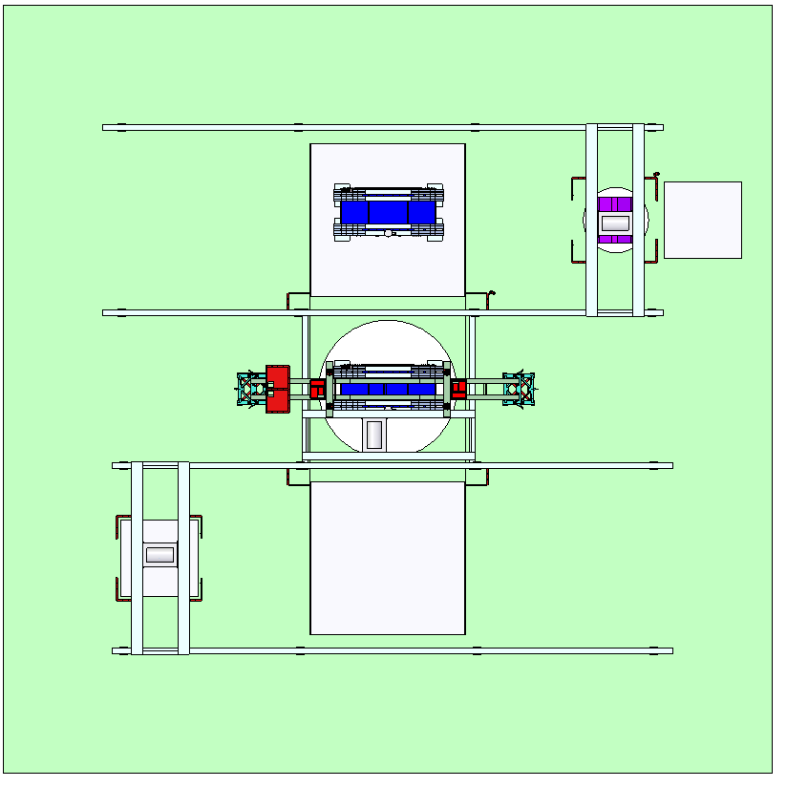
3 shaft option upper level top view

Slide 11
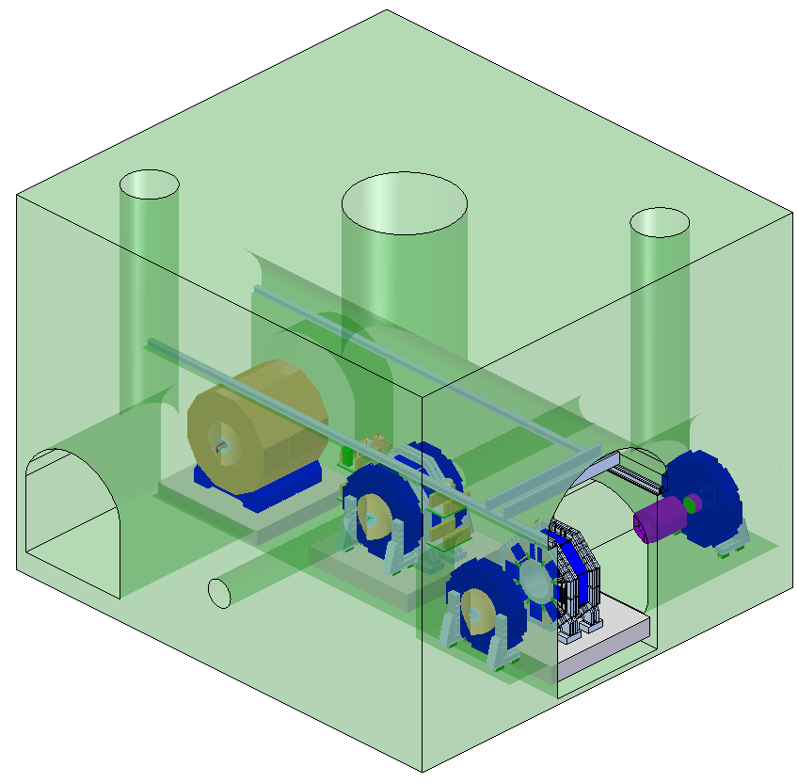
3 shaft option lower level Iso view

Slide 12
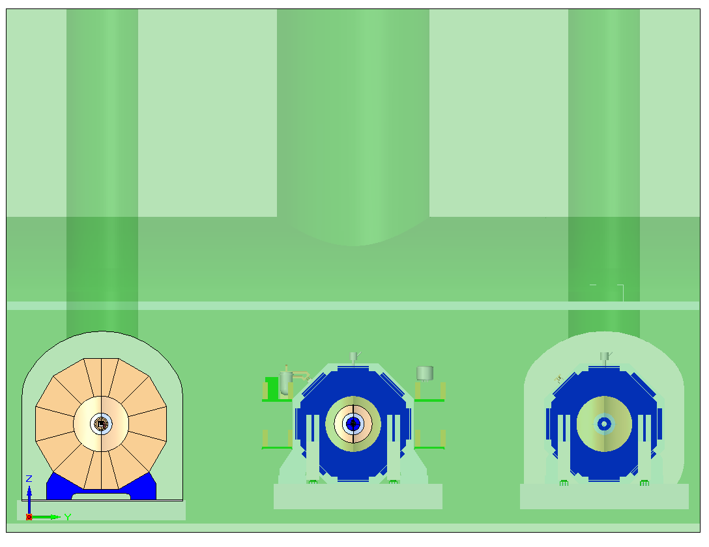
3 shaft option lower level front view

Slide 13
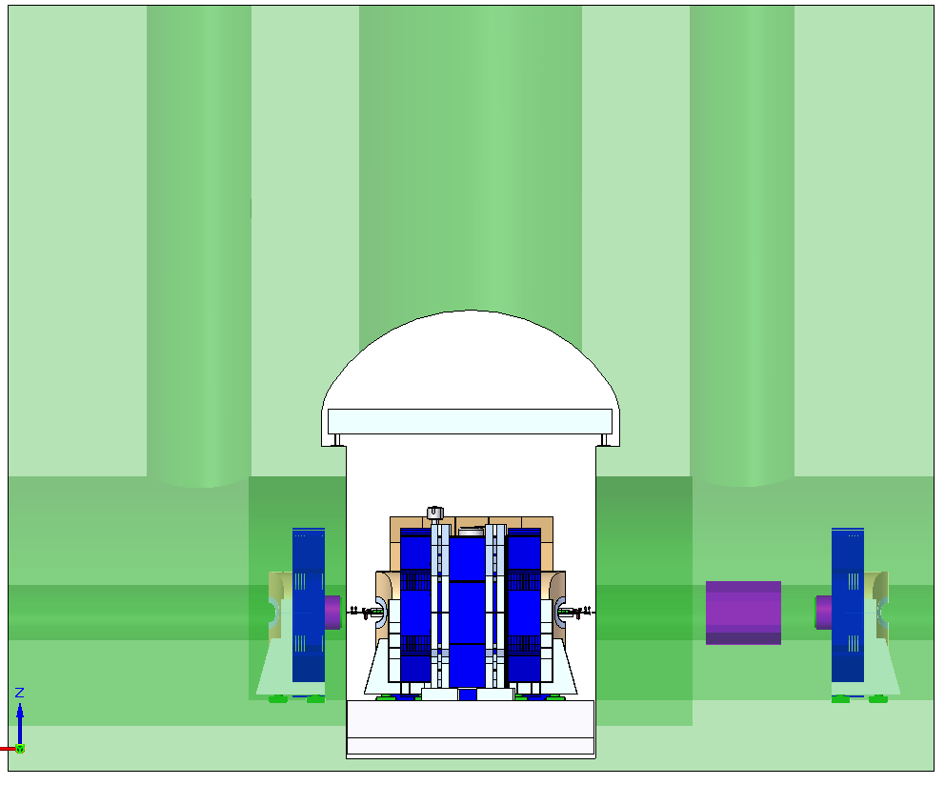
3 shaft option lower level side view

Slide 14
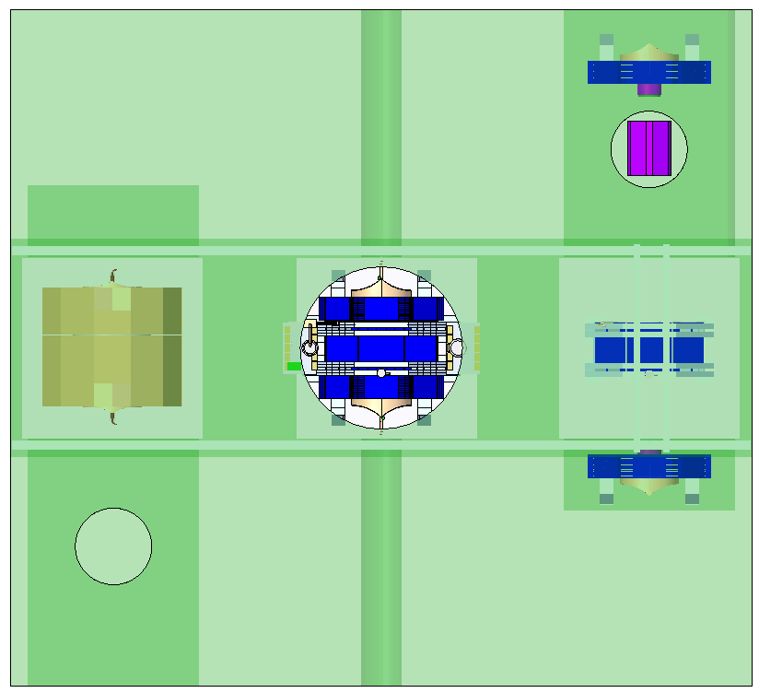
3 shaft option lower level top view

Slide 15
2 shaft option Iso view

Slide 16
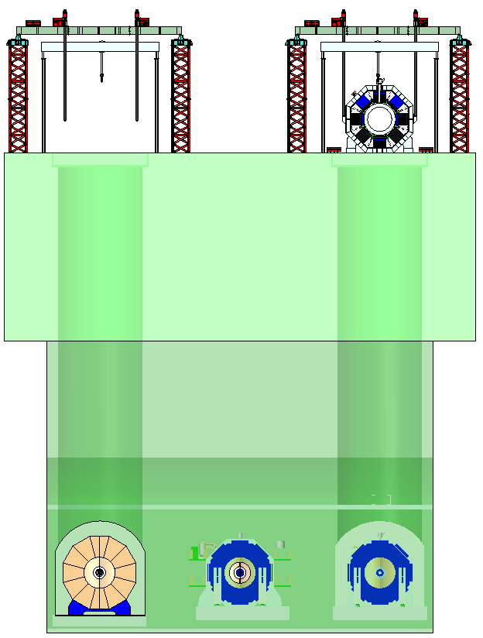
2 shaft option front view

Slide 17
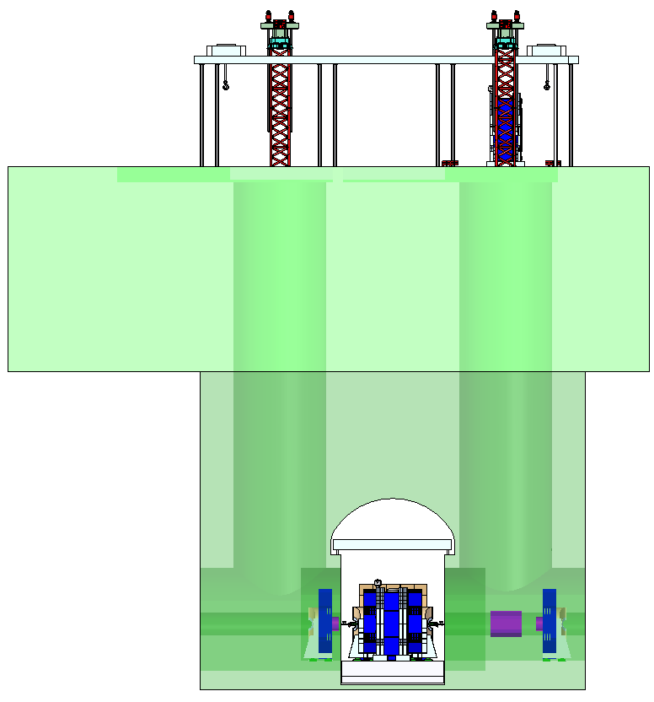
2 shaft option side view

Slide 18
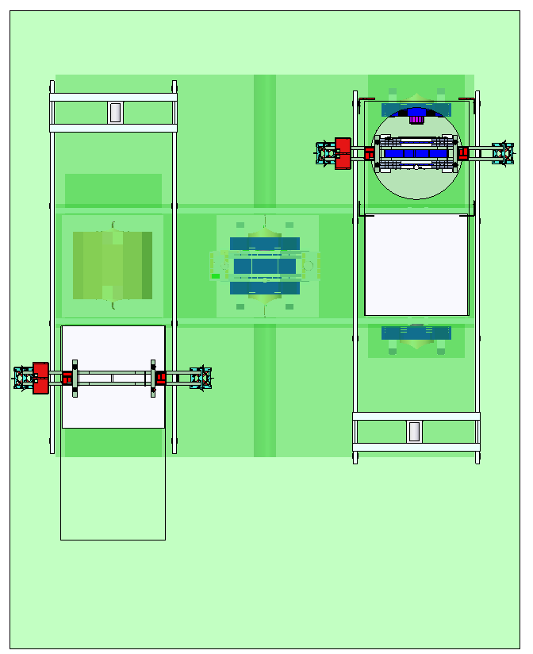
2 shaft option top view

Slide 19
3 shafts option
2 shafts option

Slide 20
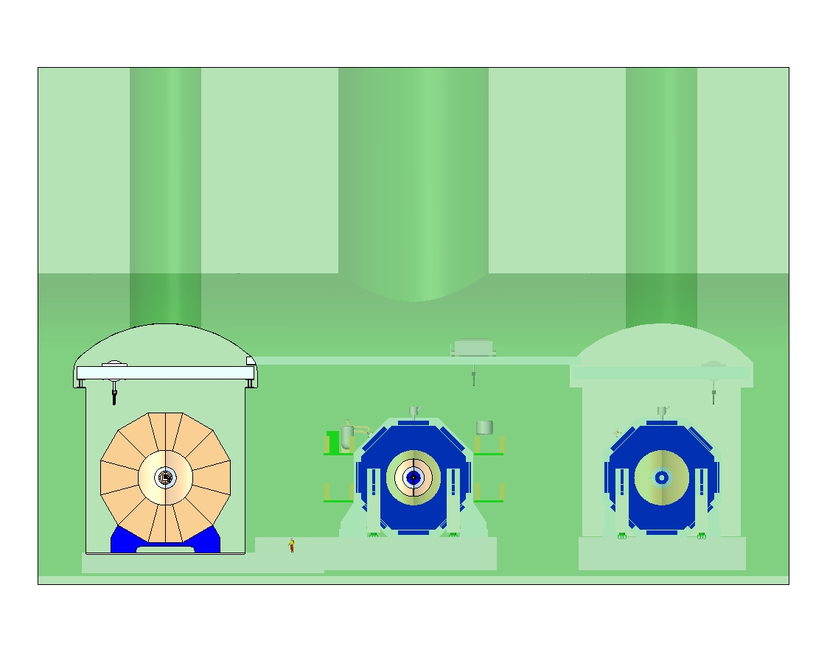
3 shafts, underground cranes

Slide 21
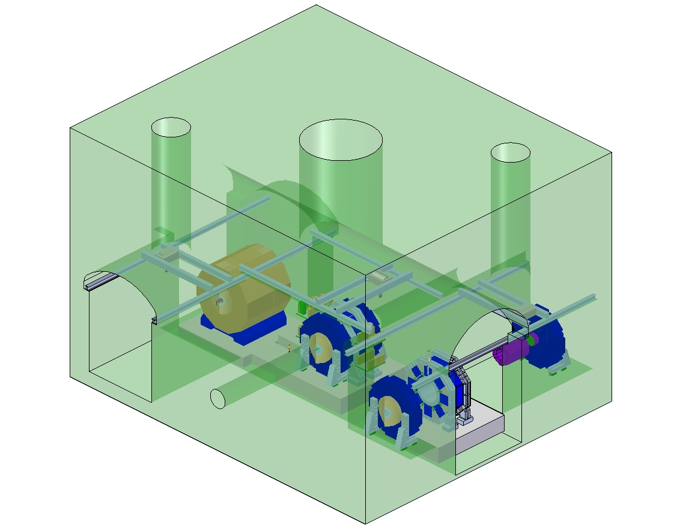
3 shafts, underground cranes

Slide 22
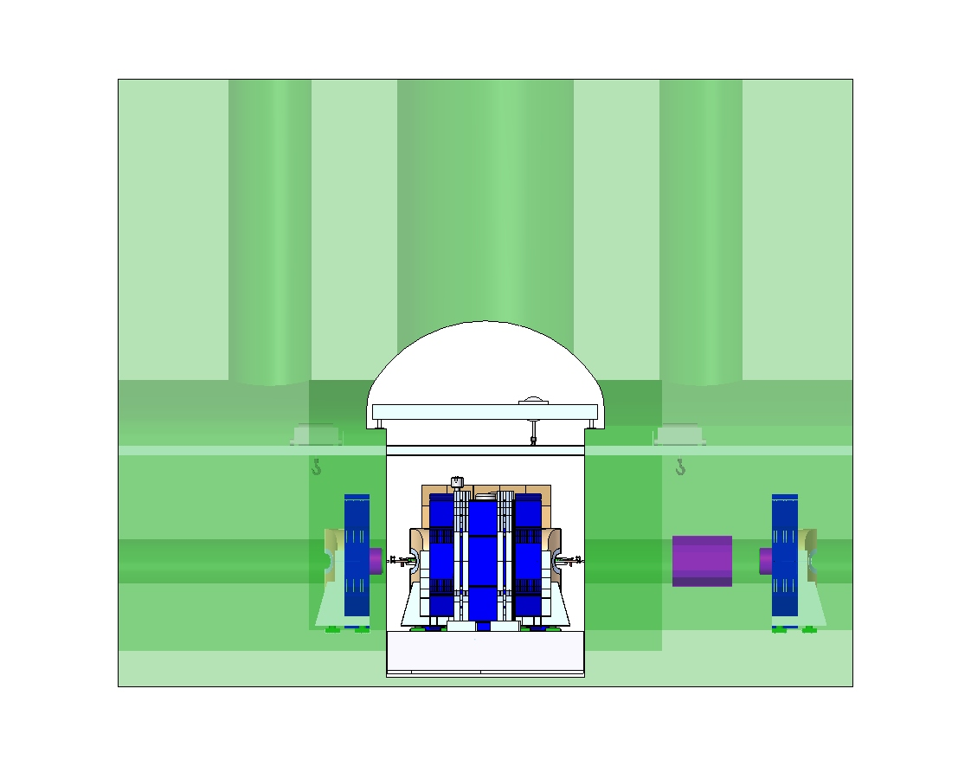
3 shafts, underground cranes

Slide 23
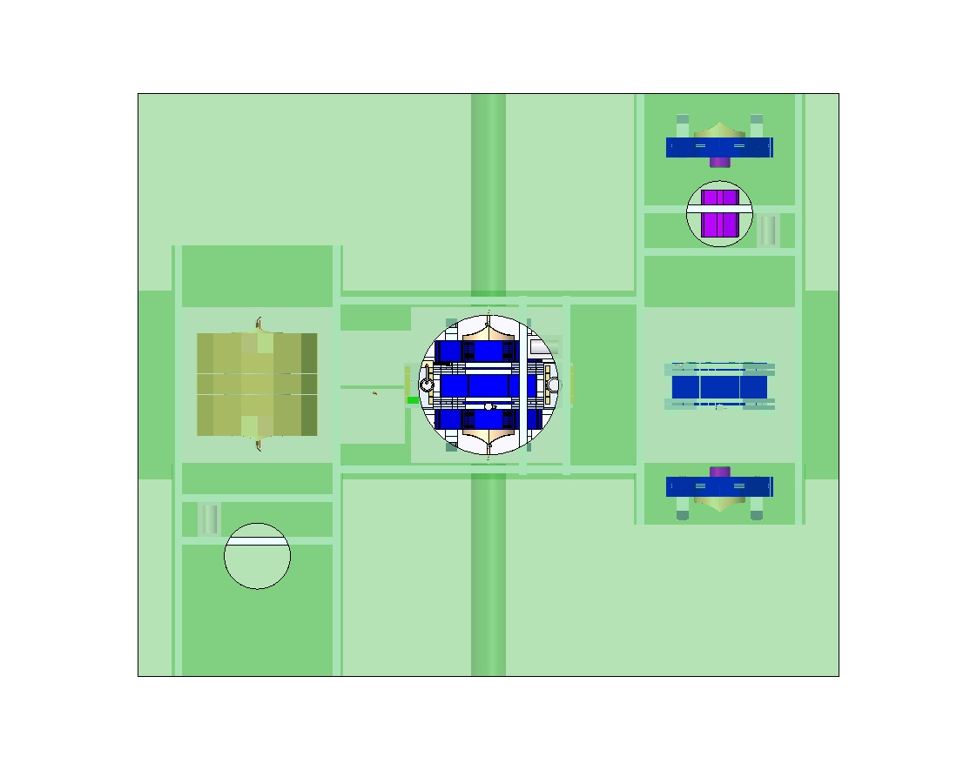
3 shafts, underground cranes

