Slide 1
Temporal Development of EM and Had showers in DRCal
Edgar Nandayapa 07/15/2011

Slide 2
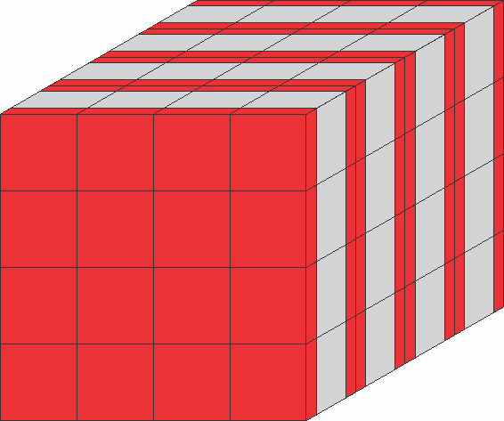
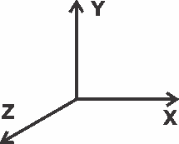
DRCal General Shape
Original is 30x30x30 ~ 1500x1500x1518 mm

Slide 3
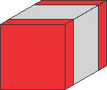
DRCal Details
Materials:
BGO and Plastic Scintillator
BGO is totally sampling
Sofware: Geant4.9.4.p01
Physics List: QGSP_BERT

Slide 4
Detector Specs
BGO
Density: 7.130 g/cm3
RadL: 1.118 cm
Th 22.694 cm
Imean: 534.1 eV
Silicon
Density: 2.330 g/cm3
RadL: 9.366 cm
TH: 45.753 cm
Imean: 173.00 eV

Slide 5
Global Time
Edep is Energy Deposition from G4SteppingAction
EEM is electromagnetic energy deposition (e-,e+, γ)
Ehad is hadronic energy deposition (everything else)
Eceren is number of energetic cerenkov photons obtain from G4StackingAction

Slide 6
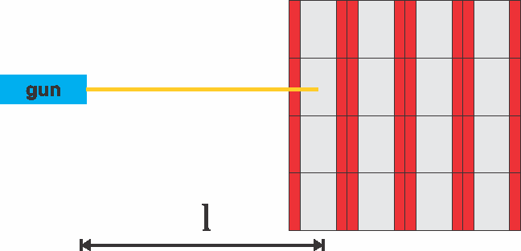
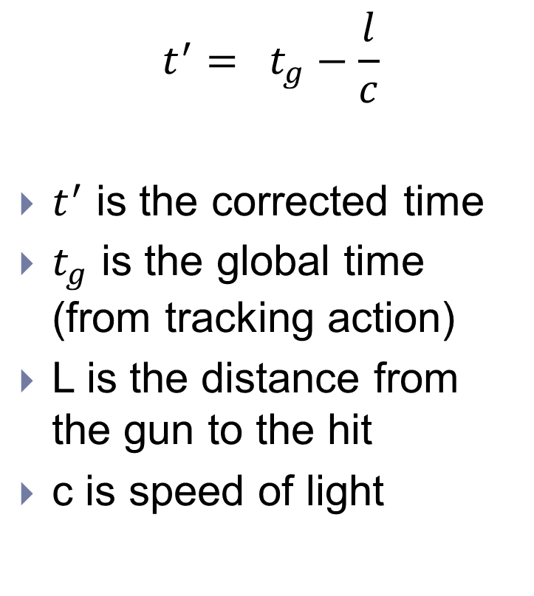
Time Correction
$$t^{′}= t_{g}−\frac{l}{c}$$
$t^{′}$ is the corrected time
$t_{g}$ is the global time (from tracking action)
L is the distance from the gun to the hit
c is speed of light

Slide 7
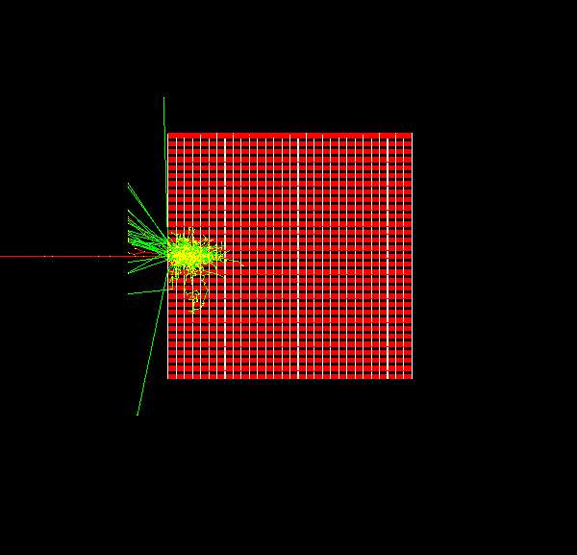
Shower electrons

Slide 8
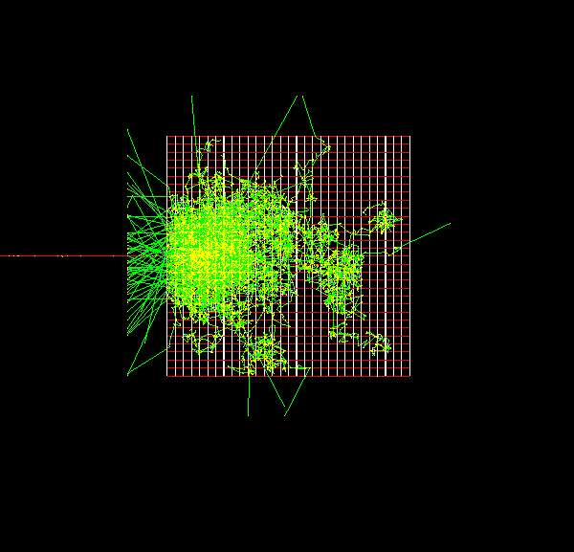
Shower from pions

Slide 9
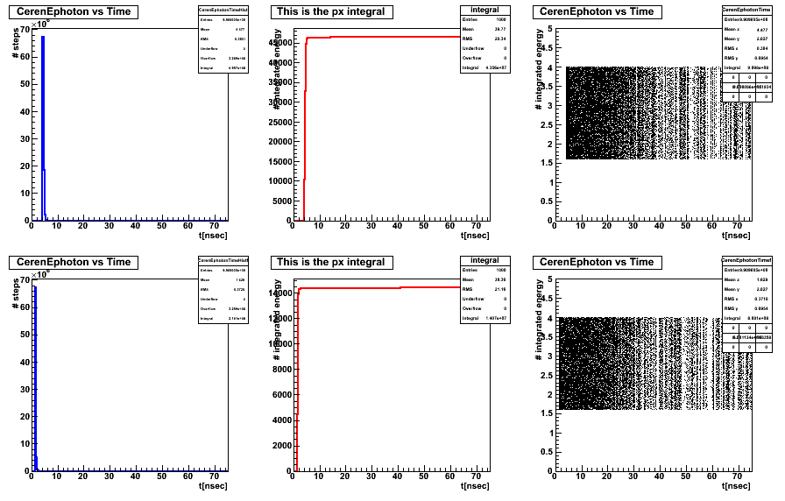
Cerenkov electrons

Slide 10
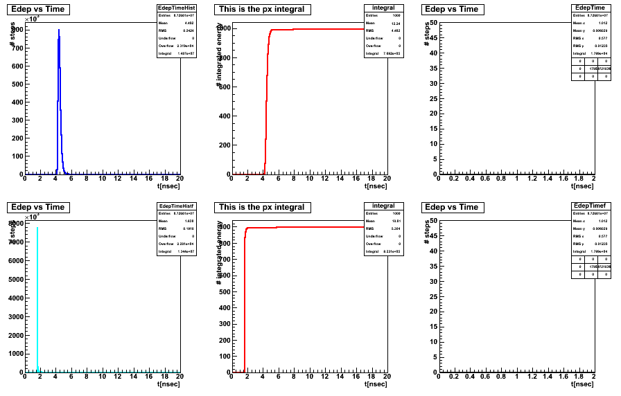
Energy Deposition electrons

Slide 11
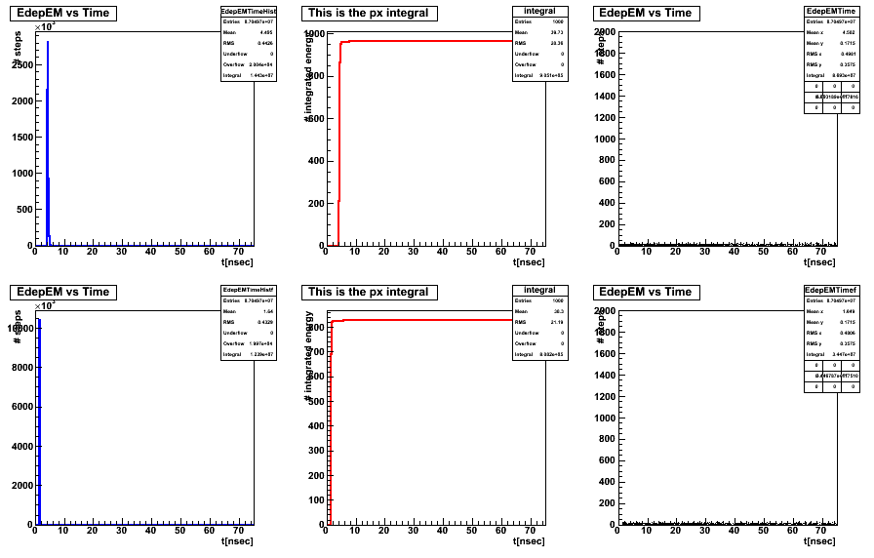
Edep EM electrons

Slide 12
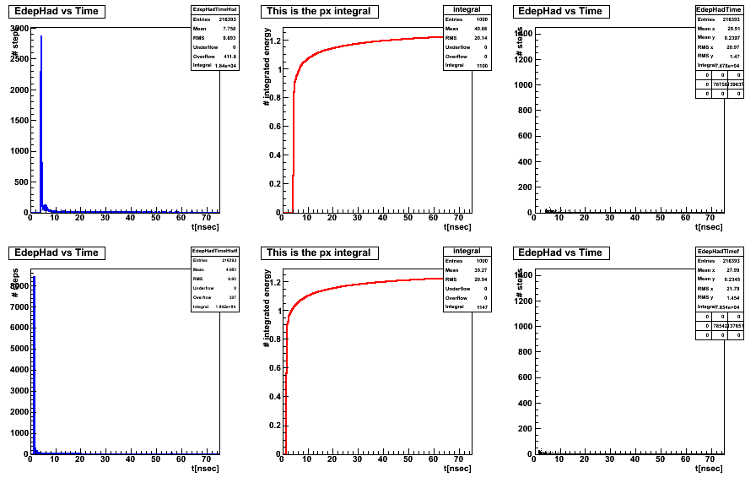
Edep Had electrons

Slide 13
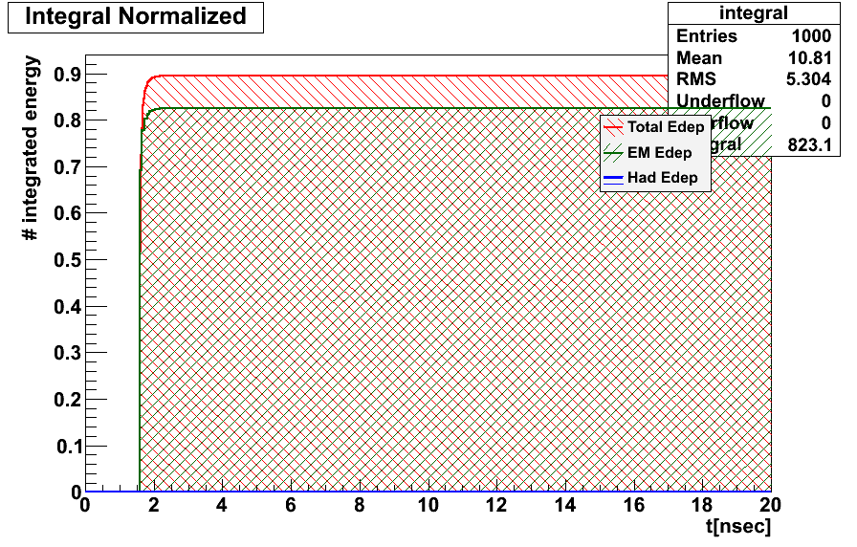
Integral of Energy over time of Electrons

Slide 14
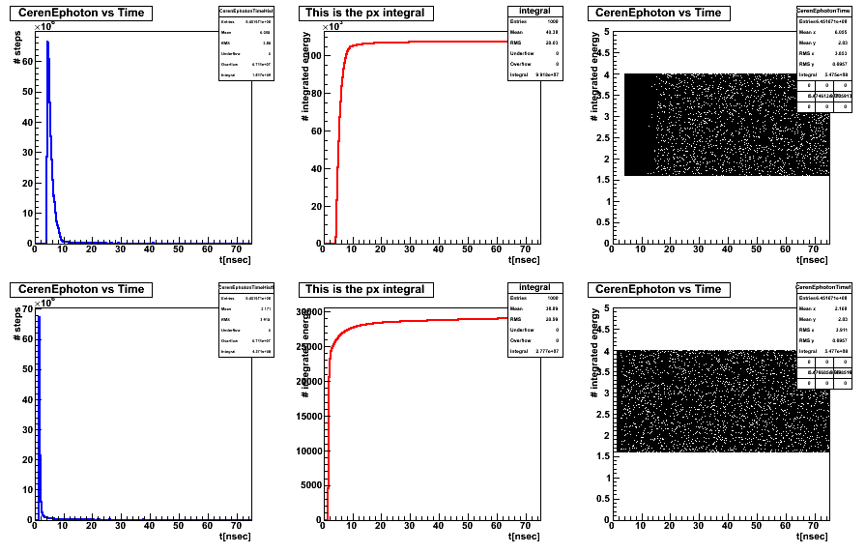
Cerenkov Pions

Slide 15
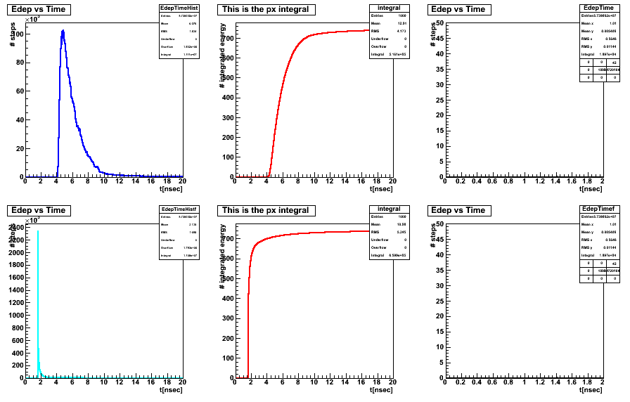
Energy Deposition Pions

Slide 16
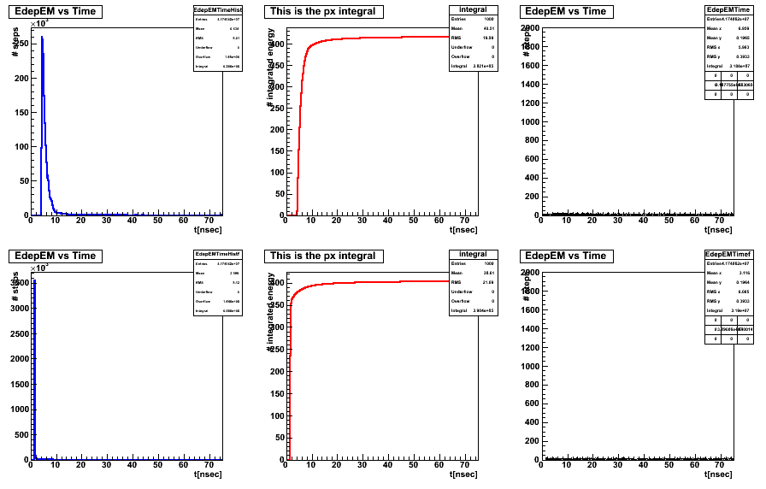
Edep EM Pions

Slide 17
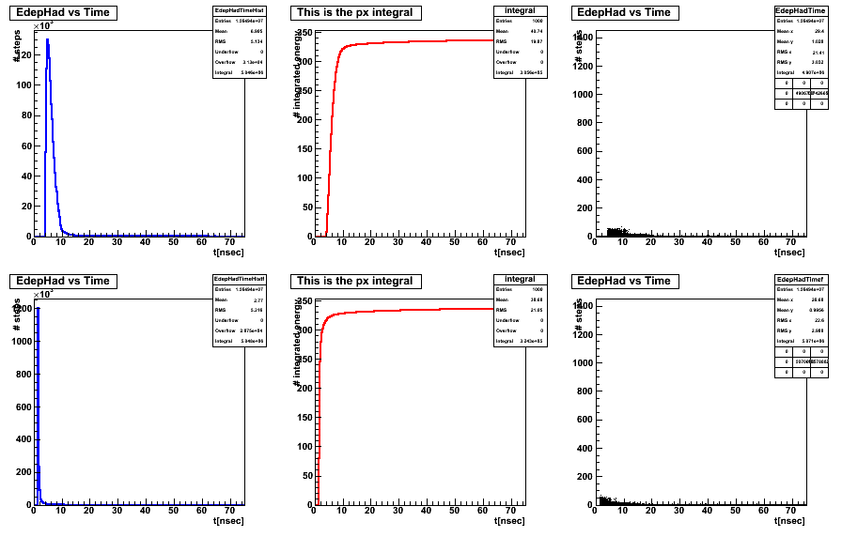
Edep Hadrons Pions

Slide 18
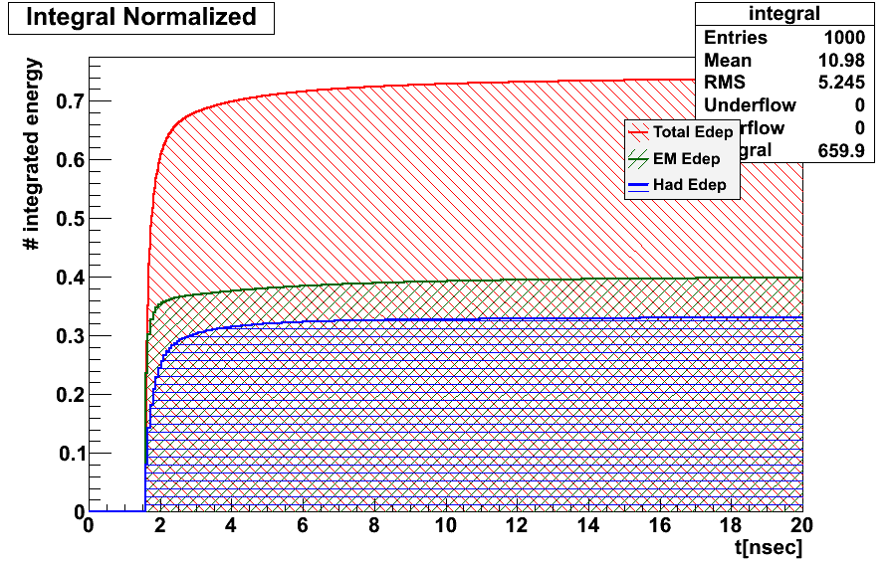
Integral of Energy over time of pions

Slide 19
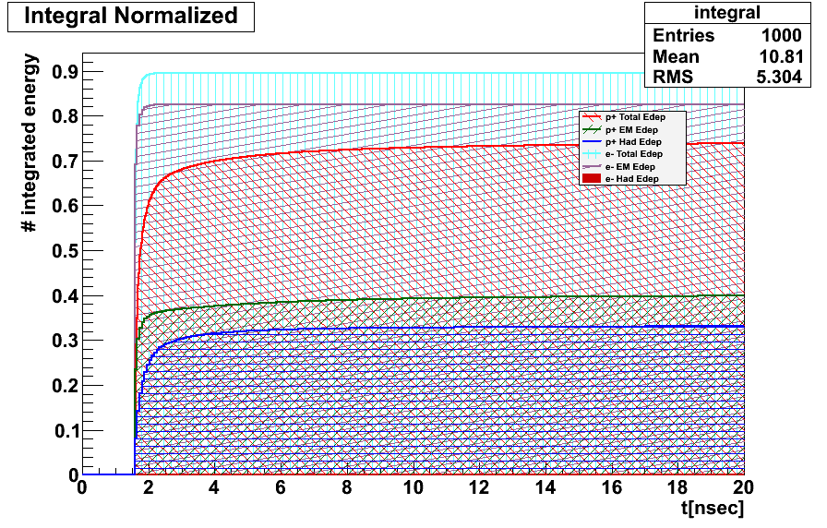
Integrated shower of energy as a function of time and corrected time

Slide 20
Conclusions
Shower developed in 6 nanoseconds to its maximum for EM and for Had in e- and pi-.

Slide 21
Future Work
Use of different physics list (now QGSP_BERT)
Use of different materials (PbWO4, W, Iron..)
Sampling with active layer of plastic scintillator to see the effect of neutrons.
Study the different physics process contributing to the signal
Modify the Hit-class to include timing information

