Slide 1
(An Introduction to) Characterization of Crystals for Dual Readout Calorimetry
Adam Para
July 15, 2011

Slide 2
Need of Crystals
We want to construct very large calorimeter from scintillating crystals.
Cherenkov light is in UV/blue: need good transmission for short wavelength.
We want to read out, and distinguish the scintillation and Cherenkov light. It is desirable that the scintillation light is ~green/yellow and slow
We need large quantities of crystals: they need to be inexpensive

Slide 3
Candidate Crystal: PbF₂
PbF₂ is an excellent Cherenkov radiator (good transparency down to λ=250nm)
It is potentially an inexpensive crystal (melting temperature ~850C)
It needs to be doped to make it scintillate. This is in principle an advantage:
  Tailor the scintillating agent to match our requirements (emission spectrum, response time)
Challenges:
  Find the scintillating dopants which are compatible with PbF₂ crystals production
  Find dopants which do not affect (in a major way) transparency to Cherenkov light

Slide 4
 | Doping |  | Doping |  |  |  | Doping
1 | none | 11 | 0.5% BaF₂ +0.25%EuF₃ | 21 | 0.2% BiF₃ | 31 | 5% BaF₂ +0.25%EuF₃
2 | 0.05% CaF₂ +0.5%EuF₃ | 12 | 5% BaF₂ | 22 | 0.75% BiF₃ +0.35%EuF₃ | 32 | 0.5% CaF₂ +1%EuF₃
3 | 1% CaF₂ + 1%EuF₃ | 13 | 10% BaF₂ +0.25%EuF₃ | 23 | 0.75% BiF₃ +0.35%EuF₃ +0.07%NaF | 33 | 1% CaF₂ +0.25%EuF₃
4 | 0.2% CaF₂ +0.25%EuF₃ | 14 | 1% BaF₂ | 24 | 1% BaF₂ +0.25%EuF₃ | 34 | 0.05% CaF₂ +0.25%EuF₃
5 | 1% CaF₂ | 15 | 0.25%ErF₃ | 25 | 1.5% BiF₃ +0.7%HoF₃ +0.15%NaF | 35 | (213-B) +0.1%Tb
6 | 0.2% CaF₂ +0.25%EuF₃ +0.025%YF₃ | 16 | 0.2% CaF₂ | 26 | 0.75% BiF₃ +0.35%ErF₃ +0.07%NaF | 36 | (93302-3) +0.1%Pr
7 | 0.2% SrF₂ | 17 | 0.25% SmF₃ | 27 | 0.75% BiF₃ +0.35%SmF₃ +0.07%NaF | 37 | (93302-4) +0.1%Nd
8 | 0.5% SrF₂ +0.25%EuF₃ | 18 | 0.25% HoF₃ | 28 | 0.35%HoF₃ +0.07%NaF | 38 | (93302-3) +0.1%Yb
9 | 0.5% SrF₂ +1%EuF₃ | 19 | 0.25% GdF₃ | 29 | 0.35%ErF₃ +0.07%NaF | 39 | (93307-6)) +0.1%Sm
10 | 0.2% BaF₂ | 20 | 0.25% PrF₃ | 30 | 0.35%SmF₃ +0.07%NaF | 40 | (P983309-4) +5000ppmTb +100ppmCe

Slide 5
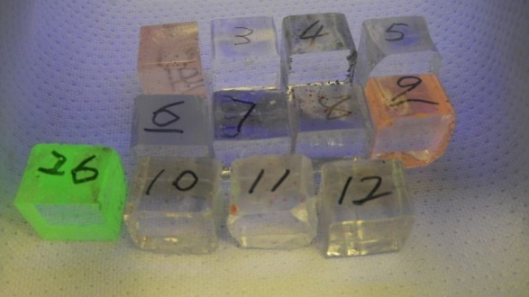
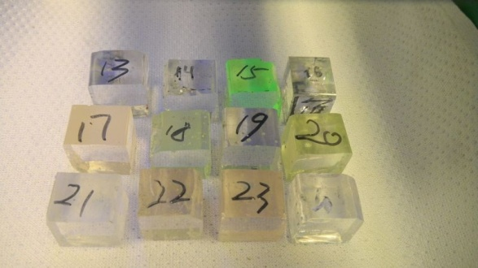
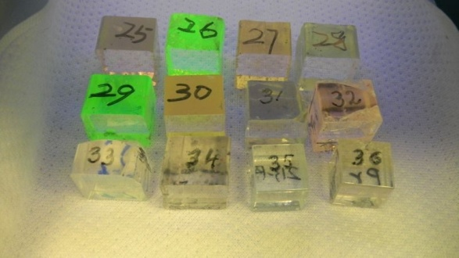
Sample Crystals Under UV excitation

Slide 6
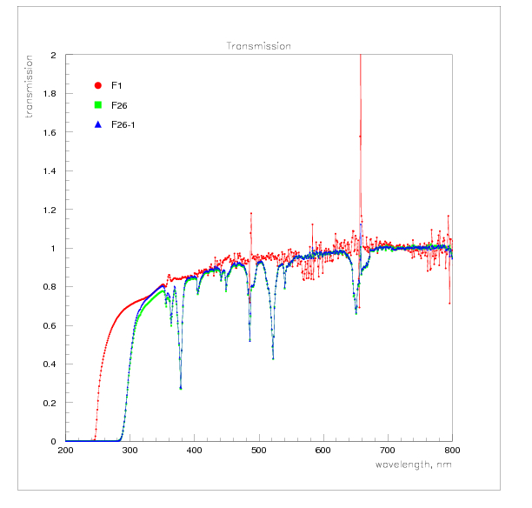
Transmission Measurement
Diffraction
grating
Photodetector
Crystal

Slide 7
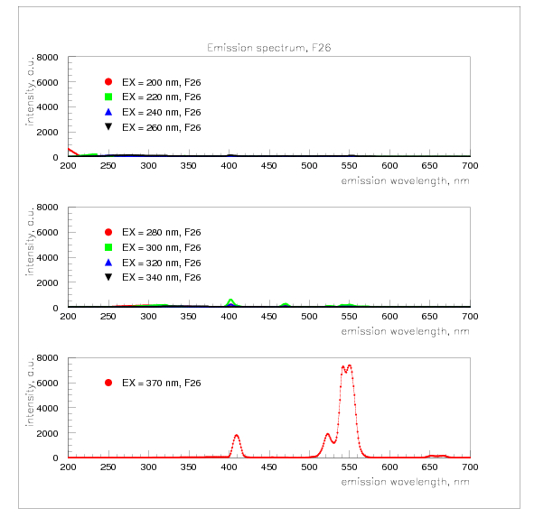
Emission Spectrum Measurement
Diffraction
grating
Photodetector
Crystal

Slide 8
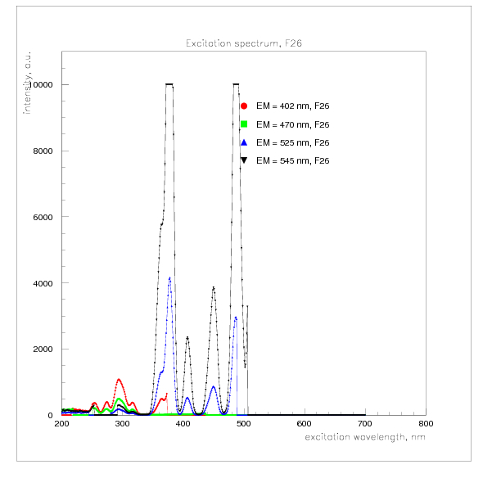
Excitation Spectrum Measurement
Diffraction
grating
Photodetector
Crystal

Slide 9
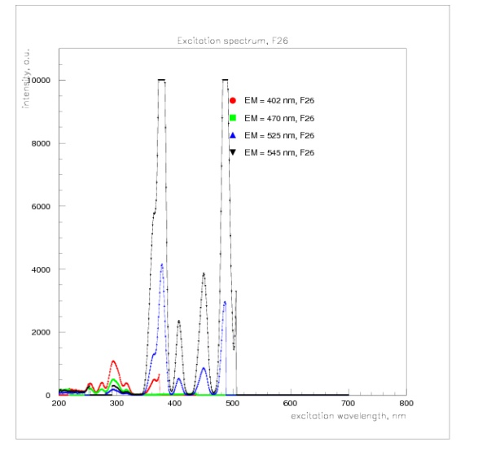
A Complete Picture

Slide 10
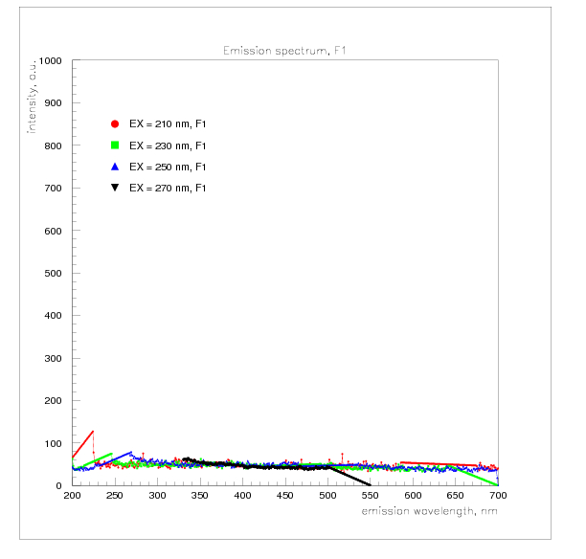
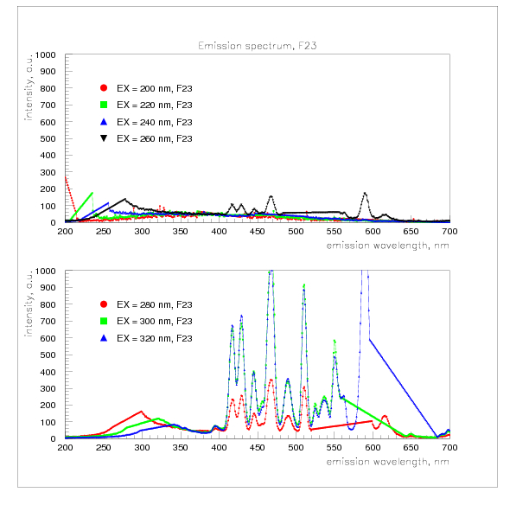
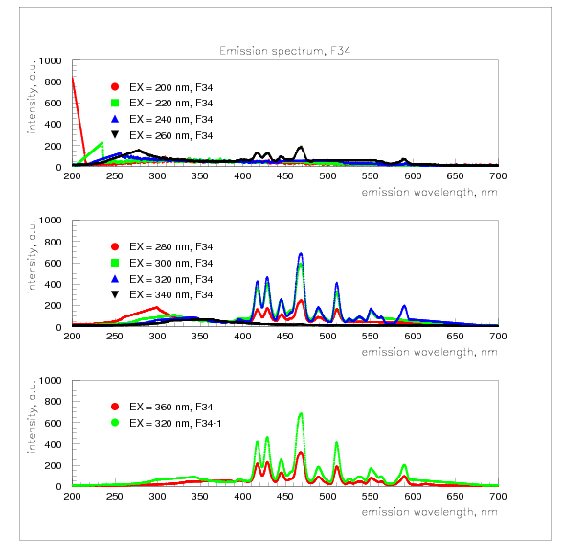
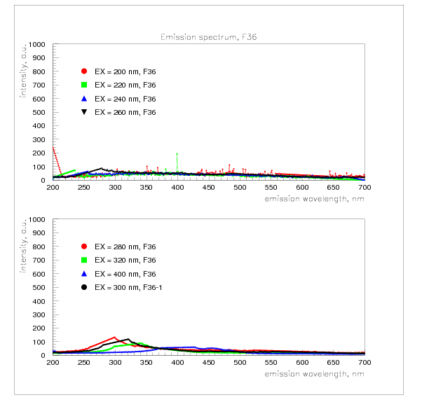
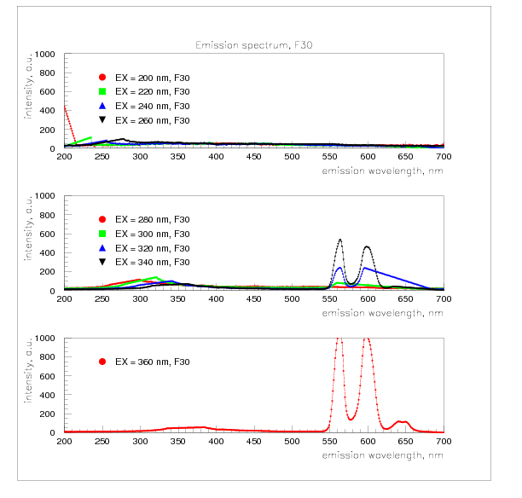
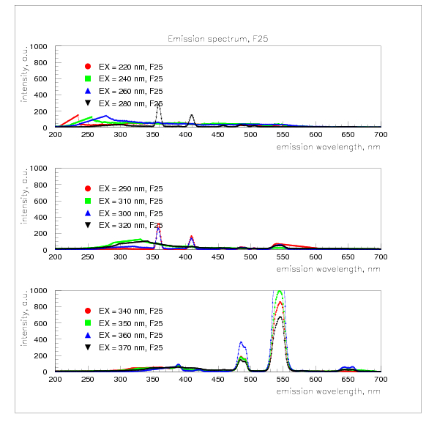
(Examples of) Emission Spectra

Slide 11
Analysis requires comparisons and finding correlations between large number of plots. Image browser utility of great help.
Browsing the image data base extremely helpful to find various defects and errors in labeling and presentation. They can (and are) fixed. But we need some cleanup utility to remove (or mark to be invisible) unwanted versions of the plots.

