Slide 1
FONT5 Board Tests
D. R. Bett

Slide 2
Synchronous 357 MHz input
to fast clock and ADC channel
FONT5
board
fast clk
357MHz
Generator
ADC
ring clk
FONT4
board
trigger

Slide 3
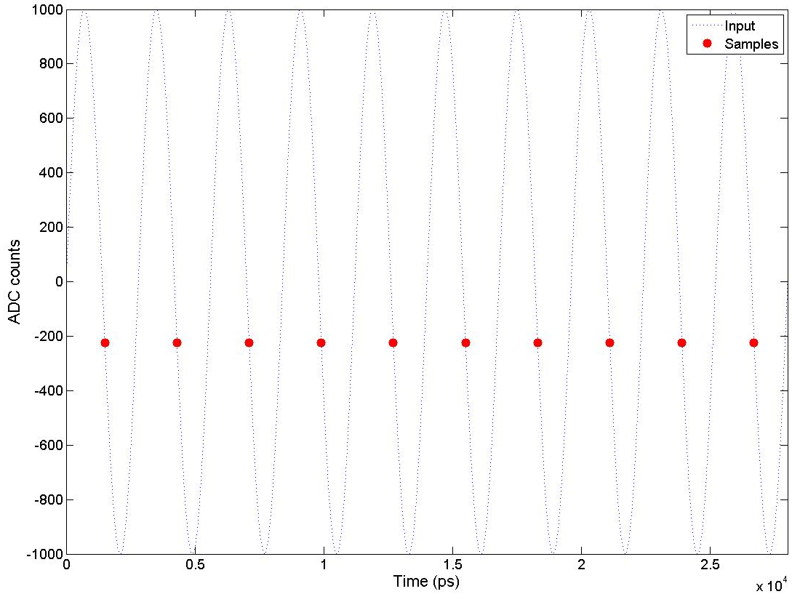
Ideal output

Slide 4
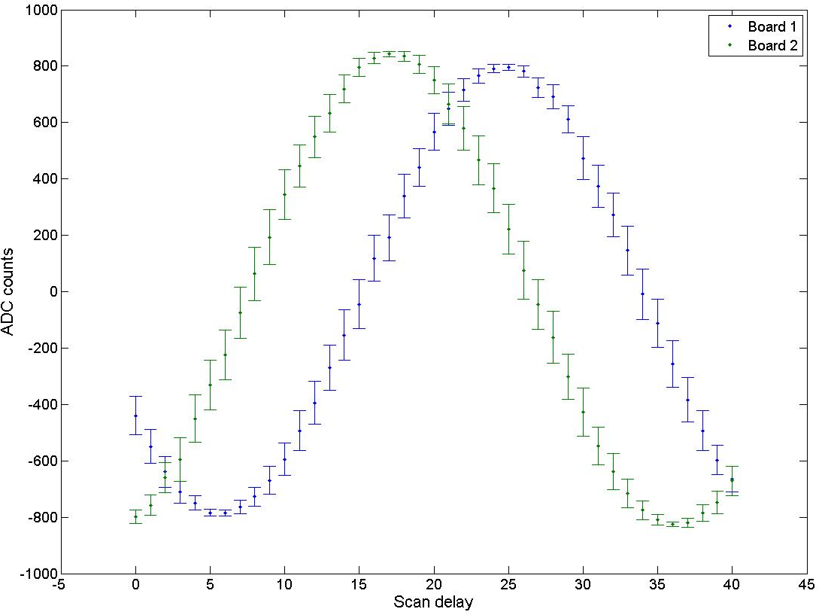
Scan delay vs. ADC counts
peak
zero

Slide 5
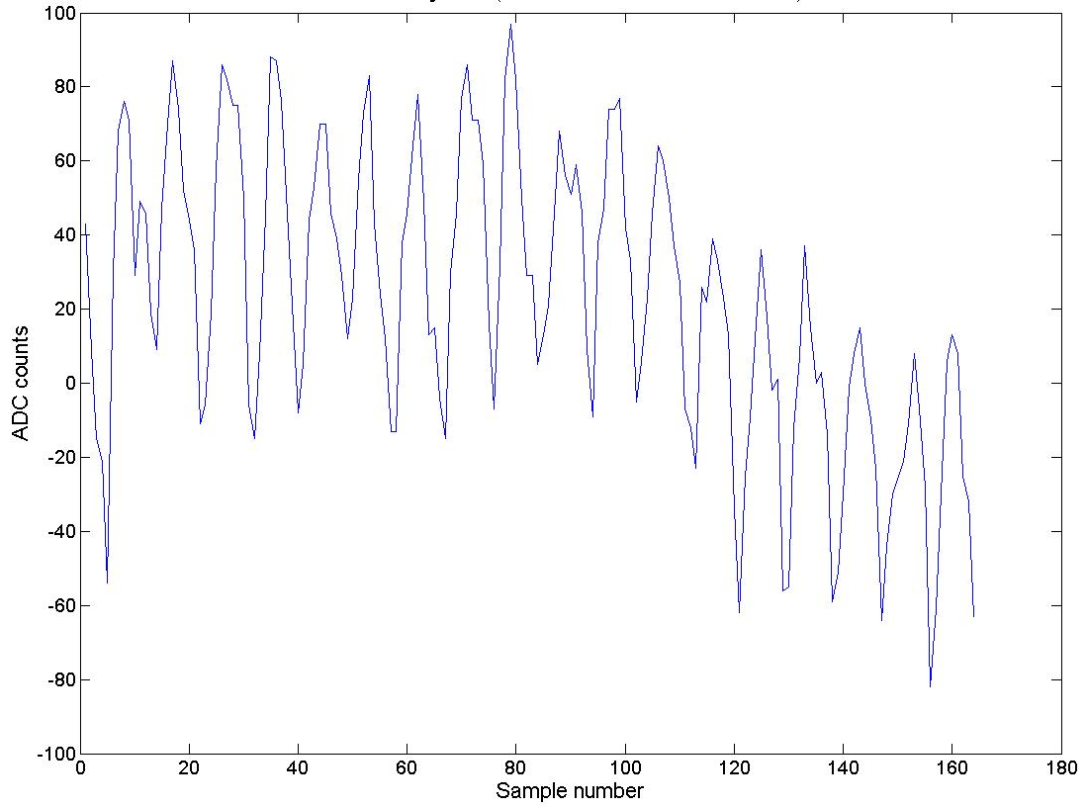
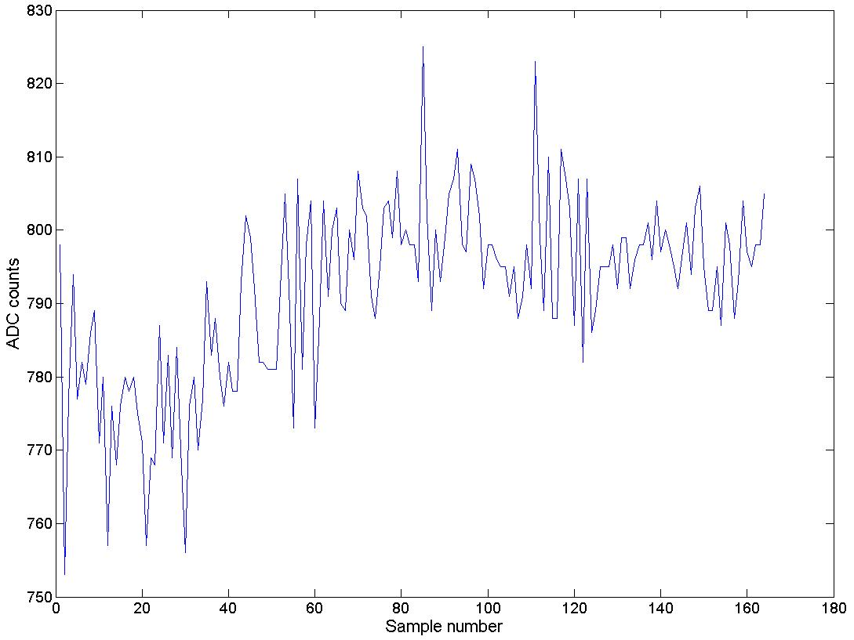
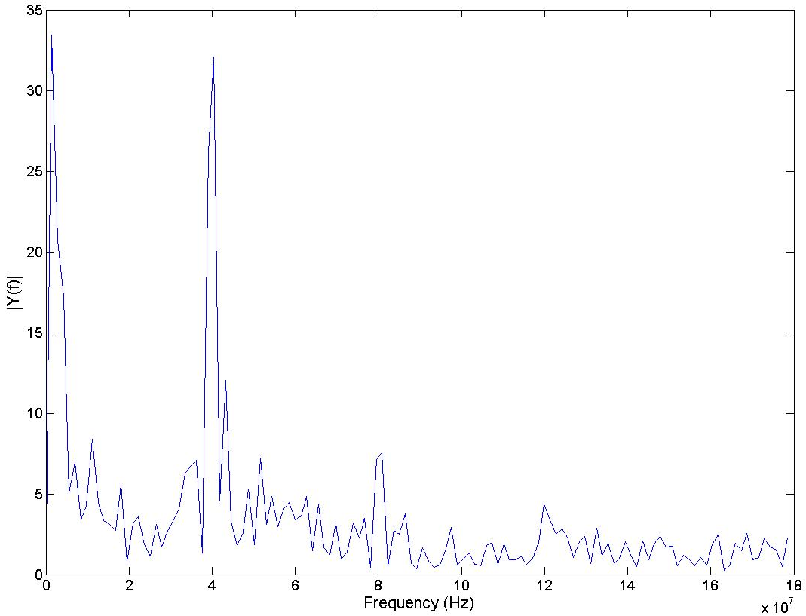
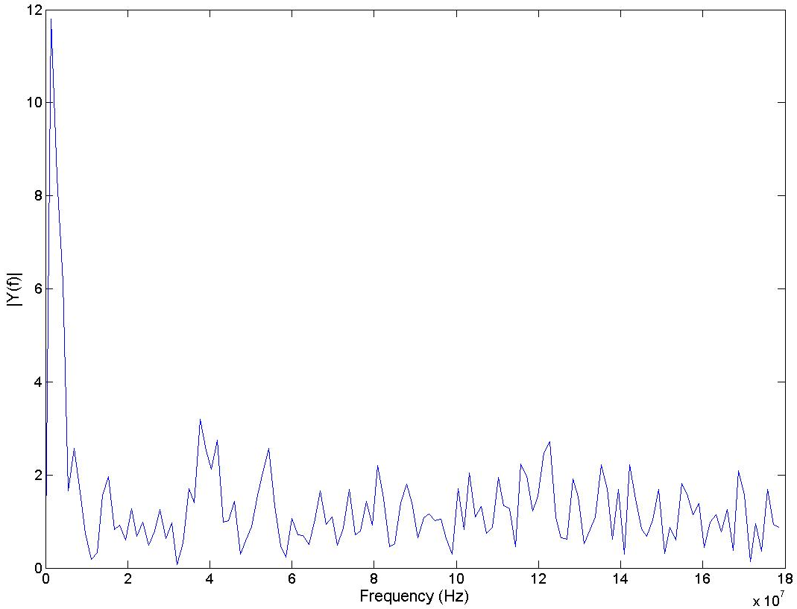
zero
peak
± 50 counts
@ 40 MHz
Raw
ADC
signal
~100 counts drift
40 MHz
FT

Slide 6
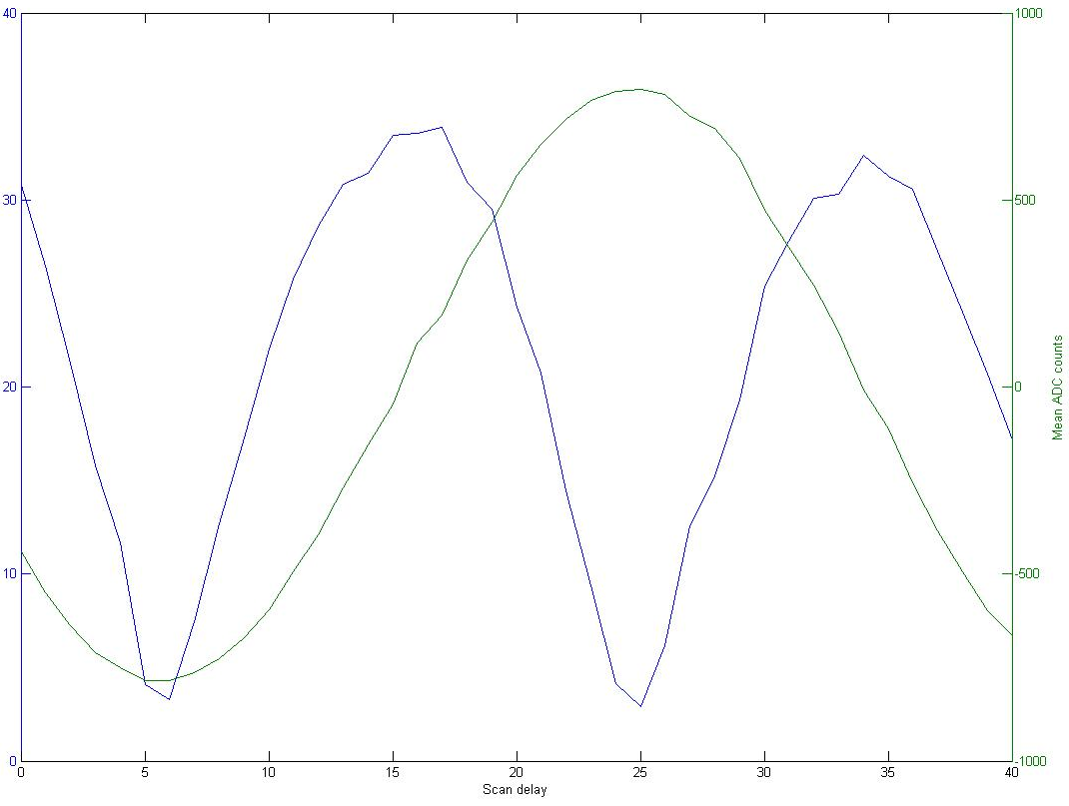
Scan Delay vs. 40 MHz component
peak
Mean amplitude of 40 MHz component
zero
Mean ADC counts
Scan delay

Slide 7
Variable frequency input to ADC channel
FONT5
board
fast clk
357MHz
Generator
Variable
Generator
ADC
ring clk
FONT4
board
trigger

Slide 8
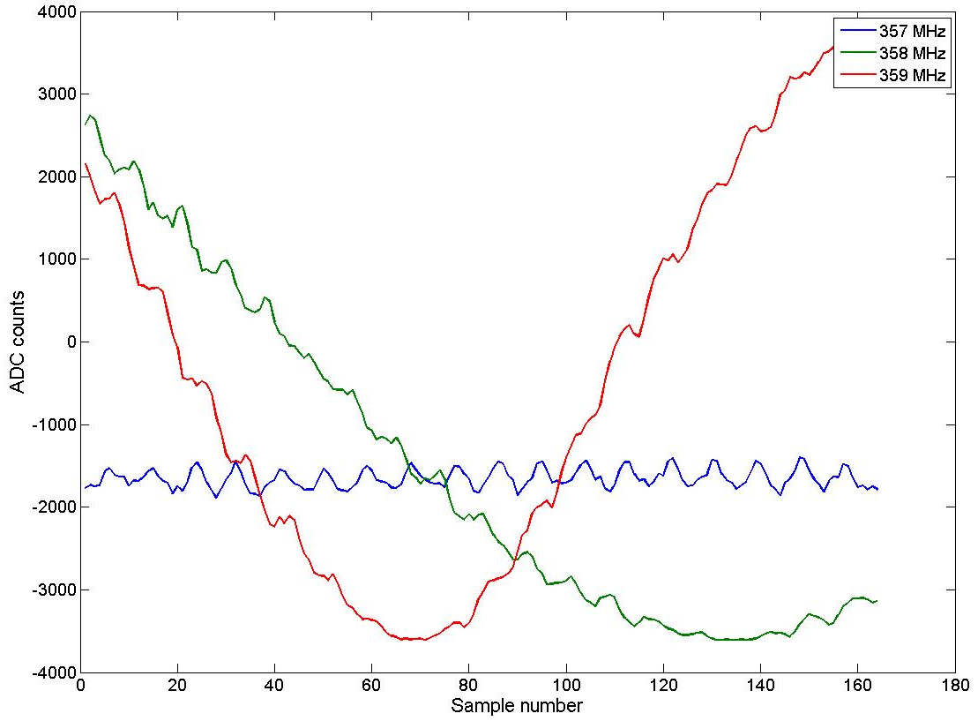
Raw signals

Slide 9
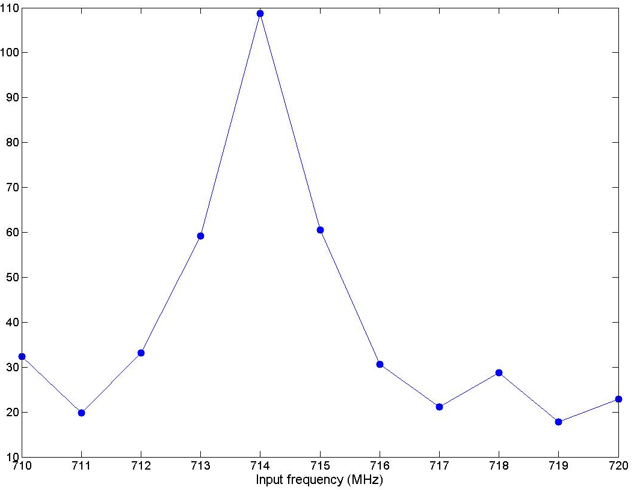
Input frequency scan in 714 MHz region
Mean amplitude of 40 MHz component

Slide 10
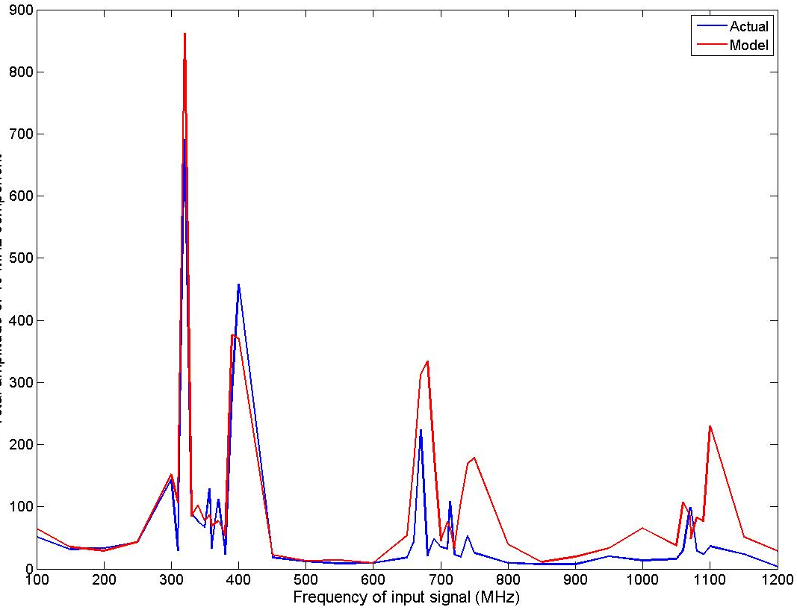
Input frequency scan
Mean amplitude of 40 MHz component

Slide 11
Synchronous, variable frequency input
to fast clock and ADC channel
FONT5
board
fast clk
Variable
Generator
ADC1
ring clk
357MHz
Generator
FONT4
board
trigger

Slide 12
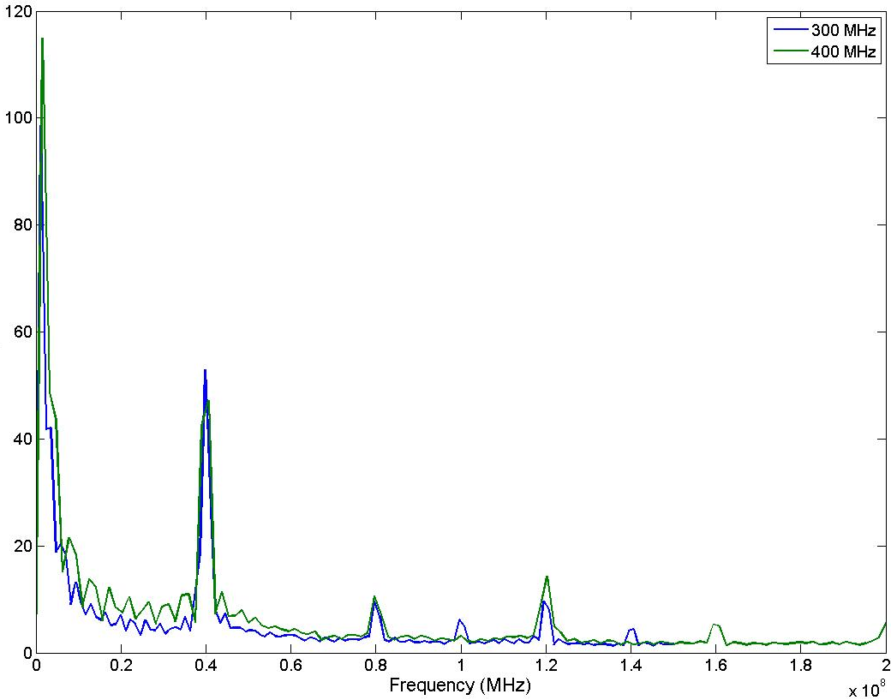
Input, fast clk frequency scan
Mean amplitude

Slide 13
Summary
Driving an ADC channel with a multiple of the fast clock input results in sampling oscillations at 40 MHz (= FPGA clock)
  max. oscillation amplitude ~5% of input
Could this be a source of noise at ATF?

Slide 14
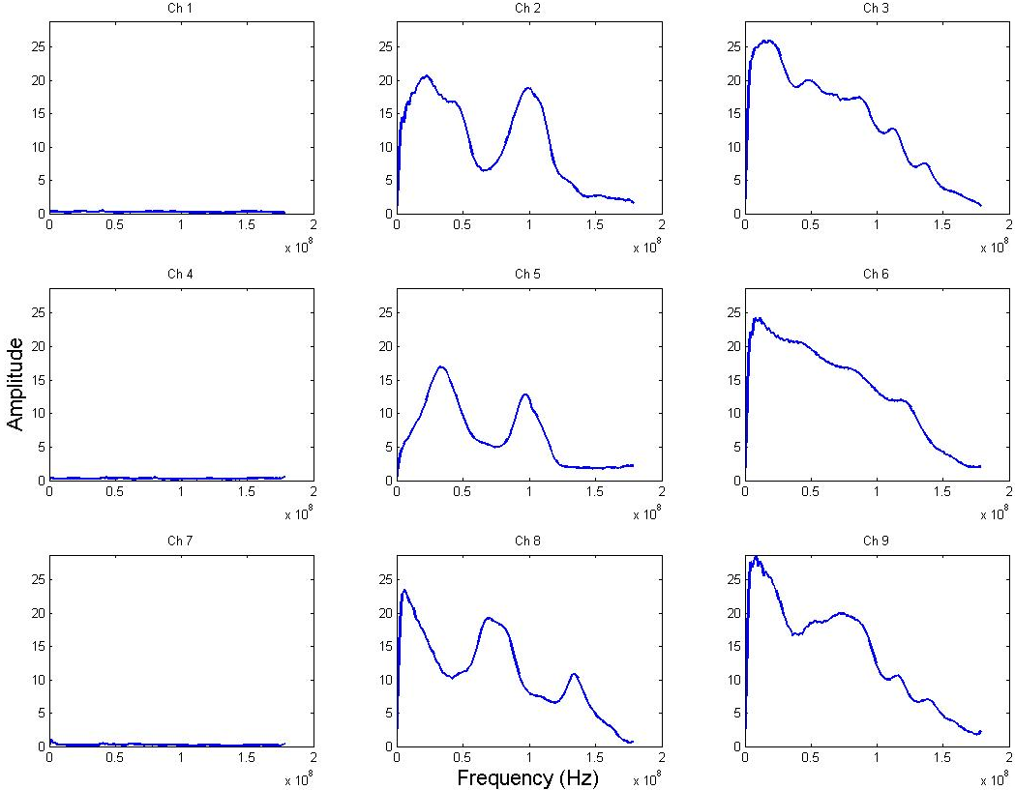
yjitrun3_30June2011.dat
NOISE
DIFFERENCE
SUM
Mean amplitude

